Slide 1
Breast milk and infant formula: Prediction, Correlation, and Classification within the joint host gut transcriptome and microbiota metagenome
Scott L. Schwartz^{1,2}, Iddo Friedberg⁵, Ivan V. Ivanov^{1,3}, Laurie A. Davidson¹, Jennifer S. Goldsby¹, David B. Dahl³, Edward R. Dougherty⁴, Damir Herman⁶, Sharon M. Donovan⁷, and Robert S. Chapkin¹
¹Program in Integrative Nutrition, Center for Environmental & Rural Health, ²Departments of Statistics, ³Veterinary Physiology & Pharmacology, and ⁴Electrical Engineering, Texas A&M University; ⁵Department of Computer Science, Miami University; ⁶Winthrop Rockefeller Cancer Institute, University of Arkansas; ⁷Division of Nutritional Sciences, University of Illinois, Urbana-Champaign.
Microbiota and mucosal immunology: the interface in health and disease,
April 14-16, San Francisco

Slide 2
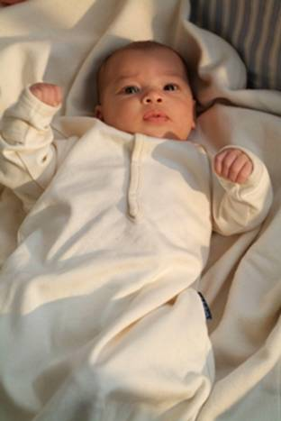
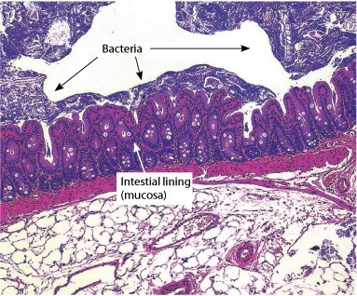
Metagenome and Transcripotome development in infants
Noninvasively uncovering the host/bacteria partnership

Slide 3
Non invasive characterization of infant transcriptome and metagenome
6 babies exclusively fed infant formula
6 babies exclusively breast fed
Stool samples collected at 3-months
Intact sloughed epithelial cells isolated and microarray mRNA measurements taken
Microbial composition assessed via Roche 454

Slide 4
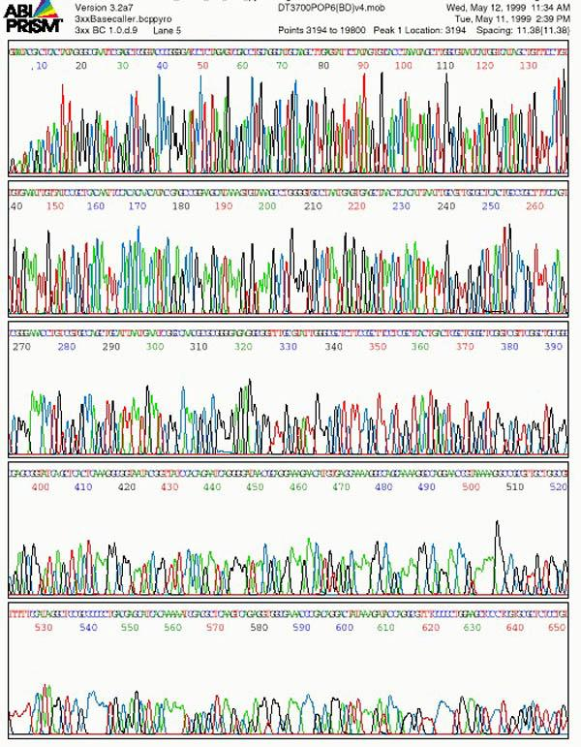
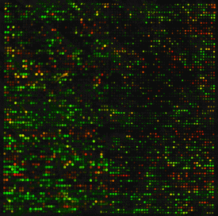
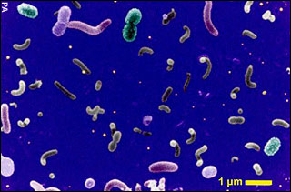
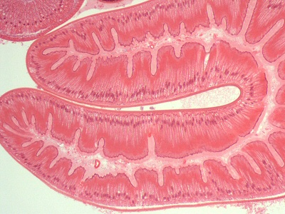
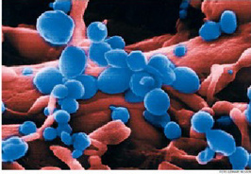
Let’s put this information together

Slide 5
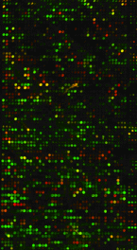
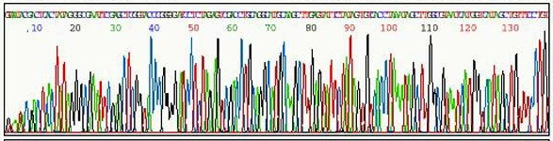
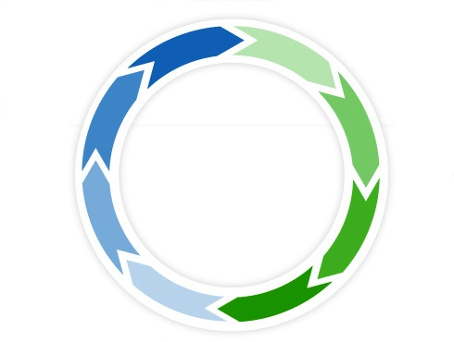
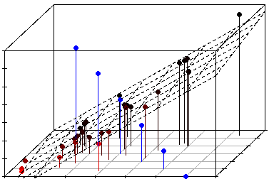
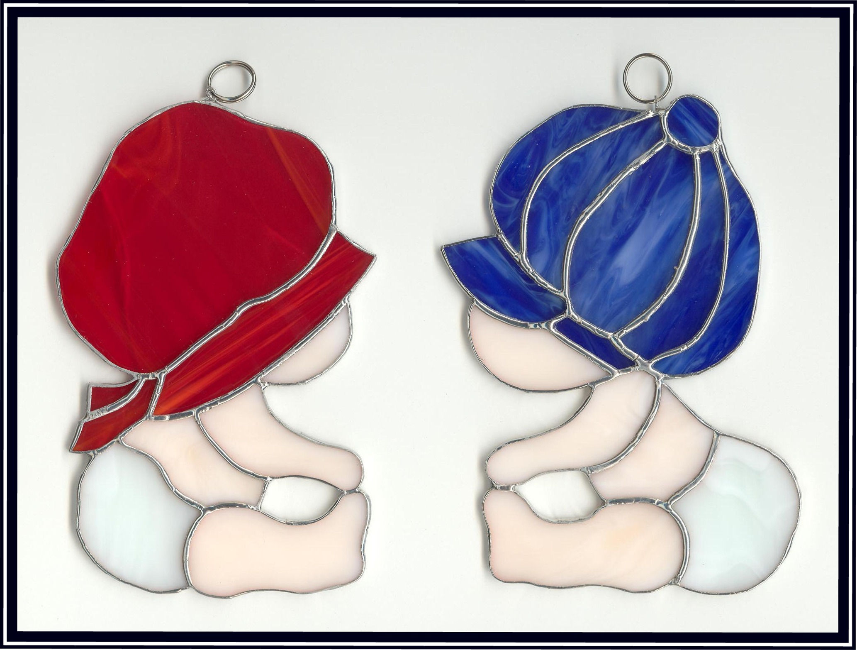
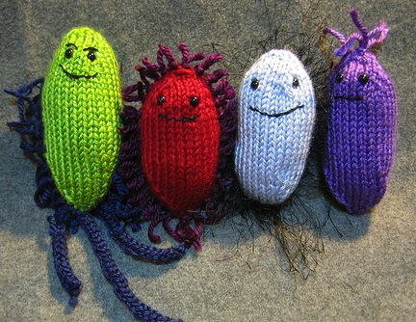
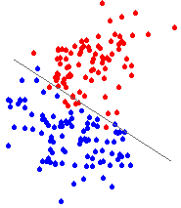

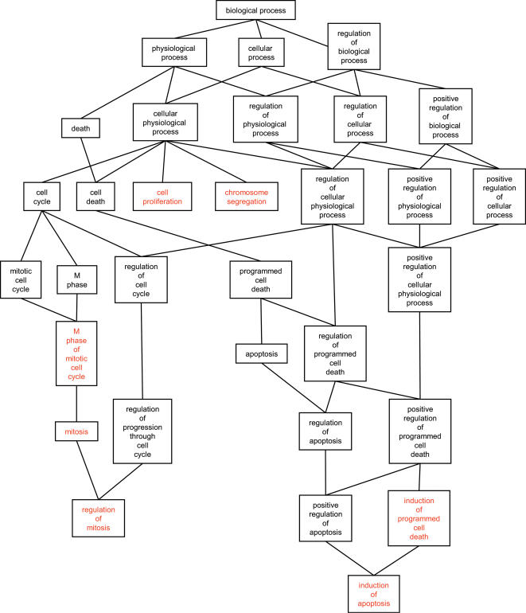
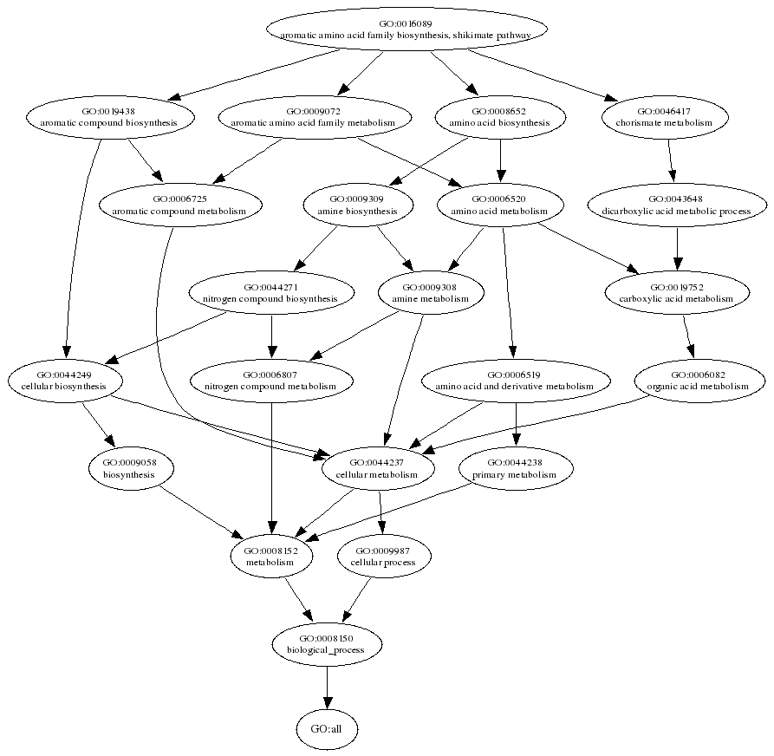
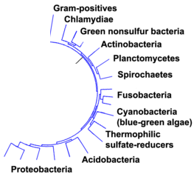
Summary
Microarray
Sequencing
Prediction
Classification
Covariance Analysis
Functional
pathways
Functional
pathways (?)
Phylum makeup

Slide 6
Phylum signatures
The composition of the metagenome varies between formula and breast fed babies

Slide 7
Gene expression prediction
Coarse phylum signature should be predictive of gross scale gene expression measurements
Gene Expression
FF(2)
Phylum
. X(1)
Predict
. X(2)
BF(1)
Phylum

Slide 8
Most informative phylum
Two strongest identifying characteristics:
firmicutes: distinguishes FF/BF
Actinobacteria: distinguishes BF/BF’ samples

Slide 9
Linear Model
Predict gene expression using
% Firmicuties and % Actinobacteria
Formula versus Breat fed treated

Slide 10
Model Fitting Results
No significance w/ multiple testing correction. But there are still some suggestions of findings

Slide 11
Metagenome/Transcriptome Correlation
Mulitvariate correlation functional categories
Metagenome, host
darker: stronger association

Slide 12
SEED 1 Metabolic functions
Metabolic function profiles tightly regulated

Slide 13
SEED 1 Metabolic functions
Tested PERCENTAGES with a permutation test:
Membrane Transport (BF/FF DE p=0.0055)
Virulence (BF/FF DE p=0.0116)
Fatty Acids and Lipids (BF/FF DE p=0.0449)
Cell Wall and Capsule (BF/FF DE p=0.0586)

Slide 14
SEED 2 Metabolic functions
Most interesting subsets of SEED 1 categories

Slide 15
SEED 2 Metabolic functions
Tested CURVES with a permutation test:
Membrane Transport (BF/FF curve p=0.7633)
Virulence (BF/FF curve p=0.0134)
Fatty Acids and Lipids (BF/FF curve p=0.2959)
Cell Wall and Capsule (BF/FF curve p=0.0652)
Respiration (BF/FF curve p=0.0749)
Clustering-based subsystems (BF/FF curve 0.085)

Slide 16
SEED Sequencing Depth
Low number of reads assigned to SEED level 3
We focus on SEED level 2

Slide 17
Pipeline: Reduction Step
Metagenome
SEED 1: Virulence
SEED 2: Subcategories
A-biotics & toxics resistance
Iron scavenging mechanisms
Type VI secretion systems
Transcriptome
OGS anno. (20%)
Panther: immune
29 FF/BF DE genes
GAB1/KLRF1/HSPA1B/HSH2D/BPIL1/GBP1/SYK/PTK2/ADORA3/HSPA1B/VAV2/PPARD/FCGR2A/ANTXR1/SPACA3/IL1A/ALOX5/OAS1/PROCR/REL/TFCP2L1/SELENBP1/CD40/IL4R/CD3E/GYPC/PTPN22/SP2/NDST1
SEED 3 info and GO and KEGG info accessible
Notes:
BPIL1, FCGR2A, OAS1, MCFD2, CD40

Slide 18
Pipeline: Repeated Testing
GAB1
KLRF1
HSPAB
HSH2D
BPIL1
GBP1
SYK
PTK2
ADORA3
HSPA1B
VAV2
PPARD
FCGR2A
ANTXR1
SPACA3
IL1A
ALOX5
OAS1
PROCR
REL
Metagenome BF/FF pre-analysis
FIXED
TFCP2L1
SELENBP1
CD40
IL4R
CD3E
GYPC
PTPN22
SP2
NDST1
Y_{1i}: A-biotics & toxics resistance
Y_{2i}: Iron scavenging mechanisms
Y_{3i}: Type VI secretion systems
X_{1i}: GAB1
X_{2i}: FCGR2A
X_{3i}: ALOX5
(subset SEED 2 percents)
(mRNA expression)
variables normalized
individually
Y_{1i} => Z_{1i}
Y_{2i} => Z_{2i}
Y_{3i} => Z_{3i}
Z_{4i} <= X_{1i}
Z_{5i} <= X_{2i}
Z_{6i} <= X_{3i}
PCA/CCA/FA
Notes:
FCGR2A" "ALOX5"

Slide 19
Example
Selected metagenome and transcriptome data
Notes:
BPIL1, FCGR2A, OAS1, MCFD2, CD40

Slide 20
Some Forshadowing: Biplot
Biplots “show” matrix data by representing both individual and variables in one plot
Notes:
BPIL1, FCGR2A, OAS1, MCFD2, CD40

Slide 21
Correlation Structure
Correlation structure in the data (scaled data)
Notes:
BPIL1, FCGR2A, OAS1, MCFD2, CD40

Slide 22
SVD… for biplots, and now PCA
If we do a SVD X = U Σ V’
[pXn] = [pXp] [pXp] [pXn]
Variables X observations Eigenvalues %² contribution scores
=
[pXn] [pXp] [pXp] [pXn]
~
~

Slide 23
Principal components analysis
Correlation structure in the data (scaled data)
Notes:
BPIL1, FCGR2A, OAS1, MCFD2, CD40

Slide 24
Principal components analysis
Correlation structure in the data (scaled data)
Notes:
BPIL1, FCGR2A, OAS1, MCFD2, CD40

Slide 25
Evaluating PCA
PCA scoring is about the rank of the data and dimensionality reduction using, for example, the first two eigenvalues
Overall proportion of variation explained
Relative proportion explained by principal comp.
Notes:
BPIL1, FCGR2A, OAS1, MCFD2, CD40

Slide 26
PCA/CC/FA – for scaled data
PCA (principal components analysis)
max Var[Σ_{i}a_{i}Y_{i}]: Σ_{i}a_{i}² = 1
“Find direction of maximal variation, sorted”
CC (canonical correlation)
max Cor[Σ_{i}a_{i}X_{i}, Σ_{j}b_{j}Y_{j}]: Var[Σ_{i}a_{i}X_{i}] = Var[Σ_{j}b_{j}Y_{j}] = 1
“Maximize correlations between linear transforms”
FA (factor analysis)
“correlation structure model”

Slide 27
PCA and CC and FA
PCA finds the orthonormal basis of maximum variation… CC is finding a basis, but it’s not orthonormal: it’s such that remapped data is standard Gaussian… These new (paired) axes maximize the correlation
FA, is somewhat different than these two… it supposes underlying latent variable set driving regression models (with residuals) dictating the multiple outcomes… but there’s identifiably problems… We want CC/FA results to “agree”

Slide 28
Canonical correlation analysis
Informative on relationships between sets
 | Canonical Variate #1 | Canonical Variate #2 | Canonical Variate #3
anti A-biotics+toxics | -1.26 | -0.35 | -2.56
Type III/IV/ESAT | -1.32 | -1.31 | -2.14
Virulence | -1.51 | -0.16 | -0.75
Prop. of var. (original data) | (6.0%) | (17.8%) | (0.03%)
Prop. of var. (transformed data) | (22.5%) | (66.8%) | (10.7%)
GAB1 | 1.28 | -1.52 | -0.55
FCGR2A | -0.29 | 1.71 | 1.31
ALOX5 | -0.08 | 0.39 | -1.17
Prop. of var. (original data) | (19.3%) | (6.2%) | (10.0%)
Prop. of var. (transformed data) | (54.7%) | (17.6%) | (27.7%)
Canonical Correlation | 74.5% | 55.6% | 27.7%
Notes:
BPIL1, FCGR2A, OAS1, MCFD2, CD40

Slide 29
Canonical correlation analysis
Canonical variates relative to the data
Notes:
BPIL1, FCGR2A, OAS1, MCFD2, CD40

Slide 30
Canonical correlation analysis
Canonical correlation
Relative proportion of variation explained by canonical variates in original data space
Canonical correlation
Relative proportion of variation explained by canonical variates in transformed data space
Notes:
BPIL1, FCGR2A, OAS1, MCFD2, CD40

Slide 31
Factor Analysis
Seeks to explain correlation within/between some bacterial characteristics (e.g., metabolic profile) and some host characteristics (e.g., set of probes)
These quantitative outcomes will be Y₁, …, Y_{T}
There will be some small set of factors seeking to explain the Y_{t}’s via factors and loadings
Y_{t} = Σ_{p} l_{tp}F_{p} + U_{t}F_{t*}

Slide 32
Factor Analysis
Y_{t} = Σ_{p} l_{tp}F_{p} + U_{t}F_{t*}
Measures: Y ~ N(0,1)
Factors: F ~ N(0,1)
Loadings: l_{tp =} cor(Y_{t,} F_{p})
Uniqueness: U_{t}² = 1 – Σ_{p} l_{tp}l_{tp}
cor(Y_{t,} Y_{t’}) = Σ_{p} l_{tp} l_{t’p}; cor(F_{p,} F_{p’}) = 0
An interesting F would drive everything

Slide 33
Factor Analysis
Factor Analysis
Assessment:
Hypothesis test of factor adequacy
Proportion of variation explained
Notes:
BPIL1, FCGR2A, OAS1, MCFD2, CD40

Slide 34
What we’re actually going to do
Choose 3, fit 3 methodolgies, get the following
PCA:
CCA:
FA:
Rank the data according to:

Slide 35
PCA and CC and FA
We want to choose the FA rotation so it seems to drive the canonical correlation

Slide 36
Immunity/Defense genes
Panther list, curated list, immunology array list
831 probes targeting immunity genes found
Two normalizations considered (Chen/Loess)
24 probes pass FDR .2 DE of both Chen/Loess
3 removed for missingness/gene duplication
Genes: "GAB1" "KLRF1" "EGFR" "HSH2D" "BPIL1" "GBP1" "PTK2" "ADORA3” "HDAC4" "HSPA1B" "VAV2" "SUFU" "FCGR2A" "IL1A" "ALOX5" "OAS1" "REL" "CD40" "IL4R" "CD3E" "SP2"
Metagenome: “Resistance to antibiotics and toxic compounds”, “Type III, Type IV, and ESAT secretion systems”, “Virulence (“Accessory colonization factor”, “Ton and tol transport systems”, “Type 1 pili (mannose-sensitive flmbrlae”)

Slide 37
PCA for finding most associated genes
All 1330 triples of genes passed into PCA
All Triples with 80% or 85% of variation explained by first two eigenvalues identified
Most prevalent genes assessed:

Slide 38
CCA: Best Host/Meta associations
Use best performing genes: "HDAC4" "SP2” "IL4R" "GAB1" "GBP1" "BPIL1" "REL" "KLRF1" "VAV2” "EGFR" and "OAS1"
Notes:
.
Finish poster
Straw man comparison (verse random set instead of DE)…
More sets of relationships between genes (DAG)
David/Ivan paper idea… next steps
Ray/Moshen/Martin stats people talk..
Sharon meeting in san fran to choose journal/okay paper idea
.

Slide 39
CCA: Best Host/Meta associations
When working with sets of three can still find most common pairings
Notes:
.
Finish poster
Straw man comparison (verse random set instead of DE)…
More sets of relationships between genes (DAG)
David/Ivan paper idea… next steps
Ray/Moshen/Martin stats people talk..
Sharon meeting in san fran to choose journal/okay paper idea
.

