Slide 1

Onboarding: High Level Overview
March 31, 2016
Note: This deck is meant as a High Level Overview only.
** Refer to project documentation (user stories) for implemented functions. **

Slide 2
Onboarding – Release 1
Care receives a significant number of calls from customers in the first 60 days of their tenure with T-Mobile. The goal of this project is to reduce these customer calls by implementing dynamic experiences to help customers understand how to self-serve in areas that drive high call volumes.
A further goal is to proactively provide customers on subsequent visits to My T-Mobile ongoing, contextually-relevant onboarding assistance

Slide 3
Index
Agenda:
Functional Overview
Technical Elements/Code Walkthrough
Demo
Author Guide (Content Changes)
Web Services Inventory
Defects
Web Server Changes
Contact

Slide 4
Checklist
As a T-Mobile customer who has chosen to take a tour of my plan, I would like a step explaining how to view additional plan and service information so that I can better understand each line item in my plan.
As a T-Mobile customer I would like to be welcomed to My TMO and presented with onboarding content so that I can learn how to self service.
As a T-Mobile customer I would like to be welcomed to My TMO so that I can begin learning how to use the site.
As a T-Mobile customer, I would like to not be presented with the Onboarding Checklist if an error occurs, so that I'm not presented with a poor experience.
As a disabled user, I would like to be able to interact with the Onboarding Checklist, so that I can learn about my T-Mobile account.
As a MyTMO user engaged in any Onboarding tour, the steps I have completed are tracked and visible to me, so that I can easily pick up where I left off
As a T-Mobile customer, I would like to return to the Onboarding experience from the global footer, so that I can continue my learning.
As a T-Mobile customer, I would like to return the the Onboarding experience from the nav menu, so that I can continue my learning.

Slide 5
Checklist - User Stories in Scope
S.N. | US | Description
1. 2. 3. 4. 5. 6. 7. 8. 9. 10. | US33876 US46550 US46552 US46542 US55238 US25112 US61759 US41426 US41424 US41425 | [Go Big] Onboarding - (Desktop) Welcome/Checklist Modal [Go Big] Onboarding - (Desktop) Welcome/Checklist Error Handling [Go Big] Onboarding - (Mobile) Welcome/Checklist Error Handling [Go Big] Onboarding - (Desktop) Welcome/Checklist Accessibility [Go Big] Onboarding - Track Steps Completed for All Tours (DESKTOP) [Go Big] Onboarding - (Mobile) Welcome/Checklist Modal [Go Big] Onboarding - Track Steps Completed for All Tours (MOBILE) [Go Big] Onboarding - (Desktop) Return to Checklist from footer [Go Big] Onboarding - (Mobile) Return to Checklist from footer [Go Big] Onboarding - (Mobile) Return to Checklist from nav menu

Slide 6

Checklist – Files Modified

Slide 7
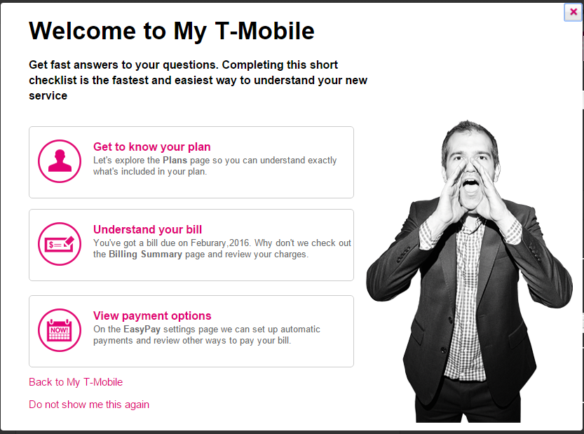
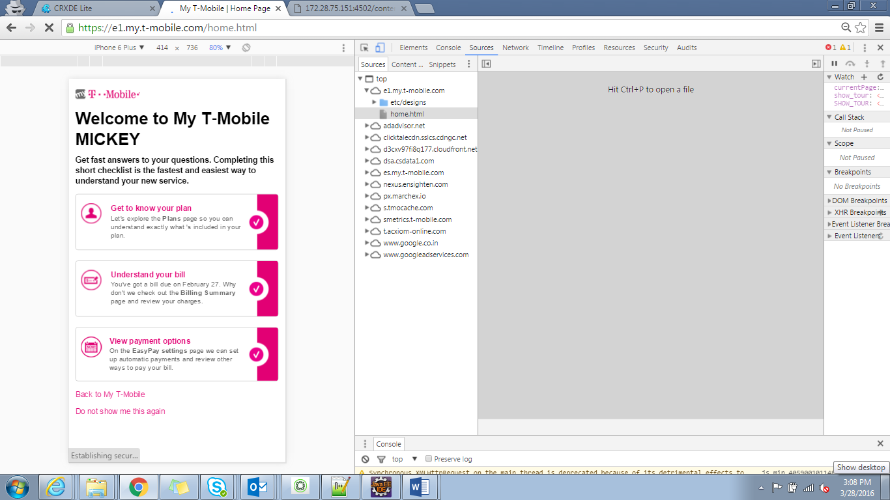
Checklist - Screenshot
Desktop:
Mobile:

Slide 8
Plans Tour
As a T-Mobile customer I would like to take a tour of my plan so that I can understand all the benefits I get from T-Mobile.
As a T-Mobile customer who has chosen to take a tour of my plan, I would like a step explaining how to view or change my plan, data or services so that I can understand how to make changes to my account.
As a T-Mobile customer who has chosen to take a tour of my plan, I would like to be presented with a summary screen so that I can understand what's on the plan page. (step1)
As a T-Mobile customer who has chosen to take a tour of my plan, I would like a step explaining how plan information is presented on the page so that I better understand my plan.(step2)
As a T-Mobile customer who has chosen to take a tour of my plan, I would like a step explaining how to view or change my plan, data or services so that I can understand how to make changes to my account.(step3)
As a T-Mobile customer who has chosen to take a tour of my plan, I would like a step explaining how I can add a new line so that I can understand how to add additional lines to my account. (step4)
As a disabled user I would like to be able to interact with the Onboarding Plan Tour so that I can learn about my plan.

Slide 9
Plans Tour - User Stories in Scope
S.N. | US | Description
1. 2. 3. 4. 5. 6. 7. 8. 9. 10. 11. | US45114 US45081 US45084 US45085 US45086 US45116 US45117 US45094 US45087 US45122 US46547 | [Go Big] Onboarding - (Desktop) Plan Tour - Change/View Plan, Data or Services [Go Big] Onboarding - (Desktop) Plan Tour - Plan Summary [Go Big] Onboarding - (Mobile) Plan Tour - Plan Summary [Go Big] Onboarding - (Desktop) Plan Tour - Account Information [Go Big] Onboarding - (Mobile) Plan Tour - Account Information [Go Big] Onboarding - (Mobile) Plan Tour - Change/View Plan, Data or Services [Go Big] Onboarding - (Desktop) Plan Tour - Add a Line [Go Big] Onboarding - (Mobile) Plan Tour - Plan Information [Go Big] Onboarding - (Desktop) Plan Tour - Plan Information [Go Big] Onboarding - (Mobile) Plan Tour - Add a Line [Go Big] Onboarding - (Desktop) Plan Tour Accessibility

Slide 10
Plans Tour– Files Modified

Slide 11
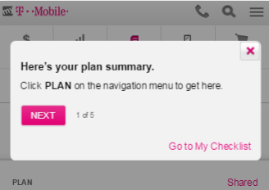
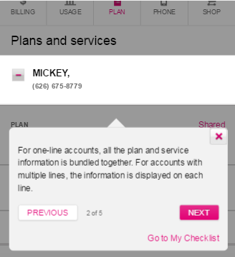
Plans Tour - Screenshot
Step 1
Step 2
Note:
Click of NEXT button proceeds to subsequent step.
Display of DONE button indicates last step of the tour.

Slide 12
Bill Tour
As a T-Mobile customer I would like to take a tour of my bill so that I can better understand what I will have to pay.
As a disabled user I would like to be able to interact with the Onboarding Bill Not Available Tour so that I can learn about my bill.
As a disabled user I would like to be able to interact with the Onboarding Bill Tour so that I can learn about my bill.
As a T-Mobile customer when I elect to begin the bill tour I would like to be presented with the first screen so that I can begin learning about my bill.
As a T-Mobile customer with multiple lines on my BAN, I would like to understand how to view line level information so that I can see charges that are specific to an individual line.
As a T-Mobile customer I would like the bill tour to display information about the individual line items of my bill so I can understand what I'm paying for.
As a T-Mobile customer with multiple lines on my BAN, I would like to understand how to view account level information so that I can see charges that are not specific to an individual line. (multi line)

Slide 13
Bill Tour- User Stories in Scope
S.N. | US | Description
1. 2. 3. 4. 5. 6. 7. 8. 9. 10. | US46549 US46543 US39701 US41486 US44944 US39764 US43202 US43204 US42941 US44945 | [Go Big] Onboarding - (Desktop) Bill Not Available Tour Accessibility [Go Big] Onboarding - (Desktop) Bill Tour Accessibility [Go Big] Onboarding - (Desktop) Bill Tour - Beginning of Tour [Go Big] Onboarding - (Desktop) Bill Tour - Account/Line Selector Step #2 (Multi-line only) [Go Big] Onboarding - (Desktop) Bill Tour - Highlight Line Items [Go Big] Onboarding - (Desktop) Bill Tour - Account/Line Selector Step #1 (Multi-line only) [Go Big] Onboarding - (Mobile) Bill Tour - Account/Line Selector Step #1 (Multi-line only) [Go Big] Onboarding - (Mobile) Bill Tour - Account/Line Selector Step #2 (Multi-line only) [Go Big] Onboarding - (Mobile) Bill Tour - Beginning of Tour [Go Big] Onboarding - (Mobile) Bill Tour - Highlight Line Items

Slide 14
Bill Tour– Files Modified

Slide 15
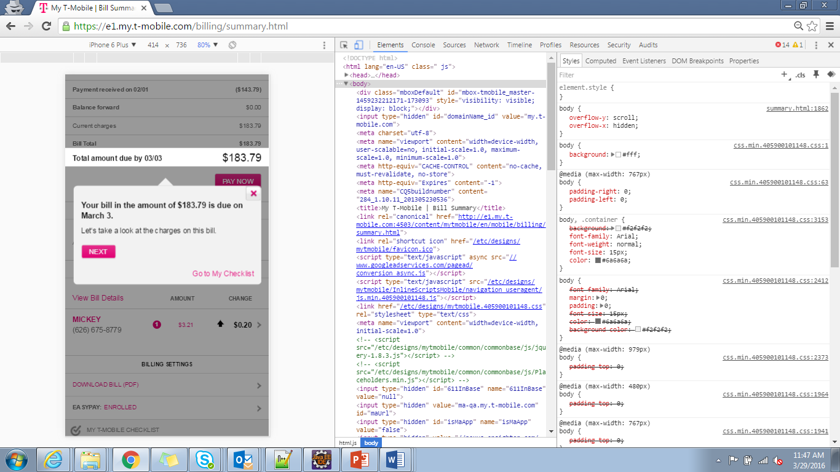
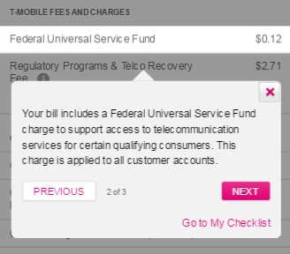
Bill Tour- Screenshot
Step 1
Step 2
Note:
Click of NEXT button proceeds to subsequent step.
Display of DONE button indicates last step of the tour.

Slide 16
Payments Tour
As a T-Mobile customer I would like to understand the benefits of EasyPay so that I can choose if EasyPay is the right payment option for me.
As a T-Mobile customer I would like to be presented with a modal that describes my payment options so that I can choose a payment method that suites my needs.
As a disabled user I would like to be able to interact with the Onboarding EasyPay modal so that I can learn about my payment options.

Slide 17
Payments Tour - User Stories in Scope
S.N. | US | Description
1. 2. 3. | US44941 US43644 US46548 | [Go Big] Onboarding - (Mobile) EasyPay Tour - Sign up Modal [Go Big] Onboarding - (Desktop) EasyPay Tour - Sign up Modal [Go Big] Onboarding - (Desktop) EasyPay Tour Accessibility

Slide 18
Payments Tour– Files Modified
Please find attached the list of files

Slide 19
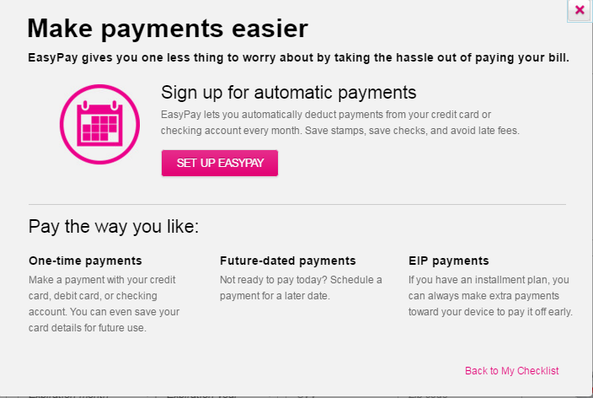
Payments Tour - Screenshot

Slide 20

Content path:
https://twire.t-mobile.com/docs/DOC-17768

Slide 21
Web Service Inventory
https://twire.t-mobile.com/docs/DOC-17358

Slide 22
Technical Design Document
https://twire.t-mobile.com/docs/DOC-17340

Slide 23
Defects
NA

Slide 24
Web Server Changes
NA

Slide 25
Questions?

Slide 26
Contact Information
Dev Leads
Onshore
Amit Mishra
Amit.Mishra27@T-Mobile.com
Iqbaldeep Singh
Iqbaldeep.Singh5@T-Mobile.com
Offshore
Prasad Chavan
Prasad.Chavan1@T-Mobile.com
Scrum Masters
Offshore
Sathya Shree Prasad
SathyaShree.Prasad16@T-Mobile.com
Nikhil Srivastava
Nikhil.Srivastava8@T-Mobile.com

