Slide 1
ClubVite
By Kevin Kostage

Slide 2
Project Goals
To make a web application in which the school would host and manage for the school clubs to utilize for scheduling club meetings, practices, and events
Automate attendance tracking to help clubs spend less time tracking attendance.

Slide 3
Methodology
Design first, then logic.
  Make sense of something that exists.
If you are going to use AI…
  Don’t make it work FOR you, make it work WITH you.
  ERRORS will be made otherwise.
    "Never trust anything that can think for itself if you can't see where it keeps its brain.“
    –JK Rowling

Slide 4
Use Case
Primary User:
Look for who is attending.
Select to attend / leave meeting
Context:
  Login, Register, select different clubs
Admin / Officer:
Add, Edit, Manage Meetings
Add, Manage Members in the Club Roster
Track Attendances
Context:
  Login, select meeting or roster

Slide 5
Tech Stack
Front End: ReactJS
  Use states, Routes, Router Dom
  Styling: Bootstrap and ChatGPT
Data Base: MySql2
  Pools Vs. Connections, Efficient Instance Recording
Back End: Express, Node
  Sessions, REST
  Nodemon, A tiny bit of Jest (not included in project due to errors/ crashes), npm
Repo
  Github

Slide 6
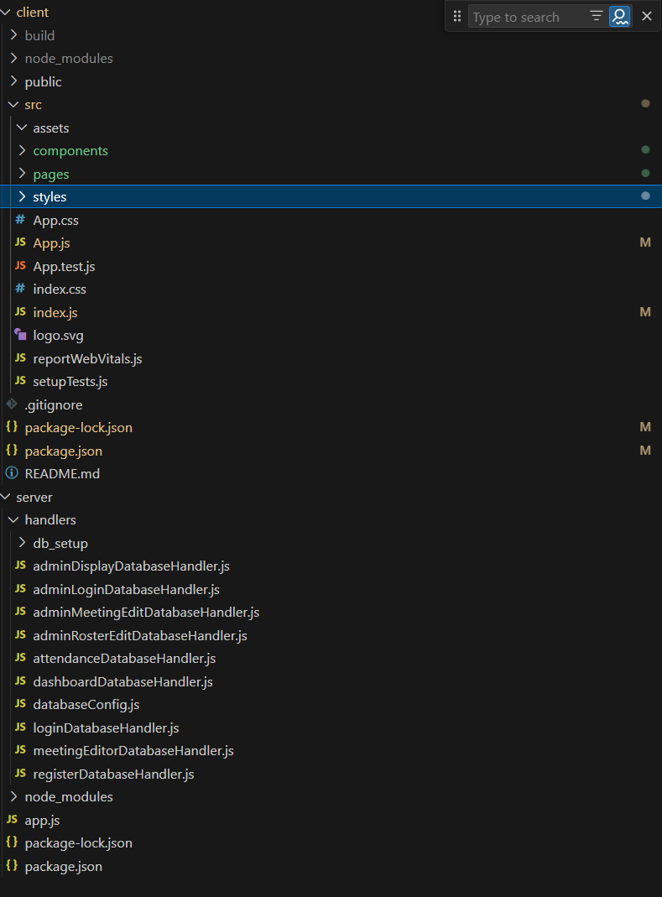
File Structure

Slide 7
Features by Sprint
Sprint 1:
Track Attendance.
Be aware of club meetings and who is going.
Make/ edit meetings
Register Primary Users
Login (Primary / Admin)
Multiple Clubs for users
Sprint 2:
Carpooling elicitation and tracking.
Security 😐
Sprint 3:
Styling ☺

Slide 8
BIG Concepts
Client-side Data filtering
DB pool connections
Saving Data via sessions
Forms & REST strategies
Intuitive UI/X

