Slide 1

Connecting SDL & SDLC and Access Control Introduction
After a bit of a SDL we will move to Access Controls

Slide 2
Topics
Algorithm review for Assignment
How does this relate to SDLC and SDL?
Baking in security from plan 1
Access Controls
4 types
Flows
Red vs. Blue 2

Slide 3
On board, let’s review our pseudo code
You should be planning your code when it comes to security
Or any real project (every project includes security)
Next assignment will be Linux Command Line (Bash tools)
Then back to Python with Json and build up this code

Slide 4
So what did we learn?
Security must be part of the plan from start:
Using a dictionary for each row allowed us to scale well and avoid issues
Scale because if we add to the csv it all matches up (with the headers)
A logic issue might not be caught and turn into garbage data for unknown timeframe
Logging (accounting part of AAA) would help us track to see what change happened and when
Helping us find the problem later (but still would be hard because we didn’t make the change)
Using a dictionary (named tuple or structure) for our severity and probability allows for instance access of values and easy changes.
Also allows for checking on changes in document or errors in input data

Slide 5

3 As
Authentication
Prove I am me
Authorization
Verify I can see
Accounting
Log what was to be
“what had happened was…”

Slide 6
Access Control = how we verify me
Authenticate: tools and methods identify users using multiple means:
01
Login Credentials
User/pass, pins
Biometrics, tokens
Multifactor Authentication
2-factor is most known but can be more
Authorize: determines appropriate level of access user has and what actions they are allowed to take (and what areas they can access)
02
Read/Write/Execute/Modify/etc.
Accounting: Log access successes and failures
03

Slide 7
4 types of access control
Discretionary access control (DAC): In this method, the owner or administrator of the protected system, data, or resource sets the policies for who is allowed access.
Mandatory access control (MAC): In this nondiscretionary model, people are granted access based on an information clearance. A central authority regulates access rights based on different security levels. This model is common in government and military environments. (ignoring)
Role-based access control (RBAC): RBAC grants access based on defined business functions rather than the individual user’s identity. The goal is to provide users with access only to data that’s been deemed necessary for their roles within the organization. This widely used method is based on a complex combination of role assignments, authorizations, and permissions. (newest)
Attribute-based access control (ABAC): In this dynamic method, access is based on a set of attributes and environmental conditions, such as time of day and location, assigned to both users and resources.

Slide 8
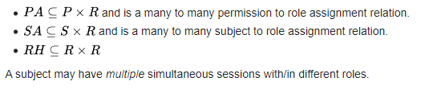
DAC vs. RBAC
One of the oldest
DAC is used with Linux we call it File Permissions
drwxr-xs-x (chmod 0765)
Set as type, owner, group, others
Also used with GitHub (Git made by the maker of Linux)
Whitelisting uses this too
Adblocker
One of newest
Adds the idea of “need to know” to regular DAC
Permission is set based on multi-criteria like an approval with job role (P x R)
S = Subject (when not a person)

Slide 9
Attribute based
A hotel resetting all access at 10am checkout time for guest account
Sharing files or folders with people within FGCU (OneDrive)
Sharing resources with “people in Team”
Anything which uses an attribute(s) to determine access
May be used with other criteria

Slide 10
Zero-Trust Security Access/Clearance
Principles states we should never trust the person or system connecting by default.
“Never trust, always verify”
Sometimes called perimeterless security
Traditional (pre-2000) was “trust, but verify”
Once you verified once – were just verified and assumed internal networks were secure
Caused data loss due to extensive, unchecked movement
How long do we have on FGCU?
Explicit verification and continuous validation
Least-privileged access (start with read, request more)

Slide 11

This works with the layers of Defense in Depth
Due to need to continually validate the connection – how would this be done? (think AAA)
Accounting – logging helps track and look for odd patterns.
Also uses other tools but accounting is an important tool in the primary purpose (stopping a threat)
Esp. important with cloud and web-based architecture (we’ll revisit then)

Slide 12
Importance
Superior risk mitigation from closing security gaps and controlling lateral movement (moving deeper into) on the network
Improved security particularly with support for bring your own device and remote employees
Strong protection for applications and data, whether they’re in the cloud or on-premises
Reliable defense against ransomware, malware, phishing attacks, and other advanced threats

Slide 13
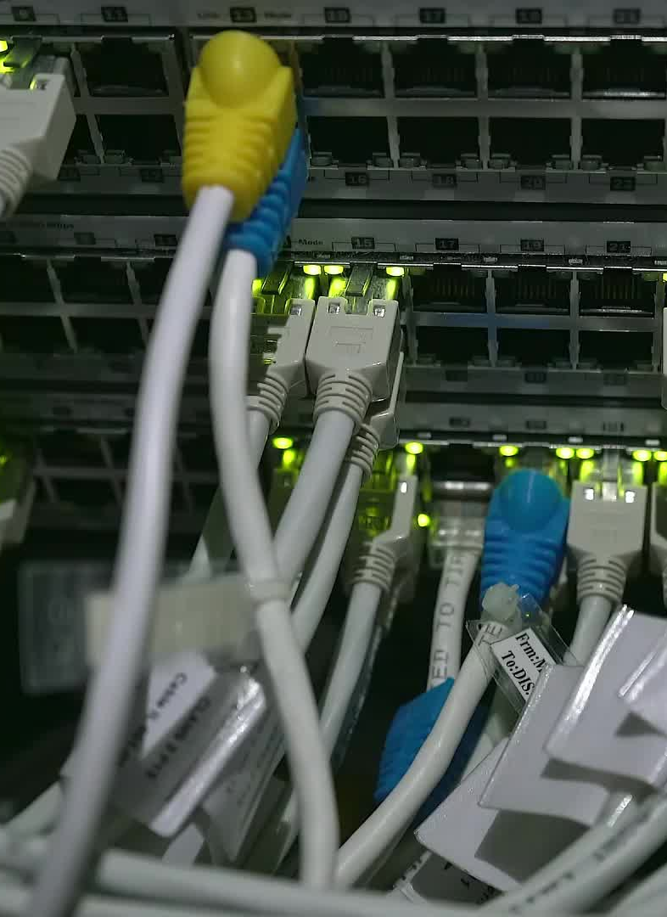
Thursday
We look at some more examples and how file systems handle access control
Also applications
And a bit of the network

