Slide 1

BotNets & IoT
Or “the process of hiding stuff”
This Photo by Unknown Author is licensed under CC BY

Slide 2
Topics
Rise of IoT and change in Security
Bots vs. BotNets
And Zombies
How BotNets get installed:
Rootkits and malware yes but “how?!”

Slide 3
New Threats, New Defenses
IoT and Bots have rising since cloud

Slide 4
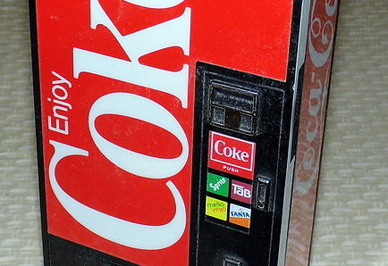
1980 – IT students connect
machine to internet to
Check temp of coke so they can be
LAZY!
This Photo by Unknown Author is licensed under CC BY-SA

Slide 5
IOT – Rise of the Devices (connected)
“Internet of Things” are devices and sensors which use wireless capabilities to communicate with themselves and other systems.
Google (really, again) StreetView started interest in 2010
Also pointed to double-edge sword (data storage on people’s devices)
Popularity increased in 2014 with smart technology and has not reached is peak
3.6 billion 2015 -> 9-13 billion 2022 -?>25.4 billion 2030

Slide 6
What are IoT? (Bluetooth/Cellular is helping)
Pacemakers
Speakers
Refrigerators
Thermostats, lights, smart home features
Baby Monitors / Cameras
Simple motion or pressure sensors (refill me!)
Pressure and Temp sensors (Cold Cola only!)
Use both Bluetooth and TCP/IP (UDP) for main connection types

Slide 7

Why now? What changed for all the items on last slide?
Cellular is small and strong now
4G or 5G – both powerful compared to 1980
Smartphones prove how small a computer can be
They are computers not really IoT anymore (though we still classify them as such because of their size & limitations)
Bluetooth allows for quick – not dropping – connectivity to sensors
Sensors are always IoT and very small
Walk out of your house listening to Ipod (which aren’t even a thing) and what happened to your music & wireless headphones in 2006?
WiFi dropped and no good cell signal so music gone, headphones drop too

Slide 8
Why such a security concern?
IoT exploded and people weren’t looking at it (see earlier about 2013) so…..kinda bad security from start
It just added a lot of endpoints rapidly and without warning
Some devices are so small that can’t really have much security
Always connected! (well, unless cell coverage is bad)
Used to have someone hacking you and if you left the area – it had to stop. Now…..
Grabbing Credit Card numbers was already seen (wifi swipe blocks)
So sniffing concerns, man-in-the-middle with a phone? So easy – let’s look
Privacy concerns (“always be recording!”)
Safety concerns
Let’s talk about Apple’s AirTag (useful and horrible), Ring, or Smart Locks
https://www.washingtonpost.com/technology/2021/05/05/apple-airtags-stalking/
BotNets, also BotNets, and finally BotNets

Slide 9
BotNets – what are those?

Slide 10
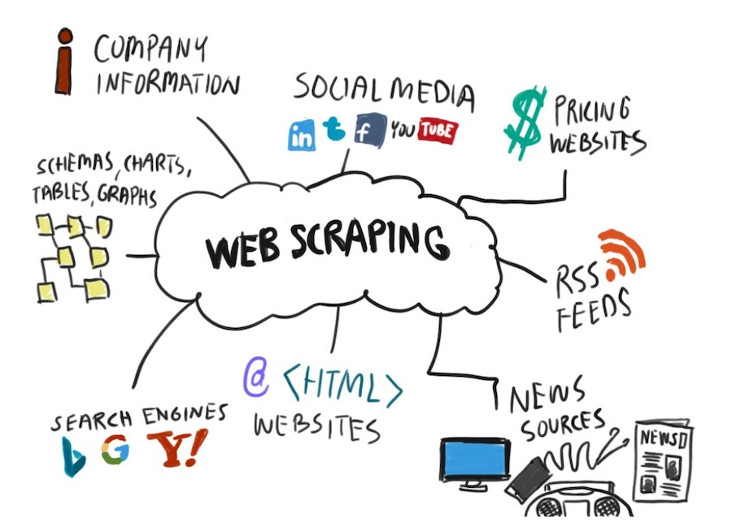
What is a bot? How does parallel help make bots?
A bot is simply a forked process (running program) which performs automated tasks to complete work.
This can be good or bad
Use APIs, use standard connection protocols, or web scraping
Don’t have to use Network – have like 5 logging bots running right now
>50% of web traffic are bots
Parallel operations allows one to fork multiple bots to perform tasks
Either split the workload or multiple sites at once
Distributed allows for massive botnets
This Photo by Unknown Author is licensed under CC BY-SA-NC

Slide 11

Single person Denial of Service
Single computer processes starts pinging site 1000x a second
Easy to prevent
Build your own bot that checks access logs and blocks this IP
Or change your ping port

Slide 12
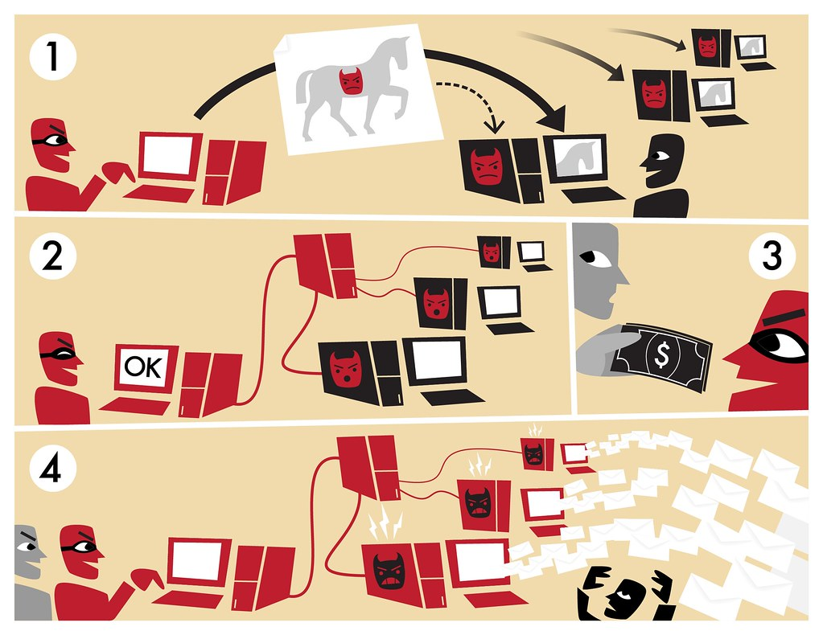
BotNet Attack
BlackHat puts a trojan on computers
Doesn’t activate Trojans (passive)
Unleashes all computers at once
Distributed Denial of Service or other
Usually using a rootkit from Trojan
This Photo by Unknown Author is licensed under CC BY-SA-NC

Slide 13
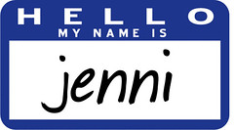
Remember China?
Whole of telecom went down?
Guess what happened?! (as best as we can guess)
they never authenticated the bots being used outside of basic login credentials and a “secret key” (AES encryption) over PKI
AES was already broken (and still is – at least the 32 & 64)
So cracked key = “Hi! I’m Jenni”
Unleashed a massive BotNet
This Photo by Unknown Author is licensed under CC BY-NC

Slide 14

Ways BotNets are used
DDoS – common, damaging but you must have a reason or backer (harder to get)
Spooks love these
Took down Norton too (couldn’t block them fast enough or determine any origins)
Massive Email Spamming
Also beloved by black hats (cause now your email looks like your email and spam filters cannot tell)
Or just a bunch of computers to send them
All other Spamming and Phishing
Name all the chat/email/message services you have on your computer and phone
Track your (i.e. every zombie’s) computer usage, browsing history, and any other information they can get (including stuff your work sends you)
Sell the history “legally” (it can be)
Sell the private info on dark web
This Photo by Unknown Author is licensed under CC BY

Slide 15

Bots with IoT – the horror!!!

Slide 16
I am a bad person named Rob – how might IoT and bots help me?
Today: Everyone is Red Team
I buy a bunch (10) cheap IoT devices (raspberrys)
I drop off these IoT devices on open networks
Open Bluetooth to direct them to install an “update”
I host a “free” wifi (hotspot on top of the free wifi)
I wait for my botnet to be ready and attack
Also, forward a bunch of data while I wait to sell
Also, lock your device with ransomware (remove? 100$)
25$ a piece (30$ w/few extra chipsets) = ~300$
Average cost spyware removal (no recovery): 200$

Slide 17
Then came IoT and the Cloud!!! Why’d it get worse?
How did the cloud with IoT make these types of attacks worse?
Easier Distributing
One person = 10 VMs = not $$$
More end-points
Smart devices
IoT
Systems designed for parallel
Swarm-as-a-Service
Better ML
$50 for cheap RaspberryPi
Later
Later
Later

Slide 18
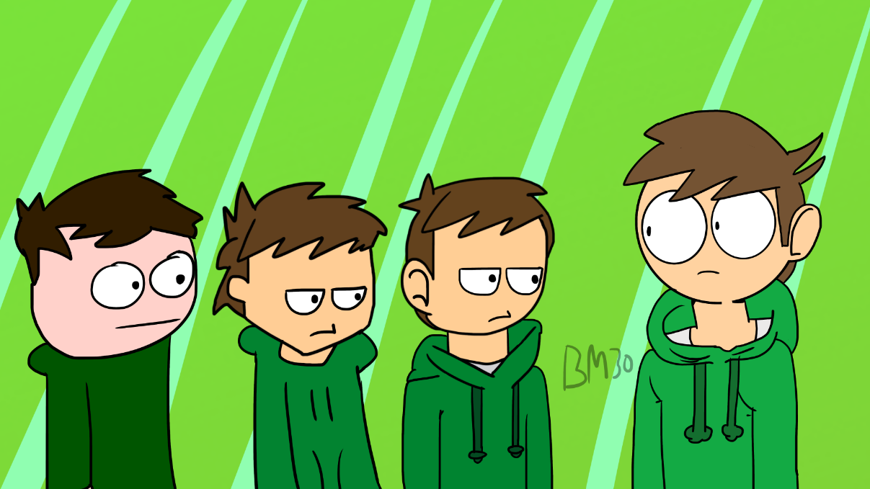
Evolution of BotNet
Improvements in AI/ML have led to:
Criminal systems which “learn and adapt”
Nachi Worm – RPC vulnerability
Mirai = Zombie malware (takes-over IoT devices)
Reaper & IoTroop – computer worms with automated spreading
Better phishing and conversational interfaces
Google translate 2012 vs 2021
Working on Alexa
More opportunities for phishing and other attacks
SMS messages, chatBots (“connect with our representative”)
This Photo by Unknown Author is licensed under CC BY-NC

Slide 19
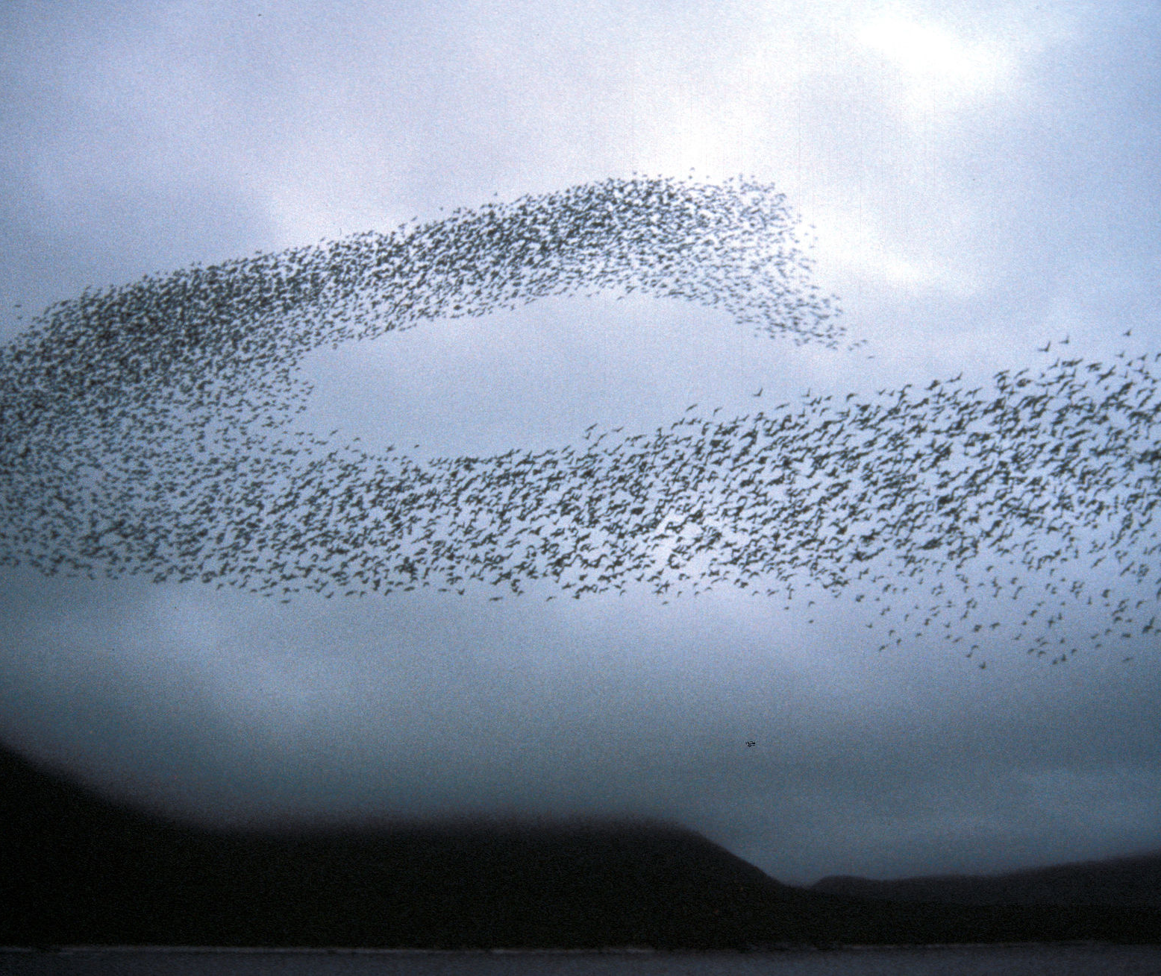
Then came the Swarms! (when we cover cloud)
This Photo by Unknown Author is licensed under CC BY-SA

Slide 20
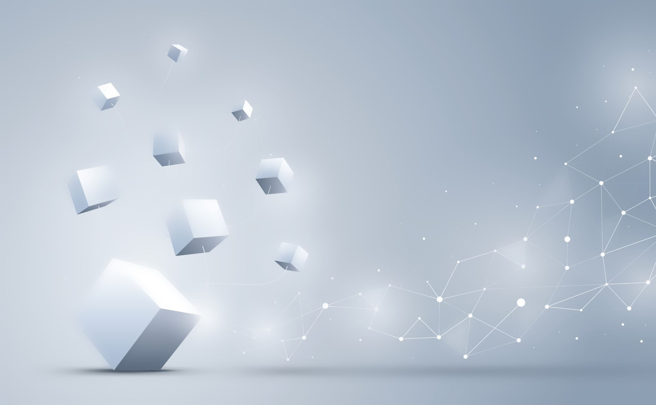
From here – encryption (web based) with how that helps with these issues
To be fair, with botnets its all about prevention – if you don’t. Its extremely hard to detect, stop, or remove.

