Slide 1
Software Security Part 2: Injection Again (user-interface attacks)
Continuing our walk through OSWAP and Top Vulnerabilities

Slide 2
Today we will finish Injection by Looking at Code & Shell/Command Injection
It is a type of user-interface attack
It happens when an attacker adds code through a vulnerability in an application
Web or Local
Includes Malicious version and Accidental Code Injection
How do you think you could accidentally Code Inject the code on the next slide?

Slide 3
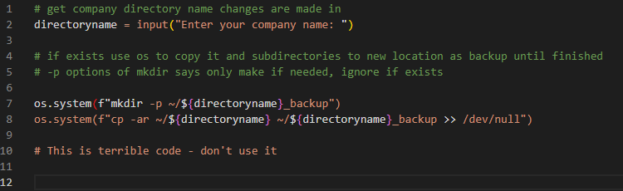
This is injectable (on accident) – causes an exception
This is injectable (maliciously) and could have horrible consequences

Slide 4
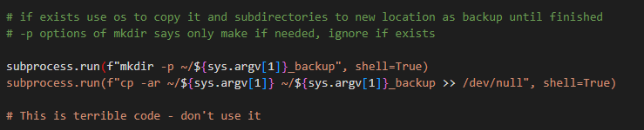
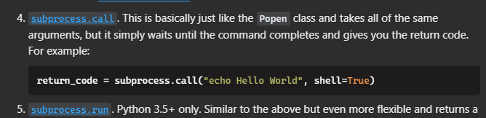
What the code would really look like
Why? Cause StackOverflow says its alright! +3000 can’t be wrong

Slide 5
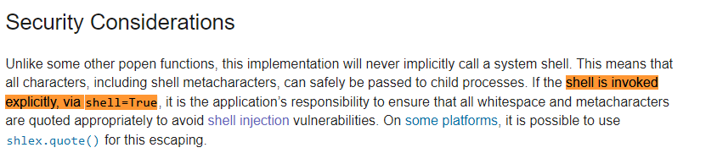
How do I find out this is a security hole? Use the docs.

Slide 6
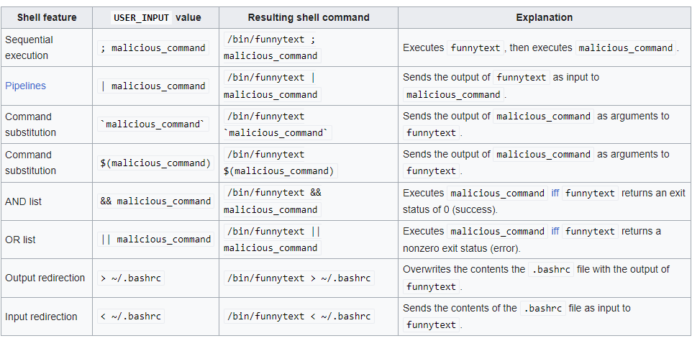
So what could have happened? Just in the mkdir:

Slide 7

How do we fix this? A few ways

Slide 8

Values from above
Use a linter
Input validation
Use whitelisting over sanitization when possible
Use libraries correctly and research new libraries before use
Read the basic docs at a minimum, web search vulnerabilities
Handle exceptions do not ignore them
Check bounds and types to ensure security – esp. in strings

Slide 9
Thursday – Design Issues Like no error checking and exception handling or using:
Eval
Python, PHP, Javascript, & many others
PHP also has passthru which is eval at a client-side level and a whole other realm of evil
C++/C is called exec or execl
Goto
C & C++ primarily

Slide 10
Languages dangers – do not use!

