Slide 1
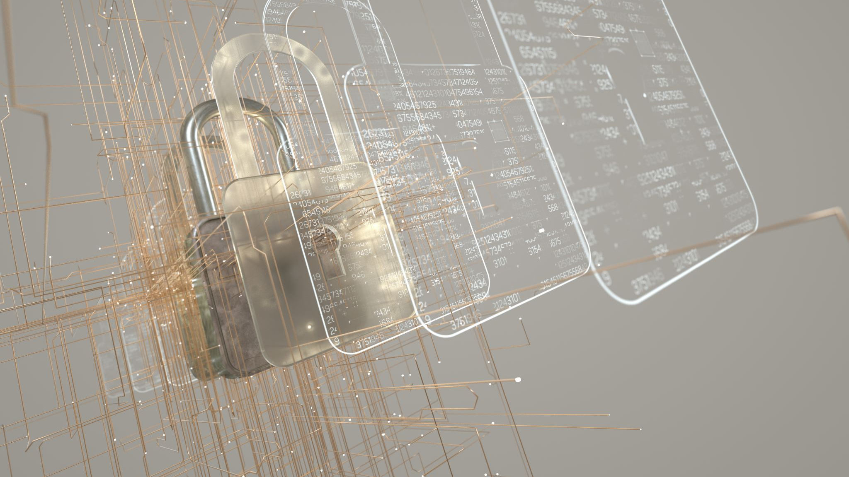
Encryption Overview and Web
Mostly an overview

Slide 2

Topics
Basic – non-computer encryption and practice
Adding in a Computer
Types of Encryption (ways its used)
Symmetry
Web
TLS & HTTPS
PKI Key

Slide 3

Intro and usage

Slide 4
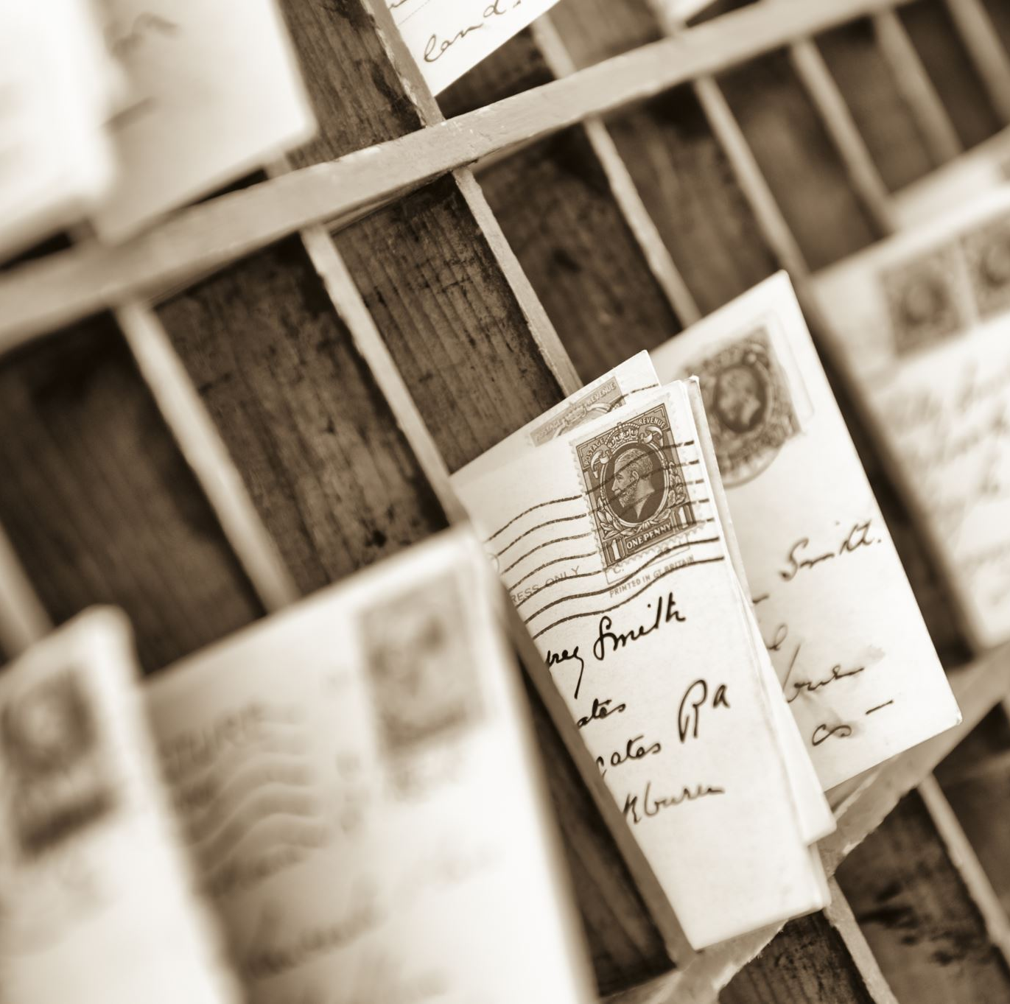
Let’s look at two common (still paper based) forms of encryption – with Jail and letters
Form one (easy to show I just happened to have it)
Both people cut out the same spaces in a piece of paper
Usually, you pick a weird letter like q or x (or both) and send each other letters with those characters carefully placed (and cut them out)
IT is your algorithm and cipher
Form two
First word is cipher, and you use Caesar
We’ll cover this one later so remember First Word.

Slide 5

Encryption
Is a lot of math in Computer Science but at its heart:
Its anything which attempts to scramble or change a communication in order to hide it
This can be with images, text, and even video or audio.
Decryption is reversing this (cracking is usually the term for decrypting when you shouldn’t be able to)
All are based on a cipher (the way to make or break it – i.e. algorithm)
Why math heavy in Computer Science?
Cause computers are scary good a computational equations
Encryption is basically just a lot of functional math

Slide 6

Different usages of encryption
On the Firmware (not hardware): encrypt the BIOS
On the OS:
You can encrypt a folder or file
Or both (in the case of a compressed zip file or certain databases)
The entire OS
Which means the entire HDD/SSD
Or virtual partition in case of VM
A partition
A section of the HDD/SSD
Any combination
a Blowfish encrypted file in an encrypted file using AES on an HDD which is itself encrypted using BitLocker or AES
Why/When is it a good idea to do each of these? When might it not be?

Slide 7
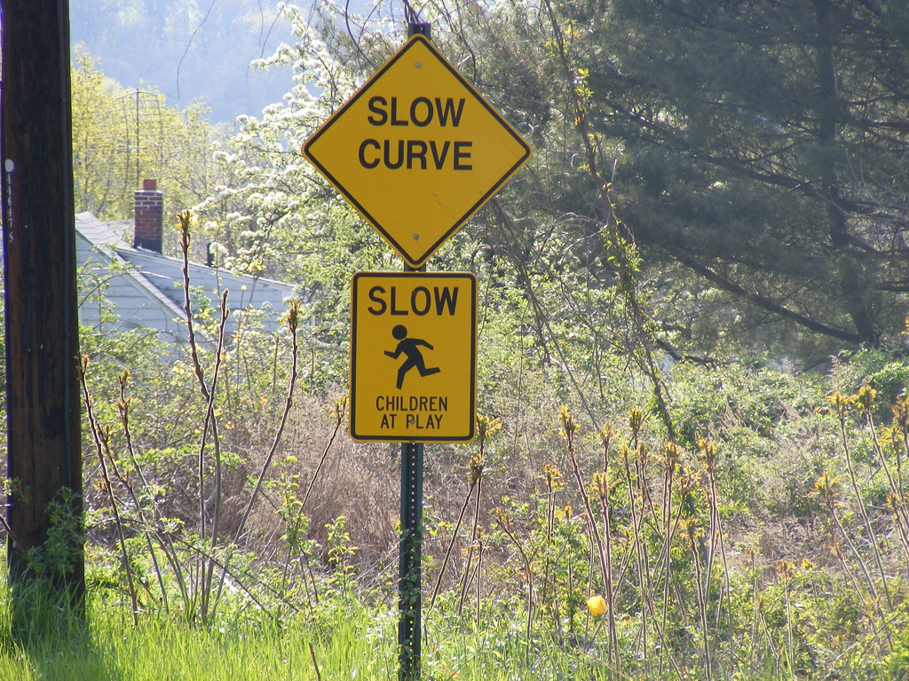
Why not use it?
An encrypted drive can lead to data loss
BitLocker if recovery information lost/not setup
Google for same reason
Apple for same reason
Linux (LUKS) if you lose the key
Its slower
Add decrypt to all read requests
Add an encrypt after all write requests
Technically its the buffer flush request (for both) but you get the idea
Do you need it?
Private files for students under FERPA on external drive = encrypt!
Your video game files? A child’s school computer? A tablet for a toddler? Grandma’s Recipes?
YES. I have been yelled at for an hour+ because an employee lost grandma’s recipes
This Photo by Unknown Author is licensed under CC BY

Slide 8

Basic Encryption and a simple algo

Slide 9
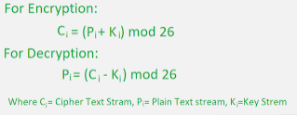
So let’s go back to our Jail Example
Julius Caesar needed a way to hide message sent to troops on the front
So he invented (or so the legend goes) a form of encryption which switched the characters around based on a “secret key”
If the Key was 5 for instance (and we were using English not Latin) we’d move “h” to “m”
Decrypt would move “m” to “h” due to same key
Let’s look at how criminals add a “key”
mod 26 = mod L

Slide 10
Making it more complex – how?
We can add more characters
Latin has 52 letters (if we include symbols & upper/lower)
We can get this up to 95 with modern English (if we include space)
Still loop at the end
We call the alphabet we are using a codex – and it doesn’t have to be English (or even an alphabet)
Criminals will send two keys:
First sentence: I’ve started reading “Chicken Soup for the Soul” and its great!
Key = great
Codex = Chicken Soup for the Soul
Could even put, I’m up to chapter 3 or some such.
Criminals 1 key is actually a few keys:
It’s a shift so “’Angel misses you.” = Angel would mean the key is: 1 14 7 5 12
Or shift each letter on the pattern (1, 1, 4, 7, 5, 1, 2)
Programming languages are pretty good when it comes to reading files or randomly generating letters in lists
Simple one is using the alphabet backwards

Slide 11
Does this make it computationally difficult?
No.
Further, No.
Are shifting pattern (called a transposition) takes a 10 billionth of a second to crack with a modern system.
build an array of letter indexes in numpy and call numpy.transpose()
Or (other way) use cycle and itertools and apply the key that way
I timed it at 18 seconds to crack a cycle key with 87 digits on my system (which is good, not great)
A computer’s brute force eliminated several algorithms for truly encrypting data.
The 18 seconds was brute force – just tried every combination until one showed plaintext
Even normal random is not random enough and Python has special libraries for generating cryptographically sound random sets
It is called secrets
But that’s next week, for now we understand the basics

Slide 12

Okay so how does the web work?

Slide 13

Encryption on the Web
Let’s review PKI and look at how HTTPS works (with TransportLayerSecurity).

