Slide 1
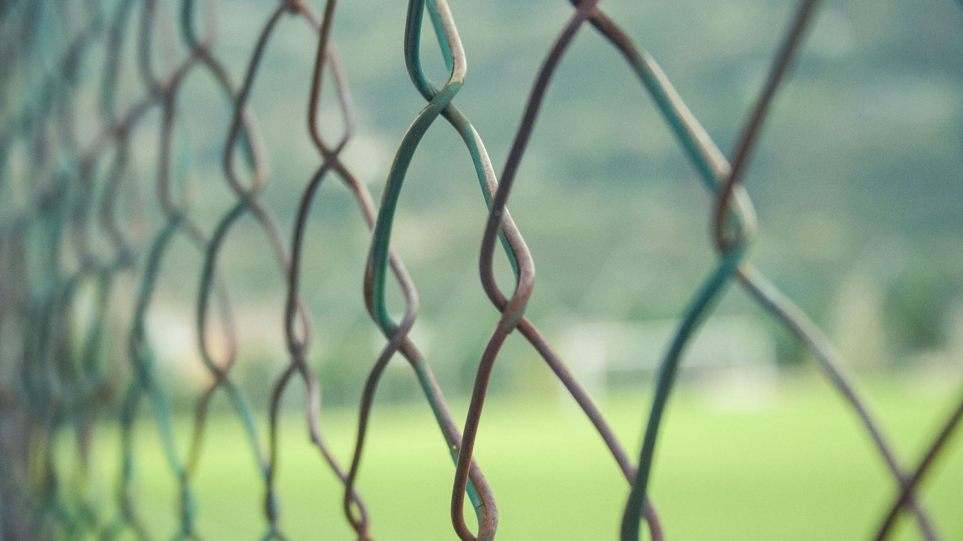
Security Management: Focus on Physical Security Considerations
Professor Greenwell

Slide 2
Topics
SPACE
Entry Points
Traffic
People

Slide 3
Limits
So we are computer scientists, software devs, ops people, engineers, etc.
We don’t need to consider physical security at a Police or Security Personnel Level
We do need to consider those items which effect our computer systems
This lecture will focus on the physical security issues and counter measures we face as IT/IS/Ops/Sec/Data people
We will continue with Threat Modeling on Thursday (and create a SWOT diagram)

Slide 4
Let’s review our risks
The results from the poll

Slide 5
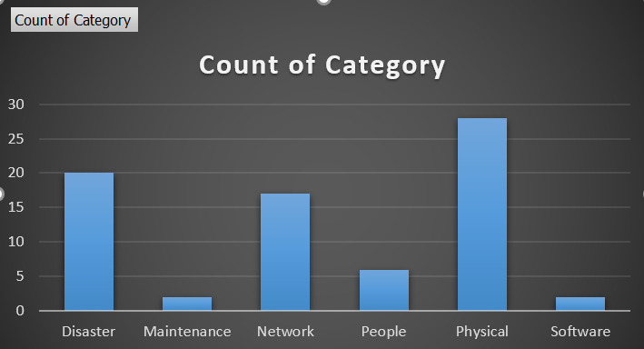
But first – let’s look at the top threat categories and in general from our classes
Physical Security issues were top
Network & Disaster secondary
People in a distant 3rd

Slide 6
By category the most stated risks:
Physical
Lack of Security System
Criminal breaking into home to perform malicious activity
Network
Unsecure network is hacked and sensitive data stolen
Outage (electric or internal/external network) removes access to the Internet
People
Forgot to secure building when leaving
Employee sabotages the network (maliciously or accidentally)

Slide 7
Let’s explore Physical Security
As it relates to our results and planning

Slide 8
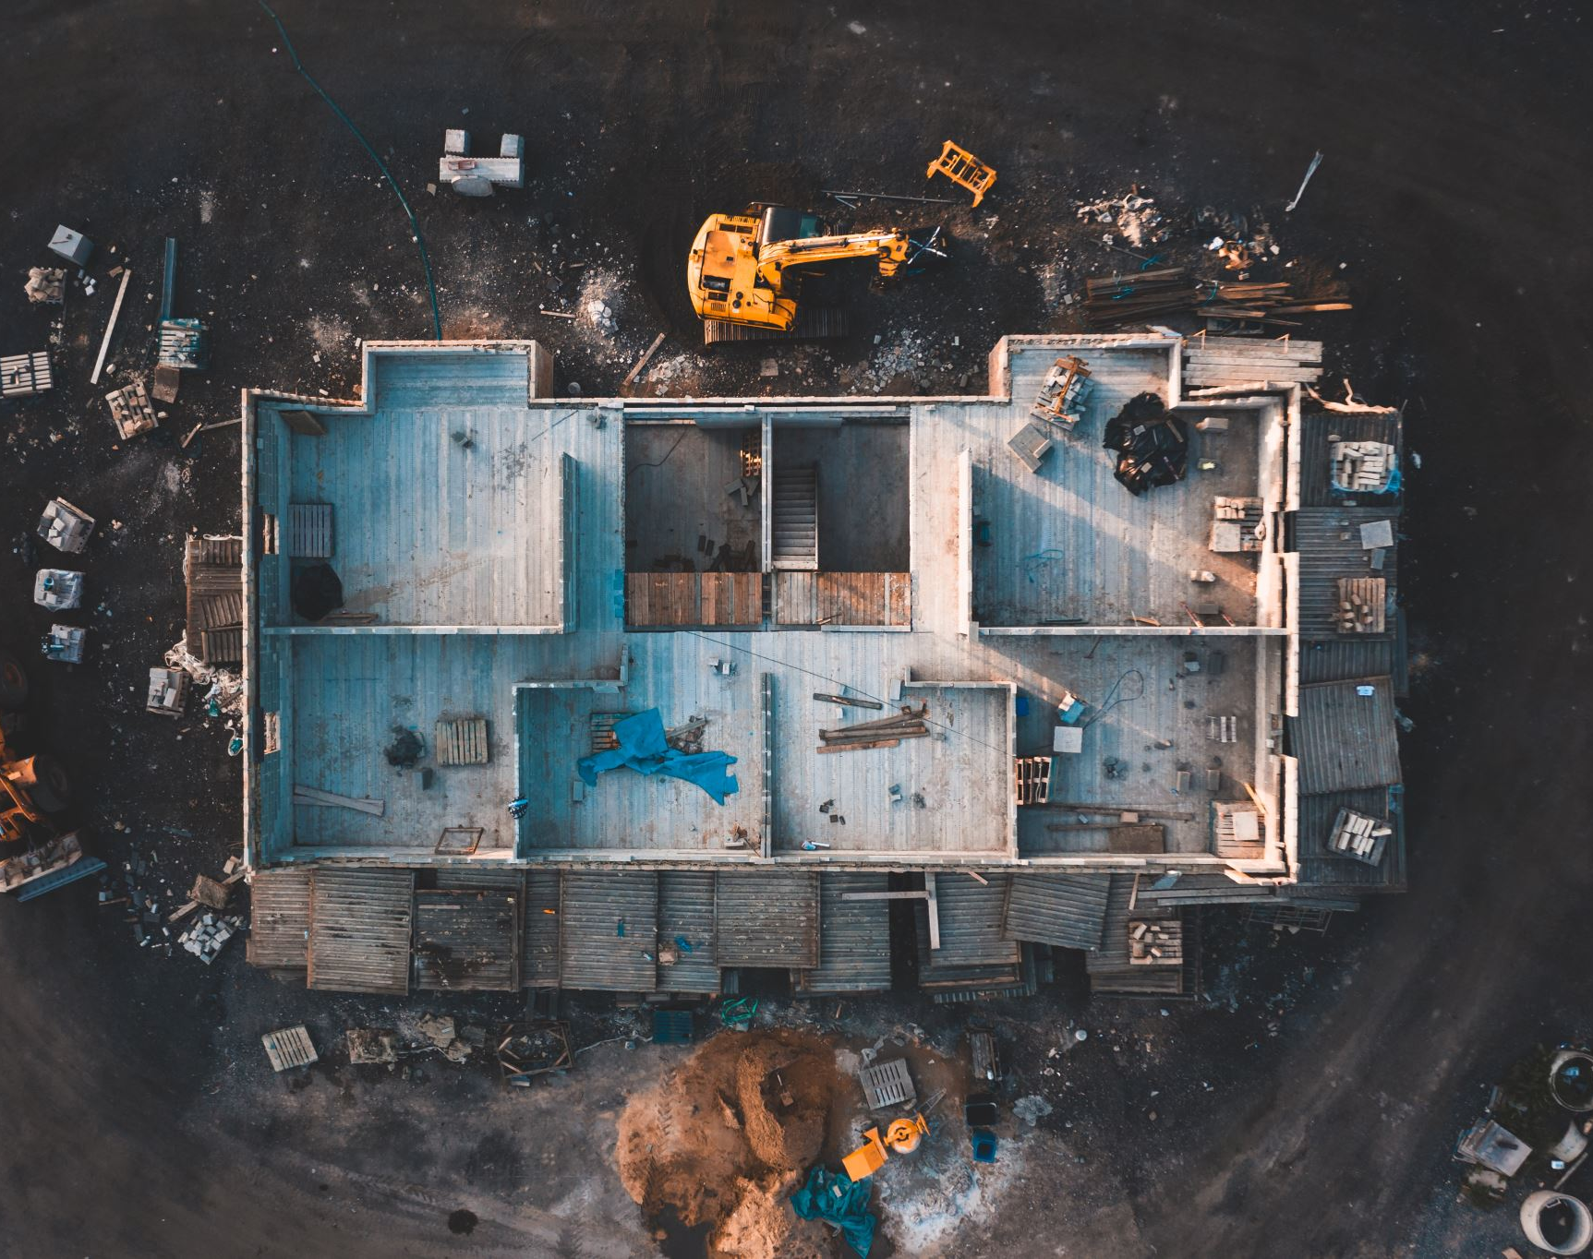
SPACE
The final fron… wait not that. Its considering our actual space – what is the location?
In our first example it was our own home
For IT:
Business and building type
Specific Rooms
What type of rooms might need extra protection?

Slide 9
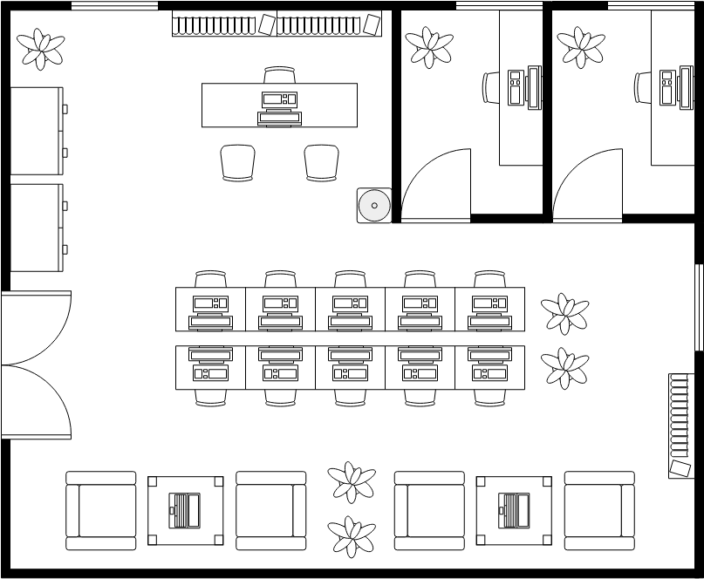
Simple - Complex
Let’s look at 2 types:
A small business layout
Simple shop from Visual Paradigms Online
A layout based on one of my worksites
On board, we’ll explore a few items first then complete that
Where is extra protection needed in this situation and why?
What should we add? (let’s look at counter measures)

Slide 10
Countermeasures = tools/methods to counter
Mechanical or Electronic Access Control
A lock or card reader
Biometric Access Control
Fingerprint reader is most common
With numpad for override
Video Surveillance
Smart lights at least
Generator
For power outages
Don’t use water-based sprinklers & elevate floor
Access based on access program

Slide 11
Simple - Complex
What counter measures do you see used here at FGCU that we could use in this building? (and where)
Keycard readers & Locks (mechanical/electric)
Guards (campus police)
Cameras (surveillance)
Also using Drones at one point
Generators & backup internet provider
Major systems have mobile systems too

Slide 12
Let’s look at the complex example
What’s the most critical IT resource (room) in this case?

Slide 13
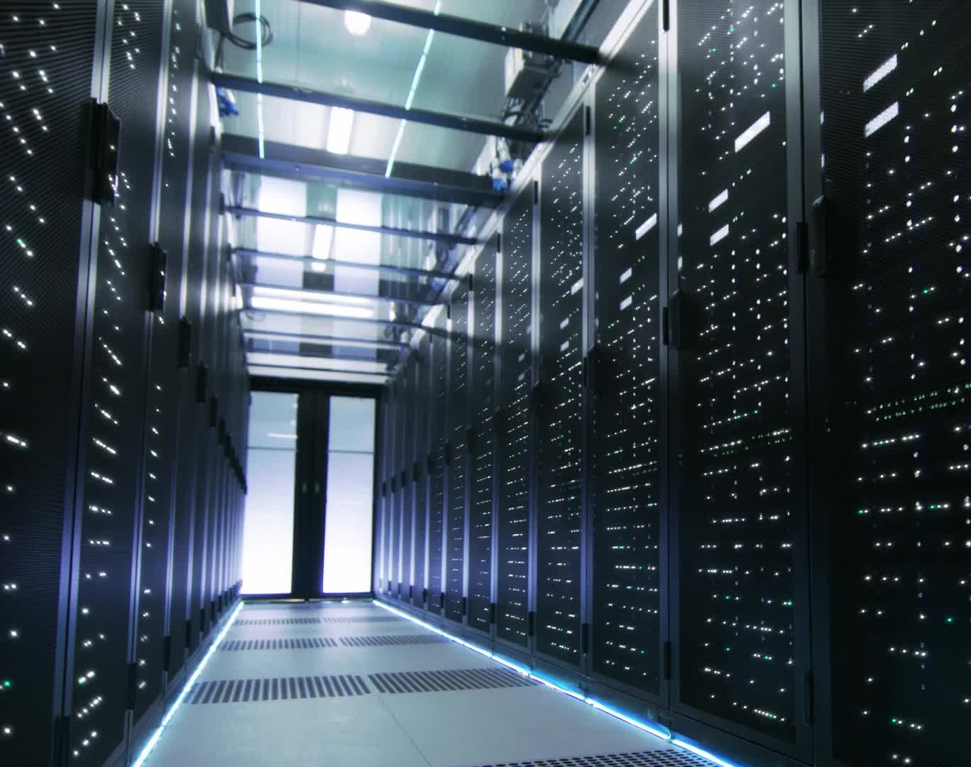
Server Room
In the Server room lives the data and the main systems. Access should be highly restricted.
How many people should be around this room daily?
Who should be let in? Who shouldn’t?
How can we limit access?
How can we deal with disaster issues?

Slide 14

Traffic and Entry Point counter measures
Move the server room away from main traffic points
Add multiple entry points which must be passed
Main entrance -> ITS Department -> Electrical and Server Sections -> Room itself
Use our countermeasures from before here too
Card Reader with pin for first 2
Pin with 2-factor phone setup for Section
Fingerprint for actual room

Slide 15

People are People
How are some ways people could cause issues and countermeasures?
Tailgating/Piggybacking: person follows you into a secure area (you hold door open for them)
Not locking the door – “trashcan in the door to stop it from closing”
Lost ID card (if card reader) or found pin written down if keypad
Person drops device (IoT/burner phone) into someone’s bag or purse which actively tries to hack network
Person pretends to be IT or other official and tricks someone into allowing access
Countermeasures: Training, Policy (with enforcement), & biometrics or multifactor authorization
Biometric & multifactor avoid the pin/id card issues
Doesn't help with others at all

Slide 16

The bad news – its all soup. We could add bio:
Fingerprint recognition
Fingerprint Geometry
Retina or Iris Recognition
Hand Geometry Recognition
Voice Recognition
Facial Recognition

Slide 17
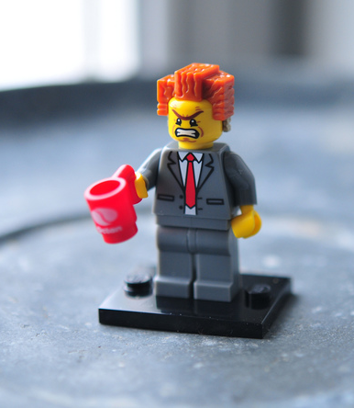
We need management support to
Implement Training Programs
Setup Policy
Enforce Policy
This is the most important part – why?
This Photo by Unknown Author is licensed under CC BY-ND

Slide 18

Others require actual building
So engineers and contractors hired to install systems
Notes:
Picture from lego movie game

Slide 19
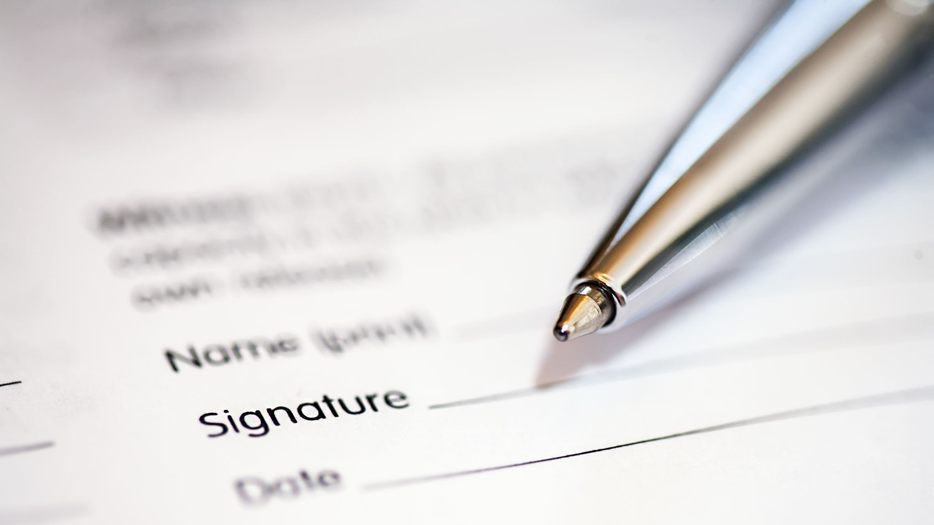
Why is important to determine these risks and threats?

Slide 20

Security Assessment Importance
Can be used to build Higher Support
Presentations from it should engage and impart importance of security
Builds case with evidence on need for investment in security
Failures/successes should be fairly described based on accurate testing

Slide 21
Next: Security Assessment Start
With some introduction to common threats and vulnerabilities and building a SWOT diagram
NOW: Does this change our risk assessment? (complete on own)

