Slide 1
Physical Security & SDL – defining our business and defining threats
From Risks to Threats

Slide 2
Topics
SDL
Threat Modeling
Defense in Depth
Defining the business
Identifying Threats
Creating a Diagram

Slide 3
Security Development Lifecycle (SDL)
This has been merged with DevSecOps in many instances
Works with a full SDLC to ensure threats, attacks, and vulnerabilities are identified and countermeasures are planned.
Part doesn’t involve software (people and physical)
May work indirectly (People, OS or network security, testing)
May directly involve the software (People, software security, network security)
Network security will have more direct involvement with a website then building an OS

Slide 4
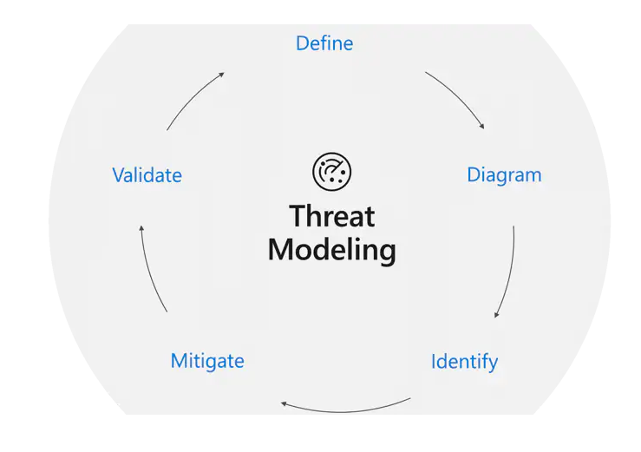

Threat Modeling process

Slide 5
Define – identify based on management provided documentation and guidance
One cannot plan security without defining the business, its mission/values, Key Performance Indicators, target market, and all the other factors a full Discovery will uncover
We will not do that (its part of an Information Systems Degree)
We will at least define what business we are looking at and what part we are planning for.
For a question, what would change in our physical security concerns between these 3 types of business:
A service provider location (we’ll say hotel)
A grocery chain location (pick your favorite)
A retail location specializing in high to midrange electronics
A corporate headquarters

Slide 6
Identify the Threats
We’ve done the first step which is defining risks.
Let’s finish that and build the first part of our risk matrix (put a few risk in it together)
We’ll use the corporate headquarters because we will also add some other threats (physical ones) by the end of today (and likely a few more risks)

Slide 7
Defense in Depth, Security in Depth, or the Onion Model
Defense in Depth is a security strategy which looks to layer security.
The onion model is the Physical security side of this.
The layers are:
Outside World Threats
Visitors
Customers/Clients (outside vendors)
Employees
IT/IS Personnel
Security Personnel
Final level can also include C-Suite, the founder, the CEO, or the like.

Slide 8
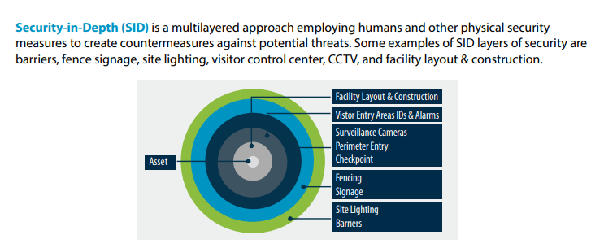
Security in Depth is the law/military side and looks like this
From Center for Development of Security Excellence (linked on slide)

Slide 9
A risk matrix feeds into a “Transition Matrix”
We colorize our model based on access level
Then plan and list:
Who is allowed in which area
Who or what authorizes access
What it can transition to/from
A visitor area can be near a client area but not near an IT area
Any Conditions
Card reader/receptionist/etc.

Slide 10
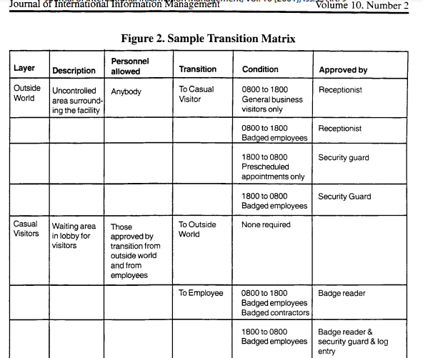
Looks like this
Notes:
Journal of International Information Management, Vol. 10 [2001], Iss. 2, Art. 9

Slide 11
Then we determine which of these are vulnerabilities (SWOT)
We also evaluate based on the earlier risks found
They may be threats or weaknesses
If they are covered, we can count them as a strength
If coverage is needed, adding the counter-measure may be an opportunity
There are others but this is a good start

Slide 12
We complete with a SWOT diagram
We’ll finish that on Tuesday, but this provides enough to ensure you can start filling in the Strengths, Weaknesses, Opportunities, and Threats
For your chosen business model
Right now let’s review the security holes caused by people that everyone identified at the beginning of class

