Slide 1
Hacker Methodology with TLS
Red Team and Blue Team

Slide 2
TLS protects against a lot but not all – let’s review
How does TLS protect us from our “dumb friend”?
Who connected to a false proxy or domain or hot-spot and is being man-in-the-middle (MiTM)?
So their information and email is not encrypted
Due to the server protections (not direct contact) and our encryption
Because Server is using TLS (or we are at least) our connection to server is still not plaintext
Our information cannot be seen
If direct connection – they still need the public key we would have initial supplied (due to asymmetric encryption) to see plaintext
To be fair, if they’ve fully rooted the device – they will have access to this but – LAYERS of DEFENSE.
If the fully rooted the server its same but worse (and that’s how data breeches happen)

Slide 3
For the next sections let’s assume something
Our dumb friend got a clue – and finally upgraded their Windows XP machine!!!
To Windows 7
Which only allows for (old) SSL encryption (no true TLS)
Let’s see what we can do if our recon showed us this

Slide 4
Bad people, Do bad things
Note: These are just examples of weaknesses that existed with SSL. TLS has fixed these from an early version (some can theoretically still happen, but the complexity makes it unlikely)

Slide 5
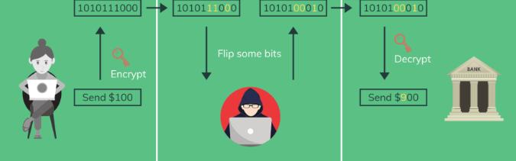
It’s encrypted because they are using SSL
But its an older encryption
And you still are connected to a MiTM
And you annoyed me (or I’m just bad)
Bit-swapping or bit-flipping attacks simply say “I cannot tell what this is, but I have it so I’m going to switch some bits around to mess with the message”
Best case: you get weird typos in email
Worst case: you were trying to connect to your bank

Slide 6
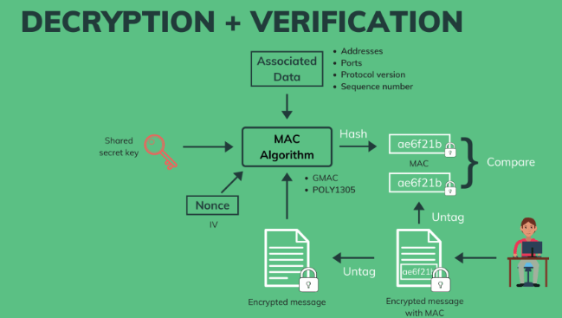
New TLS stops this
Due to the signature (the MAC)
It adds authentication not just encryption
If MAC shows alteration (which will happen if you move parts around): cannot authenticate
Cannot authenticate don’t accept message
TLS also added checking the nonce
It (since TLS 1.1?) adds its own message to the encryption (random set of characters) which it encrypts with the key (a shared secret key made with the session key)
Which increases the complexity because now you’d have to guess at a random set of characters and the normal MAC

Slide 7
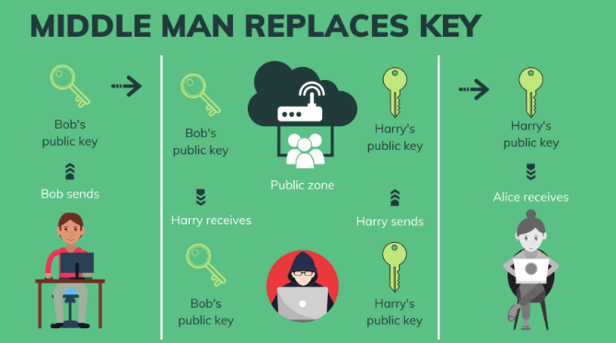
Replace the Key
Captures dumb friend’s secret key and replaces it
This is particularly damaging and old SSL would happen (TLS was built on this not happening) – What changed? (what group was added?)

Slide 8
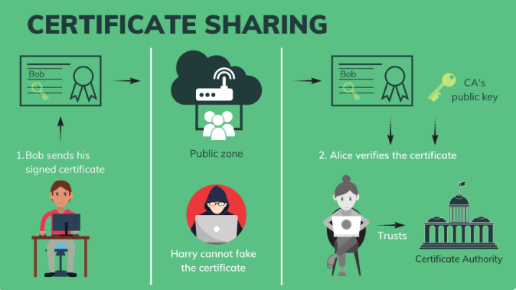
CA were added to stop this type of attack

Slide 9
Real-World, Planned Attack
The methodologies of hacking

Slide 10
IT Professionals like processes (Hacker Methodology)
Reconnaissance
Enumeration (Scanning)
Gaining Access
Privilege Escalation
Covering Tracks
Reporting

Slide 11
Hackers do too (Cyber Kill Chain)
Reconnaissance
Same: Research potential targets using any means.
Weaponization
Use knowledge to create targeted malware.
Delivery
Deliver tools to begin attack to target, through vulnerabilities found in stage 1.
Can be phishing, social engineering, a weak network connection, hotspot, dns spoof, proxy spoof, etc.
Exploitation
Use new weakness found (or caused) by delivered tools to further attack (move laterally through network towards targets and objectives).
Installation
Attempt to install actual malware and other weapons developed
full trojan horses, ransomware, rootkits, etc.
Command and Control
Take control of computers, devices, and network. Activate your weapons.
Actions on Objectives
Profit! Whatever objectives you had – carry them out now
Activate trojans or rootkits and use zombies for DDoS; steal data; lock and demand payment to unlock computers; etc.
Framework Developed by Lockheed Martin in 2022:
https://www.lockheedmartin.com/en-us/capabilities/cyber/cyber-kill-chain.html

Slide 12
Reconnaissance
Without even thinking of Linux commands, what are some ways you can RECON a business?
Call them
Web searches
Social media pages
LinkedIn is basically social media for employees
Many other ways (drone taking pictures is a fun new one)

Slide 13
Passive Recon
Passive Recon was most of what you would have mentioned, its research a group in such a way that you will not set off defenses (you avoid directly engaging with company)
Can use public information without tools
LinkedIn website is a rich tapestry of attack information
What makes it special from other job-hunting sites? (which we will also check)
Their company website
Blogs and news articles
Can use tools:
High number of DNS lookups are expected (nslookup, whois, and dig)
Specialized tools for DNS lookups (to find sub domains) – DNSDumpster, Shodan.io

Slide 14
Active Recon
After passive you start actively (directly) engaging with the target during recon.
Without tools
Calling them and other social engineering efforts
Physical checks (fake deliveries or real deliveries)
With tools:
Ping and any other connections made using HTTP, FTP, or SMTP (email) protocols
Why do you have to be careful with scam emails?
With specialized security tools
Burp

