Slide 1
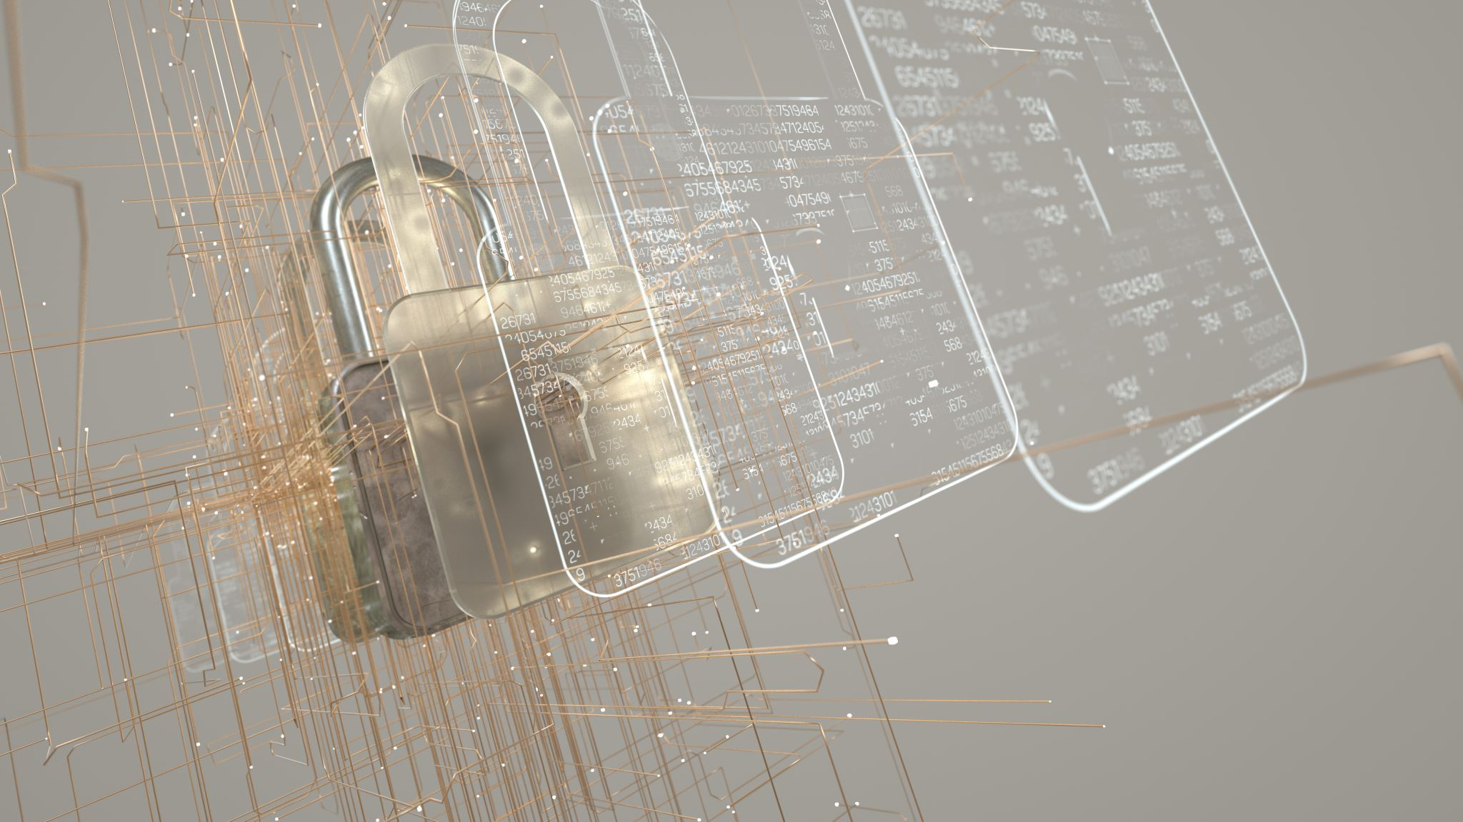
Security Basics: Risks
Professor Greenwell

Slide 2
Topics
Definitions and Terms
Risk Analysis
Risk Assessment
Risk Matrix (Qualitative vs Quanitative)
Security Management

Slide 3

Terms (from NICCS)
We are going to define a few terms which are important going forward (you will not be quizzed on these until we get to their chapters).
However, it will be hard to understand me if you don’t know these.

Slide 4
A few terms: The actors
What do you think (threat) actor means?
An individual, group, organization, or government that conducts or has the intent to conduct detrimental activities
We’ll define one actor now the “cracker or hacker or red team”. The terms have evolved over time:
Cracker = hacker once simply met a skilled programmer where cracker was used to reference those trying to break into a system (think “safe cracker”)
They were considered heroes and folktales about them abound
Crackers like to refer to themselves as hackers (whether they were or not) and non-computer experts picked up and used the term, so the meaning changed
Red Team, Blue Team, White Team, and Purple Team are industry terms referencing professional testers.
Where detrimental activities = intends harm to devices, systems, people, or networks
Hacker is now the official term (see NICCS). Still common to hear “cracker”.
When we “hack” a system for testing we are the red team and the blue team is trying to stop us

Slide 5
Other key terms
Countermeasures
Measures taken to mitigate threats, block attacks, or otherwise counter malicious actions and agents.
Cyber ecosystem
The interconnected information infrastructure of interactions among persons, processes, data, and information and communications technologies, along with the environment and conditions that influence those interactions.
Tabletop Exercise
A discussion-based exercise where personnel meet in a classroom setting or breakout groups and are presented with a scenario to validate the content of plans, procedures, policies, cooperative agreements or other information for managing an incident.

Slide 6
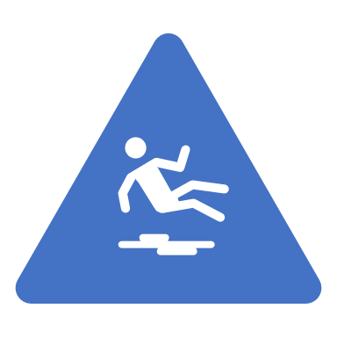
On to Risk!
The potential for an unwanted or adverse outcome resulting from an incident, event, or occurrence, as determined by the likelihood that a particular threat will exploit a particular vulnerability, with the associated consequences.

Slide 7
Risk
Before any security planning, one must understand the risks and threats faced.
This is called Risk Assessment and is the 1st stage of security planning
Usually done by a business analyst
Once risk analysis is complete the ones which require security will need it added to them
These are then included in security planning

Slide 8

Full Risk management is covered in Requirements but an overview is needed
We will cover
Risk Identification
Risk Impact Assessment
Risk Prioritization Analysis
Risk Mitigation Planning
Risk Mitigation Implementation
Risk Tracking
For more see Risk Management Chapter of MITRE System’s Engineering Guide

Slide 9

Soup Method: 1st scenario and determine a few “risks”
Here we are looking for overall risks – we’ll move to cyber/infosec after
Case 1: You and your Significant Other (SO) have purchased your first home (SPACE).
You work from home a few days a week while SO is never remote
Your field requires dealing with sensitive data.
We will make it simple, and this home is in SWFL.
You have a few heirlooms which were given to you but no individual item (besides the car) which is above 2000$ in value.
Both you and SO work so the house is empty at least 3 days out of the week (from 7-6 or so)

Slide 10
Now that we have some – let’s rate them (impact and prioritization) and model it
This is called building a Risk Matrix
Always based on 2 factors:
The Probability of it happening
The Impact or Severity it will have
We will use the following fields
Impact: Emergency, Major, Moderate, Minor
Probability: Frequent, Probable, Likely, Unlikely
(in numbers: 90%+, 60-90%, 26-59%, 0-25%)
Example: 100% chance we will lose Internet at least once a year. What is the impact (based on our scenario)?

Slide 11
Now we identify threats and vulnerabilities within the Risks
This is security management, a high-level process used to identify and mitigate threats. The process includes identifying:
Facility vulnerabilities (physical)
SPACE
Environment
Access Controls
Asset (including HR) issues
Did we miss any Risks given those categories?
How could you counter the risks we’ve listed?
Vulnerabilities within technology systems
This part is called Threat Modeling

Slide 12
From Here?
Topics:
Initial Threat Modeling
Assignments:
Read chapter 1 & 2 of book
Create your Form and gather data
Take the Syllabus quiz
Defense in Depth
From Risks to Threats
Security Management
The people problem
Physical Security

