Slide 1
From Web to Software
Not that we are done with web but need to start looking interactions of the systems and the Interface

Slide 2
Topics
Definition
Software Security Focus
Buffer Overflows
Injection (SQL)

Slide 3
Software Security Definition (it’s a broad term)
It’s a process and set of practices that must be integrated with the SDLC
SDL + DevOps = DevSecOps
Its primary purpose is to protect against threats to
The software itself
Data processed and accessed by the software
Communication with other systems and network by the software
It is based on the 6 pillars (2 triads) of security:
CIA + AAA

Slide 4
Software Security Threats (in order of coverage)
Covered already:
Hardware-Level Threats
good physical security, disaster/risk planning, and backups
Requirements-Level Threats
Risk planning, security assessments, all other planning
New:
Detailed Design Level Threats
Security Design Patterns! Well-known threats which have known solutions.
Code-Level Threats
Malicious (backdoor, logic bomb) or accidental (bugs, backdoors) threats within the source.
Not covered
Architectural-Level Threats

Slide 5
Planning (typically both are used)
Tactic-Oriented
Detect Attacks
Resist Attacks
React to Attacks
Resist Attacks
Pattern-Oriented
Determine Security Patterns which can effect Project
Access if they exist
Mitigate or Fix issues where found
Re-access until none found

Slide 6
Our Patterns (from CVE and OWASP)
Buffer Overflows
Injections (SQL, Log4J, Templates, Command)
Identification and Authentication Fails
Also includes Access Controls
Sensitive Data Exposure
Also includes Encryption issues
Security Logging and Accounting (monitoring)
Insecure Design

Slide 7
Buffer Overflow is not listed on either but was a major attack vector for years
Let’s look at it and find out: Why it was? Why its not now? Where we still have to look for it.

Slide 8
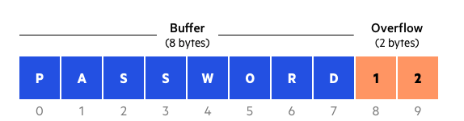
Buffer Overflow attack
Buffer Overflows are anything which overwrite memory in a Buffer because of improper allocation.
There are many types but the main ones are Stack and Heap Overflows
Buffer Overflows are used to:
DoS attacks
Changing the execution of functions (destroy data or access data)
Inject Shell Code
Which languages do you think are safe against this? Which ones aren’t? Why?

Slide 9
C & C++ are still susceptible (cause direct memory access is possible & necessary)
I actually don’t talk about these in most Security Courses anymore (they used to be a nightmare) but we use C++ here and I’ve seen:
Examples:
Given a vector or string accessing an index directly with an out-of-bounds index to write items
Using C string methods:
strcpy to make a deep copy of a string
strcat for concatenation
sprintf() to build an output with interpolated variables
Using char[] or long[] or double[]
Pointers
What do you think problems are with these? Fixes?

Slide 10
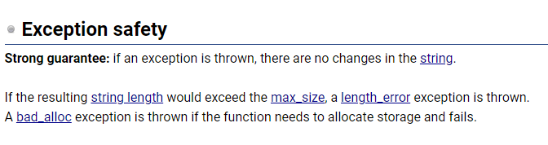
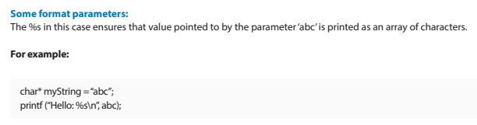
Fixes
Given a vector or string accessing an index directly with an out-of-bounds index to write items
C++: myVector.at(i);
Use STL with proper functions (which have safety features and bound checking integrated)
C: doesn’t have templates. So ensure explicit bounds checking or use libraries built for this (better string library).
C string methods:
C++: don’t use them.
myNewString = myOldString; // deep copy with bounds checking because STL (std::string)
myNewString.push_back(“yeah!”)
Use %s
C, now has safe method (n = new):
fgets, strcpy_s, strncat, snprintf
Using char[] or long[] or double[]
Don’t. Use std::array
Pointers: Avoid them in C++.
Std::variant, std::visit, storage class (auto)
Templates and use span

Slide 11
Where do you need to still look for this?
Dependencies. Hardware communications, Graphics, OS communications and handling, the internals of the language (Python: cpointers & references to mutable objects) – all are still heavy C/C++

Slide 12
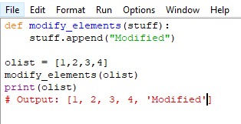

Huh? Python doesn’t get buffer overflow though?!
But it can get undocumented behavior, cause a type exception, or allow for INJECTION later. Its pass by assignment with object (mutable) references can be weird:
Where might this break our code? How might we fix this in our code?

Slide 13

Thursday – Injection part 1
SQL is a major focus (will also look at a few others though)
https://imgs.xkcd.com/comics/exploits_of_a_mom.png

