Slide 1
TLS Encryption & CIA Triad Overview
Yes, what that HTTP”S” means

Slide 2

Topics I really need to cover for TLS
What really happens during a TLS handshake?
What cryptographic algorithms are used by TLS to protect the data?
How do client and server exchange secret keys?
How Diffie-Hellman Ephemeral key exchange works?
Why do we need a digital certificate?
Why does it need to be signed by a certificate authority?
What is a digital signature? How is it signed and verified?
What perfect forward secrecy means?
How AEAD, MAC, HKDF, 0-RTT works?
What is Elliptic-Curve cryptography?

Slide 3

Subjects we will cover (Thursday focuses on Hacker side)
Overview of OSI and TLS
How TLS is used with Web communications (not just sites)
CIA Triad
How this relates to Hackme
Most of this covered on Thursday

Slide 4
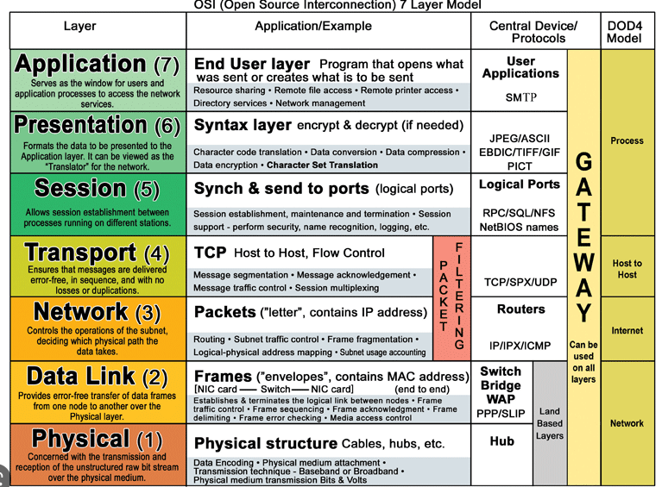
Transport Layer – what’s that?
OSI is a model used by most networking engineers which just helps to break up where items are in Network Communications
Why do we need the Sessions?
Our security in the >>>>>>>>> Layer ensures Integrity

Slide 5
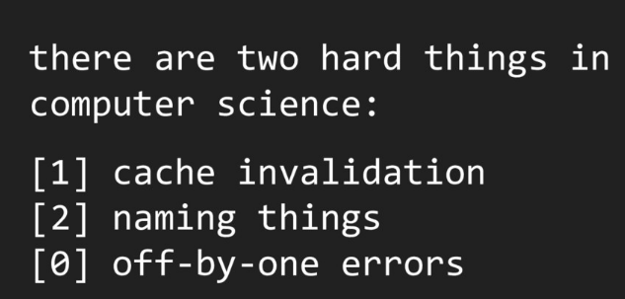

TLS (effectively) is SSL
Secure Socket Layer is the old version of TLS – its doesn’t (shouldn’t) exist anymore
TLS = SSL in naming conventions because when software was updated – they didn’t change the name
That’s it: still called an SSL certificate even though its TLS because….people

Slide 6

Web without TLS

Slide 7
Web (HTTP) is stateless
It (as a protocol) doesn’t save anything
This is an advantage and vulnerability
Advantage = interoperability and effective
For us it’s a vulnerability – why? (whole reason PKI was started)
No way to authenticate message origins or paths with just HTTP
No encryption

Slide 8

Simple Example – Let’s consider package Delivery
Now let’s change it to SMTP communications (email also uses TCP/IP)

Slide 9
CIA Triad
Infosec

Slide 10
CIA Triad is common infosec term (TLS covers 2 of these)
Confidentiality
Anything which helps to ensure only authorized people can view (read) information.
Authorized can be the general public for public information to almost no one for confidential information
Public = low threat if released or required to be released (regulations)
Sensitive = could cause some issue if released, no regulations on hiding, too much hiding could hinder work or cause backlash
Private = highly sensitive or regulated information, should be hidden but will need internal access at points to complete work. Can cause harm to stakeholders if released.
Confidential = Share with as few as possible. Most identifying information that can be collected. Can cause major harm to stakeholders if released.
Integrity
Ensures data not tampered with during transport. Also, ensures person is authorized to make changes (access controls).
Availability
Everything is available (for authorized users) at all times.

Slide 11
TLS to the rescue, used with:
Websites & Document Transfers
HTTP + TLS = HTTPS
Binary File Transfers (downloads)
FTP + TLS = FTPS
Email
SMTP + TLS = SMTPS
MTA + TLS = Mail Transfer Agent with Strict Transport Security (MTA-STS)

Slide 12

TLS <- the S <- allows for state
Confidentiality & Authentication
Allows us to Verify the identity of the communicating parties (using asymmetric – public key – cryptography)
Protects the data using symmetric cryptography during all communications.
Integrity
Prevents alteration of the data during transmission due to both encryption and error checking (checksum, frames, and packet checking) using TCP/IP.
This is a joint work between the Transportation Layer, Network Layer, and Data Link Layer but we don’t need that much detail

Slide 13
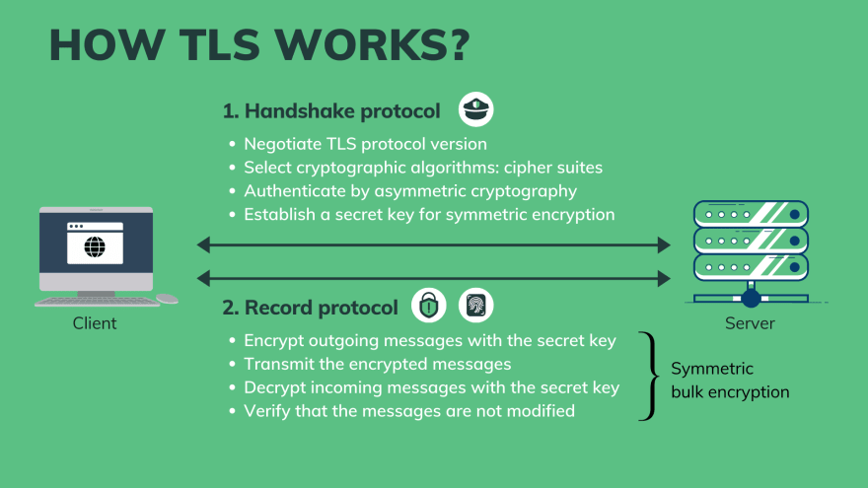
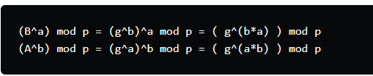
How’s it work? Using PKI & AES (& SHA)
From my cisco study guide

Slide 14
In words (simple version)
A TLS certificate is issued by a certificate authority to the person or business that owns a domain.
TLS handshake started. Between your device and Server.
Specify which version of TLS (TLS 1.0, 1.2, 1.3, etc.) they will use
Decide on which cipher suites they will use
Authenticate the identity of the server using the server's TLS certificate
Generate session keys for encrypting messages between them after the handshake is complete
The TLS handshake establishes a cipher suite over single encryption algorithm for each communication session.
So a set of algorithms and shared encryption keys (session keys) that are only valid for that session.
Sets matches using a PKI (through CA as part of TLS certificate)
Provides authentication using TLS as well, which usually consists of the server proving its identity to the client.
When all pass: message is signed with a Message Authentication Code (MAC).
The recipient can then verify the MAC to ensure the integrity of the data.
If altered in anyway, know the data is not safe (may have been tampered with).

Slide 15
From Here
We look at this from a Hacker Perspective and talk a bit more about those attacks
Bit Swapping
Passive vs. Active Recon
Hacker Methodology
For Security Testing

