Slide 1

Trust
Or: How misplaced trust has destroyed systems

Slide 2
Topics
We are going to expand on PKI this week
How browsers work in relation to the web
Take a look at the damage of bad actors
Malicious
Accidental
And relate this to both Trust and DevSecOps
TLS and encryption on Thursday

Slide 3
Review
What’s a PKI? (in a nutshell)
It’s a passport (how does a passport work?)
A website pays a certification authority to say we are who we say we are
They issue a root certificate to our website after verifying our server using TLS
With a Key (a public one)
The client verifies the website server via the CA’s Chain of Trust
They connect to us with their encrypted (using a private key) certificate
During the DNS lookup (Domain Name – see video lecture) we verify it with CA (and decrypt data)

Slide 4
A Case Study: The broken trust of Symantec
Yep, Norton’s history is kind of unsecure for a company that makes security software
So we are going to use these instances as case studies for breaking trust and failing at your goals in security
They’re also a prime example of the rise of DevSecOps to counter certain issues

Slide 5

Types of security systems
From Personal to Professional

Slide 6

Security Suite vs. AV
An Antivirus is just a system that uses predefined (caught) virus definitions to determine if your system is infected by them or if something looks like them.
A Security Suite is the Personal Side of layered security and defense in depth and adds several layers of counter-measures together (firewall + AV + VPN + etc.)
Bitdefender Total Security (currently using)
Microsoft Security (unexpectedly very highly ranked)
McAfee (built-in some models, cheap), Norton(old), TrendMicro(cross-platform), Avast(oh, we’ll cover this), others…

Slide 7
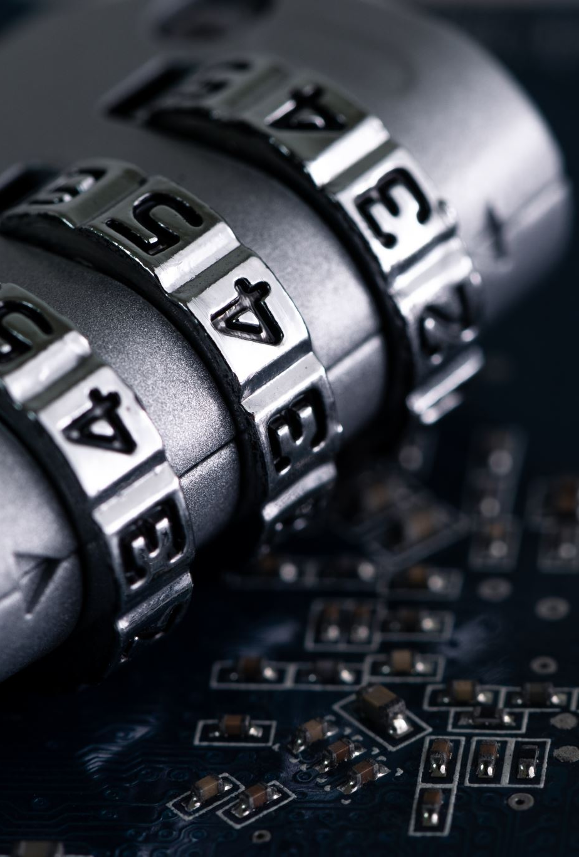
Vs. Endpoint Security (I’ve used 3 of these)
Endpoint security is the Enterprise version of a Security Suite. It adds device management, fully configurable user/group permissions and access point management, encryption options, and more. The options will be unfamiliar:
Bitdefender GravityZone
F-Secure Elements
Microsoft 365 Defender
ESET Protect Complete
Vipre Endpoint Security Cloud
…a lot more

Slide 8
“Free” Antivirus (time for our red team jersey)
I should note not all “free” antivirus is malware (Avast is “not”, AVG is fine) but you get what you pay for – all are limited at the free stage
Why do people get infected when installing “free malware”? (2 ways – first is obvious, 2nd is even for AVG or Avast):
It’s just malware. Simple as that, easy to make something free and then trick you.
It’s not the right site – time for a version of “Man-in-the-Middle”: see board.
Norton and Symantec have been guilty/victims of both and will be covered in case-studies

Slide 9
Case Study 1: Your Antivirus is Malware
In this case – scareware!

Slide 10
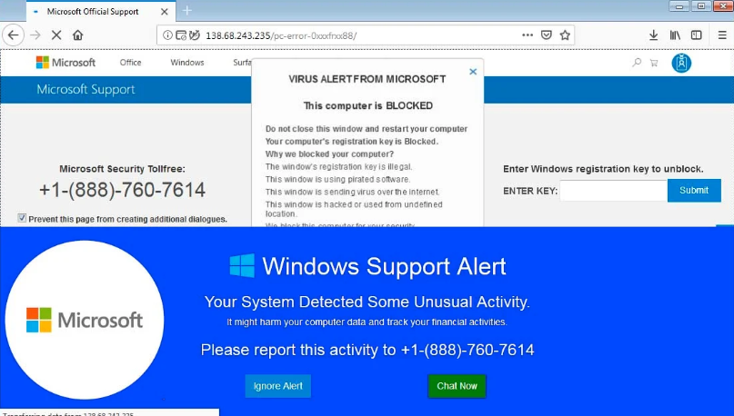
Scareware – fake but tries to trick you
Its fake but if
you say okay
give it your info
Call the number
Install the extensions
Don’t block the popups
Click “Ignore Alert”

Slide 11
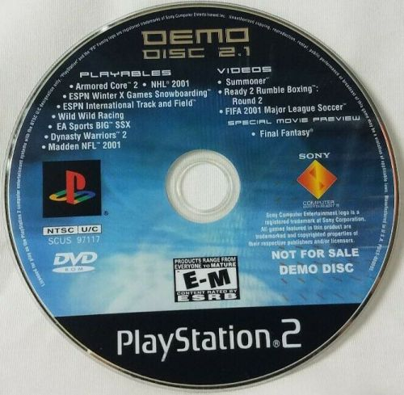
Why are Demos useful?
Started with Shareware for Doom
Famous for Xbox, Playstation, and other CD based systems
Now: mostly online but still used
This Photo by Unknown Author is licensed under CC BY-SA-NC

Slide 12
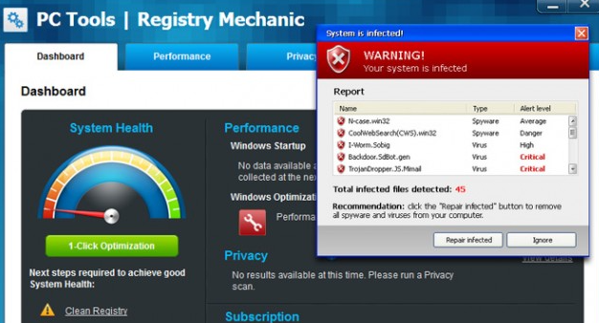
Norton bought a company and offered a Demo
They bought out the company PC Tools (a rival security software company) in 2008
The began offering a “free demo” of the software by the end of that year. It always looked like this:
What’s the problem? Click “repair” and it would Take you to Norton’s site

Slide 13

2011: PC Tools is confirmed as Scareware
According to court records, a Computer Forensic Expert determines that software is built to always show errors and hardware issues
the “repair” didn’t do anything to fix the problem (compared states were equal) so either it failed or …….
Class action lawsuit was filed
Norton settled for $11 million in 2012
Retired PC Tools in 2013 (after last licenses expired)
This Photo by Unknown Author is licensed under CC BY-SA

Slide 14

Reasons for this tactic
Sales rose 2% during that year for them (to $4 billion)
$80,000,000
CEO was let go (focus was the customer and AGILE) and replaced with Steve Bennett who focused on the product (Traditional)
Major Layoffs with transition
Focus was “our system is broken” because of profit loss and not enough marketing
He was fired in 2014 after PC Tool incident, 2011 denial of service attack (later), the next incident, and the next incident which both happened in 2012

Slide 15
Overview and Timeline (for reference)
2008: Symantec offers “free diagnostic” version of software on website
2008-2011: People use software which always shows security vulnerabilities, hardware issues, and virus so “must buy AV itself”
2011: Computer Forensic Expert determines that software is built to always show errors and push full version.
2012: Class action is pursued against Symantec who eventually settle for $11 million

Slide 16

Case Study 2:
Source code is stolen

Slide 17
2012 (yes still) old source code is stolen
January 17th disclosed that (at some point) Yama Tough stole the source of old Norton products.
Norton Utilities
Norton Internet Security and Endpoint Security
pcAnywhere
Anonymous also released the code to Norton Utilities later
Group used code to make zero-day attacks
Zero-day attacks = exploits found in code which have no patch developed for them
Why could they do this with 3-5 year old source?
Code re-use & products still active

Slide 18

How?
Symantec maintained servers in India for the old code
Third-party systems were not as well protected as Main Servers
Layoffs had been particularly hard on international groups
Indian government required access to these servers (regulations)
Hence, they also had the code
How well do you think their protection was?

Slide 19
Third Party Access Vulnerability
Your systems are Fort Knox
You have partners
Their systems are not great
You end up open and attacked due to this
See reading for full description and why on the rise

Slide 20

Case Study 3
The worst case – Google, Microsoft, Apple, and Mozilla now hate you

Slide 21
The results (started 2012 and by 2018)
Google (Sept 2018)
Starting in Chrome 70, all remaining Symantec SSL/TLS certificates will stop working, resulting in a certificate error
Apple (Aug 2018)
As of August 1, 2018, Apple partially distrusted Symantec Certificate Authorities (CAs).
For site operators using Symantec Transport Layer Security (TLS) server certificates that were issued between June 1, 2016 and December 1, 2017, these certificates were trusted until the full distrust of Symantec CAs on February 25, 2020.
All other TLS server certificates issued by Symantec are distrusted.
Mozilla (Oct 2018)
The next phase of the consensus plan is to distrust any TLS certificate that chains up to a Symantec root, regardless of when it was issued
Microsoft (Oct 2018)
Edge and Internet Explorer (IE) browsers will stop trusting certain SSL/TLS (Secure Sockets Layer/Transport Layer Security) certificates that were issued by former certificate authority (CA) company Symantec.

Slide 22
2015+ we will look at Thursday (with a supply chain attack they had too)
In 2010 Verisign (owned by Symantec) was repeatedly hacked with the company detecting it in 2011.
They at the time covered 30-42% of all Certificates on the Web
They never reported it until a SEC filing in 2012 required it.
This is part of the Certification process for CA groups
That buried information was discovered by many and called into question all certification encryption keys (they could be compromised)
Why is this important?
Collective response by OPS and Security groups: *#&#*)@!
Oliver Lavery (a leader in the field) predicted the fallout best: Can we trust any site using Verisign SSL certificates? Without more clarity, the logical answer is no.

Slide 23
Why 2015 next?
Because that’s when Google started testing certificates due to the 2012 breach (to check if it had been fixed)
There results were not great. As more than 30,000 certificates were issued to the wrong groups.
Why? Man-in-the-Middle: an attack which requires a bit more knowledge of TCP networks and will be covered Thursday

