Slide 1






HUMAN RESOURCE MANAGEMENT SYSTEM WITH DATA ANALYTICS AND DECISION SUPPORT SYSTEM.
Glen Michael Gabayoyo
Mark John Rey Espiritu
Ariel John Lactuan
CS Thesis Writing I (THS101)
Daniel Arago

Slide 2
CHAPTER I
INTRODUCTION

Slide 3
Project Context
Individuals' lives and the practice of every part of the business have been transformed by technological advancements.
The changes are speeding up, giving the educated and elite more authority over knowledge.
Humans perform the majority of the essential knowledge processing operations and execute the processes deftly.

Slide 4
The Human Resource Management System
Current problem in the existing Human Resource Management System
The Leadership Development
The HR Effectiveness Measurement
Managing Human Capital
Containing Coasts
Recruitment

Slide 5



Data Analytics
The science of studying raw data in order to draw conclusions.
Data analytics can assist a company improve its performance.
HR Analytics gives firms data-backed insight into what’s working and what isn’t, allowing them to improve and prepare for the future more efficiently.

Slide 6
Decision Support System
A system and application that assist managerial decision –makers in making timely and accurate decisions by levering data and models to handle semi-structured and unstructured changes.

Slide 7
Purpose and Description of the Study
To reduce the manual workload of these administrative activities, organizations began to electronically automate many of these processes by introducing specialized human resource management system.
To provide a system that can be handle the information of the employee and the activities that they do everyday.

Slide 8
Objectives of the Study
The major purpose of this paper is to give Data Analytics and a Decision Support System to administrators to reduce their efforts in tracking everyday occurrences such as information, employee performance, and employees.

Slide 9
Objectives of the Study
To make a web platform for the organization.
To create a connection among employee and management using chatbot.
To evaluate the developed Human Resource Management System with Data Analytics and Decision Support System using ISO/IEC 25010.
2
4
1
To create events for the employee to interact with the admin and other employees.
3
To create an employee information, attendance, Salary, etc.
5

Slide 10
Objectives of the Study
To develop a HRMS which collects and update employees’ information and records.
To embed Decision Support System in Human Resource Management System.
7
6
To integrate data analytics in the Human Resource Management System.
8

Slide 11
Scope
An HRMS is a component of the HR Department's overall system. It is a system that automates the process of evaluating and managing the daily performance of all employees. It was used to track an employee's performance to see if he or she was doing his or her duties in a timely and efficient manner. This also acts as a base of information for the department to determine whether or not a specific employee was qualified for Bonuses or promotions.
The Scope of this system was listed below:
Employees Information 7. Pay History
2. Employee Personal Information 8. View Pay History
3. Recruitment and selection 9. Announcement and Events
4. Attendance 10. User interact using chatbots
5. Block out certain information areas by user
6. Skills Profile

Slide 12
LIMITATION
The system will not focus in calculating the whole payroll but will only do the some parts or proportions of it such as uploading employee payslip.
System will only be limited to three users Super admin , HR Head and HR Assistant.
The Admin can only create, deactivate and delete the account of the hr, assistant, and applicant/employee.
The Admin can only reset the password of the account of HR, assistant, and applicant/ Employee
The Applicant can only view the application status, fillup the application details, and upload a resume.
The Admin can only create, deactivate, edit and delete the account of the hr_head, assistant, and applicant/employee.
The Admin can only reset the password of the account of HR, assistant, and applicant/ Employee.
The Applicant can only view the application status, fillup the application details, and upload a resume.

Slide 13
CHAPTER II
REVIEW OF RELATED LITERATURE

Slide 14
INTEGRATING MULTIPLE DATA SOURCES FOR LEARNING ANALYTICS (2019)
According to Chatti et al. (2017), data can be stored in a variety of formats, at a variety of organizational levels, and from a variety of sources. When data from several sources is collected and mixed when data is integrated, it may be feasible to more correctly reflect learners' dispersed actions than when each data source is used alone. When data from several sources are collected and combined, it may be feasible to more correctly reflect learners' dispersed behaviors than when each data source is used alone.

Slide 15
A DECISION SUPPORT SYSTEM FOR SOFTWARE TECHNOLOGY SELECTION
As Majumder (2015) stated that, this work presents a DSS for creating maintainable and evolvable decision models for MCDM situations that employ a six-step decision-making method. Consider a collection of market options (technologies). Furthermore, each supports a subset of the set of domain features, which includes the alternatives' most prominent technical and non-technical domain features. In other words, the goal is to find an acceptable alternative that supports a collection of required domain properties, alternative and is the best option for meeting domain feature criteria and satisfying the decision preferences. maker's In most cases, a single optimal solution for an MCDM problem does not exist, hence a decision-maker preference must be used to distinguish amongst solutions.

Slide 16
THE PRACTICE OF HUMAN RESOURCE MANAGEMENT
According to Panic et al. (2016), HRM refers to a wide variety of concepts and techniques. In the literature, authors typically utilize two meanings: one to describe management activity, and the other to suggest a certain approach to people management.

Slide 17
RELEVANCE OF THE CITED LITERATURE
This part discusses the relevance of the cited literature stated above. Different studies from local and foreign are included to further discuss the proponent’s project. The stated literature gives support to the proponent’s project which gives the connection between them and the authors of the related studies.
Based on the cited literature above, reveals how having a Human Resource Management System gives benefits to the users especially in this progressive generation of technology. Information is getting bigger and wider as time goes by especially since the enterprises are also progressing. To accommodate bigger data, innovation for a system such as HRMS is necessary. To address this gap, the researcher come up with this project entitled Human Resource Management System with Data Analytics and Decision Support System.

Slide 18
CHAPTER III
TECHNICAL BACKGROUND

Slide 19
This chapter covers the technical aspects of the project, including a description of its kind and operation. It also specifies the project's application development type.

Slide 20
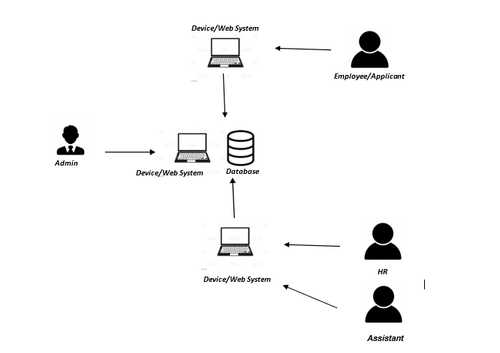









Technicality of the Project

Slide 21
How the System will work
Human Resource software makes it possible to employ information technology to manage a wide range of Human Resource tasks. An HRMS often includes the capabilities of a human capital management system and encompasses all aspects of an HRIS.
The HR manager will serve as the project's "functional lead" for human resources, offering input on people processes, KPIs(Key Performance Indicator), and needs for various HRMS services, such as recordkeeping, onboarding, training, performance management, and HR reports.

Slide 22
CHAPTER IV
METHODOLOGY

Slide 23
Research Methods Used
The researchers conducted the descriptive and developmental research that is required for the proposed project. The proposed project is a web-based system called Human Resource Management System with Data Analytics and Decision Support System

Slide 24
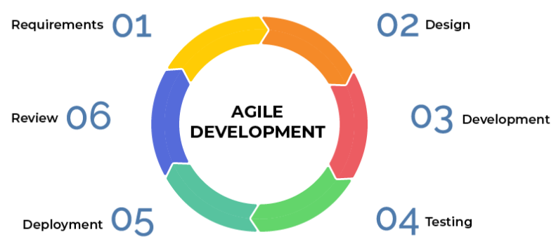
Developmental Approach
01
02
Requirements
Design
Software Design
06
03
Review
Software Development
05
Deployment
04
Testing

Slide 25
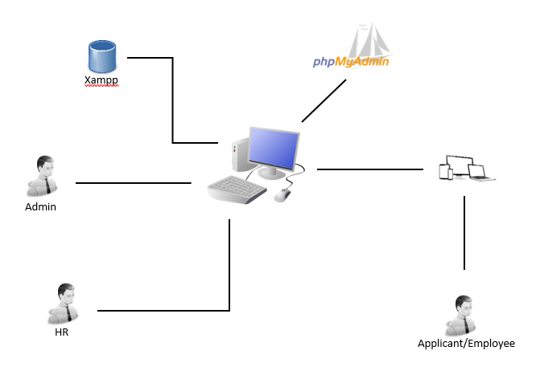
Operational Diagram/Conceptual Diagram

Slide 26
Population and Sampling Scheme
Researchers can collect data fast and conveniently using the convenience sampling technique
This method allows researchers and responders to communicate with one another based on their individual needs and willingness
The researcher will elicit replies from a random sample of participants
Researchers will choose participants at random from a pool of people who have knowledge and experience relevant to the study

Slide 27
Description of the Respondents
Distribution of the Respondents
Respondents | Sample Size | Percentage
HR | 5 | 16.67%
Employee | 25 | 83.33%
Total | 30 | 100%

Slide 28
Research Instrument
The research instrument for this study will be survey questionnaires
Research instrument enables both researchers and respondents to acquire and provide data in a straightforward and timely manner without taking up too much of each other's time.
The survey questionnaires will ask about the dependability of the Human Resource Management System with Data Analytics and Decision Support System, as well as the functionality of the web-based system
The researchers will also ask about how useful the web-based system is and the benefits of utilizing it.

Slide 29
Validation of Instrument
Survey questionnaires will be validated by research professionals and IT instructors. The survey questionnaires must be designed in such a way that they are easy for respondents to grasp and interpret. The survey questionnaires will be open to suggestions and revision, resulting in a much more reliable and useful set of data.

Slide 30
Data Gathering Procedures
The researchers obtain the necessary information from documents, files, and publications pertinent to the subject. The information was carefully read was discovered to contain thoughts and knowledge that may assist the researchers in developing this study.
The researchers employed survey questionnaires to collect data from people, which will provide further information to the researchers, particularly in the functionality section of this study.

Slide 31
Statistical Treatment
The researcher examined the acquired data using several tools. The researcher employed statistical approaches such as weighted mean, five-point rating scale, and percentage. These analyzing statistical techniques correlate to the description of the respondent's appraisal of the suggested system
The researcher employed the following statistical tools:
1. Weighted Mean
Since the factors to be evaluated, such as Functional Suitability, Performance Efficiency, Usability, Reliability, Security, and System Maintainability, are abstract or continuous, the researcher employed the weighted mean.

Slide 32
Formula:
𝑊𝑒𝑖𝑔ℎ𝑡𝑒𝑑 𝑀𝑒𝑎𝑛=Σ𝑓𝑥/𝑛
Where:
 = Summation Symbol
f = frequency
x = unit weight
n = total number of respondents
Five-Point Rating Scale
Table 2 displays the linguistic interpretations of the five-point rating system.
Weight | Mean Value | Verbal Interpretation
1 | 1.00-1.49 | Strongly Agree
2 | 1.50-.2.49 | Disagree
3 | 2.50-3.49 | Fair
4 | 3.50-4.49 | Agree
5 | 4.50-5.00 | Strongly Agree

Slide 33
The Percentage Formula will be used to determine the percentage of total respondents who agreed with the response to each question. This will be used primarily to increase the adoption of Human Resource Management System with Data Analytics and Decision Support System.

Slide 34
THANK YOU!

