Slide 1
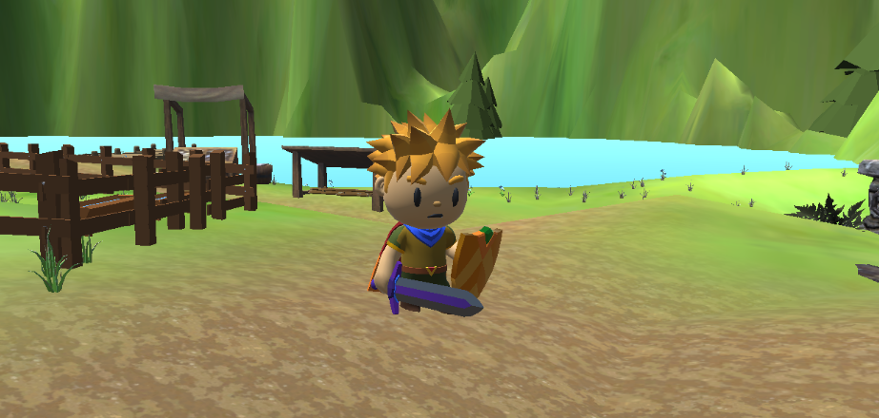
Equei Iter
By The Bright Infernos
.
Third person adventure game with open world concept. Main character must go on a quest to find magic water to heal his village from an epidemic.

Slide 2





The Team
Ashtyn Lane
Checkpoint System
Level-Up System
Terrain
Ryan Durham
Save System
Quest System
Dialog System
LaTrae’ Swann
Spell System
Weapon Switch
K-Ci Herzer
Enemy AI Systems
Enemy Animations
Scene Music
Kelvin Roman Domenech
Menu Systems
Audio Mixer
Mini Map
Spell Particle Effects

Slide 3
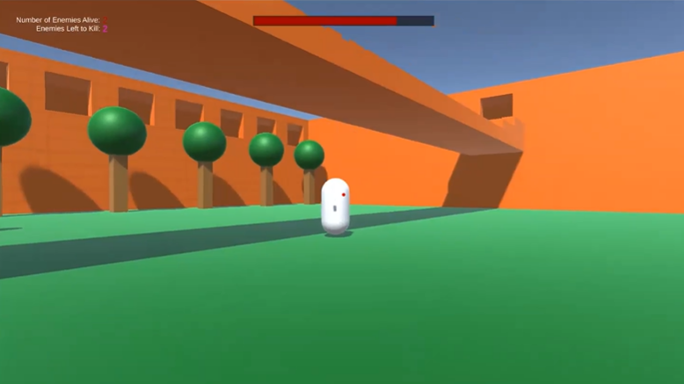
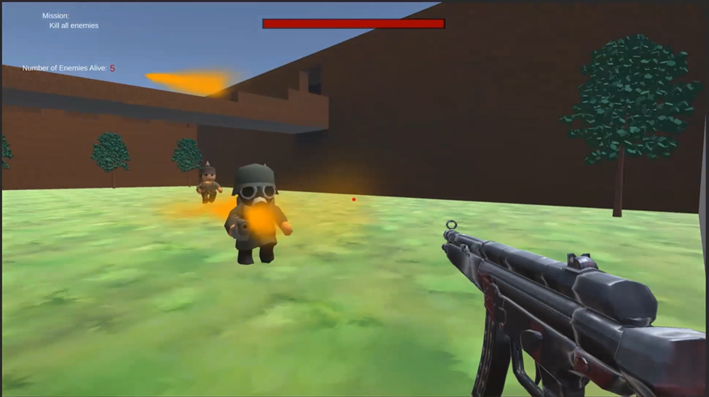
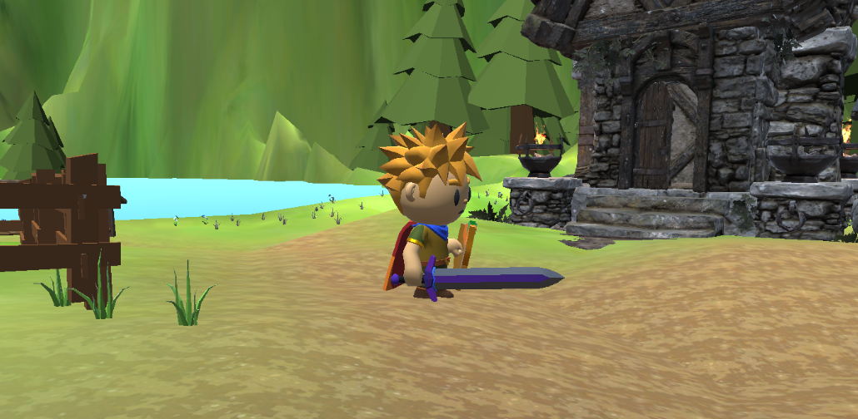
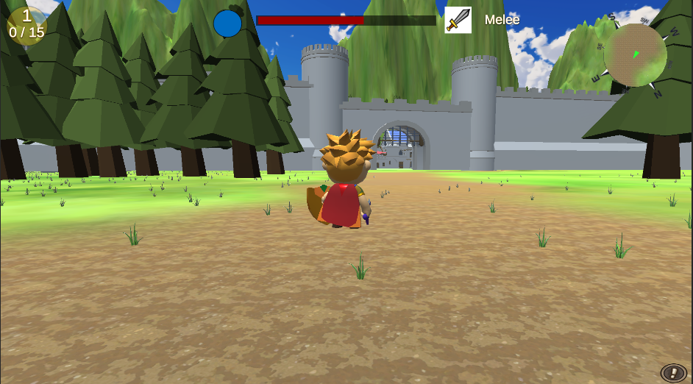
Progress
Prototype
Alpha
First Playable
Final
Notes:
Prototype = PP2 first milestone
First Playable = PP2 final milestone
Alpha = PP3 alpha milestone
Final = Game today

Slide 4
Tips/Tricks
Time Management
Be smart with your time. Over-estimate how long something will take you and get started as soon as you can. Pace yourself during the week to make sure that you don't have to rush to get things done the day the build is due.
Don't go overboard on downloading assets
Assets take up a lot of space/memory. Be conscious of what you are downloading and how much memory it uses. Git LFS has a limited amount of data you can push/pull before you have to start paying.
Don't assume the player will know everything you do
While it's easy for developers to test their own game because they know how it should work, there may be something that a new player would find confusing. Approach your play tests as someone who has never played the game before and see if it is easy to follow/complete.
Communicate
Communication is key in group projects. Keep your team mates up to date on what you are working on, what issues you are encountering, and help others with their issues if you can. If you are going to miss a meeting, let everyone know. Nothing is more frustrating than a team member that just disappears.

Slide 5
What Went Right
Scheduled Meetings
We were able to keep each other up to date on progress and help others when we could.
Particle system spells
Spells were easier to create than expected.
Checkpoint System
The checkpoint campfire system was easier to do than anticipated

Slide 6
What Went Wrong
Unequal work put in
Some team-mates did not put forth as much effort as others causing a section of the game to be incomplete.
Larger game concept
While this shouldn't have been much of a problem with 5 of us, due to some work not getting done, the larger work loaded prevented the rest of us from having extra time left over to pick up the slack.
Knockback
The knockback effect was not lerping the way it was supposed to causing it to look like the player and enemies are just teleporting backwards.
Rocky start
Due to curriculum changes, our original plan was thrown out and we had to start from scratch in the last month.

