Slide 1
Mini SOC Platform
Detection, correlation, investigation and response on a single internet-facing EC2 host
Live EC2 lab · 13 detection rules · replay + live attack simulation · real nftables containment

Slide 2
THE GAP
Why a SOC platform?
Individual security tools answer “did something happen?” — a SOC has to answer “what is happening, how bad, and what do we do?
One noisy alert is easy to miss; a coherent kill chain is not.
Response must be enforceable, not a dashboard flag.
This project builds the whole loop end to end on infrastructure we own and can attack safely.
Scope: one internet-facing EC2 instance; attack from a local Kali VM.

Slide 3
WHAT IT IS
A self-contained detection & response pipeline
Collect — nginx access/error, auth.log, a custom IDS (AF_PACKET + nftables), syslog via systemd.
Normalize — one event schema across every source.
Detect — 13 rules (pattern + threshold) over a rolling window.
Correlate — alerts from one source become a chain, then an incident.
Respond — block IP via a sudo-confined helper into nftables.
Operate — a React dashboard: overview, alerts, chains, incidents, events, rules, reports, users.

Slide 4
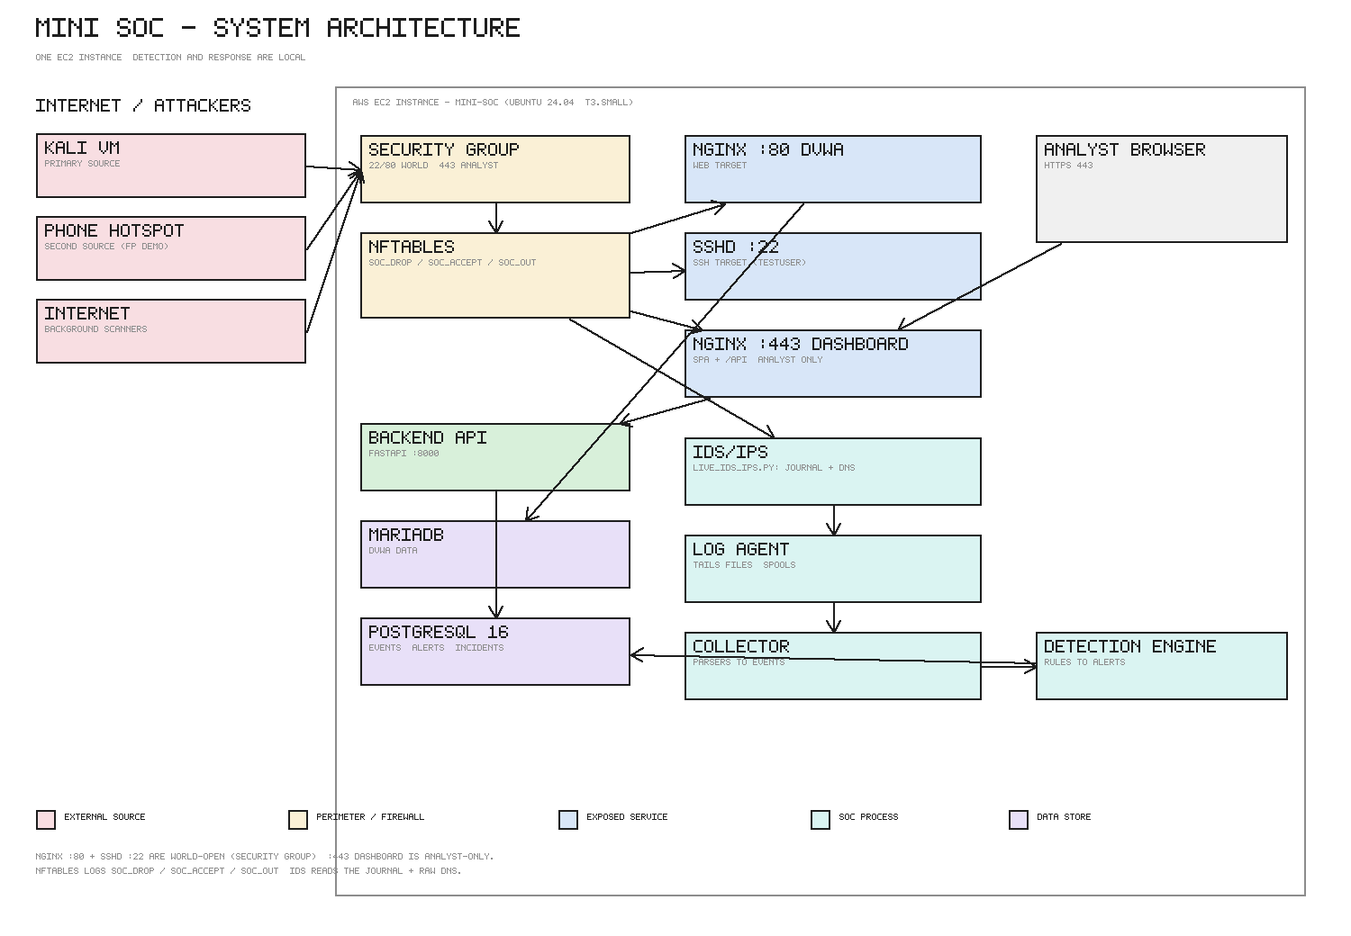
ARCHITECTURE
One host, two faces: the target and the SOC
Full diagram: docs/images/architecture.png

Slide 5
DETECTION RULES
13 rules across three families
Web (8): SQLi, LFI/path traversal, command injection, XSS, scanner User-Agent, login brute force, HTTP flood, plus the shared web parser.
Auth (2): SSH brute force (≥10 fails / 5 min) and login-success-after-brute-force (CRITICAL).
Network/IDS (3): port scan (≥20 ports / 60 s), IDS signature, unusual outbound, unusual DNS (over-long labels).
Every rule: a YAML definition, a severity, a MITRE mapping, and a page in the playbook.
Replay suite drives all 13 rules through the same engine: 13/13 pass.

Slide 6
THE LAB
How it is tested without a real victim
Single Ubuntu 24.04 t3.small EC2 instance, Elastic IP, Security Group locked to 22 / 80 / 443-from-analyst.
DVWA (deliberately vulnerable) serves as the web target on :80.
attack-sim/ scripts run from a local Kali VM: nmap, hydra, sqlmap, Nikto, and the host-originated outbound/DNS sims.
Rules of engagement: only our own instance, brief and non-sustained; HTTP flood is replay-only.

Slide 7
DEMO STORY
One attacker, 13 alerts, 45 seconds
Recon — NET-PORTSCAN-001, IDS-SIG-001.
Web exploitation — WEB-SQLI / XSS / CMD / LFI / SCAN / BF / FLOOD.
Credential attack — SSH-BF-001 → SSH-SUCCESS-001 (CRITICAL).
Post-compromise — NET-OUTBOUND-001, DNS-ANOMALY-001.
All 13 from one src_ip → chain 1 → incident INC-2026-0001.
Timeline is from the real detection engine (seed_demo.py).

Slide 8
CORRELATION
13 alerts are one story, not 13 tickets
Rules key on src_ip + a time window; alerts from one source inside the window share a chain_id.
The dashboard surfaces the chain timeline and offers promote-to-incident.
Deduplication: a repeated pattern updates the same alert's count/last_seen instead of creating a new one.
The incident is the unit of response — notes, actions, status history (→ contained → resolved → closed).

Slide 9
RESPONSE
Containment is real, not a dashboard flag
block IP → POST /api/actions/{id}/execute (confirm: true) → sudo /usr/local/sbin/soc-block add <ipv4> [timeout]
The helper re-validates the address and refuses allow-listed or non-IPv4 targets — even when called directly.
Result lands in nftables: inet filter blocklist (default 3600 s).
Proof: nft list set inet filter blocklist; the attacker's connection now times out.
sudoers grants the backend nothing but that one script.

Slide 10
FALSE POSITIVES
A second, benign source must stay quiet
A phone hotspot provides a genuinely different public IP.
Benign page loads from it raise nothing (sub-threshold); exploitation-shaped traffic from the attacker raises 13.
The rules key on payload and volume — not on traffic existing.
Stray benign hits are triaged FALSE POSITIVE and the source is allow-listed.
See docs/testing/second-source-ip.md and reports/incident-reports.md (0002).

Slide 11
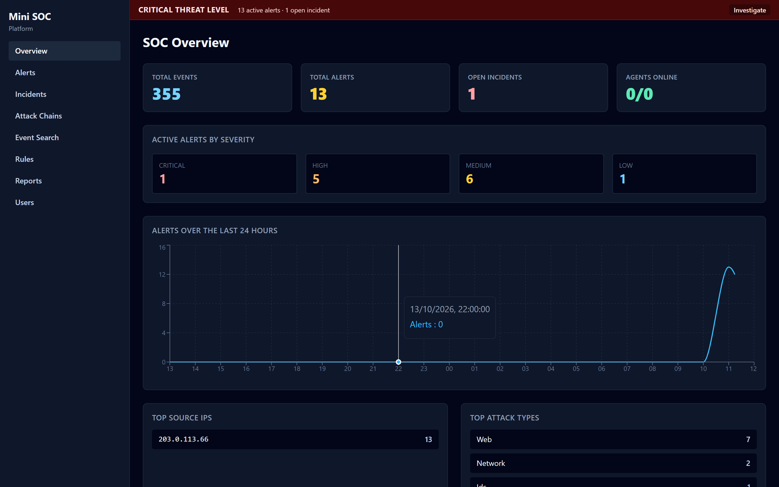
DASHBOARD
Overview — live posture

Slide 12
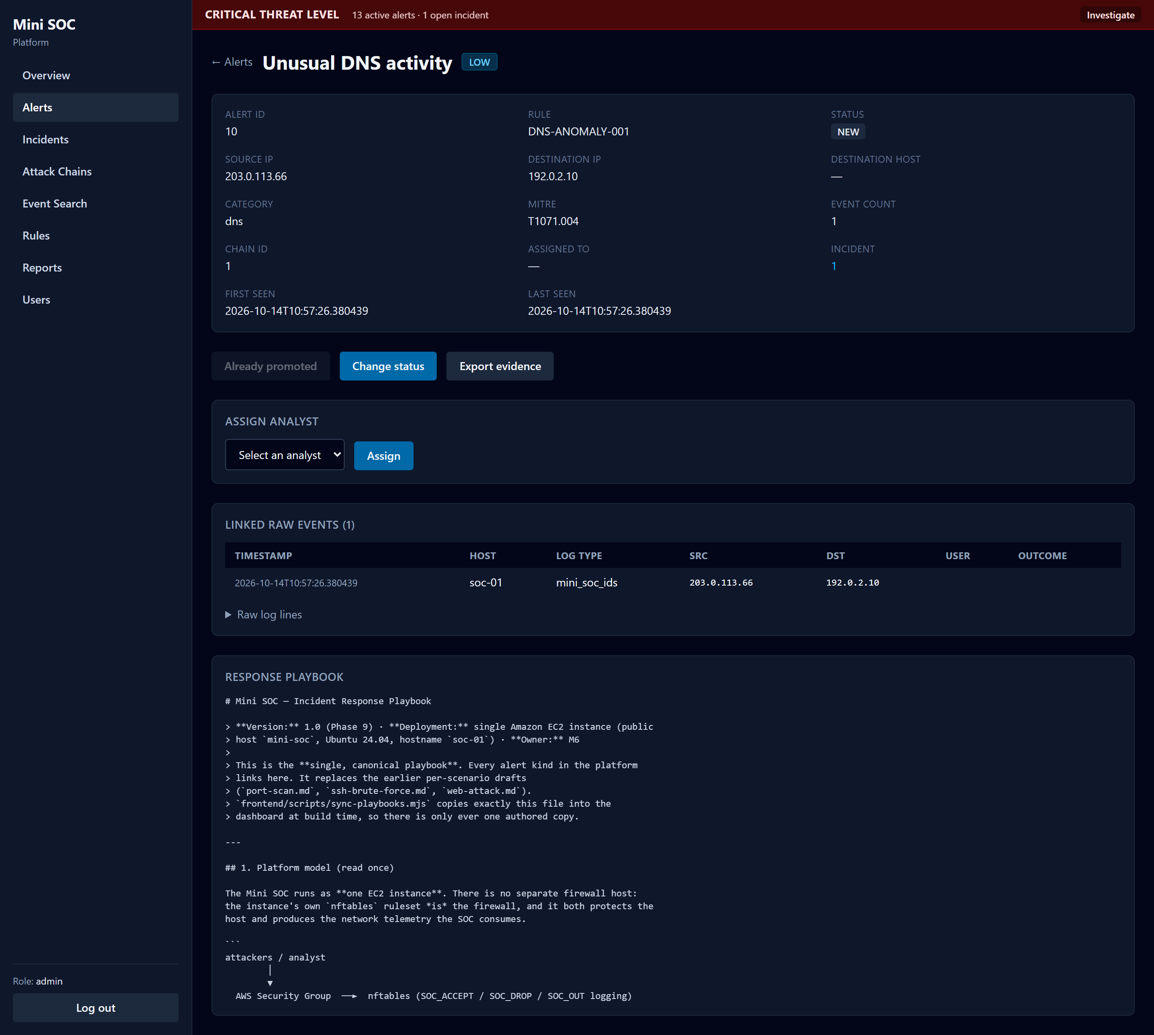
DASHBOARD
Alert detail — evidence + linked events

Slide 13
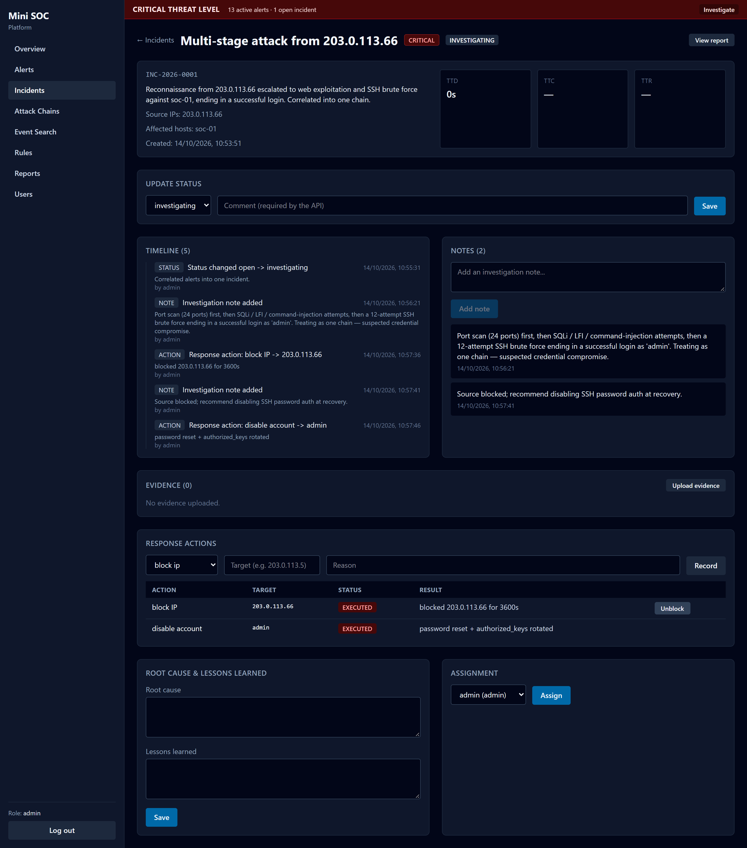
DASHBOARD
Incident — timeline, notes, response actions

Slide 14
QUALITY
What is verified, and how
13/13
116
18
0
rules fire in replay
python tests passed
frontend tests
open High security findings
Detection replay: 13/13 rules, dedupe and chain formation.
pytest across ids / backend / collector / agents; vitest + build for the frontend.
CI (.github/workflows/ci.yml) runs all of it on every push.
Security review: injection, JWT tampering, RBAC, upload, exposed ports, helper injection.

Slide 15
DELIVERABLES
What ships
Code — collector, detection engine, IDS, backend API, React dashboard, agents.
Rules — 13 YAML definitions + the response playbook.
Infra — deploy/install.sh (one command) + the EC2 host-config snapshot.
Docs — lab setup, architecture, contracts, analyst user guide (with screenshots), test plan, results, security review, incident reports.
Attack simulation + replay suite for reproducible testing.

Slide 16
WRAP-UP
Lessons and next steps
Detection is easy to demo; correlation is what makes it useful.
Containment must be enforceable and auditable — a real firewall action.
Low false positives are a design goal, tested with a second benign source.
Next: key-only SSH, alerting integrations (email/Slack), and a second host to exercise cross-host correlation.

