Slide 1
A SEMINAR ON
DEVELOPMENT OF INERTIA AND PRIMARY FREQUENCY CONTROLLERS FOR BRUSHLESS DOUBLY FED RELUCTANCE GENERATOR FOR WIND APPLICATIONS
BY
NAME: OKORIE KELECHI
REG NO: 20154987028
PRESENTED TO
THE DEPARTMENT OF ELECTRICAL AND ELECTRONIC ENGINEERING FUTO IN PARTIAL FUFILLMENT OF THE REQUIREMENTS FOR THE AWARD OF MASTERS DEGREE (M.ENG) IN CONTROL SYSTEMS ENGINEERING
SUPERVISOR: DR OBICHERE J. K.

Slide 2
OUTLINE
INTRODUCTION / BACKGROUND OF STUDY
PROBLEM STATEMENT
AIM AND OBJECTIVE
JUSTIFICATION OF STUDY
SCOPE OF STUDY
LITERATURE REVIEW
MATERIALS AND METHOD
CONCLUSION

Slide 3
INTRODUCTION/BACKGROUND OF STUDY
Wind energy has been an essential source of energy for mankind for about 3000 years now
Conventional energy sources (fossil fuels and nuclear) have been at the forefront of energy, especially electric energy, generation because they are more attractive
Conventional energy sources emit green house gasses and can lead to nuclear leakage thereby causing pollution
There is also fear of possible depletion of fossil fuel in the future
Because of the growing need for more energy and the potential dangers of conventional energy sources, there is an urgent need for clean and renewable energy sources and the gradual retirement of conventional energy sources

Slide 4
BACKGROUND OF STUDY CONTD.
Renewable/clean energy sources include wind energy, solar energy, hydro energy, geothermal energy, e.t.c.
These energy sources are clean and do not cause pollution to the environment are now the fastest-growing sources.
Wind energy in particular has been used to create electric energy and have been connected to various electric grids
However, they are some problems associated with connecting wind energy to the grid

Slide 5
PROBLEM STATEMENT
The grid is gradually moving from synchronous and rotating machine based to inverter based
Due to the variability of wind speed, wind turbines are de-coupled from the grid by the use of AC-DC-AC converters.
The synchronous and rotating machines provided inertia and primary frequency response during frequency events due their rotating masses which have inertia and their primary frequency controllers.
A major issue in wind energy integration into the grid is the provision of frequency response by wind turbines since their rotating masses are decoupled from the grid

Slide 6
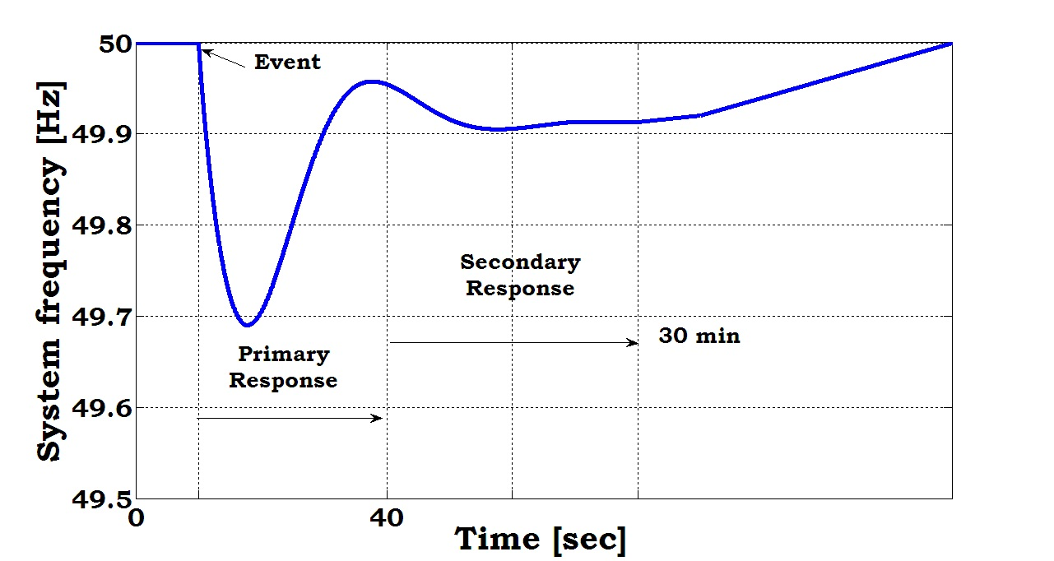
Frequency Event / Frequency Response

Slide 7
AIMS AND OBJECTIVES
The primary objective of this work is to develop and inertia and primary frequency controllers for grid connected Brushless Doubly Fed Reluctance Generator (BDFRG) wind turbine
Secondary objectives include the following
To increase wind energy penetration limit
Determination of the effect of parameter selection on the controllers
To determine the appropriate level of power reserve for brushless doubly fed reluctance generator to participate in grid frequency stabilization
Test the system using constant and variable wind speed condition

Slide 8
JUSTIFICATION
Renewable energy sources are currently dominating the energy mix, and replacing the traditional generation sources
High penetration of renewable energy sources like wind energy into the grid without appropriate provision of Frequency control ancillary service from this wind turbines could lead to grid instability which could cause generator trip and under frequency load shedding.
High penetration of renewable energy like wind energy into the grid should be encouraged because it emits no dangerous gasses and as such improves public health
Renewable energy sources would lead to cheaper electricity since wind energy is almost free except for the initial setup cost, thereby having huge economic benefit

Slide 9
SCOPE OF THE STUDY
Developing an inertia and primary controller for Wind Energy Conversion Systems (WECS)
The controller is develop only for grid-connected Brushless Doubly Fed Reluctance Generator Wind Turbine
The controller is tested under constant and varying wind conditions

Slide 10
LITERATURE REVIEW
AUTHOR | TITLE | RESULT | LIMITATION
Ioannis et al., (2012) | Frequency Control in Autonomous Power Systems with High Wind Power Penetration | It was found that the proposed controller could provided valuable active power support similar to conventional generation during transient events for DFIG and PMSG under constant and varying wind conditions. | The emerging Brushless Doubly Fed Reluctance Generator was not considered
Yuan et al., (2016) | An Integrated Wind Turbine Controller with Virtual Inertia and Primary Frequency Response for Grid Dynamic Frequency Support | Using the proposed system 40% reduction in frequency deviation was achieved by using the proposed inertia and primary frequency controller | Only the DFIG wind turbine was considered and the result was obtained under constant wind conditions
Vidyanandan et al., (2013) | Primary Frequency Regulation by De-loaded Wind using Variable Droop | Variable droop was used for primary frequency response and it was found that variable droop performed better that fixed droop | The research was carried out using only the Doubly Fed Induction Generator and research was obtained under constant wind conditions
Obichere et al., (2016) | Improved Power Factor Controller for Wind Generation and Applications | A novel optimum power factor control mechanism was designed for the BDFRG and the optimum power factor control conditions was met for BDFRG | Inertia response and primary frequency control was not considered

Slide 11
MATERIALS
LAPTOP COMPUTER
MATLAB/SIMULINK SOFTWARE
MODEL OF WIND ENERGY CONVERSION SYSTEM
MODEL OF ELECTRICITY GRID
SIMULINK POWER SYSTEM TOOLBOX

Slide 12
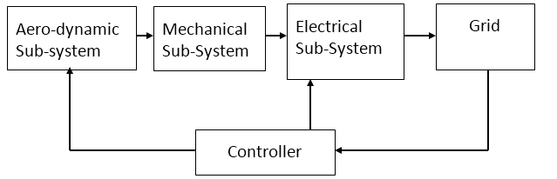
METHODOLOGY
The methodology consists in counteracting deviations by measuring the grid’s frequency and injecting active power into the grid as appropriate. This will be achieved by concerted effort between the virtual inertia controller and the primary frequency controller. A PD controller will be used and modified accordingly to achieve the desired result

Slide 13
CONCLUSION
Because of the growing need for more energy and the potential dangers of conventional energy sources, there is an urgent need for clean and renewable energy sources and the gradual retirement of conventional energy sources
For connecting renewable energy sources like wind energy to the grid a lot of economic and technical issues like grid frequency security and stability will have to be considered and taken care of
Wind Energy Conversion Systems (WECS) should be provided with the ability to simulate virtual inertia and primary frequency response, thereby acting like the conventional generation systems

Slide 14
THANK YOU!

