Slide 1



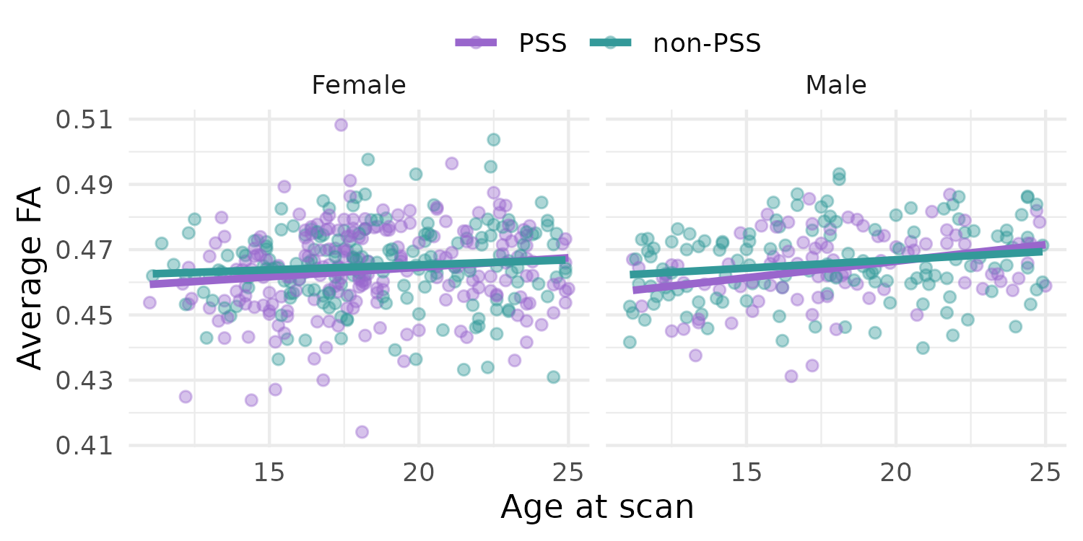
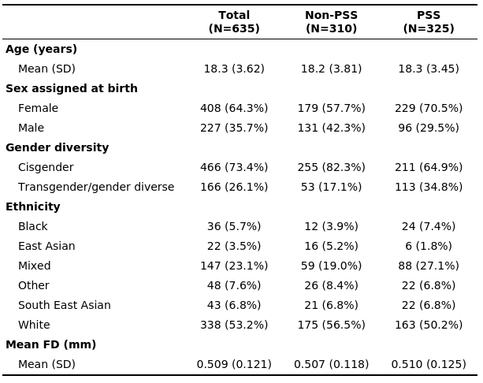
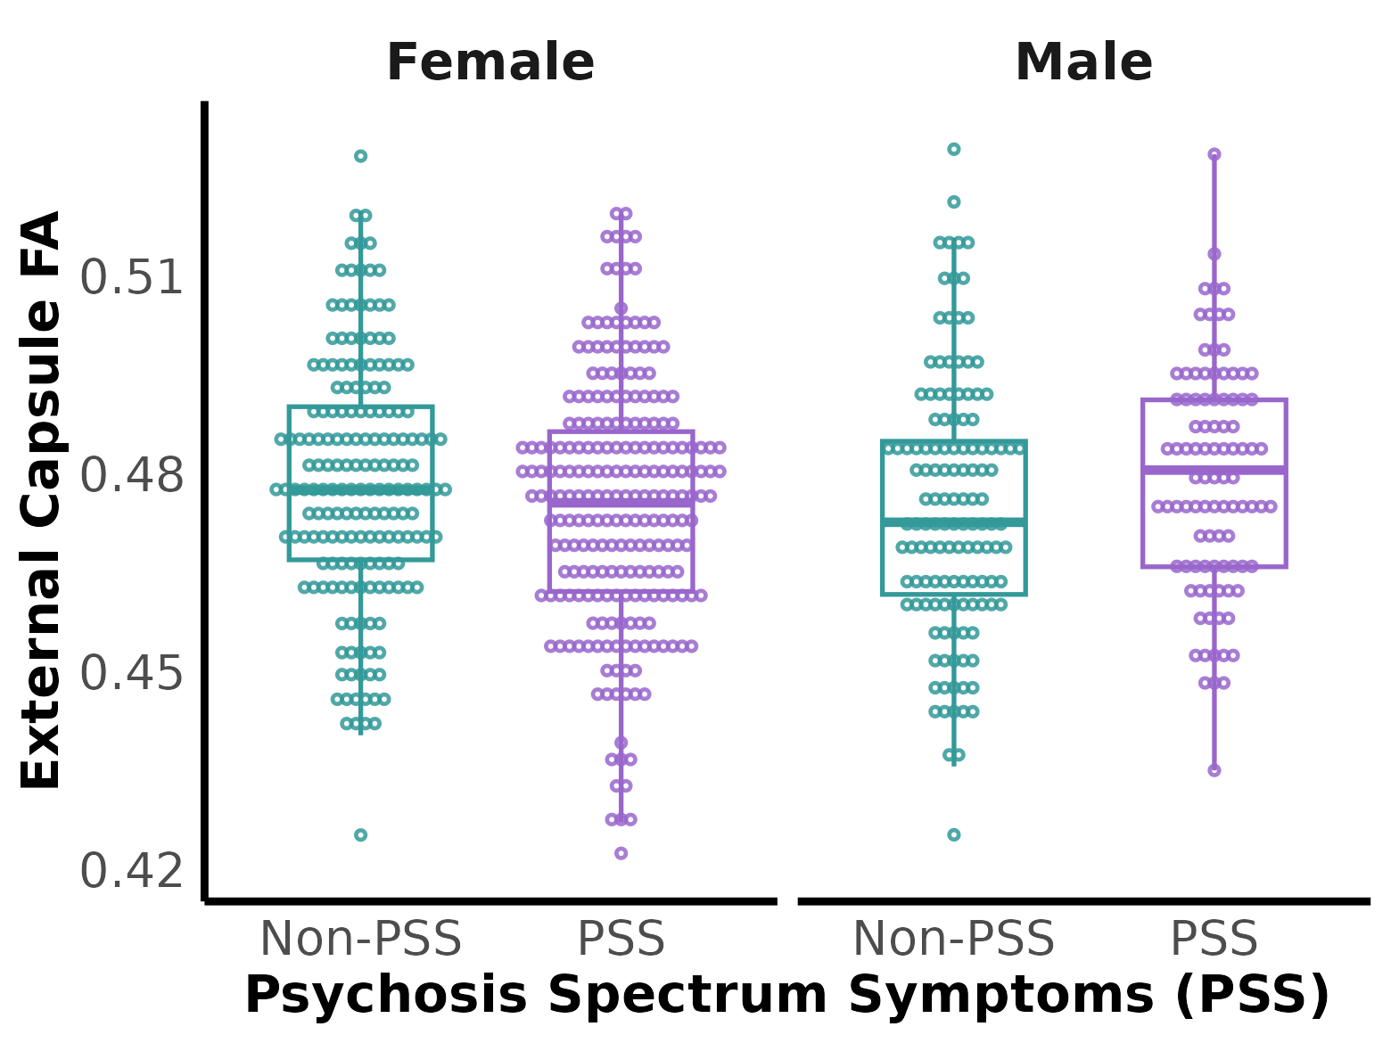
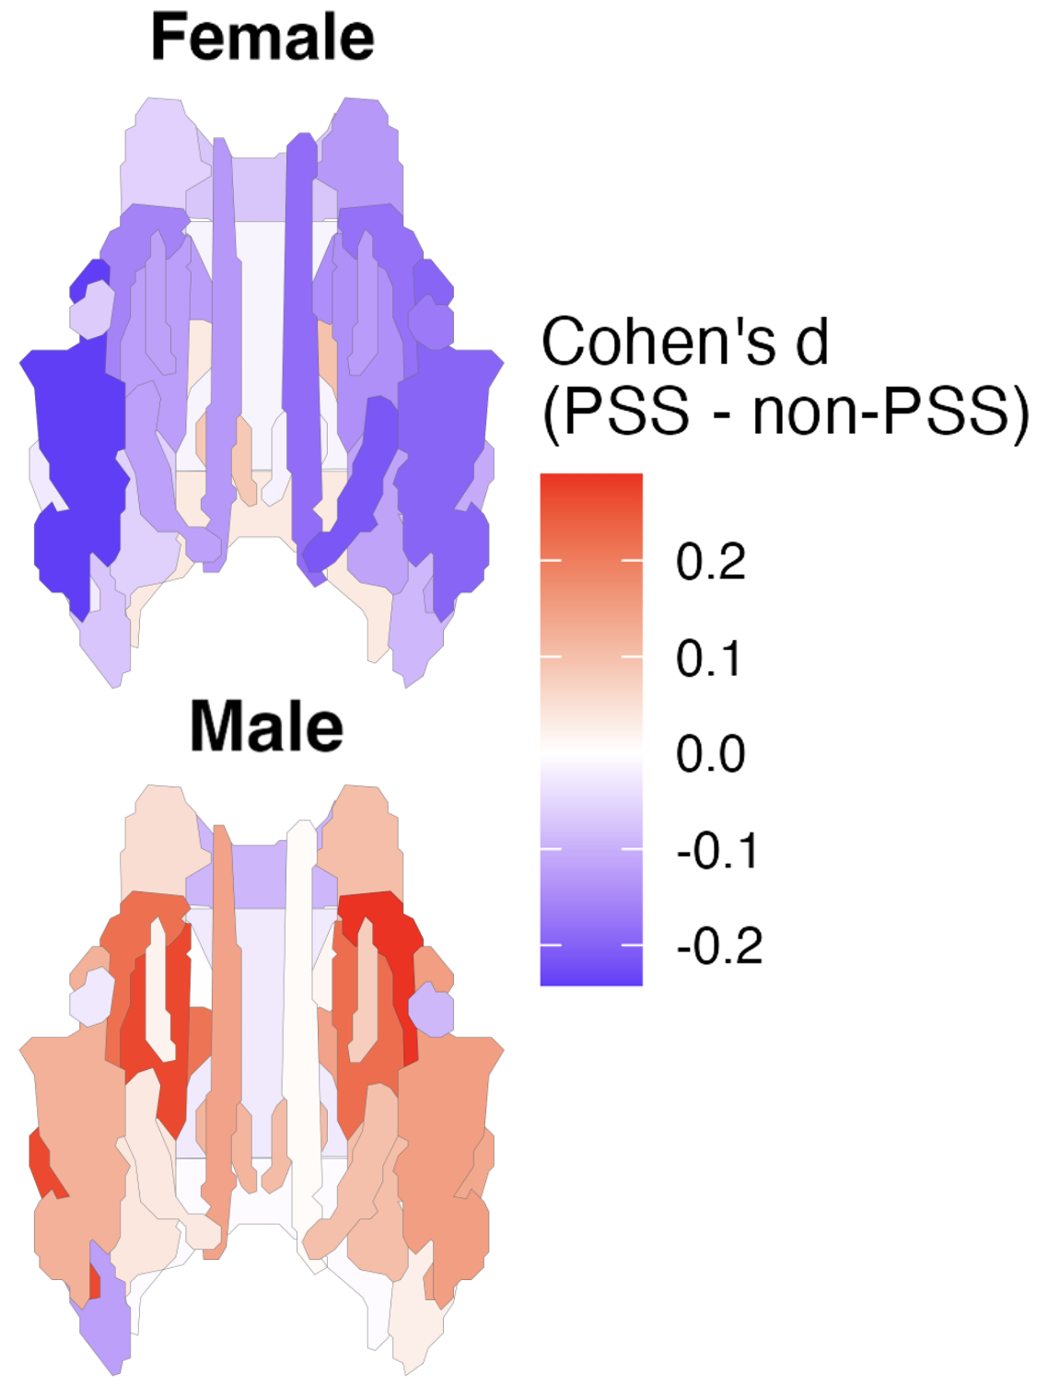
Fractional Anisotropy Differences in Youth With Psychosis Spectrum Symptoms in the Toronto Adolescent and Youth (TAY) Cohort Study
Kelei Xiao^{1,2}, Jiya Shah^{2,3}, Shane Cleary^{2,3}, Stephanie Ameis^{2,3,4}, Kristin Cleverley^{2,3}, Darren B. Courtney^{2,3}, Daniel Felsky^{2,3}, George Foussias^{2,3}, Benjamin Goldstein^{2,3}, Lisa Hawke^{2,3}, Nicole Kozloff^{2,3}, Yuliya Nikolova^{2,3}, Alexia Polillo^{2,3}, Lena Quilty^{2,3}, Aristotle Voineskos^{2,3}, Wei Wang^{2,3}, Erin Dickie^{2,3,} and the TAY CAMH Cohort Study Group
(1) McMaster University (2) Center for Addictions and Mental Health (CAMH) (3) University of Toronto (4) The Hospital for Sick Children
BACKGROUND
RESULTS
CONCLUSION
Psychosis spectrum symptoms (PSS) are subclinical psychotic experiences that may be risk factor for clinical psychosis.¹
Adults with schizophrenia spectrum disorders show age-related differences in fractional anisotropy (FA)²
Table 1. Baseline demographics of participants.
No significant effect of PSS status on average FA.
There was a significant sex-by-PSS effect.
Female
Male
LIMITATIONS & FUTURE DIRECTIONS
AIMS AND HYPOTHESIS
Our analyses are conducted on baseline data only; causality cannot be established
Future research should aim to further explore the role of sex as a potential moderator in tract-level FA differences among youth with PSS.
Aim 1: To investigate whether similar patterns of FA deviations exist in youth with PSS
Hypothesis: Youth with PSS will have lower average FA values compared to non-PSS youth.
Fig 1. There was no significant difference in PSS vs non-PSS youth for average FA (d=-0.09; t(630)=-1.17; p=0.24).
Female
Male
METHODS
REFERENCES
1. DeRosse P et al. Examining the Psychosis Continuum. Curr Behav Neurosci Rep. 2015.
2. Harms MP et al. Fractional anisotropy in individuals with schizophrenia and their nonpsychotic siblings. Psychiatry Res Neuroimaging. 2015.
3. Dickie EW et al. Neuroimaging and Biosample Collection in the Toronto Adolescent and Youth Cohort Study: Rationale, Methods, and Early Data. Biol Psychiatry. Cogn Neurosci Neuroimaging. 2024
TAY CAMH Cohort Study
635 youth aged 11-24 seeking or accessing services at CAMH.
PSS assessed using the Prime Screen-Revised Questionnaire
Diffusion magnetic resonance imaging scans were collected and preprocessed using QSIPrep.³
Linear regression model with age, sex, and motion as covariates
Female
Male
Cohen’s d
(PSS – Non-PSS)
Acknowledgments: The TAY Cohort Study is funded by the CAMH Discovery Fund. This study would not be possible without the time and effort of our study research staff, our Youth and Caregiver Advisors and the generous participation of our adolescents, youth and caregivers' participation.
Figure 2. A visual summary of effect sizes across all tracts. PSS was associated with increased average FA in males (d=−0.12; t(223)=−0.93; p=0.355) but decreased in females (d=−0.08; t(404)=−0.80; p=0.421).
Figure 3. Exploratory tract-level analyses showing a sex-by-PSS interaction in the external capsule (t(629)=2.30; p=0.022).

