Slide 1
Predicting mortality in Intensive Care Units with artificial intelligence
Supervisor:
Prof. Jim Briggs
Student:
Davide Garofalo
UP963994

Slide 2
What does it mean to predict mortality?
Decisions support
Save lives
Save money

Slide 3
Crisp-DM
01
Business Understanding
02
Data Understanding
03
Data Preparation
04
Modeling
05
Evaluation
06
Deployment

Slide 4
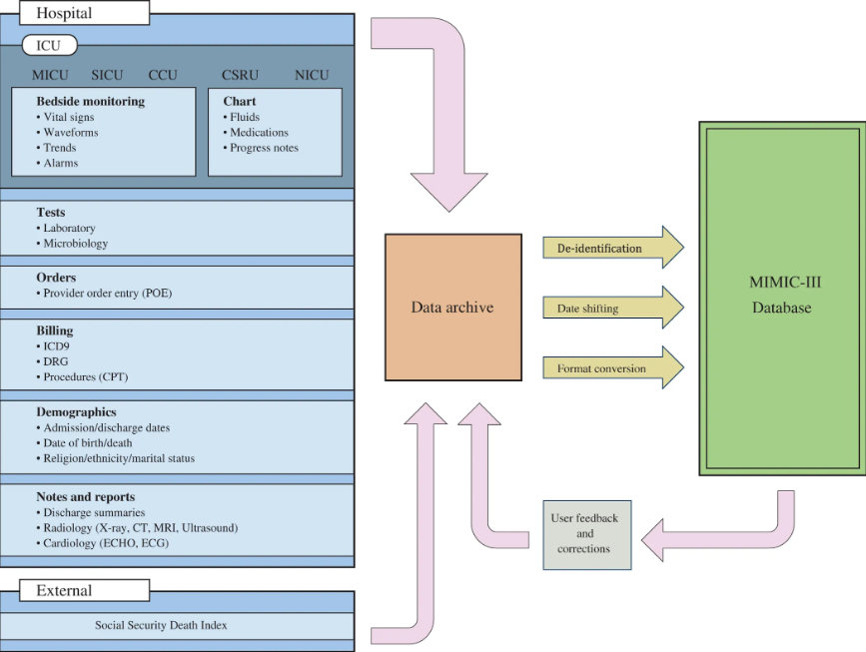
MIMIC – III
MIMIC-III (Medical Information Mart for Intensive Care III) is a large, freely-available database comprising deidentified health-related data associated with over forty thousand patients who stayed in critical care units of the Beth Israel Deaconess Medical Center between 2001 and 2012. It includes demographics, vital signs, laboratory tests, medications, and more
More than 60˙000 ICU stays
Collected from almost forty thousand patients.
40 tables – 100+ columns – 5˙000˙000+ rows
High temporal resolution and high-grade information systems used for collection of the data.
De-identified anonymous data
Data conforms to Health Insurance Portability and Accountability Act (HIPAA) standards

Slide 5
Patient’s Data
Hemoglobin
White Blood Cell count
Blood Urea Nitrogen
Albumin
Creatinine
Sodium
Potassium
Glucose
VITAL SIGNS
LABORATORY ANALYSIS
Heart Rate (Pulse)
Oxygen Saturation(SpO2)
Blood Pressure
Temperature (°C)
Respiration Rate
Consciousness state (Glasgow Coma Scale)

Slide 6
Population Inclusion Criteria
Length of Stay 24h or more
Only Adults
Shorter stays could lead to insufficient data.
The physiology of adults is substantially different from the one of childrens and adolescents.
Admission type = “Urgent” or “Emergency”
First ICU stay for every hospital admission
Non elective admissions are less likely to end up in ICU.
Multiple ICU stay from the same admission tend to be highly correlated

Slide 7
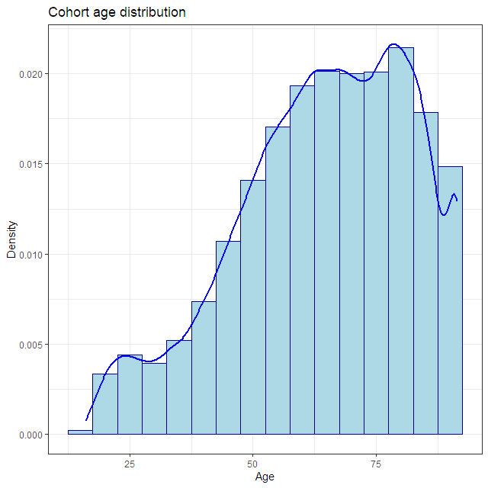
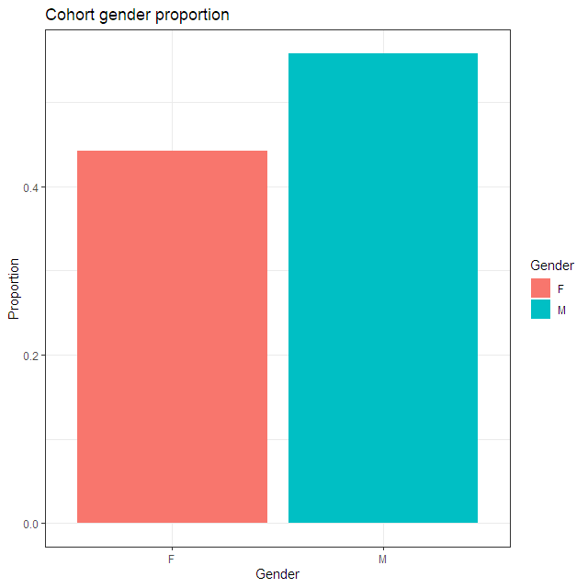
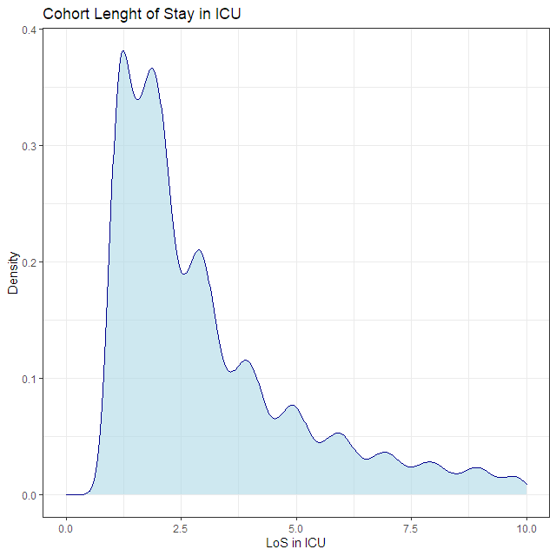
Patients have been filtered to be adults (more than 16 years of age). A large number of patients is aged 60 or more.
Exploratory
DATA
Analysis
Males are about 8% more numerous than women.
Length of stay in ICU is skewed to the right, with a median of 2.68 days and a mean of 4.81 days. Minimum length of stay is fixed to one day.

Slide 8
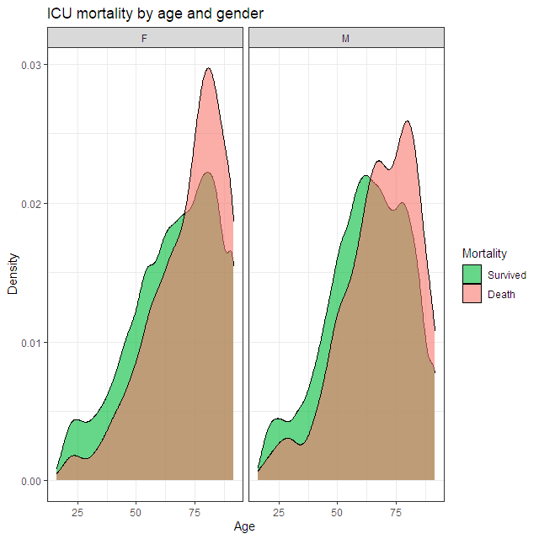


Exploratory
DATA
Analysis
Females Mortality Proportion
Females Mean Age of Death (with CI)
Males Mortality Proportion
Males Mean Age of Death (with CI)

Slide 9
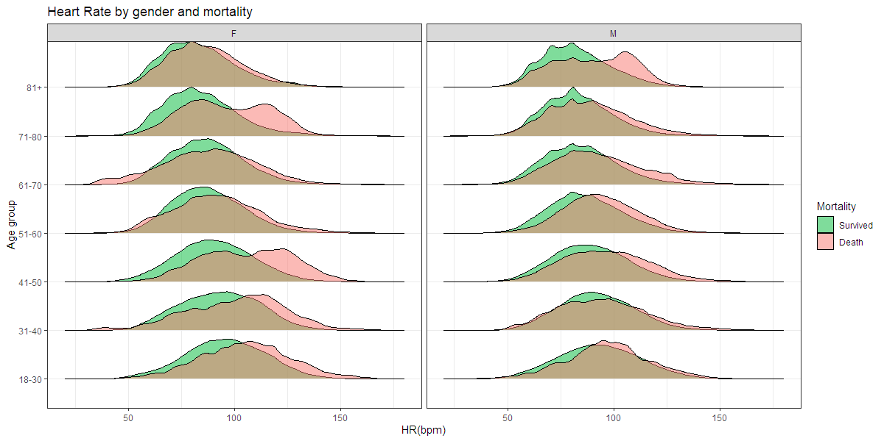
Exploratory DATA Analysis
You can simply impress your audience and add a unique zing and appeal to your Presentations. Easy to change colors, photos and Text. Get a modern PowerPoint Presentation that is beautifully designed. You can simply impress your audience and add a unique zing and appeal to your Presentations. Easy to change colors, photos and Text. Get a modern PowerPoint Presentation that is beautifully designed.
Modern Portfolio Presentation

Slide 10
Data Preparation
Dealing with outliers
Dealing with missing values
Data transformations
Three main types of techniques for searching and removal:
Domain knowledge based
Statistical measures
Machine learning
You can either leave them as they are, impute with artificial intelligence techniques, fill with previous or next available value or interpolate with statistical measures
Data normalization
Data standardization
Features transformation (like Wavelets, log transformations) etc. …

Slide 11
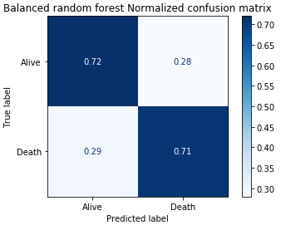
Machine Learning Models
Balanced Models
 | Balanced Accuracy | Geometric Mean | AUROC
Balanced Bagging | 0.705 | 0.698 | 0.789
Easy Ensemble Classifier | 0.710 | 0.710 | 0.778
RUSboost | 0.710 | 0.711 | 0.788
Metrics
Balanced Accuracy: the rate of correct classifications (in the balanced case defined as avg of recall on each class)
Geometric Mean: the balance between classification performances on both the majority and minority classes
AUROC: probability that the model ranks a random positive example more highly than a random negative example
Balanced Random Forest
Metrics
 | Balanced Random Forest
Balanced Accuracy | 0.715
Geometric Mean | 0.715
AUROC | 0.787

Slide 12
Thank You
UP963994

