Slide 1

HOSPITAL PATIENT FLOW ANALYTICS
Presented by : The Cloud Analysts
Trainer: TIM MICAH-GRACE
Date: 14/07/2026
MetroCareNHS Trust

Slide 2

Introduction
MetroCare NHS is experiencing pressure on:
Patient flow
Patients waiting time
Bed Availability

Slide 3

Objectives:
Analyse waiting times by department
Understand admission outcomes
Investigate whether staffing levels affect delays
Identify key causes of poor patient flow.
Conclusion
Recommendations

Slide 4
Dataset Overview and Methodology
Datasets used:
Admissions dataset
Admission type
Waiting time
Length of stay
Outcome
Bed pressure score
Staffing dataset
Date
Department
Staff on duty
Methods:
Data cleaning
VLOOKUP/XLOOKUP to join staffing data
PivotTables
Data visualisations

Slide 5
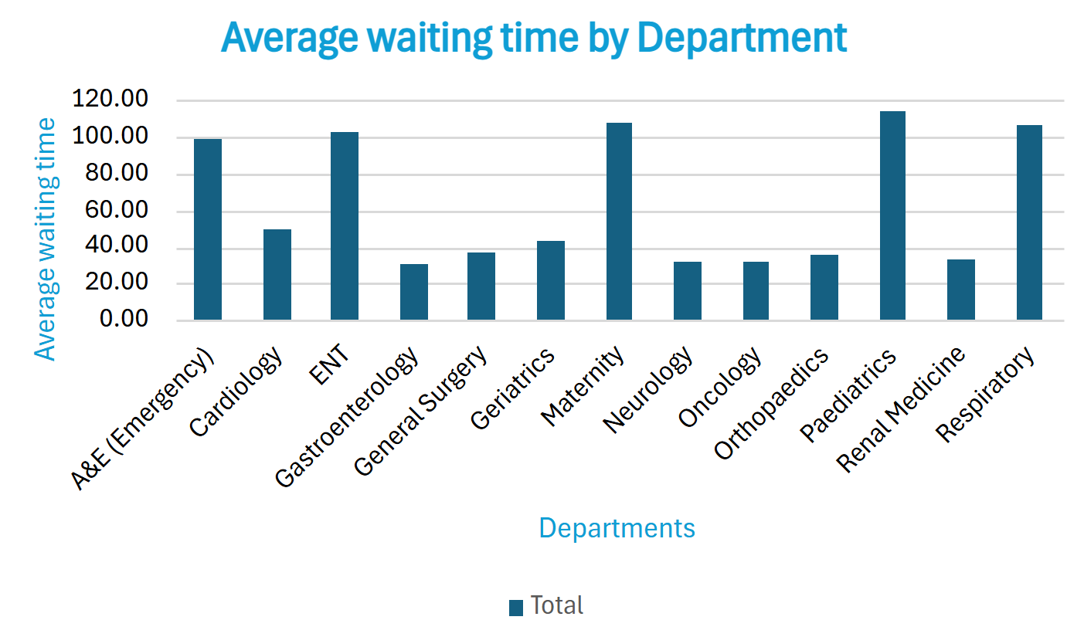
Average Waiting time by department
All departments experience waiting times above
20 minutes, showing common pressure on patient flow.
Paediatrics has the highest average waiting time
(114 minutes).
Maternity, Respiratory, ENT, and A&E also show
significant delays.
These departments should be prioritised for
operational improvement.

Slide 6
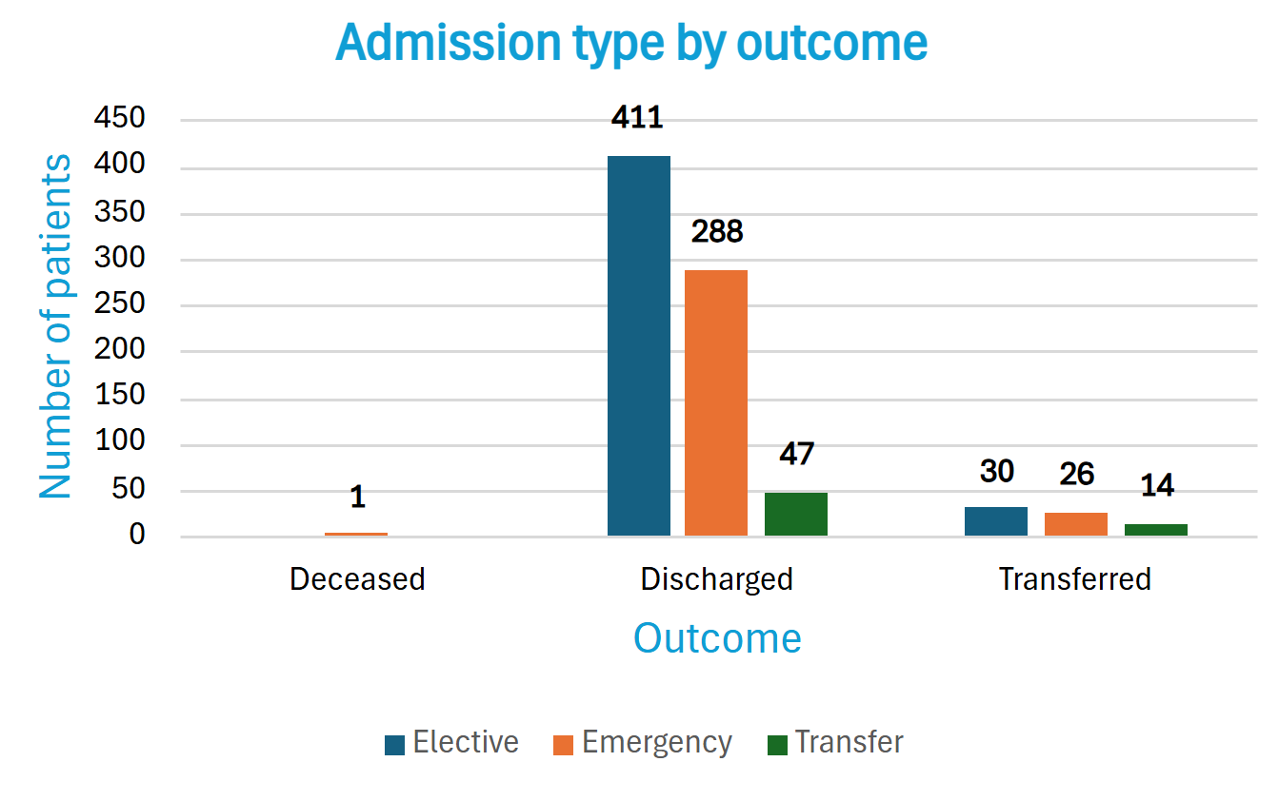
Admission type by Outcome
Total number admitted: 817 patients
- 746 patients discharged.
- 70 patients transferred.
Emergency admission recorded 1 deceased outcome.

Slide 7
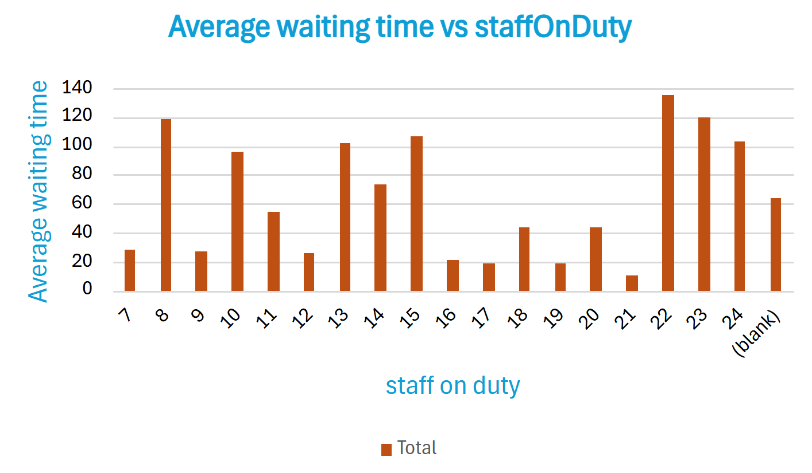
Staffing levels vs waiting time
Higher staffing levels do not always lead to shorter
waiting times.
Lower staffing levels can be associated with shorter
waits in some cases.
Waiting times might be influenced by other factors
(Patient arrival volumes, emergency demand, department workload, patient complexity, etc...)

Slide 8
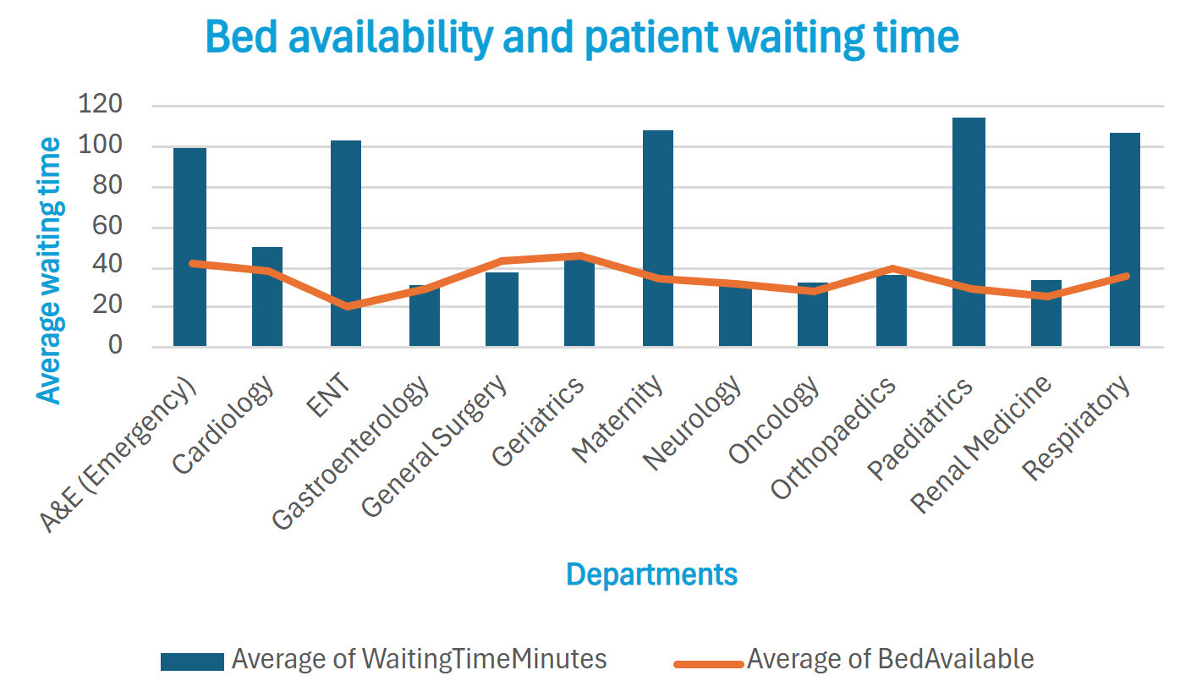
Bed Availability vs waiting time by department
Some departments with more beds still experience long waiting times.
Departments with lower waiting times generally have adequate bed capacity.
Bed availability may influence delays, but it is not the only factor affecting patient flow.

Slide 9

Conclusion
Waiting time problems are concentrated in specific departments,especially Paediatrics, Maternity, Respiratory, ENT, and A&E.
Most patients were discharged successfully, but delays appear within the patient pathway.
Staffing levels alone do not explain waiting time variation.
The hospital should prioritise high-wait departments and ensure resources are allocated where they are most needed.

Slide 10

Recommendations
Prioritize improvement in departments with the longest waiting times (Paediatrics, Maternity, Respiratory, ENT, A&E).
Review staffing capacity and allocate clinical resources based on demand.
Ensure the right medical teams are available when demand is high.

Slide 11


Slide 12



Questions
Suggestions

