Slide 1
theGardener features

Slide 2
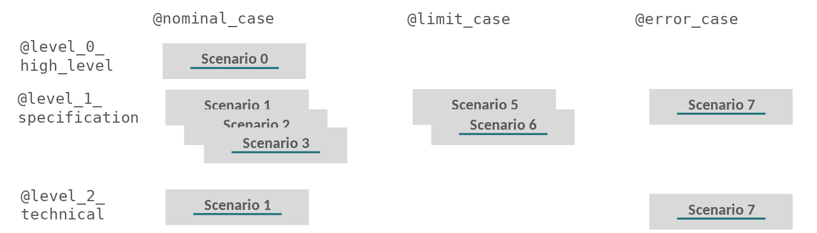
We should improve the process
Emails
User Story
Acceptance Criteria
HARD
Write scenarios so that both PO and DEV can understand
PO
DEV
Wrote it
with DEV
Wrote it
with PO
Scenarios
HARD
Implementation based on
the scenarios
Anyone
Difficult to access to the accurate documentation
Reflect features in production
Code is driven by scenarios
Move to production
Production
Integration tests
1

Slide 3

With theGardener
User Story
Acceptance Criteria
Write scenarios so that both PO and DEV can understand
PO
DEV
Wrote it
with DEV
Wrote it
with PO
Scenarios
Implementation based on
the scenarios
Search / Navigate Generate documentation
Anyone
Reflect features in production
Code is driven by scenarios
Move to production
Production
Integration tests
1

Slide 4




Open source project on Apache Licence 2.0
Hosted on GitHub
Stack
https://github.com/KelkooGroup/theGardener
1

Slide 5
Features milestones
M1 : Generate documentation (Work in progress)
M2 : Administration
M3 : Packaging
M4 : Write scenario through a work flow
M5 : Generate an API documentation
1

Slide 6
M1 : Generate documentation
→ organise
Scenario
Scenario
Scenario
Scenario
Scenario
Scenario
Scenario
Scenario
Scenario
Scenario
Scenario
Scenario
Scenario
Scenario
Scenario
Scenario
Scenario
Scenario
Scenario
Scenario
Scenario
Scenario
Scenario
Scenario
Scenario
Scenario
Scenario
Scenario
Scenario
Scenario
Scenario
Scenario
Scenario
Scenario
Scenario
Scenario
Scenario
Scenario
Scenario
Scenario
Scenario
Scenario
Scenario
Scenario
Scenario
Scenario
Scenario
Scenario
Scenario
Scenario
Scenario
Scenario
Scenario
Scenario
Scenario
Scenario
Scenario
Scenario
Scenario
Scenario
Scenario
Scenario
Scenario
Scenario
Scenario
Scenario
Scenario
Scenario
Scenario
Scenario
Scenario
Scenario
Scenario
Scenario
Scenario
Scenario
Scenario
Scenario
Scenario
Scenario
Scenario
Scenario
Scenario
Scenario
Scenario
Scenario
Scenario
Scenario
Scenario
Scenario
Scenario
Scenario
Scenario
Scenario
Scenario
Scenario
Scenario
Scenario
Scenario
Scenario
Scenario
Scenario
Scenario
Scenario
Scenario
Scenario
Scenario
Scenario
Scenario
Scenario
Scenario
Scenario
Scenario
Scenario
Scenario
Scenario
Scenario
Scenario
Scenario
Scenario
Scenario
Scenario
Scenario
Scenario
Scenario
Scenario
Scenario
Scenario
Scenario
Scenario
Scenario
Scenario
Scenario
Scenario
Scenario
Scenario
Scenario
Scenario
Scenario
Scenario
Scenario
Scenario
Scenario
Scenario
Scenario
Scenario
Scenario
Scenario
Scenario
Scenario
Scenario
Scenario
Scenario
Scenario
Scenario
Scenario
Scenario
Scenario
Scenario
Scenario
Scenario
Scenario
Scenario
Scenario
Scenario
Scenario
Scenario
Scenario
Scenario
Scenario
Scenario
Scenario
Scenario
Scenario
Scenario
Scenario
Scenario
Scenario
Scenario
Scenario
Scenario
Scenario
Scenario
Scenario
Scenario
Scenario
Scenario
Scenario
Scenario
Scenario
Scenario
Scenario
Scenario
Scenario
Scenario
Scenario
Scenario
Scenario
Scenario
Scenario
Scenario
Scenario
Scenario
Scenario
Scenario
Scenario
Scenario
Scenario
Scenario
Scenario
Scenario
Scenario
Scenario
Scenario
Scenario
Scenario
Scenario
Scenario
Scenario
Scenario
Scenario
Scenario
Scenario
Scenario
Scenario
Scenario
Scenario
Scenario
Scenario
Scenario
Scenario
Scenario
Scenario
Scenario
Scenario
Scenario
Scenario
Scenario
Scenario
Scenario
Scenario
Scenario
Scenario
Scenario
Scenario
Scenario
Scenario
Scenario
Scenario
Scenario
Scenario
Scenario
Scenario
Scenario
Scenario
Scenario
Scenario
Scenario
Scenario
Scenario
Scenario
Scenario
Scenario
Scenario
Scenario
Scenario
Scenario
Scenario
Scenario
Scenario
Scenario
Scenario
Scenario
Scenario
Scenario
Scenario
Scenario
Scenario
Scenario
Scenario
Scenario
Scenario
Scenario
Scenario
Scenario
Scenario
Scenario
Scenario
Scenario
Scenario
Scenario
Scenario
Scenario
Scenario
Scenario
Scenario
Scenario
Scenario
Scenario
Scenario
Scenario
Scenario
Scenario
Scenario
Scenario
Scenario
Scenario
Scenario
Scenario
Scenario
Scenario
Scenario
Scenario
Scenario
Scenario
Scenario
Scenario
Scenario
Scenario
Scenario
Scenario
Scenario
Scenario
Scenario
Scenario
Scenario
Scenario
Scenario
Scenario
Scenario
Scenario
Scenario
Scenario
Scenario
Scenario
Scenario
Scenario
Scenario
Scenario
Scenario
Scenario
Scenario
Scenario
Scenario
Scenario
Scenario
Scenario
Scenario
Scenario
Scenario
Scenario
Scenario
Scenario
Scenario
Scenario
Scenario
Scenario
Scenario
Scenario
Scenario
Scenario
Scenario
Scenario
Scenario
Scenario
Scenario
Scenario
Scenario
Scenario
Scenario
Scenario
Scenario
Scenario
Scenario
Scenario
Scenario
Scenario
Scenario
Scenario
Scenario
Scenario
Scenario
Scenario
Scenario
Scenario
Scenario
Scenario
Scenario
Scenario
Scenario
Scenario
Scenario
Scenario
Scenario
Scenario
Scenario
Scenario
Scenario
Scenario
Scenario
Scenario
Scenario
With many projects, we can end up with many many many … BDD scenarios
1

Slide 7
M1 : Generate documentation
→ organise
@nominal_case
@limit_case
@error_case
@level_0_ high_level
Scenario
Scenario
Scenario
Scenario
Scenario
Scenario
Scenario
Scenario
Scenario
Scenario
Scenario
Scenario
Scenario
@level_1_ specification
Scenario
Scenario
Scenario
Scenario
Scenario
Scenario
Scenario
Scenario
Scenario
Scenario
Scenario
Scenario
Scenario
Scenario
Scenario
Scenario
Scenario
Scenario
Scenario
Scenario
Scenario
Scenario
Scenario
Scenario
Scenario
Scenario
Scenario
Scenario
Scenario
Scenario
Scenario
Scenario
Scenario
Scenario
Scenario
Scenario
Scenario
Scenario
Scenario
Scenario
Scenario
@level_2_ technical
Scenario
Scenario
Scenario
Scenario
Scenario
Scenario
Scenario
Scenario
Scenario
First we can just add some tags at scenario level categorize them a bit
1

Slide 8
M1 : Generate documentation
→ organise 2/n
@nominal
@limit
@error
@nominal
@nominal
@limit
@error
@limit
@error
@nominal
@high_level
@nominal
@limit
@error
@nominal
@high_level
@limit
@error
Scenario
@limit
@error
@high_level
@high_level
Scenario
@high_level
Scenario
@nominal
@high_level
Scenario
Scenario
@limit
@error
@nominal
Scenario
@nominal
Scenario
@limit
@error
@specification
Scenario
@limit
@error
Scenario
Scenario
Scenario
Scenario
@specification
Scenario
Scenario
@high_level
@nominal
Scenario
Scenario
@limit
@error
@specification
Scenario
Scenario
Scenario
Scenario
@high_level
Scenario
@specification
Scenario
Scenario
@nominal
@high_level
@limit
@error
Scenario
@nominal
Scenario
Scenario
@limit
@error
@specification
Scenario
Scenario
Scenario
Scenario
Scenario
Scenario
@specification
Scenario
Scenario
Scenario
@high_level
Scenario
Scenario
@nominal
Scenario
Scenario
@limit
@error
@high_level
Scenario
Scenario
Scenario
@nominal
@high_level
Scenario
@limit
@error
@technical
Scenario
Scenario
Scenario
Scenario
@specification
@nominal
@technical
@limit
@error
Scenario
Scenario
Scenario
@specification
Scenario
Scenario
Scenario
@technical
Scenario
Scenario
@high_level
Scenario
Scenario
@specification
Scenario
Scenario
Scenario
@technical
Scenario
Scenario
@nominal
@high_level
Scenario
@limit
@error
Scenario
Scenario
Scenario
@technical
Scenario
Scenario
Scenario
@nominal
@high_level
Scenario
@limit
@error
Scenario
@technical
Scenario
Scenario
@nominal
@limit
@error
@specification
Scenario
Scenario
Scenario
@specification
Scenario
Scenario
Scenario
Scenario
@high_level
Scenario
@specification
Scenario
Scenario
Scenario
@technical
Scenario
Scenario
@high_level
Scenario
Scenario
Scenario
Scenario
Feature
@high_level
Scenario
Feature
Scenario
Scenario
Scenario
Scenario
@technical
@specification
Scenario
Scenario
Scenario
Scenario
@technical
Scenario
Scenario
@specification
Feature
Feature
Scenario
Scenario
Scenario
Scenario
@specification
Scenario
Scenario
Scenario
Feature
@technical
Scenario
Scenario
Scenario
Scenario
Scenario
Feature
Scenario
Scenario
Scenario
Scenario
Scenario
@technical
@specification
Scenario
Scenario
@technical
Scenario
Scenario
@specification
Scenario
Scenario
Scenario
@specification
Scenario
Scenario
Scenario
Feature
Scenario
Scenario
Scenario
@technical
Scenario
Scenario
Scenario
Feature
Scenario
Scenario
Feature
@technical
@technical
Scenario
Scenario
Feature
@technical
Scenario
Scenario
Feature
@technical
Scenario
Scenario
Feature
@technical
Scenario
Scenario
Feature
Feature
Feature
Feature
Feature
Feature
Each scenario is in a feature
1

Slide 9
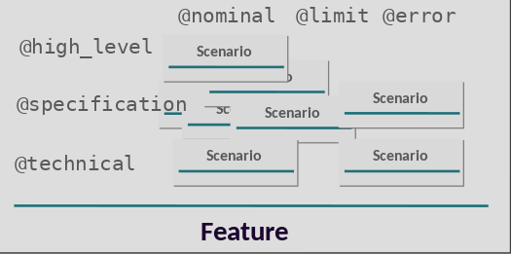
M1 : Generate documentation
→ organise
Project
Project
Project
Project
Project
Project
Project
Project
Project
Project
Project
Project
Each feature is in a project … but still we can have many many projects
1

Slide 10
M1 : Generate documentation
→ organise
API user view
External User
Project
Business view
Business
Engineering view
Engineering
theGardener give the opportunity to organize project by views
1

Slide 11
M1 : Generate documentation
→ organise 3/n
API user view
Project
Project
Project
External User
Business view
Project
Business
Project
Engineering view
Project
Project
Engineering
Project
Each view give access to the projects in a hierarchic way
<number>

Slide 12
M1 : Generate documentation
→ organise 3/n
API user view
Project
Project
Project
Project
Project
Project
External User
Project
Project
Business view
Project
Project
Project
Project
Business
Project
Project
Engineering view
Project
Project
Project
Project
Project
Project
Project
Engineering
Each view can give access to some project, many projects or all the projects is needed
<number>

Slide 13
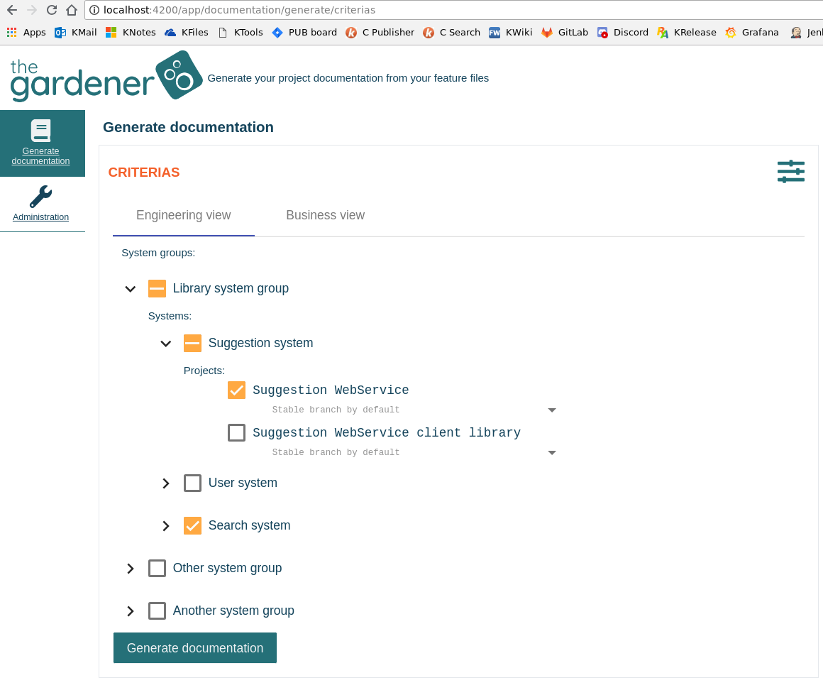
M1 : Generate documentation
→ criterias
<number>

Slide 14
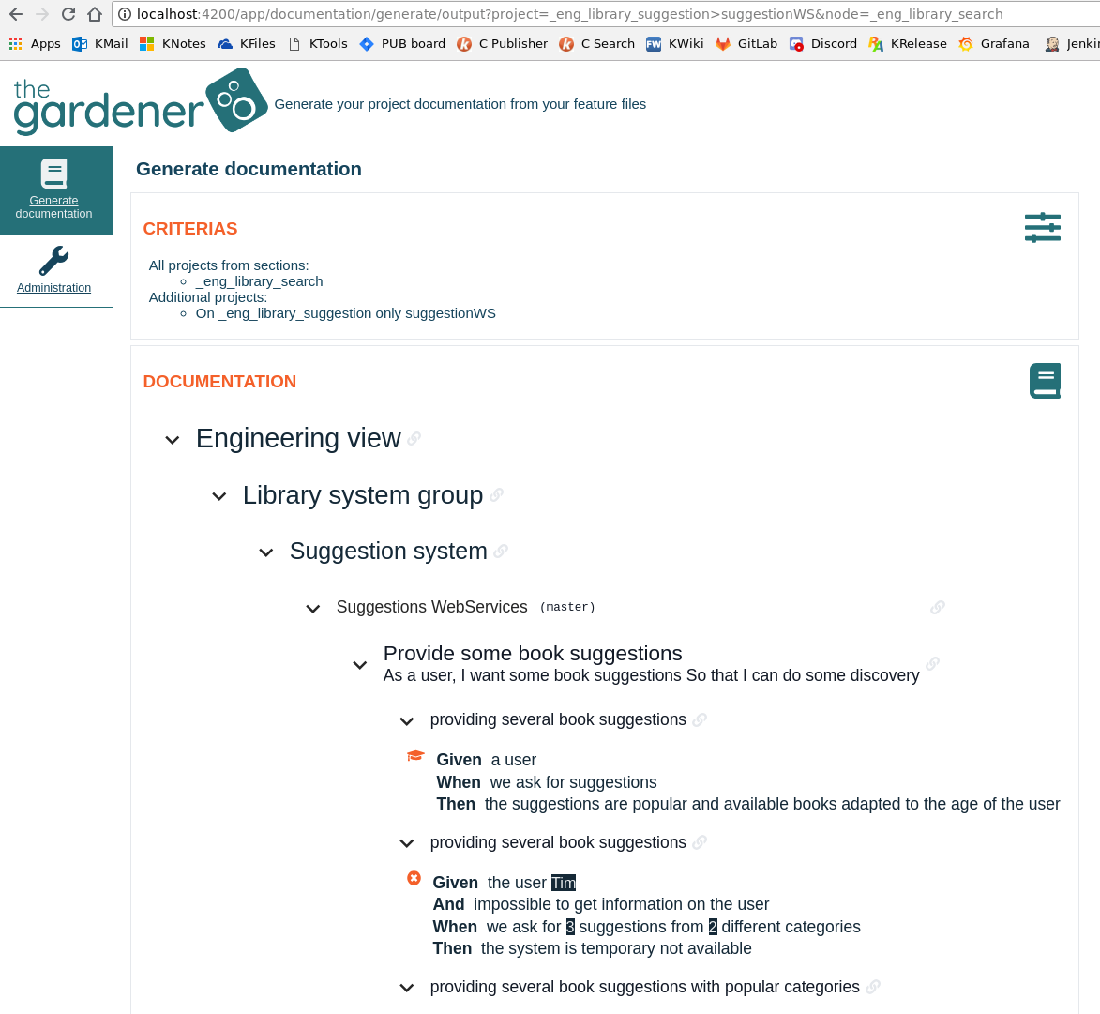
M1 : Generate documentation
→ documentation
<number>

Slide 15

Original idea and main contributors from
Contributors welcomed !

