Slide 1
theGardener in a nutshell

Slide 2
BDD : Behavior Driven Development
Bla bla bla….
Bla bla bla...
PO
DEV
A good way to open the discussion with the product owner
A contract between the product owner and the dev team
1

Slide 3
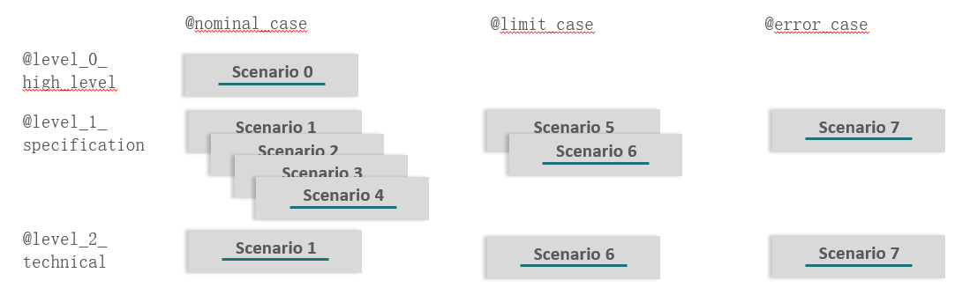
BDD : Behavior Driven Development
2 or 3
hours
Write scenario
PO
DEV
Improve the team velocity
1

Slide 4

BDD : Behavior Driven Development
DEV
Guide the dev in the implementation of the feature
1

Slide 5
BDD : Behavior Driven Development
DEV
BDD
Make the refactoring at component level possible and easy
1

Slide 6

BDD : Behavior Driven Development
Anyone
Exhaustive accurate executable documentation
1

Slide 7
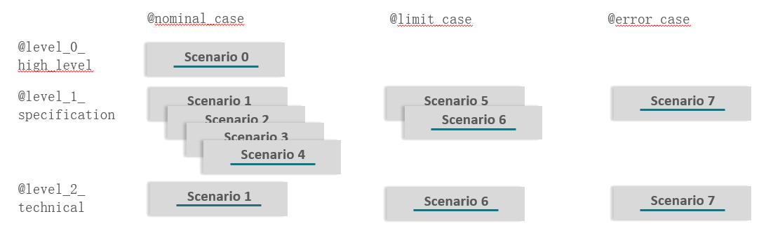
BUT we should improve the process
Emails
User Story
Acceptance Criteria
HARD
Write scenarios so that both PO and DEV can understand
PO
DEV
Wrote it
with DEV
Wrote it
with PO
Scenarios
HARD
Implementation based on
the scenarios
Anyone
Difficult to access to the accurate documentation
Reflect features in production
Code is driven by scenarios
Move to production
Production
Integration tests
1

Slide 8

With theGardener
User Story
Acceptance Criteria
Write scenarios so that both PO and DEV can understand
PO
DEV
Wrote it
with DEV
Wrote it
with PO
Scenarios
Implementation based on
the scenarios
Search / Navigate Generate documentation
Anyone
Reflect features in production
Code is driven by scenarios
Move to production
Production
Integration tests
1

Slide 9




Open source project on Apache Licence
Hosted on GitHub
Stack
Milestones :
Give access easy to the scenarios (Work in progress)
Write scenario through a work flow (Not started)
https://github.com/KelkooGroup/theGardener
1

Slide 10
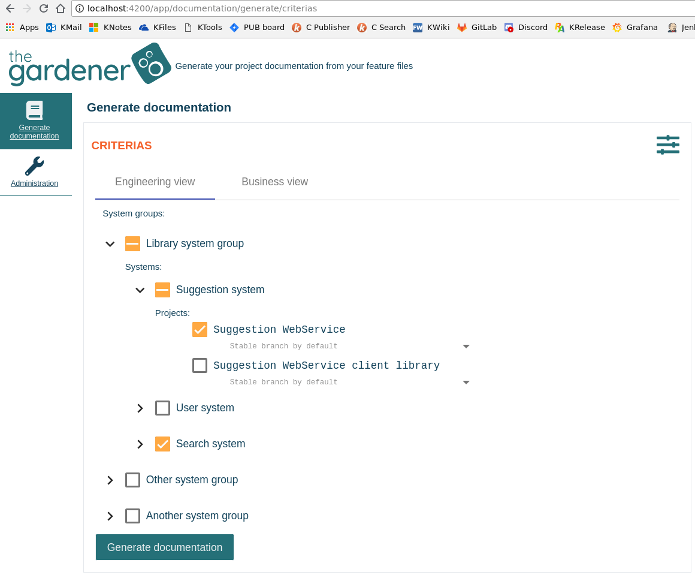
Give access to scenario : criterias
1

Slide 11
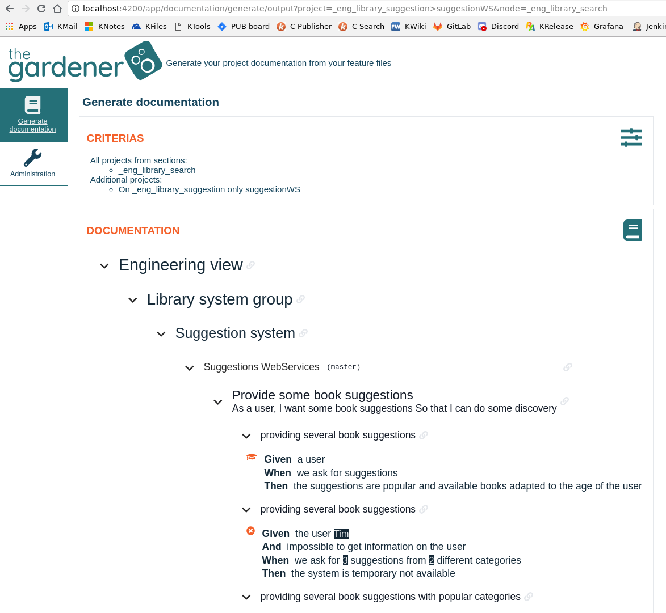
Give access to scenario : documentation
1

Slide 12

Original idea and main contributors from
Contributors welcomed !

