Slide 1


BEGINNER COURSE
Introduction to
Pandas
for Python
Data Analysis • Cleaning
DataFrames
NumPy
CSV Files

Slide 2





What is Pandas?
The most powerful Python data library
Tables & DataFrames
Stores data like Excel spreadsheets inside Python
Data Cleaning
Fix, rename, and transform messy data fast
Analysis
Stats, grouping, filtering all in one line
AI
Prep datasets for Machine Learning models
File I/O
Read & write CSV, Excel, JSON and more

Slide 3
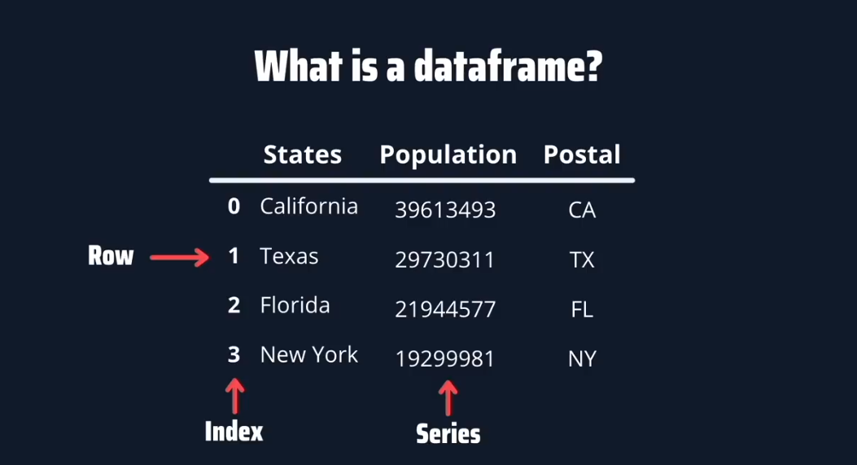

Slide 4
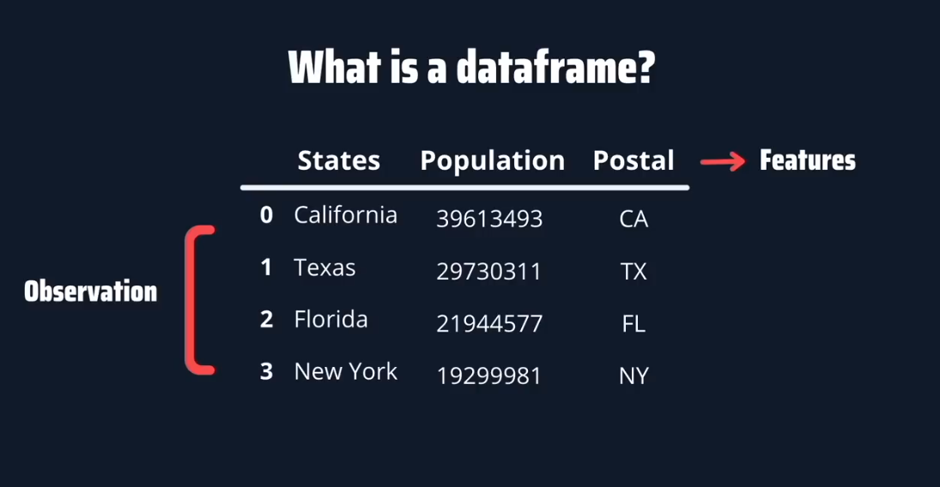

Slide 5
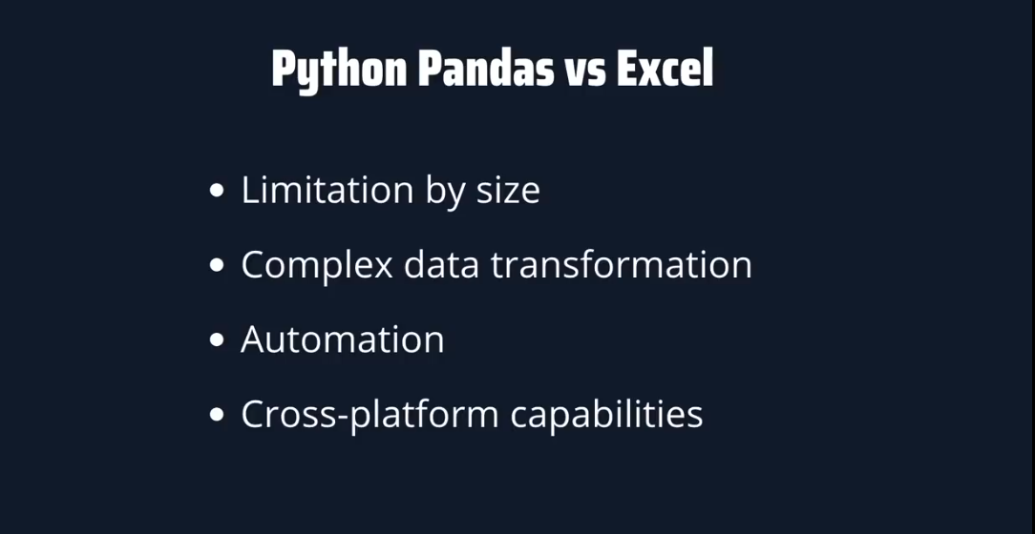

Slide 6
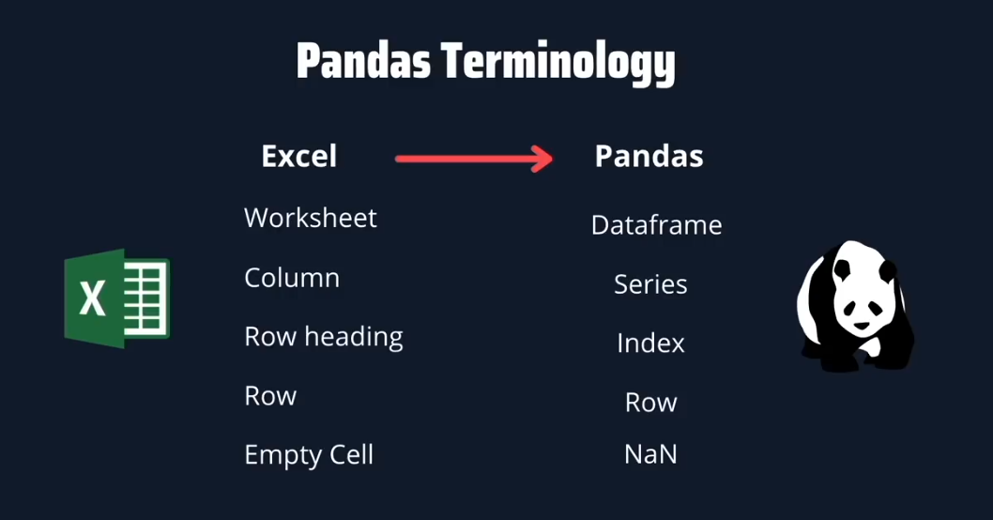

Slide 7
Setup & Import
STEP 1 — Install
pd
pip install pandas numpy
The standard alias used by every data scientist worldwide. Keeps code short.
STEP 2 — Import
np
import pandas as pd
import numpy as np
# pd → short for pandas
# np → short for numpy
NumPy supercharges Pandas with fast array operations and random data generation.
After importing, you're ready to work with data!

Slide 8
Core Structures
Series — 1D Column
DataFrame — 2D Table
ages = pd.Series([20, 25, 30, 35])
print(ages)
# Output:
# 0 20
# 1 25
# 2 30
# 3 35
# dtype: int64
data = {
"Name": ["John","Ama","Kofi"],
"Age": [20, 22, 24],
"Score": [90, 85, 88]
}
df = pd.DataFrame(data)
print(df)
Think of Series like a single spreadsheet column
Name
Age
Score
0
John
20
90
Index
Value
1
Ama
22
85
0
20
2
Kofi
24
88
1
25
2
30
Multiple columns = multiple Series side by side
3
35

Slide 9
Creating Datasets with NumPy
np.arange(1, 11)
import pandas as pd
import numpy as np
# Generate 10 student records
student_ids = np.arange(1, 11) # [1..10]
ages = np.random.randint(18, 30, size=10)
scores = np.random.randint(50, 100, size=10)
students = pd.DataFrame({
"Student_ID": student_ids,
"Age": ages,
"Score": scores
})
print(students.head())
→ [1, 2, 3, 4 … 10]
Sequence of numbers from start to stop
np.random.randint(18, 30, size=10)
→ [21, 27, 19 …]
10 random integers between 18 and 29
np.random.seed(42)
Save to CSV
→ —
students.to_csv("students.csv", index=False)
Fixes randomness so results are reproducible

Slide 10





Exploring Your Dataset
df.head(5)
df.tail(5)
df.info()
First 5 rows
Last 5 rows
Column types & nulls
df.describe()
df.shape
df.columns
Mean, min, max, std dev
Rows × Columns tuple
List all column names

Slide 11
Select & Filter Data
SELECTING
FILTERING
# Single column → returns a Series
df["Score"]
# Multiple columns → returns a DataFrame
df[["Name", "Score"]]
# By row index (position)
df.iloc[0] # first row
df.iloc[0:3] # rows 0,1,2
# By label
df.loc[0, "Score"] # row 0, Score col
# Scores above 80
high = df[df["Score"] > 80]
# Multiple conditions
df[(df["Age"] > 20) & (df["Score"] > 75)]
# Text match
df[df["Name"] == "Ama"]
# isin filter
df[df["Name"].isin(["Ama", "Kofi"])]
How filtering works visually:
John • 72
Ama • 85
Kofi • 91
df[df['Score'] > 80] -> Ama, Kofi (passed!)

Slide 12




Transforming Data
Add Column
Update Value
df["Passed"] = df["Score"] >= 50
df["Grade"] = df["Score"].apply(
lambda x: "A" if x>=90 else "B" if x>=75 else "C")
# By index
df.loc[0, "Score"] = 95
# Across whole column
df["Score"] = df["Score"] * 1.05
Delete
Rename
# Remove column
df.drop("Passed", axis=1, inplace=True)
# Remove row
df.drop(0, axis=0, inplace=True)
df.rename(columns={
"Score": "Marks",
"Name": "Student"
}, inplace=True)

Slide 13
Handling Missing Data
Create with Nulls
NaN = Not a Number
01
Python's placeholder for missing values
data = {
"Name": ["John", "Ama", None],
"Score": [90, None, 80]
}
df = pd.DataFrame(data)
Detect Nulls
Real datasets
02
Often have 10–30% missing values
df.isnull() # True where NaN
df.isnull().sum() # Count per column
df.dropna() # Remove null rows
Fill Nulls
Strategy matters
03
Wrong fill = biased ML model
df.fillna(0) # With zero
df.fillna(df.mean()) # With column mean
df["Score"].fillna(
df["Score"].median()) # Specific col

Slide 14


Sort, Group & Aggregate
Sorting
# Descending by Score
df.sort_values("Score", ascending=False)
# Multiple columns
df.sort_values(["Dept","Salary"])
GroupBy
df.groupby("Department")["Salary"].mean()
# Multiple aggregations
df.groupby("Dept").agg({
"Salary": ["mean","max","min"],
"Age": "count"
})
# Result:
# Department
# Finance 4800
# IT 4200
# Sales 3600
# HR 3100

Slide 15
Building AI-Ready Datasets
1
Generate
import pandas as pd
import numpy as np
np.random.seed(42)
dataset = pd.DataFrame({
"Age": np.random.randint(18, 60, 100),
"Income": np.random.randint(2000, 10000, 100),
"Purchased": np.random.choice([0, 1], 100)
})
print(dataset.head())
Use NumPy to simulate realistic numerical features
2
Clean
Handle nulls, remove duplicates, fix types
3
Engineer
Add calculated columns (ratios, flags, categories)
4
Export
Save as CSV / pass directly to sklearn or TensorFlow

Slide 16
Quick Reference Cheat Sheet
Function
Purpose
Category
df.head()
Show first 5 rows
Explore
df.tail()
Show last 5 rows
Explore
df.info()
Column types & null counts
Explore
df.describe()
Mean, min, max, std
Explore
df.shape
Rows × Columns
Explore
df['col']
Select one column
Select
df[['a','b']]
Select multiple columns
Select
df.loc[r, c]
Select by label
Select
df.iloc[r, c]
Select by position
Select
df[df['col']>x]
Filter rows by condition
Filter
df.sort_values('col')
Sort by column
Transform
df.groupby('col').agg()
Group & aggregate
Transform
df.fillna(val)
Fill missing values
Clean
df.dropna()
Remove rows with nulls
Clean
df.drop('col', axis=1)
Delete column
Transform
df.to_csv('file.csv')
Save to CSV
I/O
pd.read_csv('file.csv')
Load from CSV
I/O

Slide 17

Your Learning Path
Series & DataFrames
Filter & conditionals
GroupBy & aggregation
Read CSV / Excel
Add / delete columns
Apply & lambda functions
head(), info(), describe()
Handle missing data
Merge & join datasets
Selecting columns
Sort values
Time series basics

Slide 18
Try It Yourself!
Add a Passed column
import pandas as pd
import numpy as np
names = ["Ama", "Kojo", "Yaw", "Akosua"]
scores = np.random.randint(50, 100, size=4)
df = pd.DataFrame({"Name": names, "Score": scores})
# Explore
print(df)
print(df.describe())
# Try these challenges:
# 1. Add a "Passed" column (True if Score >= 60)
# 2. Filter only students who passed
# 3. Sort by Score descending
# 4. Calculate mean score with df["Score"].mean()
1
df["Passed"] = df["Score"] >= 60
Filter passed students
2
df[df["Passed"] == True]
Sort descending
3
df.sort_values("Score", ascending=False)
Calculate mean score
4
df["Score"].mean()

Slide 19
You're Ready to Start!
Pandas is the #1 tool every Data Analyst / Scientist uses daily.
Master it and unlock the world of data science.
#pandas
#numpy
#DataFrame
#data cleaning
#AI engineering
#groupby
#CSV
#Machine Learning
Keep building. Keep learning. 🚀

