Slide 1

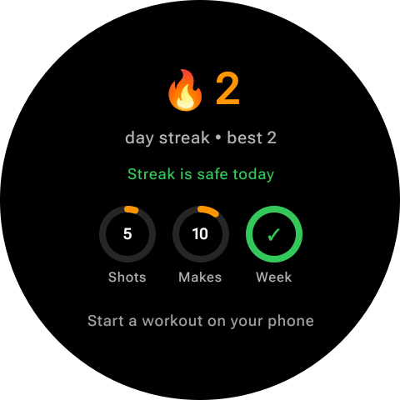
SQUATCH SPORTS · CPTS 423 · TEAM 11
Sprint 4 Review
Android & Wear OS expansion + gamification
Kellam Adams · Melvin Sanare · Kaleb Kebede
Sprint 4: August 27 – September 30, 2026
Notes:
Hi, we're Team 11. This is our Sprint 4 review for the Squatch Sports basketball training app. This semester we're expanding the app to Android phones and Wear OS watches and adding gamification to make training more fun.

Slide 2



INTRODUCTION
Project and team
Squatch Sports is a basketball shooting-practice app. Players pick a drill on their phone and log every make, miss, and swish on their watch with a quick swipe.
Our iOS and watchOS work from last semester is now in Squatch Sports' production app. This semester we're bringing it to Android and Wear OS and adding gamification.
Client goal: “hide the broccoli.” Make logging and reviewing workouts fun enough that players keep coming back.
Kellam Adams
Android & Wear OS port lead: phone app, watch app, and phone/watch messaging
Melvin Sanare
Android gamification: streaks, goal progress, watch sync, testing, and the GitHub board
Kaleb Kebede
iOS gamification: XP and level system; goal progress
Notes:
Squatch Sports helps basketball players practice shooting on their own. The phone runs the drill and the watch records every shot with a swipe. Our first-semester iOS and watchOS work is now in the Squatch Sports production app. The client's theme for this semester is 'hide the broccoli': the tracking is the healthy part players need, and our job is to make it enjoyable. Kellam led the Android and Wear OS port, Melvin built streaks and goal progress on the Android phone and watch and managed testing and the GitHub board, and Kaleb built the XP and level system on iOS.

Slide 3
SPRINT 4 OBJECTIVES
Two gamification features + a 90% Android port
01
Streak tracking
02
Goal progress
Current and best streak, milestones, and celebration feedback
Shot goals with progress rings and completion feedback, plus XP and levels on iOS
Owner: Melvin
COMPLETE
Owner: Kaleb & Melvin
COMPLETE
03
Android port (~90%)
04
Wear OS integration
All major iOS flows working in the Android emulator
Watch logs shots and syncs with the Android phone
Owner: Kellam
COMPLETE
Owner: Kellam
COMPLETE
Notes:
Our Sprint 4 goal was to implement two gamification features and complete about 90% of the Android and Wear OS port with all major flows working. That broke into four objectives: streak tracking, goal progress, the Android port, and Wear OS integration. All four were completed this sprint.

Slide 4
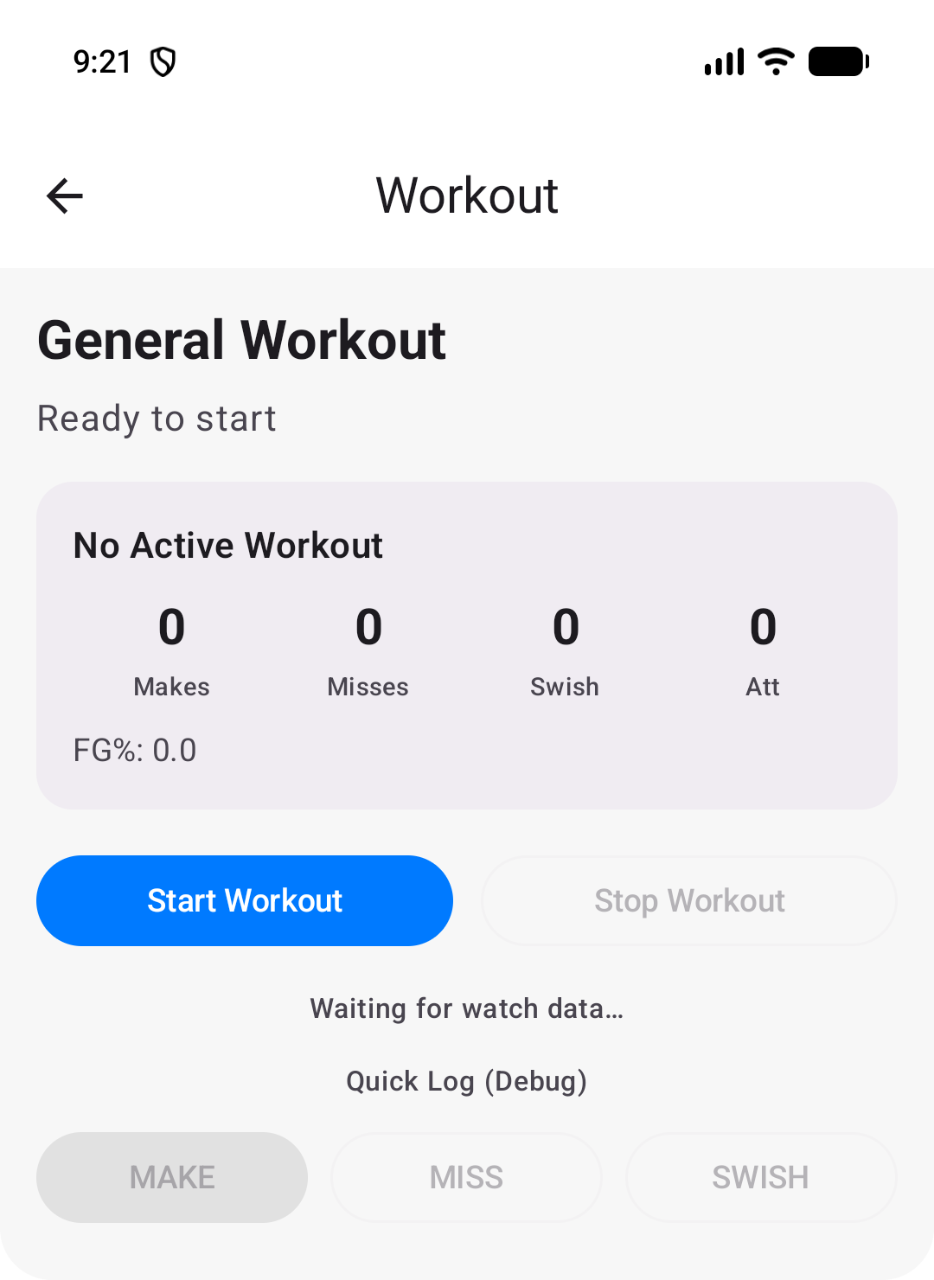
FEATURE · KELLAM ADAMS
Android & Wear OS port
Kotlin + Jetpack Compose project with phone, watch, and shared modules
8 phone screens ported: Dashboard, Drills, Drill Details, Workout, History, Analytics, Goals, Settings
Watch: court view, swipe to log shots (up = make, down = miss, right = swish), workout summary
Same shot codes and drill data as the Apple version
Pixel phone + Wear OS emulator
14 / 16
iOS/watchOS features at full parity (~90%). Settings polish and disconnect recovery are next.
Notes:
Kellam ported the iOS and watchOS app to Android using AI tools, as the client asked. It's a Kotlin and Jetpack Compose project with a phone app, a Wear OS app, and a shared module. All eight phone screens were ported, and the watch has the court view, swipe-to-log shots, and the workout summary. We kept the same shot codes and drill data as the Apple version. 14 of 16 features are at full parity, which puts the port at about 90%. DEMO: start a drill on the phone and log shots on the watch.

Slide 5
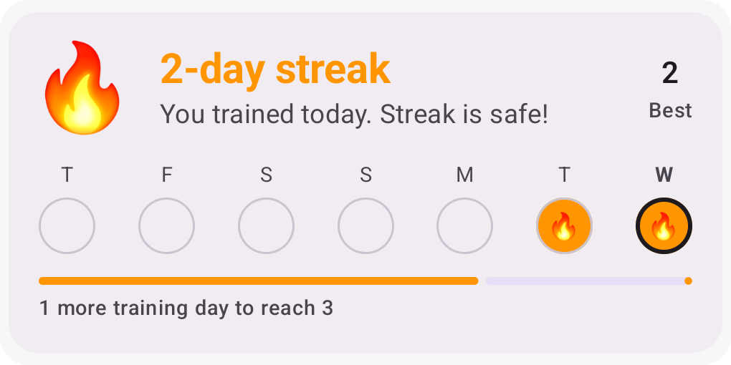




FEATURE · MELVIN SANARE
Streak tracking
Training day
Any day with 1+ workout. Two sessions on one day still count as 1 day.
Rest day
One missed day keeps the streak alive, since rest is part of training.
Reset
Two missed days in a row reset the streak. The best streak is kept.
After a workout: “Streak started!” · “Streak continued!” · “New personal best!” · “Milestone reached!”
Milestones
3, 7, 14, 30, 50, 100, and 365 days trigger a celebration.
Notes:
I built streak tracking on the Android phone. A training day is any day with at least one workout. Because this is a workout app, one missed day counts as a rest day and keeps the streak alive, but two missed days in a row reset it, and the best streak is always kept. The dashboard shows the streak, the best streak, a 7-day calendar, and progress toward the next milestone. After a workout, a popup celebrates a new streak, a continued streak, a new personal best, or a milestone. DEMO: Settings, Load Demo History, then finish a workout to hit the 7-day milestone.

Slide 6
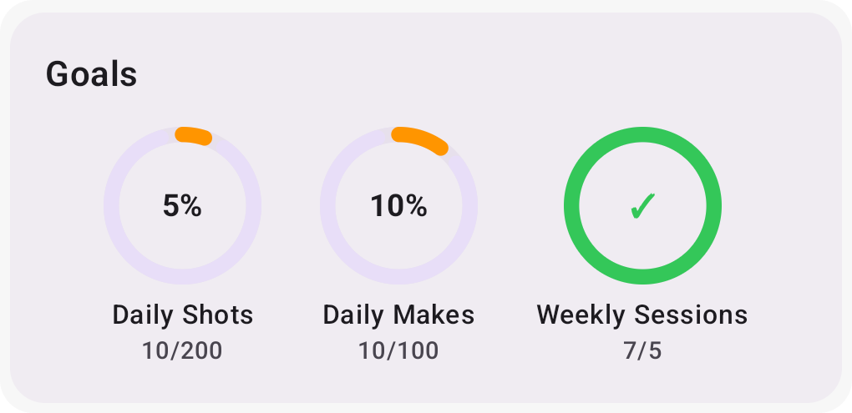
FEATURE · MELVIN SANARE & KALEB KEBEDE
Goal progress
200
100
Daily shots
Daily makes
5
75%
Weekly sessions
Today's FG% (10+ shots)
Animated progress rings turn green with a check when a goal is done
Goals are editable and saved on the phone
Trophy popup, once per goal per day (per week for sessions)
Defaults shown; players can change any target.
Notes:
Goal progress gives players daily and weekly targets: daily shots, daily makes, weekly sessions, and today's shooting percentage, which only counts after at least ten shots so one lucky make doesn't count. Progress shows as animated rings that turn green when the goal is done. Goals can be edited and are saved, and completing a goal shows a trophy popup once per day or week so it doesn't repeat after every workout. DEMO: edit a goal, finish a workout, show the rings and popup.

Slide 7
FEATURE · MELVIN SANARE
Gamification on the watch
Phone
Wear OS Data Layer
Watch
Calculates streak and goal progress
Syncs a stats snapshot + live popups
Shows streak, rings, and popups with a vibration
phone => data /squatch/stats {"currentStreak":2,"bestStreak":2,...}
watch <= data /squatch/stats {"currentStreak":2,"bestStreak":2,...}
watch -> phone /squatch/workout/shot 2
Every phone/watch message is logged under the SquatchComm tag in Logcat, which is our evidence that the Wear OS integration works end to end.
Notes:
Since the client suggested gamification fits the watch, I brought it to Wear OS. The phone calculates the streak and goals and syncs a snapshot to the watch through the Wear OS Data Layer, so the watch shows your streak and goal rings as soon as it opens. When the phone celebrates, the watch shows the same popup and vibrates. Every message between phone and watch is logged, which you can see here in Logcat. DEMO: show the watch home screen and the Logcat filter.

Slide 8
FEATURE · KALEB KEBEDE · iOS
XP and levels
+25
+1
+2
+15
per completed workout
per make
bonus per swish
for 75%+ shooting
Level up every 100 XP
Player Progress card on the Dashboard
“Workout Complete!” and “Level Up!” alerts after each workout
XP updates automatically from saved workouts
Level 1 · 45 / 100 XP · 55 XP to Level 2
Example: 5 swishes in Free Throws = 25 + 5 + 10 + 15 = 55 XP
Notes:
Kaleb built an XP and leveling system on iOS. Players earn 25 XP for completing a workout, 1 XP per make, 2 bonus XP per swish, and 15 bonus XP for shooting 75% or better. Every 100 XP is a new level. The dashboard shows a Player Progress card, and after each workout an alert shows the XP earned or a Level Up message. The goal is to make finishing every workout feel rewarding and give players something to keep progressing toward.

Slide 9
TESTING & VALIDATION
Verified with known data and real devices
36 / 36
unit tests passing
53% → 0%
Full workouts: shots swiped on the watch match the phone's counts
Changed the phone's date: next day, rest day, and two missed days
Edited and completed goals; the popup appears once per period
idle CPU after fixing the flame animation
Notes:
We have 36 automated unit tests, all passing. The streak tests use known workout dates, and the goal tests compare expected versus calculated progress with known data. We also tested on paired phone and watch emulators, changing the phone's date to check the next day, a rest day, and two missed days. Testing also caught a real problem: an endless flame animation kept the app using over half a CPU core and made the emulators unresponsive. Limiting it to three pulses brought idle CPU to zero.

Slide 10
KANBAN & TEAM CONTRIBUTIONS
Work tracked on GitHub
# | Issue | Owner | Status
15 | Streak tracking | Melvin | Closed
16 | Goal progress | Melvin, Kaleb | Closed
17 | Android port (~90%) | Kellam | Closed
18 | Wear OS integration | Kellam, Melvin | Closed
22 | XP & levels (iOS) | Kaleb | Closed
19 | Apple Watch repeated-shot bug | Team | Sprint 5
20 | Android/Wear OS polish | Team | Sprint 5
Sprint 4 milestone, story-point labels, and acceptance criteria on every issue.
Notes:
All work is tracked on our GitHub board with a Sprint 4 milestone, story-point labels, and acceptance criteria on each issue. SHOW: the GitHub issues page filtered by the Sprint 4 milestone. Kellam completed the Android port and Wear OS integration, I completed streak tracking, goal progress, and the watch sync, and Kaleb completed goal progress and the iOS XP system. Two issues, the Apple Watch repeated-shot bug and Android polish, move to Sprint 5.

Slide 11
CLIENT MEETINGS
Two meetings with Squatch Sports this sprint
Sep 2
Semester kickoff
Sep 17
Client consultation
iOS work is live in the production app
New focus: Android + Wear OS, stats review, gamification
Use AI for the port; team builds selected features
Sprint 4–6 plan accepted
Duolingo-style ideas: streaks, goals, practice time
Bi-weekly demos over Microsoft Teams
“Hide the broccoli”
Make logging and reviewing workouts fun enough that players keep coming back.
Notes:
We met with Mike Niehl and Preston David from Squatch Sports twice this sprint. On September 2 they told us our iOS work is live in their production app and set the new direction: Android and Wear OS, a stats review, and gamification. On September 17 they accepted our Sprint 4 through 6 plan. Their guiding idea is 'hide the broccoli.' Minutes for both meetings are in our repository.

Slide 12




RESPONSIBLE USE OF AI
AI sped us up; testing kept us honest
How we used it
What it improved
AI converted the iOS app to Android (Kellam). Claude Code wrote the streak, goal, and watch-sync code and tests, and helped read device logs (Melvin).
We built the features quickly while learning Android for the first time, and got 36 automated tests using known dates and data.
Limitations we found
Verification & accountability
An AI-written animation passed every test but froze the emulators. AI also only follows the rules we give it, so we designed the streak rules ourselves.
Every feature was reviewed and tested on emulators. Final decisions and deliverables are the team's responsibility.
Notes:
As the client requested, we used AI heavily this sprint. Kellam used AI to convert the iOS app to Android, and I used Claude Code to write the streak, goal, and watch-sync code and unit tests, and to diagnose problems from device logs. It let us move fast while learning Android. But it has limits: an AI-written animation passed every test and still froze the emulators, which we only caught by testing on devices. AI also only follows the rules we give it, so the team designed the streak rules. Every feature was reviewed and tested by us, and all final decisions are the team's responsibility.

Slide 13

ACHIEVEMENTS & CHALLENGES
What we delivered and what we overcame
Android phone + Wear OS apps working end to end
Challenge | How we solved it
First time building for Android (and on Windows) | Set up Android Studio with paired phone and Wear OS emulators
Testing streaks across multiple days | Changed the emulator's date and added Load Demo History
Emulators stopped responding | Measured CPU, limited the animation, cold booted the emulator
Features built on different platforms | Shared rules and one GitHub board for the whole team
Streaks and goals on the phone and watch
XP and levels on iOS
36 passing unit tests
GitHub milestones, issues, and story points
From Sprint 3: saving data and recovery were our open items. The Android app saves workouts on the phone, and the watch keeps the last stats sync.
Notes:
Our main achievements: the Android phone and Wear OS apps work end to end, streaks and goals run on the phone and watch, XP and levels run on iOS, 36 unit tests pass, and our GitHub board shows everyone's work. Challenges: none of us had built for Android before, so we had to set up Android Studio and paired emulators; testing streaks across days required changing the emulator's date; and the emulators became unresponsive until we found and fixed the animation. Compared to Sprint 3, the data-saving and recovery items we left open are now handled on Android.

Slide 14
NEXT STEPS & RETROSPECTIVE
Sprint 5: October 1 – 31
1
Finish Android and Wear OS polish and disconnect handling (#20)
Went well
2
Fix the Apple Watch repeated-shot bug (#19)
Port came together quickly
Every member shipped a feature
Known-date tests gave confidence
3
Improve stats and charts; add practice-time tracking
4
Refine gamification across platforms from client feedback
To improve
Agree on platforms earlier
Test on devices sooner
Commit in smaller pieces
5
Integration and defect testing
Client feedback applied: gamification built around “hide the broccoli,” and AI used for the port as requested.
Notes:
In Sprint 5 we'll finish the Android and Wear OS polish and disconnect handling, fix the Apple Watch repeated-shot bug, improve stats and charts and add practice-time tracking, refine gamification based on client feedback, and run integration and defect testing. Looking back, the port came together quickly and every member shipped a feature. Next time we want to agree on platforms earlier, test on devices sooner, and commit in smaller pieces. Based on client feedback, we built gamification around 'hide the broccoli' and used AI for the port as they asked.

Slide 15
Thank you
Squatch Sports now runs on Android phones and Wear OS watches
Streaks, goals, and XP make every workout feel rewarding
Sprint 5: finish the port, improve stats, refine gamification
Thanks to Mike Niehl and Preston David at Squatch Sports. Questions and feedback are welcome.
github.com/KellamA/Squatch-Sports-Team-11-Capstone-Project
Notes:
To wrap up: Squatch Sports now runs on Android phones and Wear OS watches, and streaks, goals, and XP make every workout feel more rewarding. Next sprint we'll finish the port, improve stats, and refine gamification. Thank you to Mike and Preston at Squatch Sports for their guidance, and thank you for watching. We welcome any questions or feedback.

