Slide 1


CPTS 423 · TEAM 11
Sprint 5 Review
Train. Track. Compete.
Kellam Adams · Melvin Sanare · Kaleb Kebede
October 1–31, 2026
Notes:
Presenter: Kellam
Target narration: ~45 seconds (plus any live demo)
We are Team 11: Kellam, Melvin and Kaleb. Squatch Sports helps basketball players choose drills on a phone, log makes, misses and swishes on a watch, and review their progress. The client calls the motivation goal “hide the broccoli”: make useful training habits enjoyable. Sprint 5 adds friendly 1v1 competition and aligns the major features across Apple and Android. Melvin handled parity and the iPhone/Apple Watch foundation, Kaleb built nearby iPhone games, and Kellam ported the feature to Android and Wear OS.
Sources / evidence:
https://github.com/KellamA/Squatch-Sports-Team-11-Capstone-Project/blob/melvin-sprint5-docs/Sprints/Sprint_5/Sprint_Report/Sprint5_Report.md

Slide 2
OBJECTIVES
Same goals. Both platforms.
01
Gamification parity
02
Phone + watch 1v1
Streaks, goals, XP and celebrations.
Rules, scorekeeping and saved records.
Melvin
MERGED
Melvin
MERGED
03
Nearby iPhone play
04
Android + Wear OS
One shared match on two phones.
Bring the 1v1 experience to Android.
Kaleb
COMPLETE
Kellam
MERGED
SQUATCH SPORTS · TEAM 11
02
Notes:
Presenter: Kellam
Target narration: ~35 seconds (plus any live demo)
Our goals were gamification parity, phone/watch 1v1, nearby competition and the Android/Wear OS port. The Android work is merged into main through PR 38 and issue 32 is closed. Kaleb’s nearby iPhone feature is considered tested and complete based on Kellam’s team confirmation. These are completed implementation goals; Android Nearby hardware acceptance and client rollout remain separate next steps. The two ecosystems still do not play one mixed Android–iPhone match.
Sources / evidence:
https://github.com/KellamA/Squatch-Sports-Team-11-Capstone-Project/blob/melvin-sprint5-docs/Sprints/Sprint_5/Sprint_Report/Sprint5_Report.md
https://github.com/KellamA/Squatch-Sports-Team-11-Capstone-Project/pull/38
https://github.com/KellamA/Squatch-Sports-Team-11-Capstone-Project/issues/32

Slide 3
FEATURES/DEMO · MELVIN
1v1 match mode
Choose your street rules
RED
BLUE
Track points and possession
8
6
Undo, resume and save
Illustrative scoreboard
Friends · History · Win/loss records
SQUATCH SPORTS · TEAM 11
03
Notes:
Presenter: Melvin
Target narration: ~55 seconds (plus any live demo)
The iPhone 1v1 mode lets users add friends, select Red or Blue, choose 1s/2s or 2s/3s, target score, win by two, make-it-take-it and first possession. It tracks baskets, fouls, turnovers, steals and ball possession. A match is an event log, so replay computes the state and undo removes the last event. A paused match survives closing the app; a saved finished match updates overall and head-to-head records. Possession-based restrictions on which player may log actions are planned in issue 25. The visual is a diagram, not an iOS device screenshot.
Demo cue: Show setup, log a basket and foul, undo, then finish/save a short game.
Sources / evidence:
https://github.com/KellamA/Squatch-Sports-Team-11-Capstone-Project/pull/24
https://github.com/KellamA/Squatch-Sports-Team-11-Capstone-Project/issues/28
https://github.com/KellamA/Squatch-Sports-Team-11-Capstone-Project/issues/25

Slide 4
FEATURES/DEMO · MELVIN
Progress on the phone. Plays on the wrist.
Streaks
Goals
XP + levels
Build a training habit
See progress at a glance
Reward every workout
Plays →
WATCH
PHONE
← Scores
Score · Miss · Foul · Turnover · Undo · Save
SQUATCH SPORTS · TEAM 11
04
Notes:
Presenter: Melvin
Target narration: ~50 seconds (plus any live demo)
Gamification was split by platform in Sprint 4: Android had streaks/goals and iOS had XP. Sprint 5 brings the same major gamification rules and celebrations to both platforms. The watch has big scoring buttons, your/opponent pages, Miss, Foul, Turnover, Undo and Save. The phone applies the official rules and sends back the scoreboard. Apple Watch requests the active game on open or reconnect, fixing the waiting-screen issue found in simulator testing. Steals remain phone-only. Apple Watch workout-driven keep-alive is Sprint 6 work assigned to Kellam in this presentation.
Demo cue: Show the paired Apple Watch score, log a play and show the phone update; briefly show the gamification progress.
Sources / evidence:
https://github.com/KellamA/Squatch-Sports-Team-11-Capstone-Project/issues/27
https://github.com/KellamA/Squatch-Sports-Team-11-Capstone-Project/issues/29
https://github.com/KellamA/Squatch-Sports-Team-11-Capstone-Project/issues/36
https://github.com/KellamA/Squatch-Sports-Team-11-Capstone-Project/blob/melvin-sprint5-docs/Sprints/Sprint_5/Sprint_Report/Sprint5_Report.md

Slide 5
FEATURES/DEMO · KALEB
One match. Two iPhones.
YOUR PHONE
OPPONENT
↔
Same match
Your own side
Same match
Your own side
Discover → Connect → Play
Tested and complete
SQUATCH SPORTS · TEAM 11
05
Notes:
Presenter: Kaleb
Target narration: ~55 seconds (plus any live demo)
Nearby iPhone play uses Apple MultipeerConnectivity. Both phones share a match ID and settings, but use opposite local player sides. Scoring, fouls, turnovers, steals, possession, undo, finish and cancel sync without echoing remote events. Each phone continues updating its own paired Apple Watch. The feature is tested and complete per Kellam’s current team confirmation; this is not a new assistant-run iOS test session. Follow-up ticket 31 is still open on GitHub and needs board reconciliation separately from the confirmed feature status. No new Swift test counts or latency measurements are claimed.
Demo cue: Use Kaleb’s team-tested nearby iPhone demonstration: connect, start, log plays on both phones and show paired-watch updates.
Sources / evidence:
https://github.com/KellamA/Squatch-Sports-Team-11-Capstone-Project/pull/26
https://github.com/KellamA/Squatch-Sports-Team-11-Capstone-Project/issues/30
https://github.com/KellamA/Squatch-Sports-Team-11-Capstone-Project/issues/31
https://github.com/KellamA/Squatch-Sports-Team-11-Capstone-Project/blob/melvin-sprint5-docs/Sprints/Sprint_5/Sprint_Report/Sprint5_Report.md

Slide 6
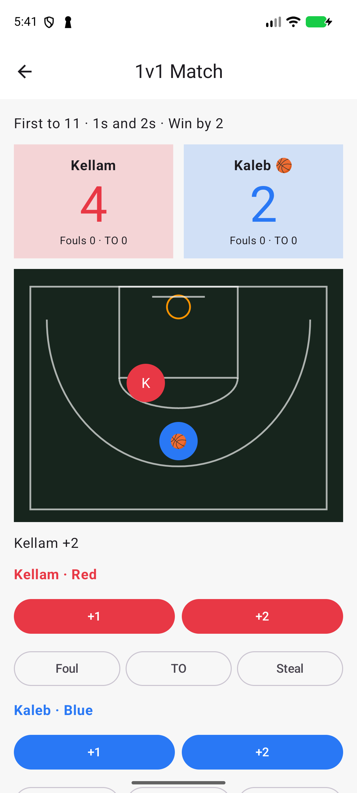
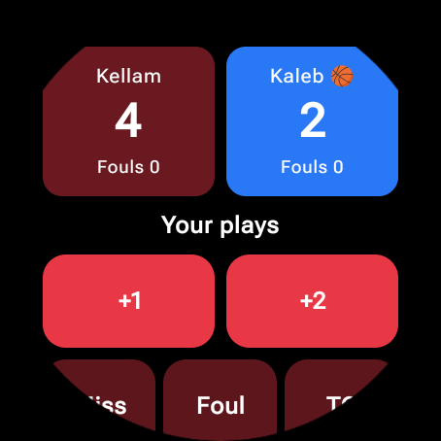
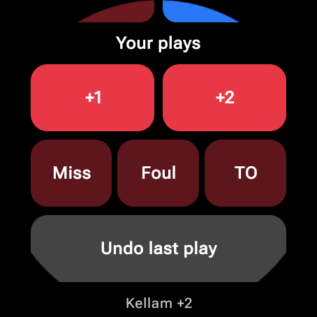
FEATURES/DEMO · KELLAM
Android + Wear OS
Phone and watch scorekeeping
Saved matches and records
Nearby Android-to-Android play
MERGED
Scroll for more controls
SQUATCH SPORTS · TEAM 11
06
Notes:
Presenter: Kellam
Target narration: ~65 seconds (plus any live demo)
The Android/Wear OS port is merged in PR 38 and issue 32 is closed. Shared Kotlin code contains the rules, persistence, records and event replay, while Compose supplies friends/setup/court and watch controls. Wear OS commands are saved before sending, and persisted IDs prevent duplicate scoring. Nearby Android play uses encrypted Google Nearby Connections with code confirmation on both phones. The connecting phone hosts; guest phone/watch commands queue until the host acknowledges them. Tests cover duplicate/dropped replies, stale snapshots, reconnects and restarts. The screenshots are genuine current emulator captures of a temporary 4–2 fixture, later discarded without saving a record. The round watch is scrollable; not all controls fit at once. Android Nearby radio validation on physical phones remains pending. There is no Android-to-iPhone interoperability.
Demo cue: Phone: Dashboard → 1v1 → Add Friend → Play → Start. Watch +2; phone opponent +2; watch +2 then Undo; finish/save a short game. Briefly show Nearby Players and its permission/code-confirmation flow. Allow 75–90 seconds for the live segment.
Sources / evidence:
https://github.com/KellamA/Squatch-Sports-Team-11-Capstone-Project/pull/38
https://github.com/KellamA/Squatch-Sports-Team-11-Capstone-Project/issues/32
android/README.md
Sprints/Sprint_5/Testing/Android_Verification.md

Slide 7
DEPLOYMENT & TESTING
Built. Tested. Ready for device rollout.
121 / 121
13 / 13
2
Unit tests
Emulator UI checks
Debug APKs
Paired-emulator scoring and Undo verified.
Next: Android Nearby hardware checks + client distribution.
SQUATCH SPORTS · TEAM 11
07
Notes:
Presenter: Kellam
Target narration: ~55 seconds (plus any live demo)
The requested Gradle command, ./gradlew :app:assembleDebug :wear:assembleDebug testDebugUnitTest, passed on merged Android code and was repeated with --rerun-tasks for fresh execution. JUnit XML reports 121 passing JVM tests with no failures/errors. The last clean UI run had nine phone and four Wear OS tests passing; its actual timestamps are retained. Both debug APKs were produced. In the actual paired emulator apps, watch-to-phone scoring, phone-to-watch scoring, watch Undo and cancellation/clearing also worked. These results do not prove physical Android Nearby radio behavior or real-device latency. Client distribution/accounts and collected player feedback remain follow-ups. Kaleb’s iPhone status is team-confirmed rather than derived from these Android results. The report-ready screenshot and raw logs are linked in the notes.
Sources / evidence:
Sprints/Sprint_5/Testing/Android_Test_Results.png
Sprints/Sprint_5/Testing/Android_Build_Test_Results.txt
Sprints/Sprint_5/Testing/Android_Test_Results.json
https://github.com/KellamA/Squatch-Sports-Team-11-Capstone-Project/issues/33
https://github.com/KellamA/Squatch-Sports-Team-11-Capstone-Project/issues/34

Slide 8
KANBAN
Delivered this sprint
Issue | Feature | Owner
#27 | Gamification parity | Melvin
#28 | iPhone 1v1 | Melvin
#29 | Apple Watch scoring | Melvin
#30 | Nearby iPhone play | Kaleb
#32 | Android / Wear OS port | Kellam
SQUATCH SPORTS · TEAM 11
08
Notes:
Presenter: Melvin
Target narration: ~35 seconds (plus any live demo)
All five listed implementation tickets are closed. Melvin owns the parity, iPhone 1v1 and Apple Watch implementation work: 5 + 8 + 5 story points. Kaleb’s nearby implementation is five points and is tested/complete per team confirmation. Kellam’s Android port is eight points, merged through PR 38 which closed issue 32. Pull request IDs and full acceptance details stay in these notes instead of cluttering the table.
Sources / evidence:
https://github.com/KellamA/Squatch-Sports-Team-11-Capstone-Project/issues/27
https://github.com/KellamA/Squatch-Sports-Team-11-Capstone-Project/issues/28
https://github.com/KellamA/Squatch-Sports-Team-11-Capstone-Project/issues/29
https://github.com/KellamA/Squatch-Sports-Team-11-Capstone-Project/issues/30
https://github.com/KellamA/Squatch-Sports-Team-11-Capstone-Project/issues/32

Slide 9
KANBAN
Sprint 5 closeout
Issue | Remaining item | Owner
#31 | Reconcile nearby follow-up ticket | Kaleb
#33 | System, integration + user testing | Team
#34 | Real devices + TestFlight / Play testing | Team
#35 | Report, MoMs, slides + demo video | Melvin / team
Kaleb’s feature is complete; #31 is board reconciliation.
SQUATCH SPORTS · TEAM 11
09
Notes:
Presenter: Melvin
Target narration: ~35 seconds (plus any live demo)
These Sprint 5 closeout items remain visible rather than being hidden in the notes. Issue 33 covers system/integration checks, latency and user feedback. Issue 34 covers physical devices and client TestFlight/Play internal testing. Issue 35 includes the report, meeting minutes, slides and actual recorded demo/video link; the presentation does not imply the video has been uploaded. Kaleb’s nearby feature is considered tested and complete per Kellam’s confirmation. The existing GitHub ticket 31 is still open, so its remaining presentation item is reconciling the board with that confirmed completion, not claiming the feature is untested.
Sources / evidence:
https://github.com/KellamA/Squatch-Sports-Team-11-Capstone-Project/issues/31
https://github.com/KellamA/Squatch-Sports-Team-11-Capstone-Project/issues/33
https://github.com/KellamA/Squatch-Sports-Team-11-Capstone-Project/issues/34
https://github.com/KellamA/Squatch-Sports-Team-11-Capstone-Project/issues/35

Slide 10
KANBAN
Sprint 6 ownership
Issue | Next task | Owner
#25 | Player / possession rules | Kaleb
#36 | Apple Watch keep-alive | Kellam
#37 | Remove duplicate iCloud files | Kellam
#19 | Fix repeated-shot bug on Apple Watch | Team
Also tracked: Android / Wear OS UI and regression polish (#20).
SQUATCH SPORTS · TEAM 11
10
Notes:
Presenter: Melvin
Target narration: ~35 seconds (plus any live demo)
The upcoming work stays visible: player/possession restrictions, Apple Watch workout keep-alive, duplicate-file cleanup and the older repeated-shot bug. Kellam owns issues 36 and 37 in this presentation as requested; the slide edit does not change GitHub assignee fields. Android/Wear OS UI, regression polish and the remaining edge cases also stay tracked under issue 20. The full Sprint 5 closeout work is on the previous slide so the backlog can be read without dense text or hiding tasks in the notes.
Sources / evidence:
https://github.com/KellamA/Squatch-Sports-Team-11-Capstone-Project/issues/25
https://github.com/KellamA/Squatch-Sports-Team-11-Capstone-Project/issues/36
https://github.com/KellamA/Squatch-Sports-Team-11-Capstone-Project/issues/37
https://github.com/KellamA/Squatch-Sports-Team-11-Capstone-Project/issues/19
https://github.com/KellamA/Squatch-Sports-Team-11-Capstone-Project/issues/20

Slide 11
CLIENT MEETINGS
Feedback shaped the feature
SEPTEMBER 30
OCTOBER 14
Align the platforms
Make it watch-first
Gamification parity + a new 1v1 mode.
Keep the court. Let each player use a phone.
October 28 meeting cancelled.
SQUATCH SPORTS · TEAM 11
11
Notes:
Presenter: Kaleb
Target narration: ~35 seconds (plus any live demo)
The September 30 Sprint 4 demo/planning meeting set parity and 1v1 as the next goals, with Apple implementation first and Android/Wear OS porting afterward. The October 14 review emphasized wrist input, preserving the existing court, and letting each player use their own phone. Online accounts were left for later. October 28 was cancelled and is not counted as a held meeting. Melvin’s documentation branch contains both minutes.
Sources / evidence:
https://github.com/KellamA/Squatch-Sports-Team-11-Capstone-Project/blob/melvin-sprint5-docs/Sprints/Sprint_5/MoM/MoM_2026-09-30.md
https://github.com/KellamA/Squatch-Sports-Team-11-Capstone-Project/blob/melvin-sprint5-docs/Sprints/Sprint_5/MoM/MoM_2026-10-14.md

Slide 12
REPORT
Documentation for handoff
Report
Meeting minutes
Test evidence
Features + team contributions
Decisions + action items
Results + logs + screenshots
Next: recording + unlisted video link.
SQUATCH SPORTS · TEAM 11
12
Notes:
Presenter: Kaleb
Target narration: ~30 seconds (plus any live demo)
The report and meeting minutes were sourced from Melvin’s documentation branch, commit 86171e9. That draft predates the Android merge and latest team confirmation, so reconcile its old pending/local-only wording before submission. The Android verification package includes the screenshot, actual Gradle logs, JSON summaries and APK hashes. The presentation and speaker scripts are ready. The recording and actual unlisted video URL still need to be produced; no course submission, upload or client release is being claimed.
Sources / evidence:
https://github.com/KellamA/Squatch-Sports-Team-11-Capstone-Project/blob/melvin-sprint5-docs/Sprints/Sprint_5/Sprint_Report/Sprint5_Report.md
https://github.com/KellamA/Squatch-Sports-Team-11-Capstone-Project/tree/melvin-sprint5-docs/Sprints/Sprint_5/MoM
Sprints/Sprint_5/Testing/Android_Verification.md
https://github.com/KellamA/Squatch-Sports-Team-11-Capstone-Project/issues/35

Slide 13
AI
AI accelerated. The team verified.
01
02
03
Build faster
Review carefully
Verify results
Porting, tests and debugging
Rules, code and UX decisions
Automated checks + device tests
Final decisions and deliverables remain our responsibility.
SQUATCH SPORTS · TEAM 11
13
Notes:
Presenter: Melvin
Target narration: ~45 seconds (plus any live demo)
AI coding tools accelerated Swift-to-Kotlin porting, feature implementation, tests and diagnosis of emulator/toolchain issues. AI also helped organize this deck and the evidence package. Humans chose the gameplay rules, team split, watch UX and acceptance standards. A build or generated test alone cannot prove real-device radio behavior; the team reviews code and tests it in context. Kaleb’s iPhone testing is team-provided confirmation, distinct from the Android tests reproduced here. We remain responsible for the result and for completing the outstanding hardware and release checks.
Sources / evidence:
https://github.com/KellamA/Squatch-Sports-Team-11-Capstone-Project/blob/melvin-sprint5-docs/Sprints/Sprint_5/Sprint_Report/Sprint5_Report.md
Sprints/Sprint_5/Testing/Android_Verification.md

Slide 14
ACHIEVEMENTS & CHALLENGES
What we delivered. What we learned.
Delivered
Learned
Aligned major features
Order plays in one place
Phone + watch 1v1
Design for round screens
Nearby competition
Test on hardware earlier
SQUATCH SPORTS · TEAM 11
14
Notes:
Presenter: Team
Target narration: ~45 seconds (plus any live demo)
The achievement is a full path from training and rewards into phone/watch 1v1 and nearby competition within each platform. Ordering guest commands at one host, saving IDs and replaying event logs handle duplicate and delayed plays. The Android SDK mismatch was solved by pinning a Nearby release compatible with the project’s Kotlin compiler rather than bypassing checks. Round watches require large controls plus scrolling/paging; we are not claiming that every screen is validated on every device. Kaleb’s feature is complete per team confirmation. Android physical Nearby checks, latency, client distribution and collected user feedback remain the key unfinished acceptance work.
Sources / evidence:
https://github.com/KellamA/Squatch-Sports-Team-11-Capstone-Project/blob/melvin-sprint5-docs/Sprints/Sprint_5/Sprint_Report/Sprint5_Report.md
android/README.md
android/gradle/libs.versions.toml

Slide 15
NEXT STEPS
Validate. Refine. Hand off.
01
Validate Android Nearby on hardware
02
Collect player feedback
03
Prepare client testing + final handoff
SQUATCH SPORTS · TEAM 11
15
Notes:
Presenter: Kellam
Target narration: ~40 seconds (plus any live demo)
The implementation is already merged, so the next work is acceptance and handoff rather than another Android publishing task. Test Android Nearby with two real phones and paired watches, record latency/reconnect behavior, collect actual player feedback and coordinate TestFlight/Play internal distribution with the client. Rehearse and record this sprint review, add the unlisted link and reconcile the report. Sprint 6 ownership is shown in the Kanban slide: Kaleb handles possession restrictions, and Kellam handles Apple Watch keep-alive plus repository cleanup. Mixed Android–iPhone games require a shared transport or backend and are not delivered here.
Sources / evidence:
https://github.com/KellamA/Squatch-Sports-Team-11-Capstone-Project/issues/33
https://github.com/KellamA/Squatch-Sports-Team-11-Capstone-Project/issues/34
https://github.com/KellamA/Squatch-Sports-Team-11-Capstone-Project/issues/35
https://github.com/KellamA/Squatch-Sports-Team-11-Capstone-Project/issues/25
https://github.com/KellamA/Squatch-Sports-Team-11-Capstone-Project/issues/36
https://github.com/KellamA/Squatch-Sports-Team-11-Capstone-Project/issues/37

Slide 16
Thank you
More ways to train.
More reasons to return.
Mike Niehl · Preston David
Squatch Sports
Notes:
Presenter: Kellam
Target narration: ~20 seconds (plus any live demo)
Sprint 5 aligns the major feature set, adds 1v1 on phones and watches, and enables nearby games within each platform ecosystem. The Android port is merged; Kaleb’s nearby feature is tested and complete per team confirmation. Android hardware acceptance and client rollout are next. Thank you to Mike and Preston at Squatch Sports. We welcome questions and feedback.
Sources / evidence:
https://github.com/KellamA/Squatch-Sports-Team-11-Capstone-Project/blob/melvin-sprint5-docs/Sprints/Sprint_5/Sprint_Report/Sprint5_Report.md
https://github.com/KellamA/Squatch-Sports-Team-11-Capstone-Project

