Slide 1
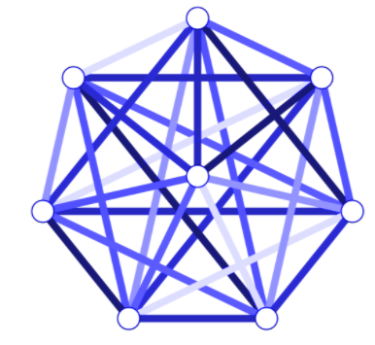
Clik CSCI6600 Database Project
Team Members: Kelle Clark Gregory Sutton

Slide 2
Project Presentation Overview
Project Idea
Project Objectives
Project Database Design
Demo Project Database
Demo Project Application
Application Design
Technologies and Tools

Slide 3
Clik Social Networking
Why we developed Clik
To promote physical interaction
To focus on real/deep connections
To reduce curated content
We believed we could bring people together better off screen

Slide 4
Project Objectives
Set reasonable goals for our project.
Develop a baseline we could build on in the future.
Develop a database backend to capture information about people, events and the relationships between each entity.
Develop a web front end that focused on the micro.

Slide 5
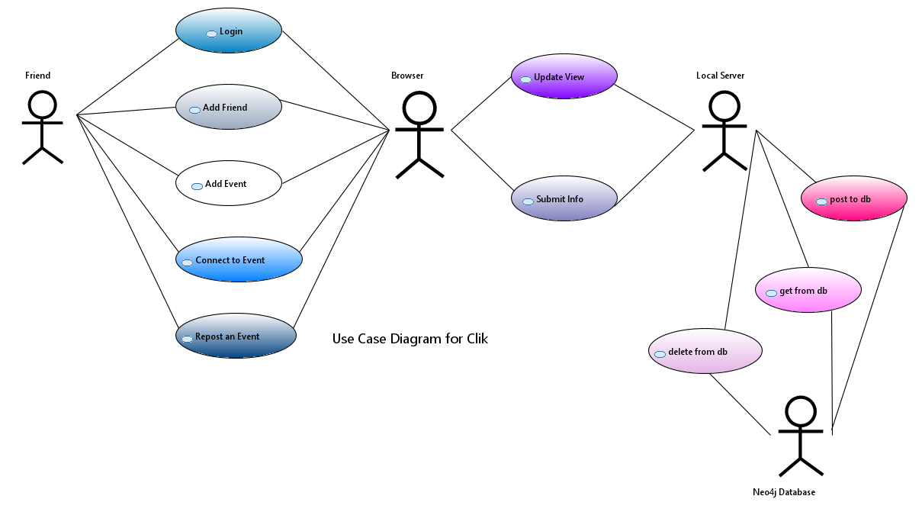
Clik Project Design
Functional and NonFunctional Requirements
Use Cases
Flows

Slide 6
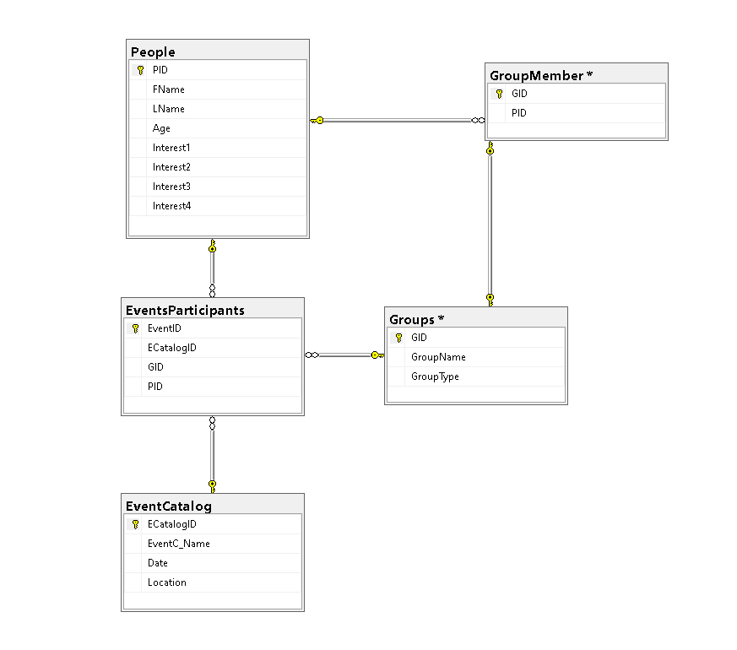


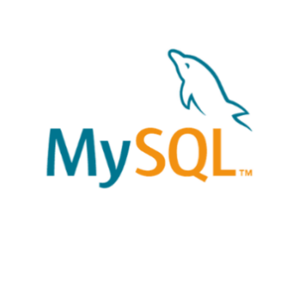
Project Design Overview
Project Design – Consider Database Choices
Would a RDMS work?
Too rigid
Too bulky
Didn’t seem like the best fit

Slide 7
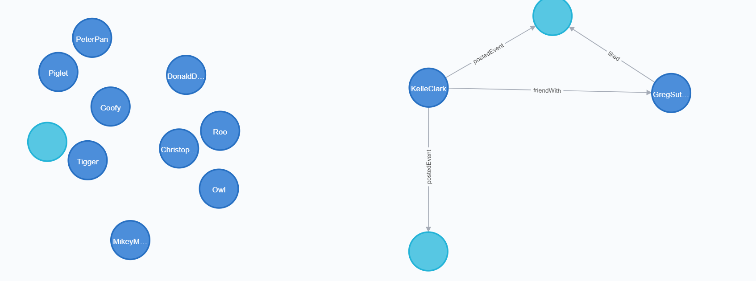
Project Design – Graphical Database

Slide 8

Clik’s design heritage
Quickstart Flask tutorial Social Media example….
https://neo4j.com/blog/building-python-web-application-using-flask-neo4j/
Nicole White redid using Flask, Neo4j and Py2Neo driver
Building Social Recommendations into a Python web app using Neo4j
Josh Thurston focused on security for registration Flask User Auth with Neo4j. I’ve been working on a Flask App… | by Josh-T | The Startup | Medium
Neovis a Neo4j driver added to the mix
neo4j-contrib/neovis.js: Neo4j + vis.js = neovis.js. Graph visualizations in the browser with data from Neo4j. (github.com)

Slide 9






Clik’s Design: Tools and Technology

Slide 10
Demo of Clik

Slide 11
References
Neovis: https://github.com/neo4j-contrib/neovis.js/
https://neo4j.com/blog/building-python-web-application-using-flask-neo4j/
Building Social Recommendations into a Python web app using Neo4j
Flask User Auth with Neo4j. I’ve been working on a Flask App… | by Josh-T | The Startup | Medium

