Slide 1
Data Presentation: H-1B Data Trends and H-1B Employer Data Hub
Michael Hoefer, Chief
Office of Performance and Quality
APRIL 18, 2019

Slide 2
H-1B PETITIONS APPROVED
The increase in H-1B petitions is due to the increase in approved continuing employment petitions, including amended petitions (SIMEIO).

Slide 3
H-1B COMPENSATION
Median annual compensation is higher for continuing employment.
Slight annual increases in median compensation for both initial and continuing employment.

Slide 4
H-1B Requests for Evidence (RFEs)
Percent of completions with RFE has increased and RFE data are cyclical.
Approvals of completed applications with an RFE have declined.

Slide 5
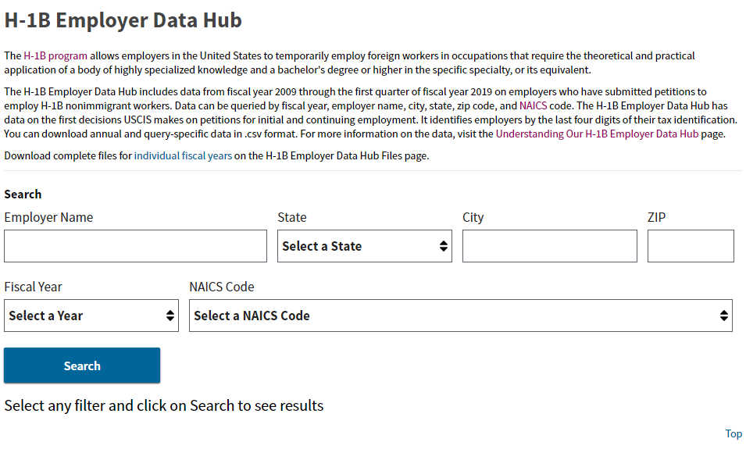

H-1B EMPLOYER DATA HUB
Distinguish between New/Initial Employment and Continuing Employment
Calculate Approval and Denial Rates
Download Individual Fiscal Years, FY 2009 – Q1 FY 2019
Search by Employer Name, State, City, ZIP, and NAICS
What can you do?

Slide 6
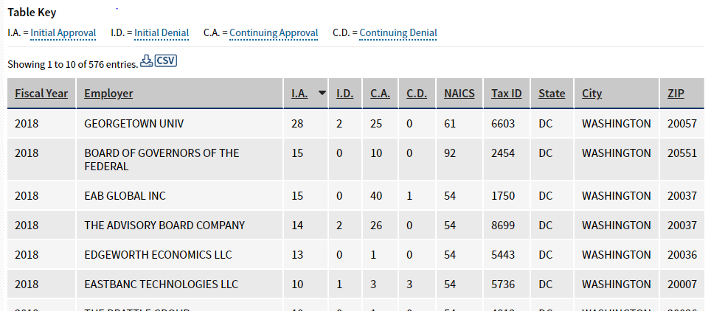
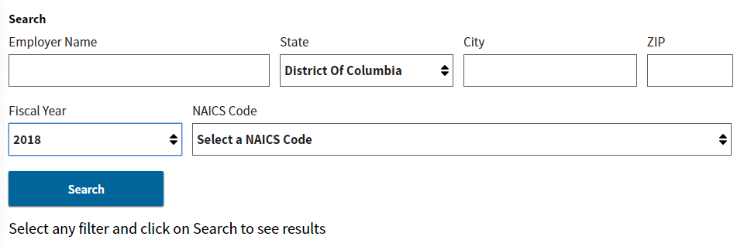
H-1B DATA HUB EXAMPLE
Notes:
Selected STATE – “DC”
Selected Fiscal Year – “2018”
Sorted highest to lowest - “Initial Approvals”

