Slide 1
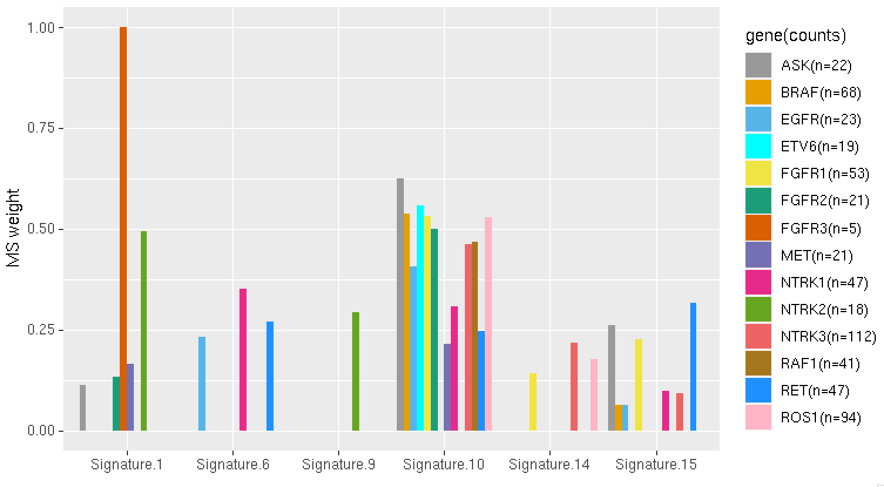
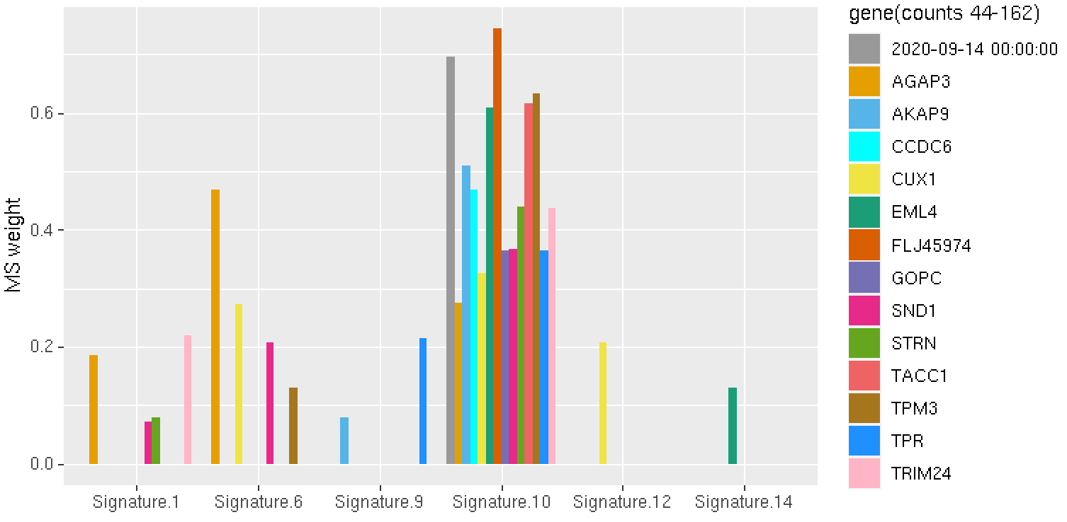
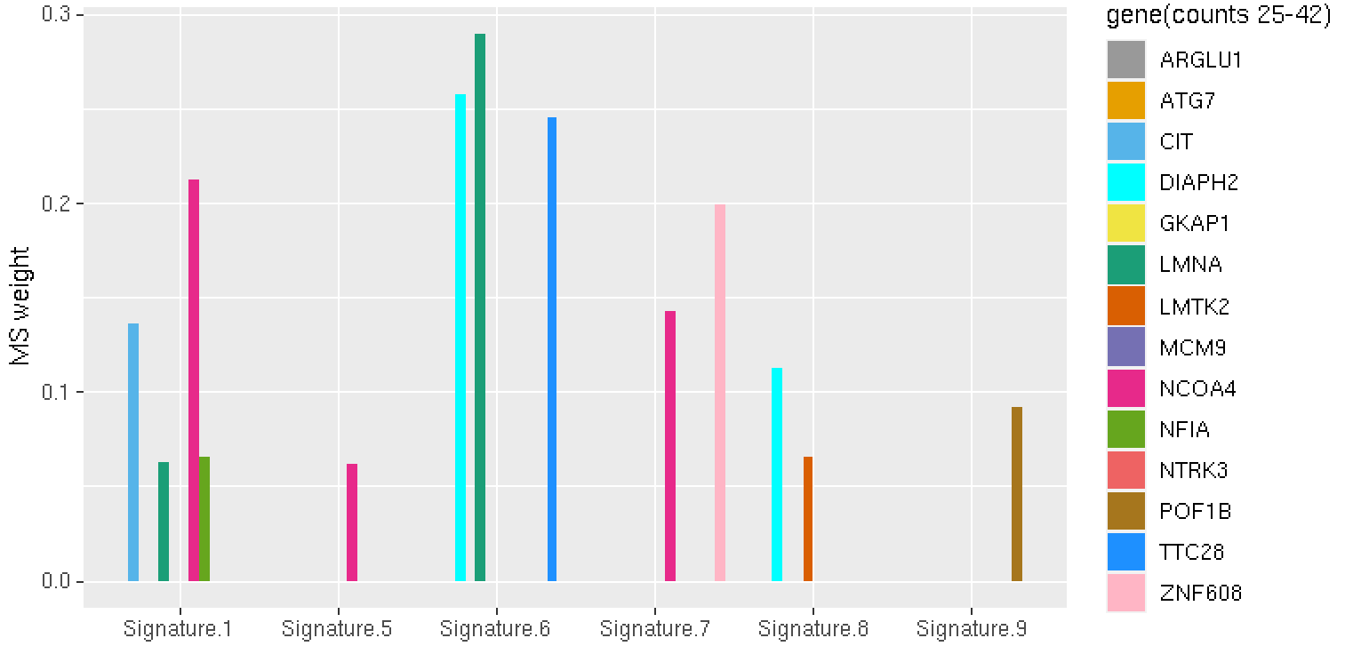
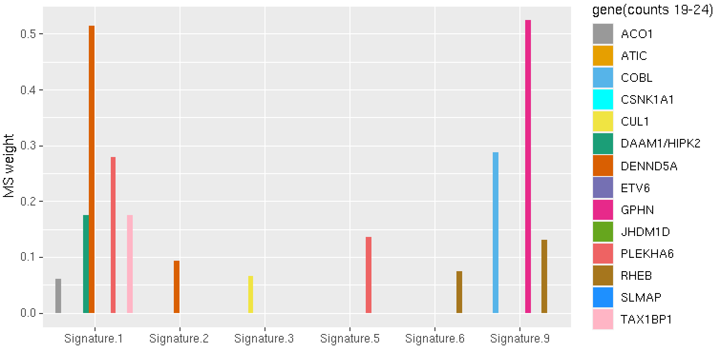
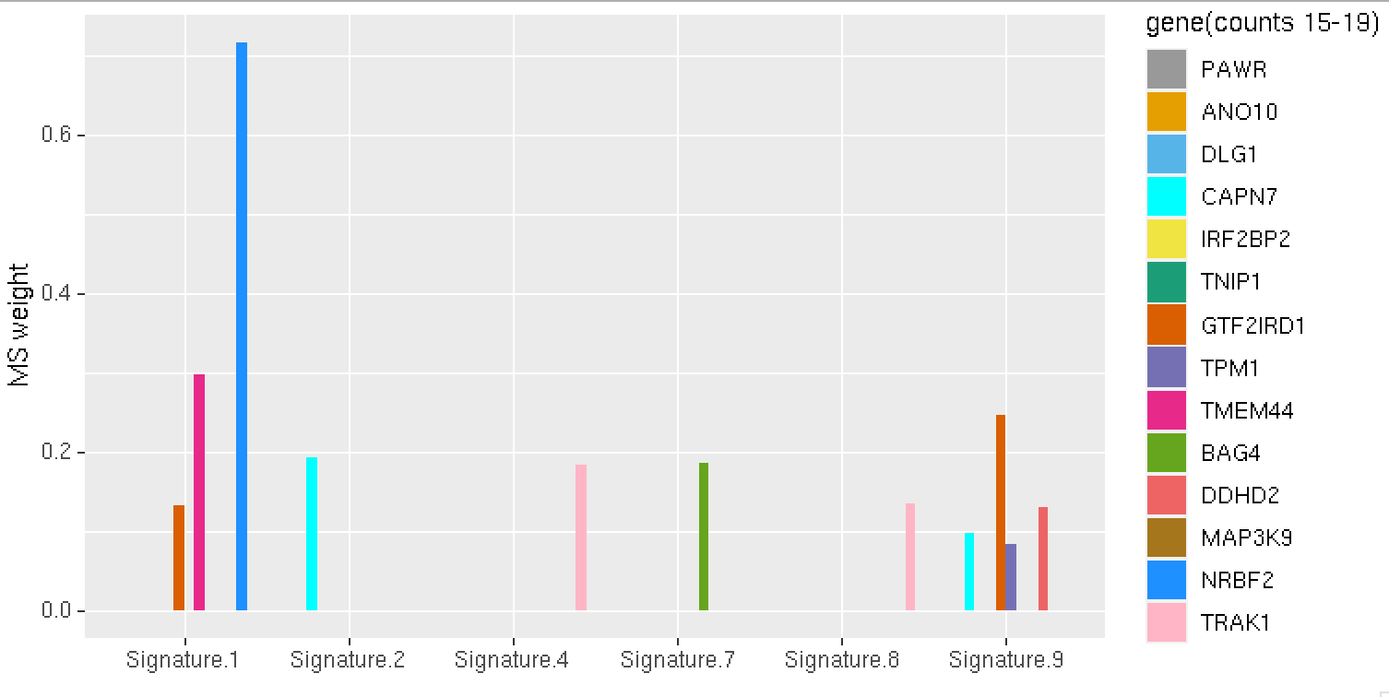
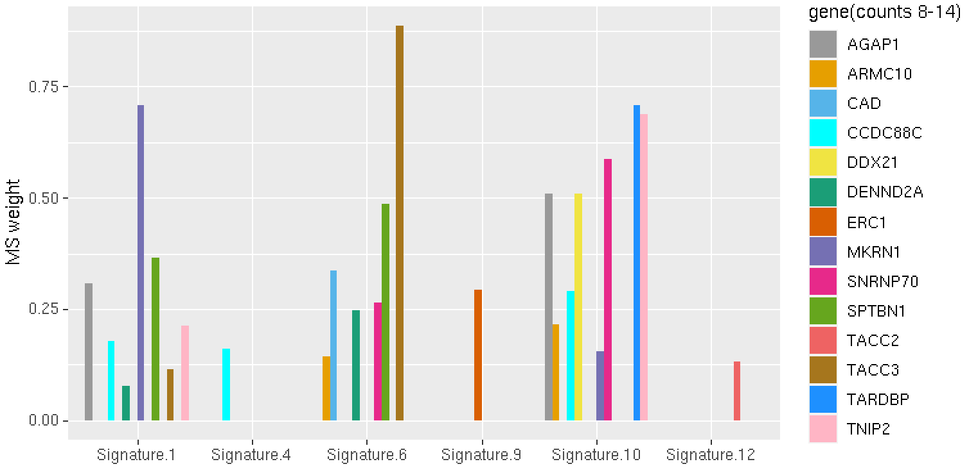

Slide 2
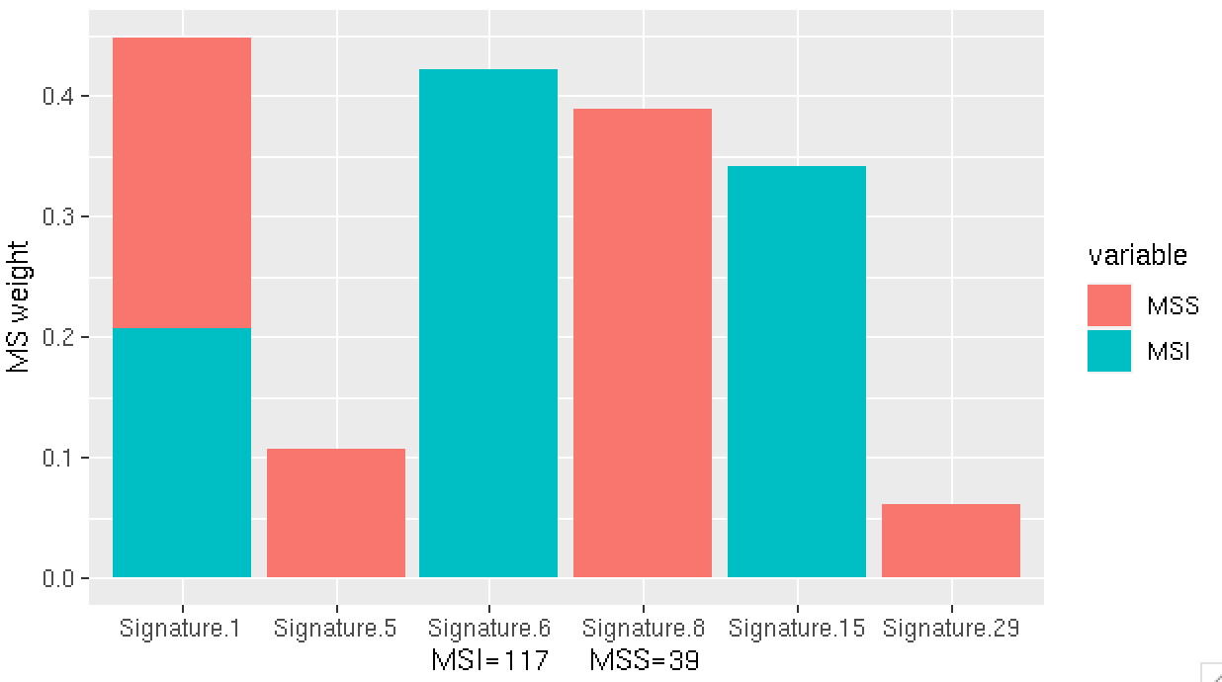
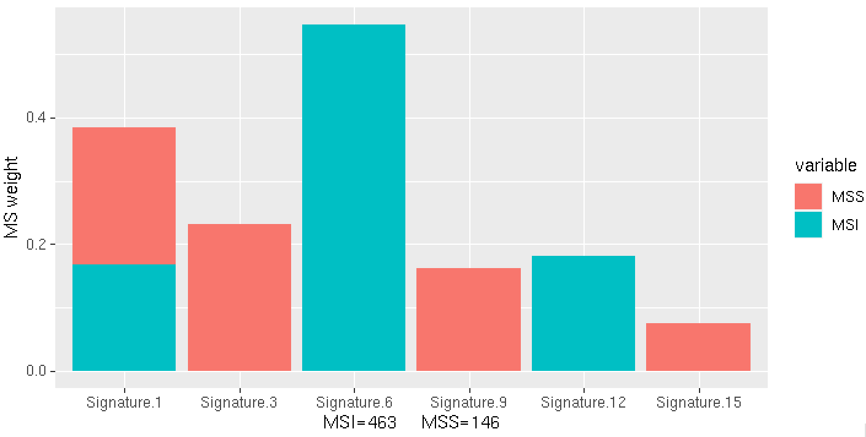
Junction1
Junction2

Slide 3
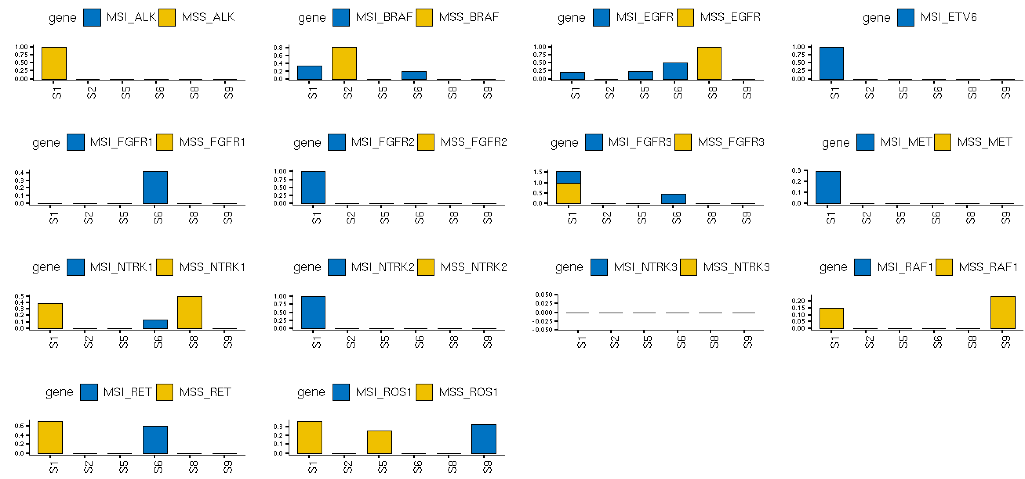
Junction1

Slide 4
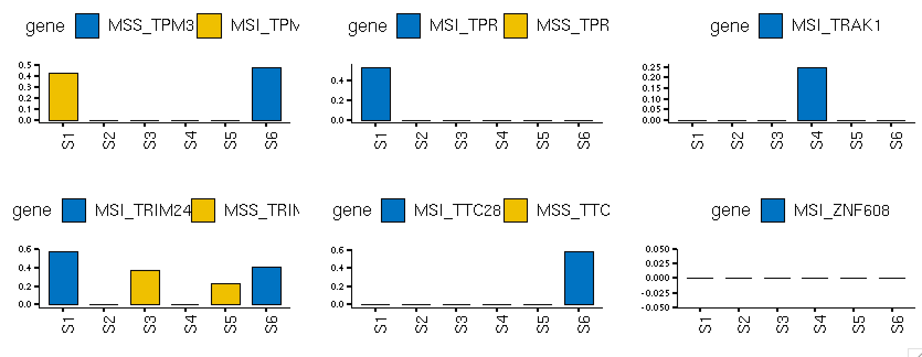
Junction2

Slide 5
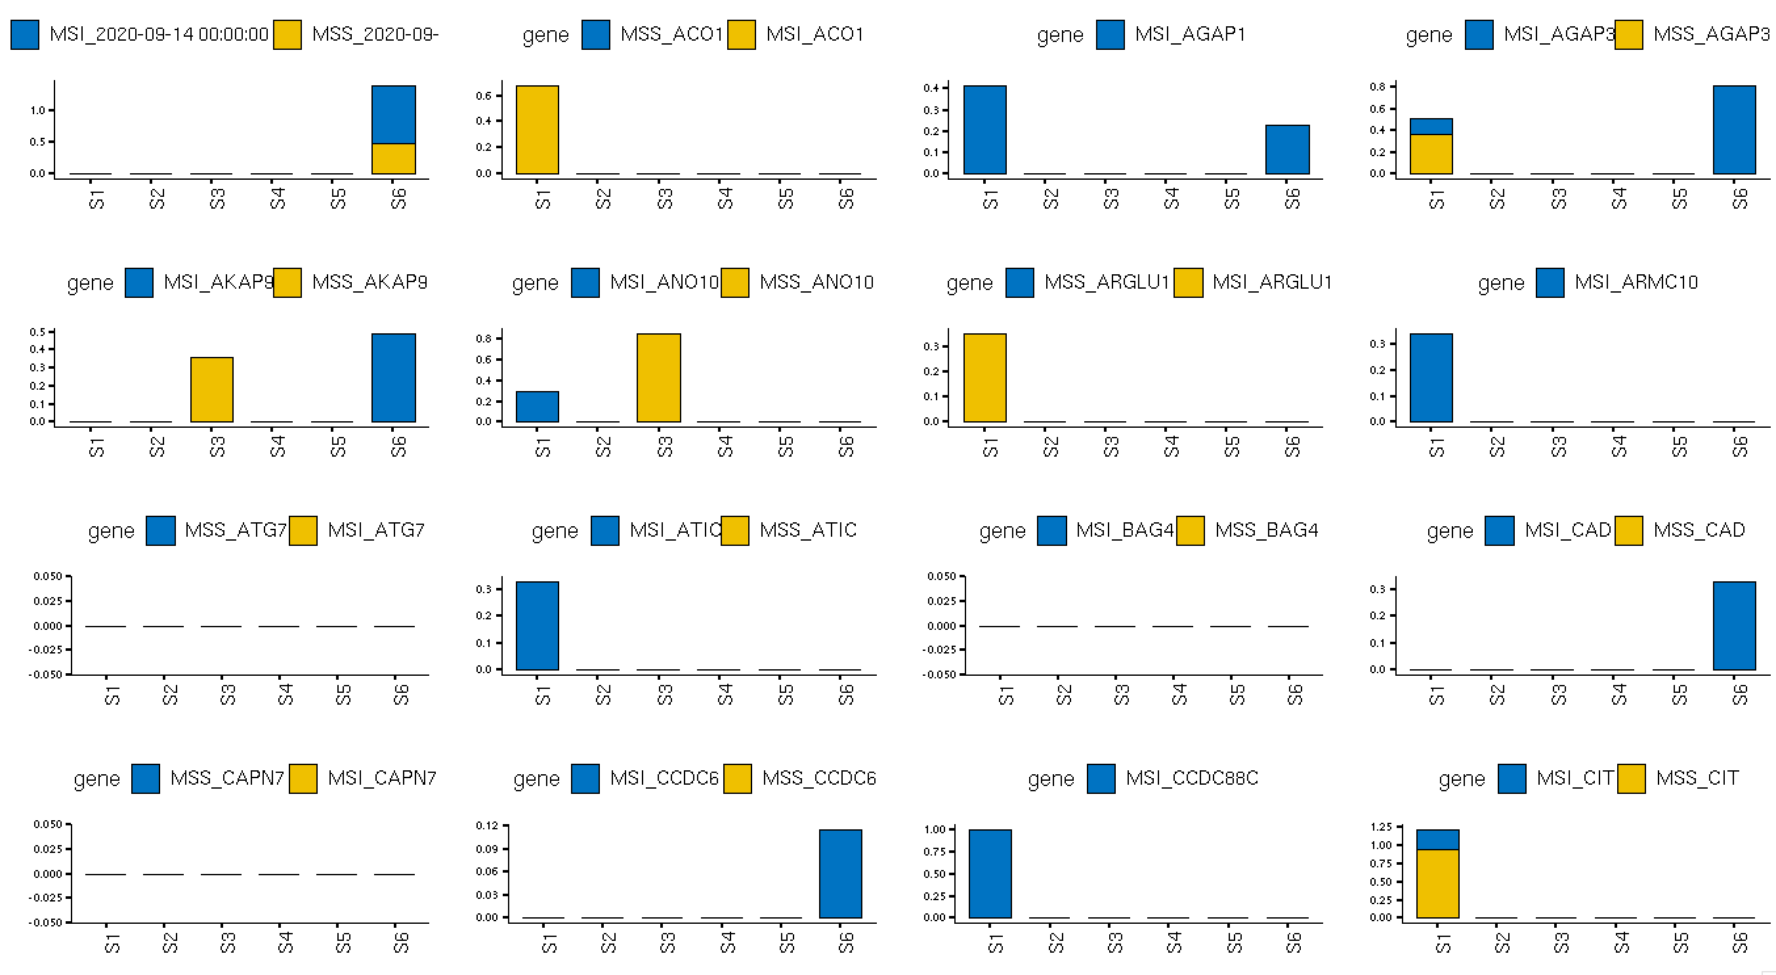
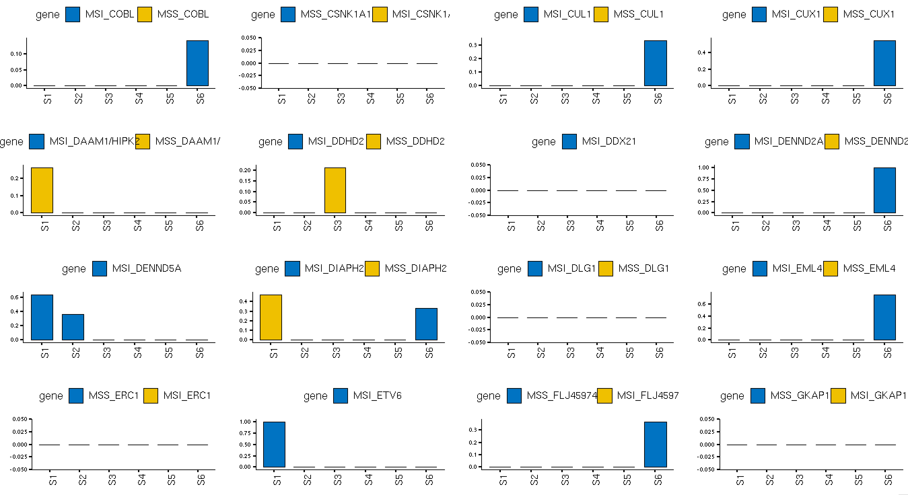
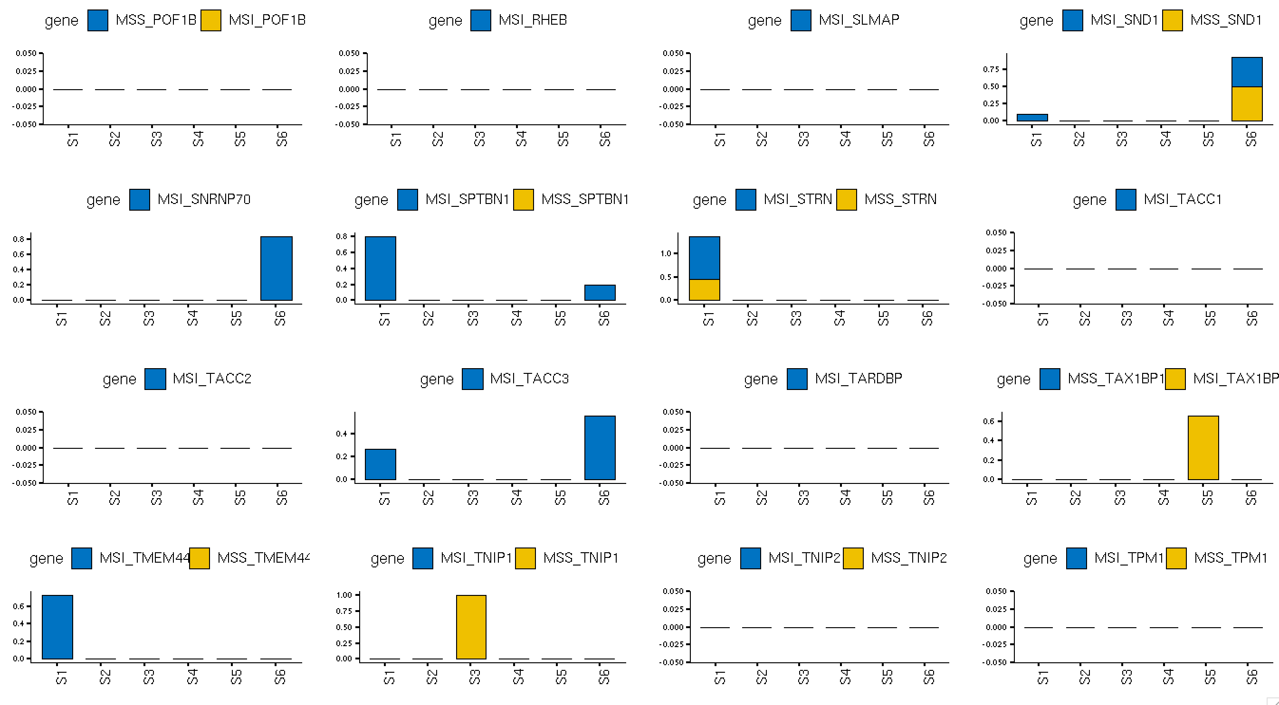
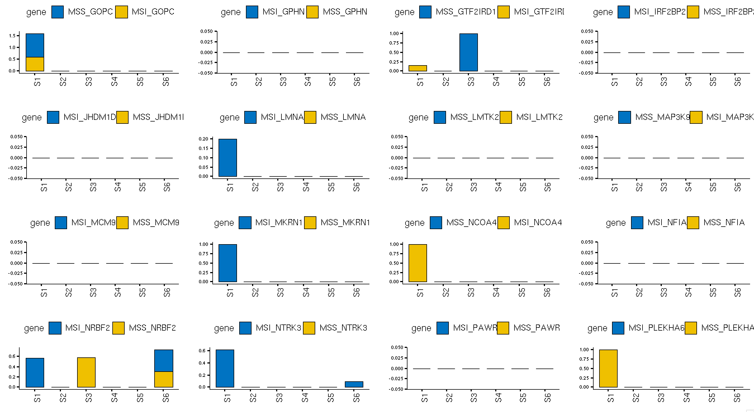
Junction2

Slide 6
Emu; SomaticSignatures; pmsignature; signeR; Helmsman; MutSignatures; Qpsig | De novo mutation signature; Selection of optimal numbers of signatures; Group-wise comparison (differential analysis)
SparseSignatures; deconstructSigs; YAPSA; Sigfit; MutationalPatterns; SigProfiler; SignatureAnalyzer; MutSigTools; SigProfilerSimulator | Capable of indels or structure variations signatures; Strand bias analysis; Group mutations in specific genomic or epigenomic contexts; Simulate mutational signatures
Palimpsest; SignatureEstimation; StickySig; SigsPack; TrackSig; maftools; TensorSignatures | Clonal evolution analysis; Generate processive groups; Estimate stability of mutational signature exposure; APOBEC enrichment analysis; Collaborate mutation types and genomic features to de novo mutation signatures;
Notes:
Try to find out other softwires for section 3.

Slide 7
Fischer, A., Illingworth, C. J., Campbell, P. J., & Mustonen, V. (2013). EMu: probabilistic inference of mutational processes and their localization in the cancer genome. Genome biology, 14(4), 1-10.
Gehring, J. S., Fischer, B., Lawrence, M., & Huber, W. (2015). SomaticSignatures: inferring mutational signatures from single-nucleotide variants. Bioinformatics, 31(22), 3673-3675.
Shiraishi, Y., Tremmel, G., Miyano, S., & Stephens, M. (2015). A simple model-based approach to inferring and visualizing cancer mutation signatures. PLoS genetics, 11(12), e1005657.
Rosales, R. A., Drummond, R. D., Valieris, R., Dias-Neto, E., & Da Silva, I. T. (2017). signeR: an empirical Bayesian approach to mutational signature discovery. Bioinformatics, 33(1), 8-16.
Carlson, J., Li, J. Z., & Zöllner, S. (2018). Helmsman: fast and efficient mutation signature analysis for massive sequencing datasets. BMC genomics, 19(1), 1-5.
Fantini, D., Vidimar, V., Yu, Y., Condello, S., & Meeks, J. (2020). MutSignatures: An R Package for Extraction and Analysis of Cancer Mutational Signatures. bioRxiv.
Lynch, A. G. (2016). Decomposition of mutational context signatures using quadratic programming methods. F1000Research, 5(1253), 1253.
Ramazzotti, D., Lal, A., Liu, K., Tibshirani, R., & Sidow, A. (2019). De novo mutational signature discovery in tumor genomes using SparseSignatures. bioRxiv, 384834.
Rosenthal, R., McGranahan, N., Herrero, J., Taylor, B. S., & Swanton, C. (2016). DeconstructSigs: delineating mutational processes in single tumors distinguishes DNA repair deficiencies and patterns of carcinoma evolution. Genome biology, 17(1), 1-11.
Huebschmann, D., Gu, Z., & Schlesner, M. (2015). YAPSA: yet another package for signature analysis. R package version, 1(0).
Gori, K., & Baez-Ortega, A. (2018). sigfit: flexible Bayesian inference of mutational signatures. bioRxiv, 372896.
Blokzijl, F., Janssen, R., van Boxtel, R., & Cuppen, E. (2018). MutationalPatterns: comprehensive genome-wide analysis of mutational processes. Genome medicine, 10(1), 33.
Bergstrom, E. N., Huang, M. N., Mahto, U., Barnes, M., Stratton, M. R., Rozen, S. G., & Alexandrov, L. B. (2019). SigProfilerMatrixGenerator: a tool for visualizing and exploring patterns of small mutational events. BMC genomics, 20(1), 1-12.
Alexandrov, L. B., Kim, J., Haradhvala, N. J., Huang, M. N., Ng, A. W. T., Wu, Y., ... & Islam, S. A. (2020). The repertoire of mutational signatures in human cancer. Nature, 578(7793), 94-101.
Bergstrom, E. N., Barnes, M., Martincorena, I., & Alexandrov, L. B. (2020). Generating realistic null hypothesis of cancer mutational landscapes using SigProfilerSimulator. BioRxiv.
Shinde, J., Bayard, Q., Imbeaud, S., Hirsch, T. Z., Liu, F., Renault, V., ... & Letouzé, E. (2018). Palimpsest: an R package for studying mutational and structural variant signatures along clonal evolution in cancer. Bioinformatics, 34(19), 3380-3381.
Huang, X., Wojtowicz, D., & Przytycka, T. M. (2018). Detecting presence of mutational signatures in cancer with confidence. Bioinformatics, 34(2), 330-337.
Sason, I., Wojtowicz, D., Robinson, W., Leiserson, M. D., Przytycka, T. M., & Sharan, R. (2020). A sticky multinomial mixture model of strand-coordinated mutational processes in cancer. Iscience, 23(3), 100900.
Schumann, F., Blanc, E., Messerschmidt, C., Blankenstein, T., Busse, A., & Beule, D. (2019). SigsPack, a package for cancer mutational signatures. BMC bioinformatics, 20(1), 1-9.
Rubanova, Y., Li, R., Wintersinger, J., Sahin, N., Deshwar, A., Morris, Q., & PCAWG-11 working group. (2018). TrackSig: reconstructing evolutionary trajectories of mutation signature exposure. BioRxiv, 260471.
Mayakonda, A., Lin, D. C., Assenov, Y., Plass, C., & Koeffler, H. P. (2018). Maftools: efficient and comprehensive analysis of somatic variants in cancer. Genome research, 28(11), 1747-1756.
Vohringer, H., & Gerstung, M. (2019). Learning mutational signatures and their multidimensional genomic properties with TensorSignatures. bioRxiv, 850453.
Notes:
Go over the list
There can be a little more.
Before 9 pm tonight.

