Slide 1

Capstone One
NFL Play by Play Data Analysis
By: Kellen Potocsnak

Slide 2
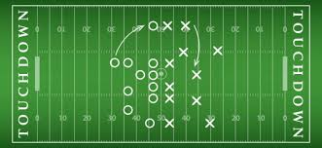
Questions and Goals
This project will analyze play by play data from the 2020 NFL season
The primary goal is to determine what type of plays are the most successful
  Which team runs the most high percentage plays?
  Which team runs the fewest high percentage points?

Slide 3
The Data
Data can be found at NFLSavant.com under 2020 play by play data
Roughly 44,000 regular season plays stored in as CSV data

Slide 4
Data Exploration
How do we define success?
  Gaining 40% of yards to gain on first down → Success
  Gaining 60% of yards to gain on second down → Success
  Gaining a first down on third of fourth down → Success
Why define success this way instead of by average yards per play?
  The statistic above gives us a better look at what an actual success looks like on the field.
  Example: On third down and one the primary goal of the team is to get a first down, not the most yards.

Slide 5
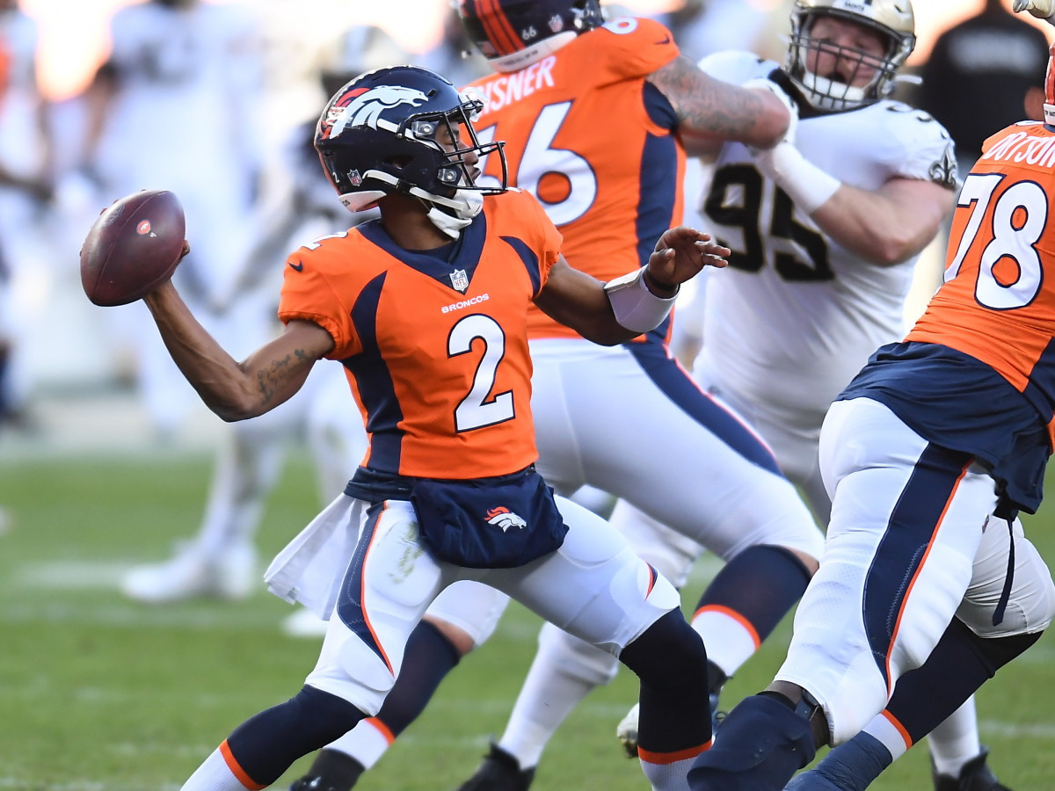
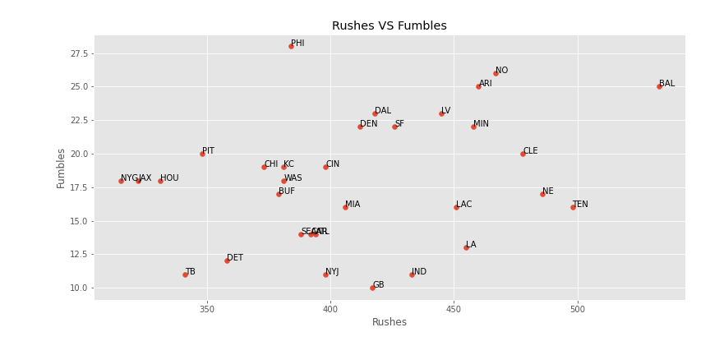
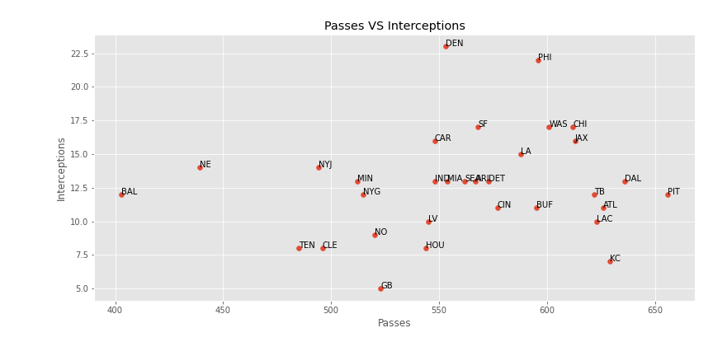
Data Exploration
What could go wrong?

Slide 6
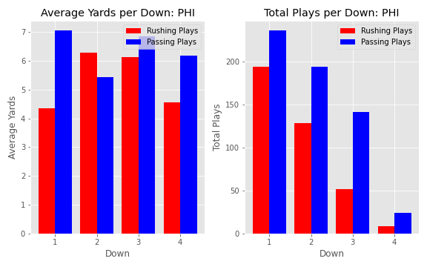
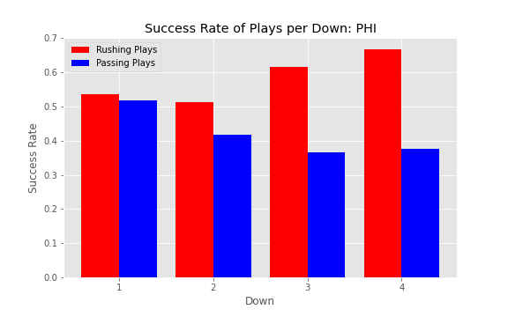
Data Exploration
How do the two success statistics measure up​?

