Slide 1
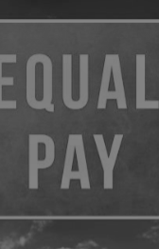

EXPLORING THE
WAGE GAP
Alisha Hill
Ericka Houle
Kelli Smith
SMU Data Science Boot Camp
Project 4: Capstone
December 1, 2021

Slide 2

INTRODUCTION
As an all-female group in this Data Science Capstone Project, we wanted to analyze the wage gap in the workplace..
INSPIRATION
Topic
Color Scheme
Website Design
Power Point Design

Slide 3


DATA
DATASETS
Glassdoor- Analyze Gender Pay Gap (Kaggle)
Earnings by demographics Annual Reports 2015-2020
Latitude and Longitude for Every Country and State (Kaggle)
DATA CLEANING
Word consistency
BLS annual demographic data formatting
Merged BLS dataset with Lats/Longs dataset
DATA TRANSFORMATION
Annual salary calculated field
Standardized scale for maps
Converted gender to an integer
One-hot encoding categorical conversion

Slide 4



HYPOTHESIS
Gender wage gap has reduced over the years.
The age gap would reduce as women age and are no longer in the childbearing years.
Occupation does affect the wage gap.
We can achieve at least 80% accuracy in our machine learning model.
Notes:
Click on the hypothesis picture to go to the website

Slide 5


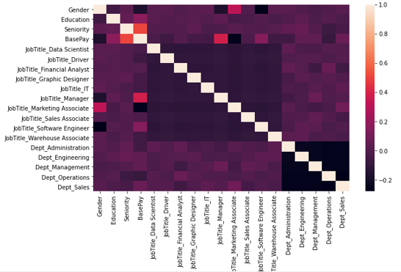
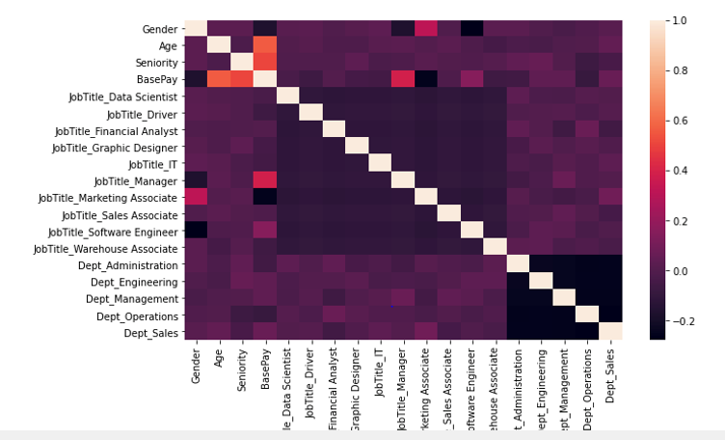

MACHINE LEARNING
INITIAL MODEL- 52.2%
Features: Gender, Education, Seniority, Job Title, and Department
OPTIMAL MODEL- 82.9%
Features: Gender, Age, Seniority, Job Title, Department
LINEAR REGRESSION

Slide 6
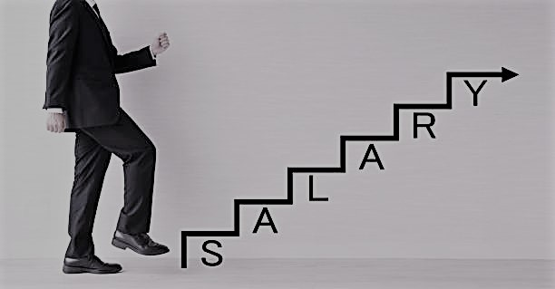


FUTURE WORK
Further state level gap analysis
Nero Network
Light Mode and Dark Mode Website
LIMITATIONS
Glassdoor dataset was small and questionable
Seek larger more recent datasets
Utilize API on BLS website

Slide 7
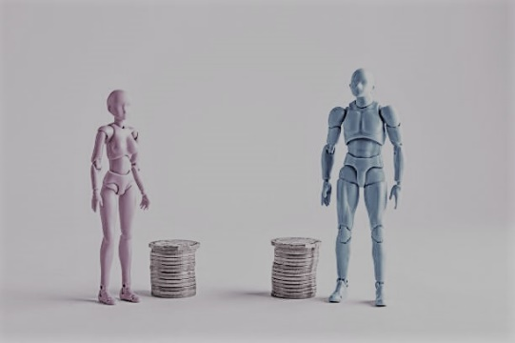

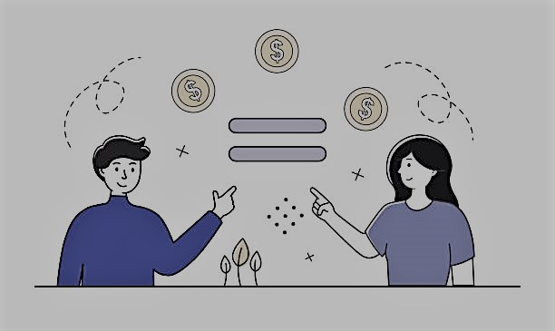
CONCLUSIONS
Gender wage gap has reduced over the years. FALSE
The age gap would reduce as women age and are no longer in the childbearing years. UNKNOWN
Occupation does affect the wage gap. TRUE
We can achieve at least 80% accuracy in our machine learning model. TRUE

Slide 8

QUESTIONS

Slide 9
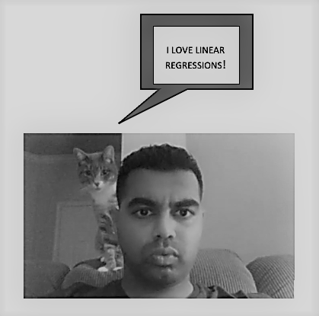


THANK YOU

