Slide 1
STDs
Kelli Kennedy

Slide 2
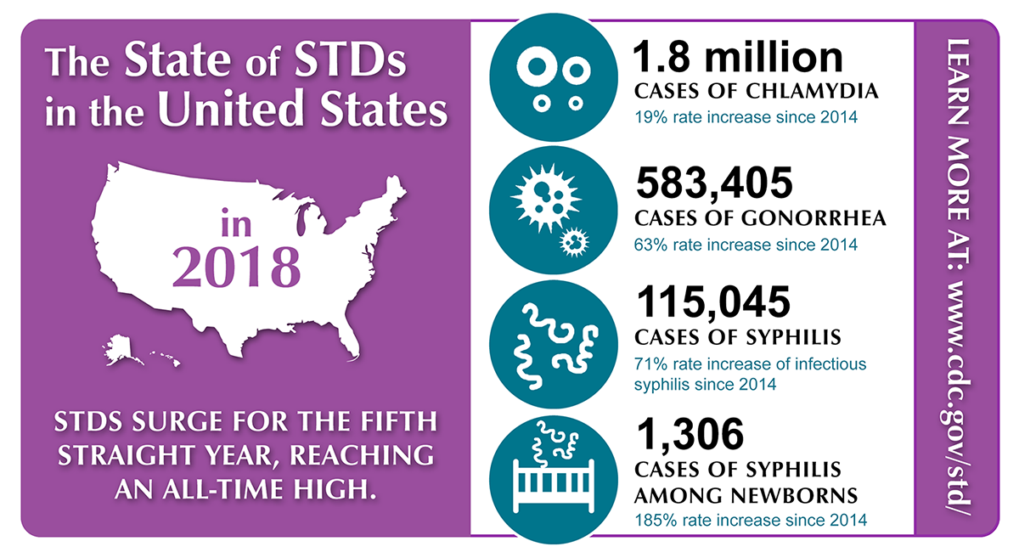
Increasing Rate of STD Infections in US

Slide 3




Data Collection
Data
Methods
9 different files over 200 rows
TOSed, Timeouts, Et al.
Queried directly from site interfaces
Unpublished APIs
Ran through Pandas, etc
Used StatsModels and sklearn
Dropped or transformed much of the data

Slide 4
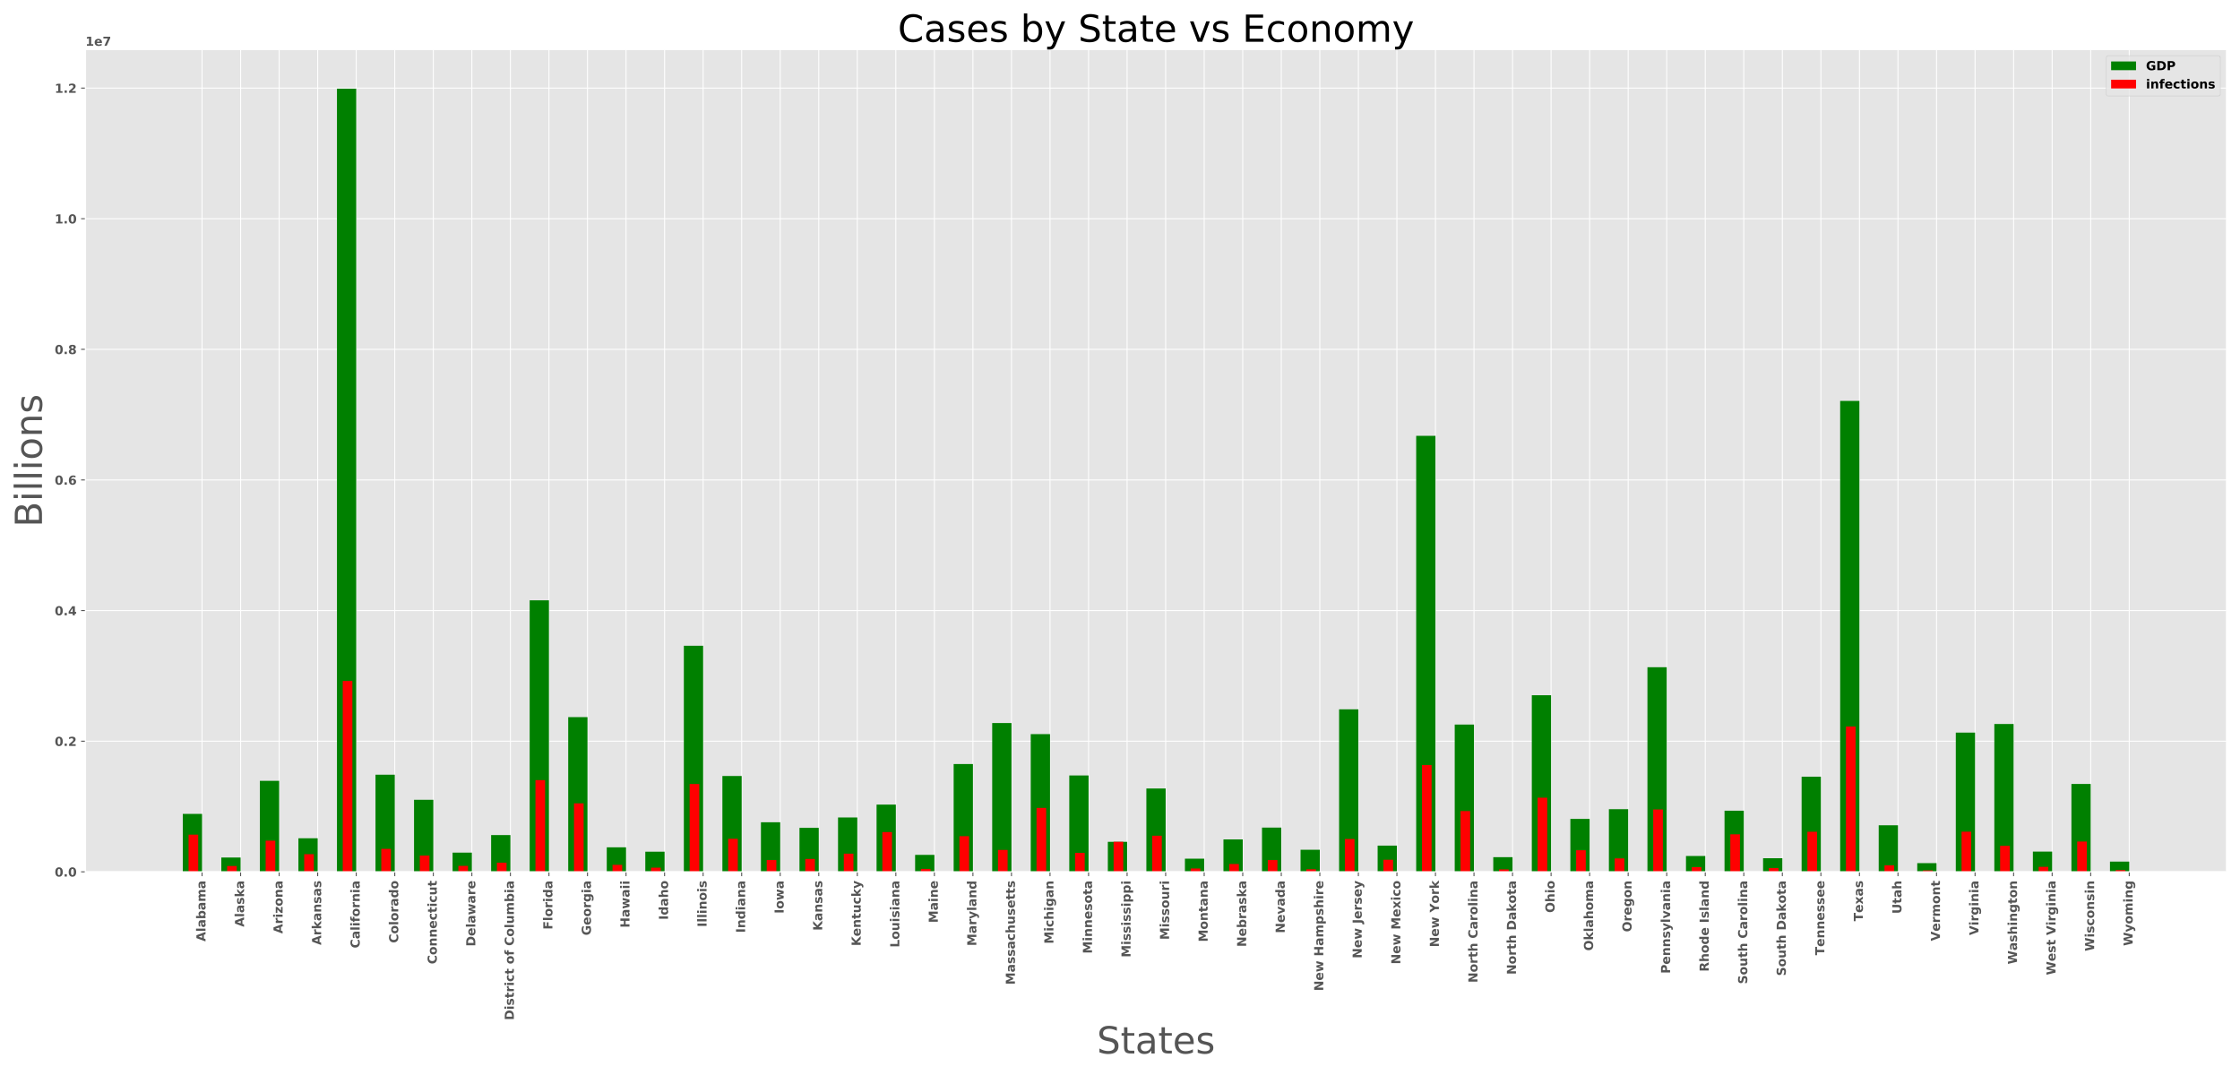
State Distribution vs GDP

Slide 5
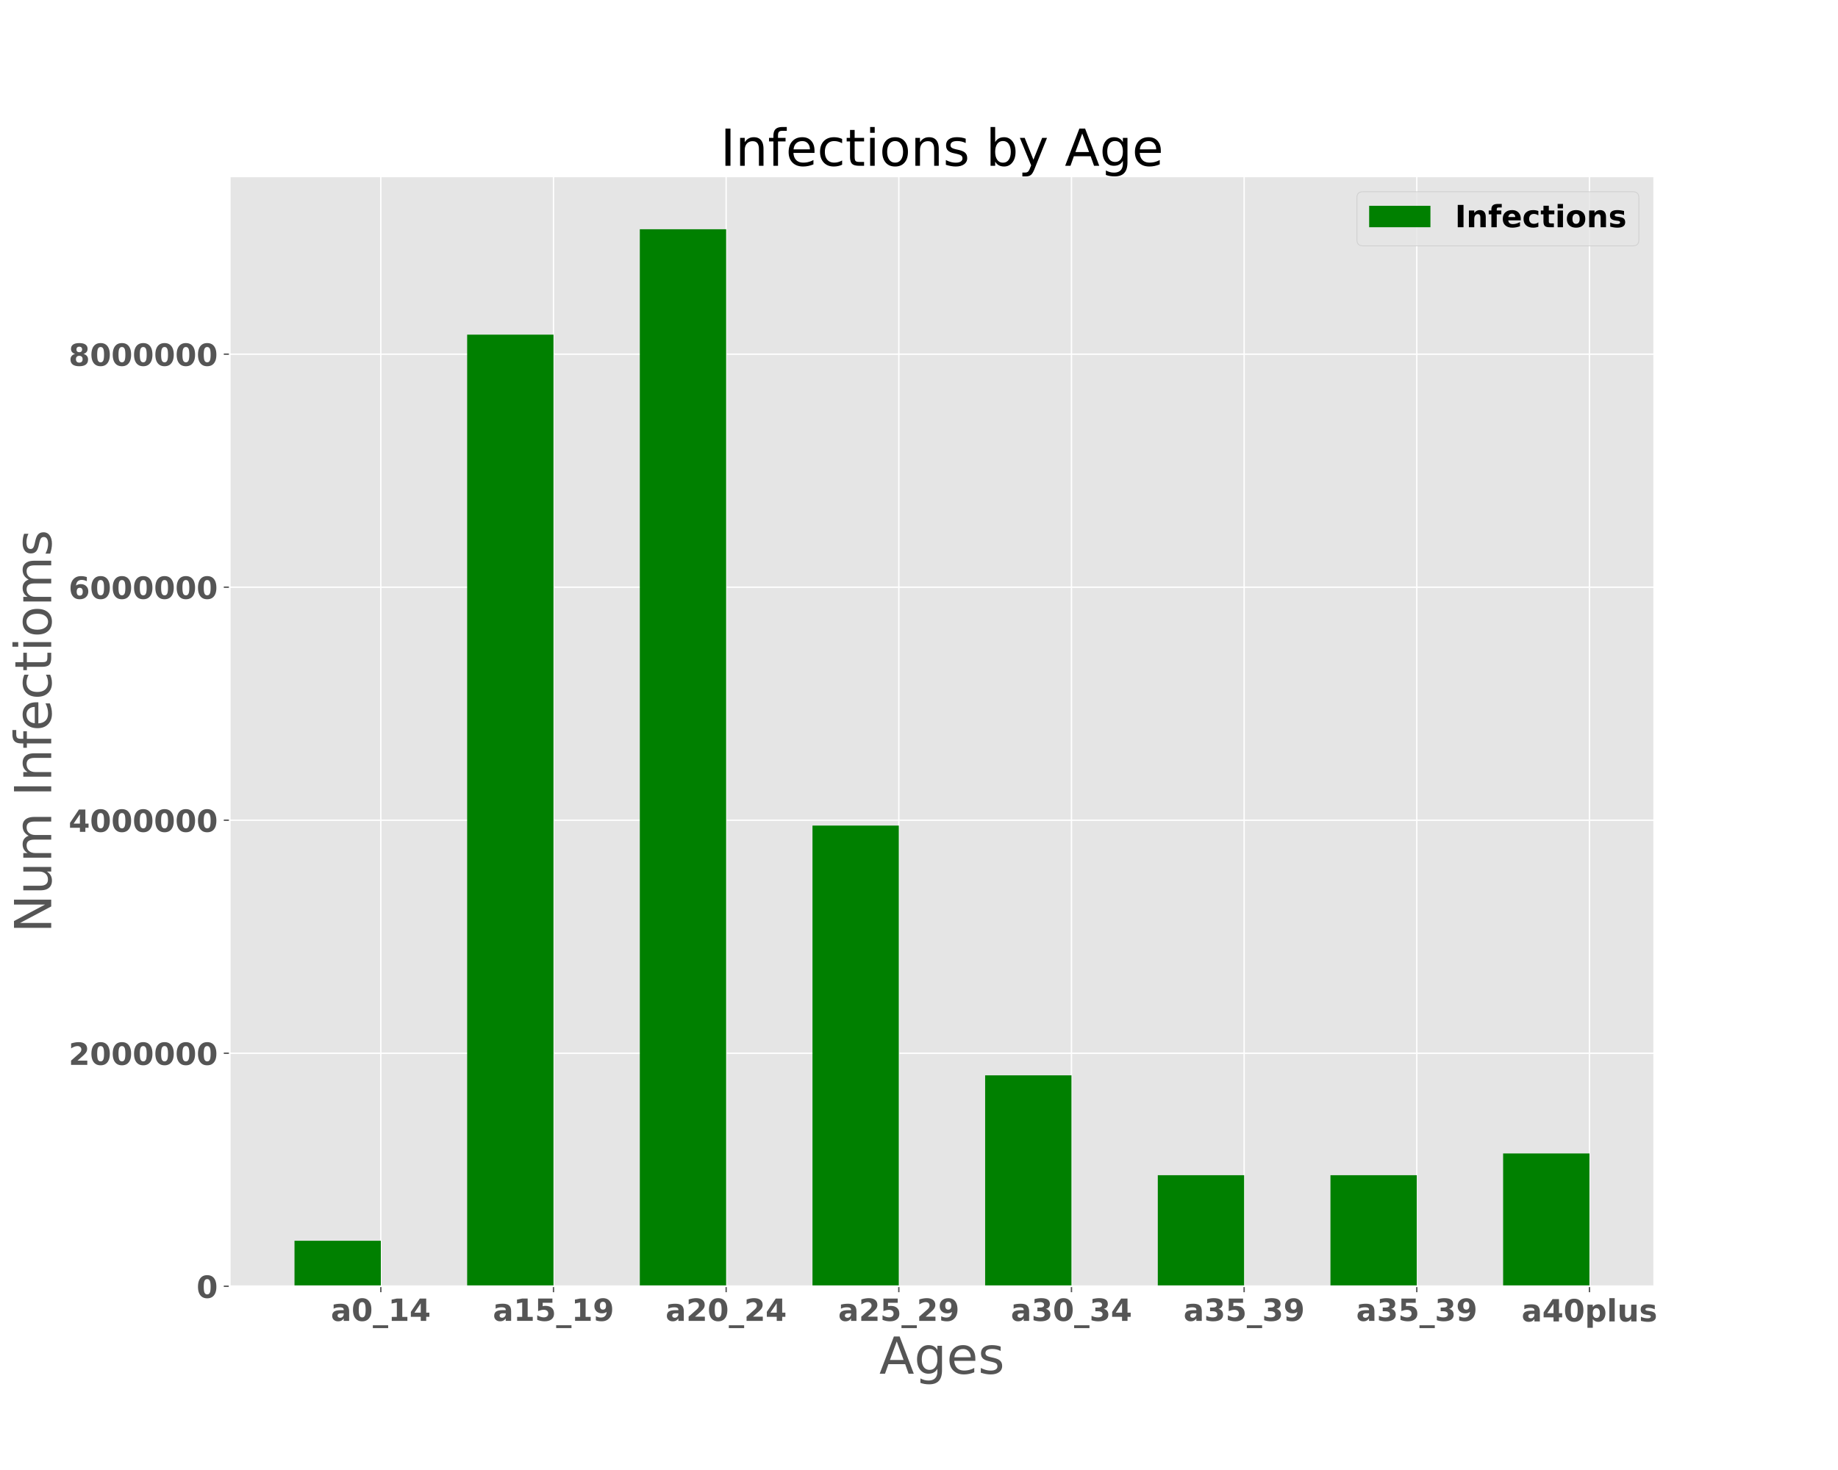
Age Distribution

Slide 6
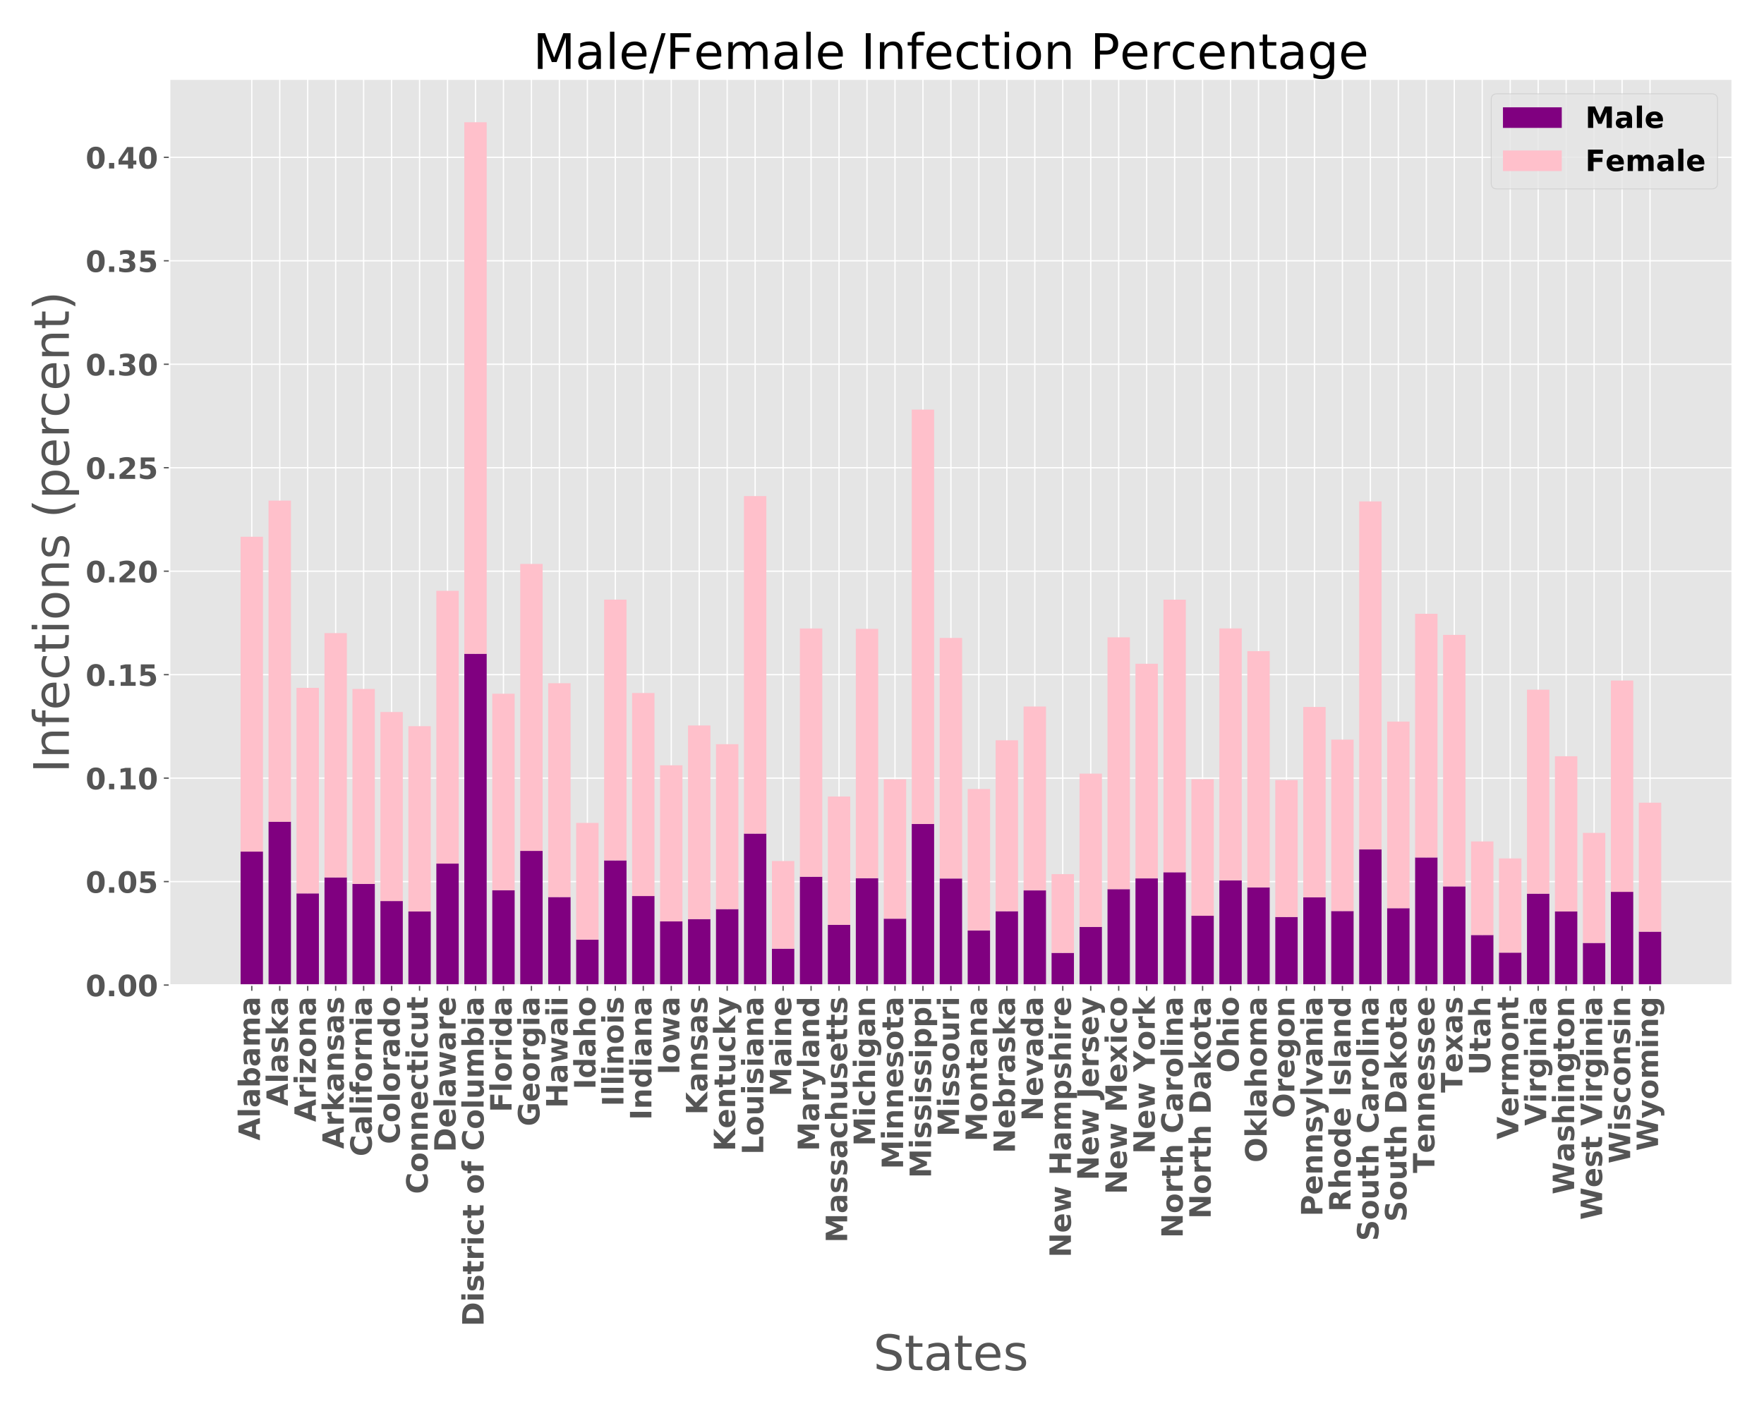
Male/Female Distribution

Slide 7
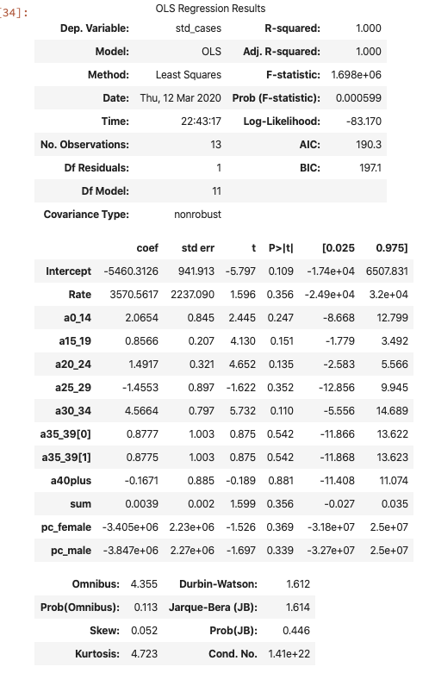

Analysis
0.9998924599865974

Slide 8





Recommendations

Slide 9

Questions

