Slide 1
STDs
Kelli Kennedy

Slide 2

Increasing Rate of STD Infections in US

Slide 3




Data Collection
Data
Methods
9 different files over 200 rows
TOSed, Timeouts, Et al.
Queried directly from site interfaces
Unpublished APIs
Ran through Pandas, etc
Used StatsModels and sklearn
Dropped or transformed much of the data

Slide 4
Analysis
R-squared = 1 on raw data.
Strong multicollinearity indicated by the pair plot.
P-values indicate only 3 engineered features for the model
Added external economic data with no affect

Slide 5
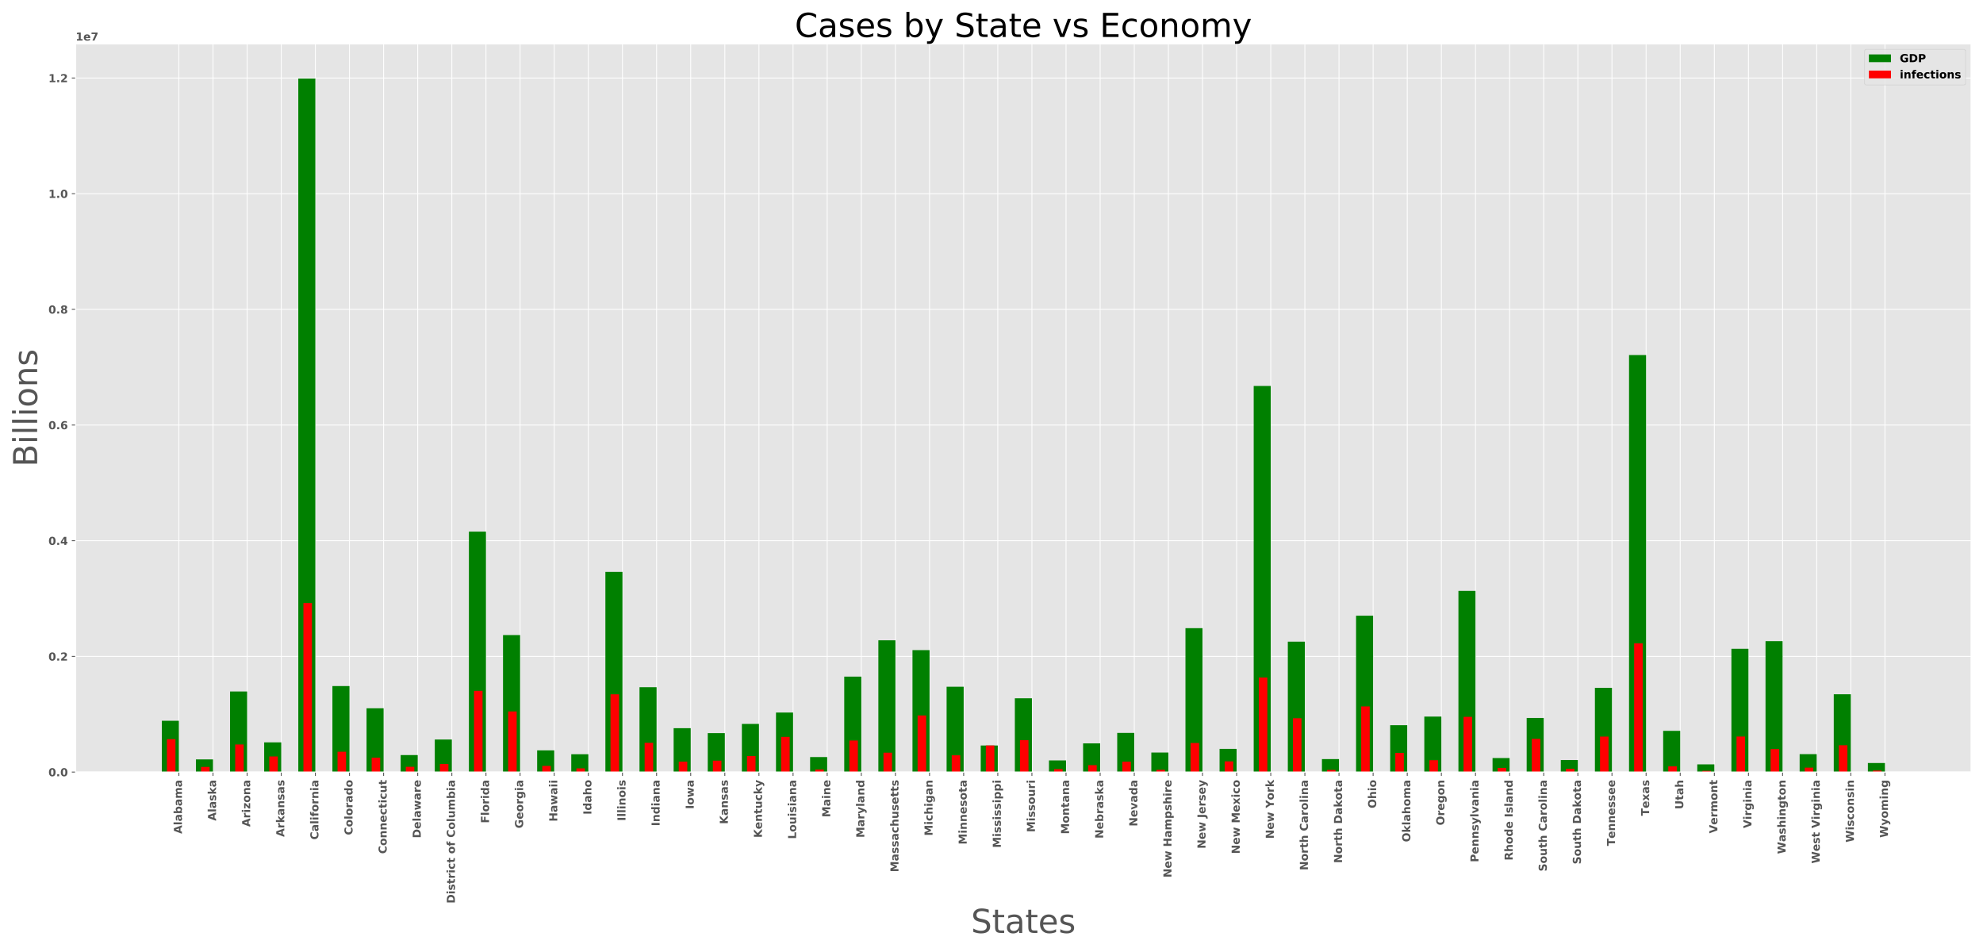
State Distribution vs GDP

Slide 6
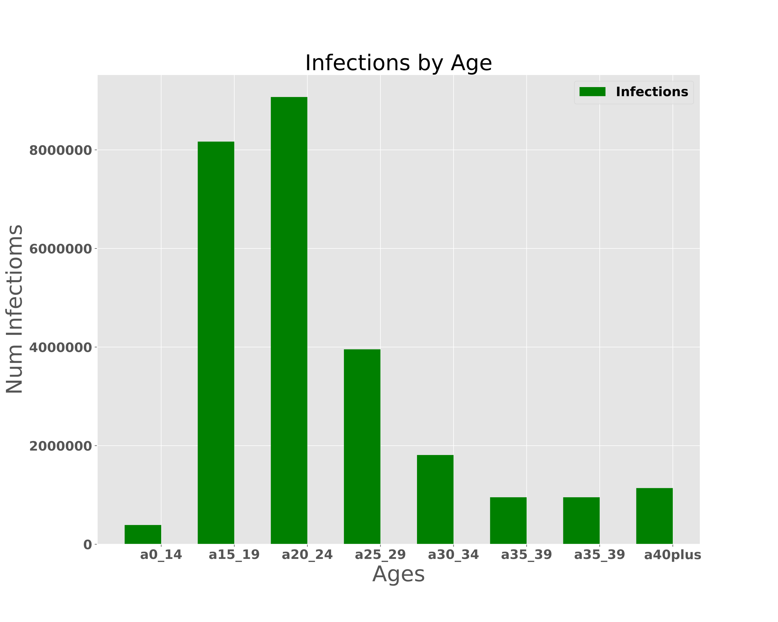
Age Distribution

Slide 7
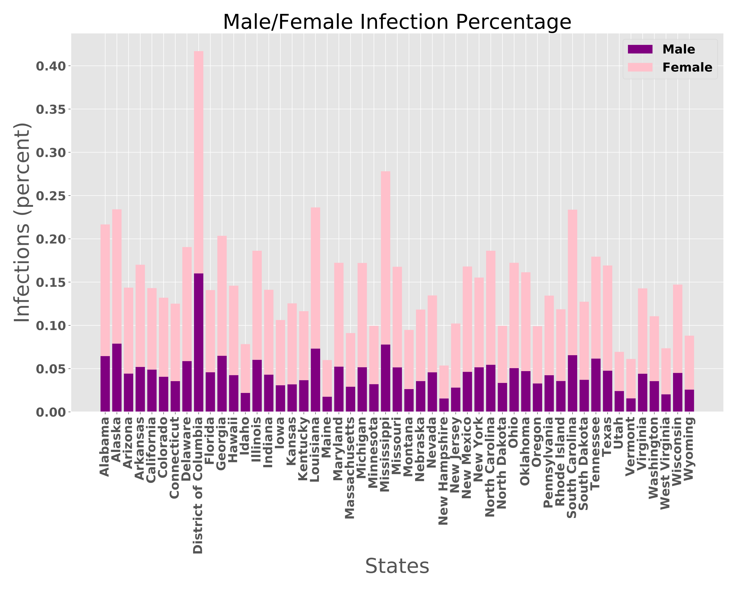
Male/Female Distribution

Slide 8




Recommendations
States to move to or avoid based on MF

Slide 9

Questions

