Slide 1
Tanzanian wells
Kelli Kennedy

Slide 2
Problem

Slide 3
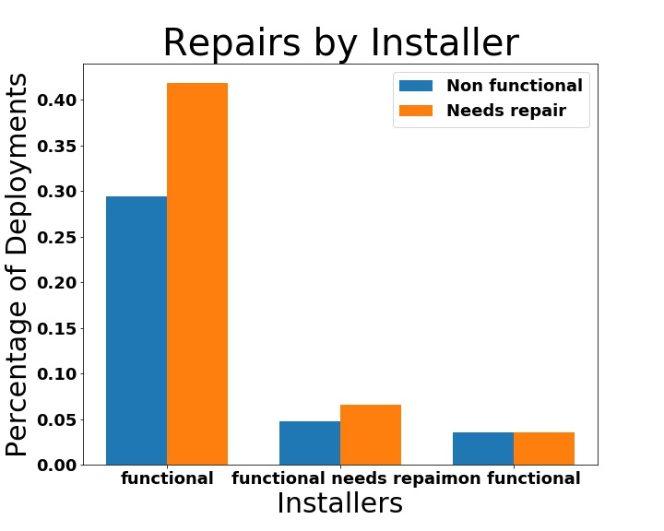

Slide 4
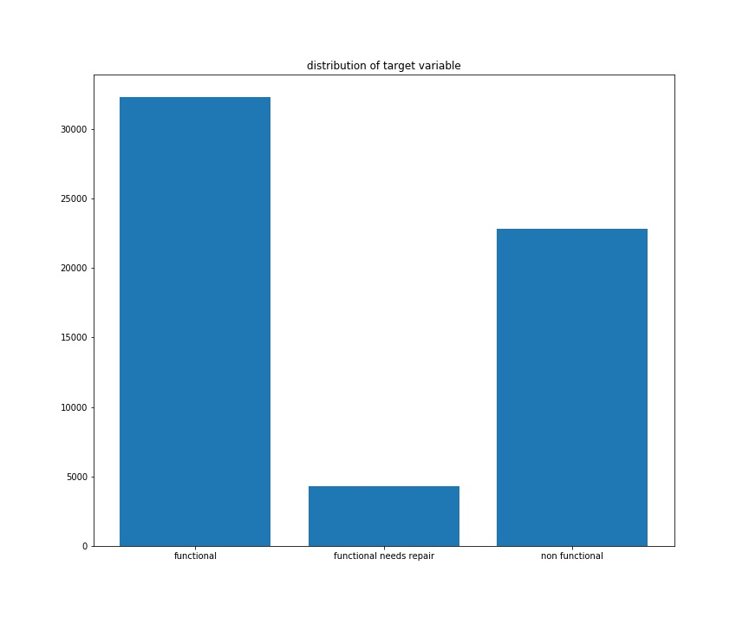

Slide 5
