Slide 1
MERRA data for class
Located at http://www.atmo.arizona.edu/~brunke/Atmo541A
Download ATMO541A2017proj.tar
At UNIX prompt: tar –xvf ATMO541A2017proj.tar

Slide 2
MERRA data for class
Located at http://www.atmo.arizona.edu/~brunke/Atmo541A
File name format:
var.Y###.P###.YYYYMMDDHH.dat
var = Variable abbreviation
Surface Multiple levels (650, 700, 725, 750 hPa)
ps = surface pressure (Pa) u = zonal wind (m/s)
slp = sea level pressure (Pa) v = meridional wind (m/s)
omega = vertical wind (Pa/s)
T = temperature (K)
Z = geopotential height (m)
KM = momentum diffusivity (m²/s²)
KH = heat diffusivity (m²/s²)

Slide 3
MERRA data for class
Located at http://www.atmo.arizona.edu/~brunke/Atmo541A
File name format:
var.Y###.P###.YYYYMMDDHH.dat
Y### = Location abbreviation (Y005 for 5ºN or Y050 for 50ºN)
P### = Pressure level (P650, P700, P725, P750, surf)
YYYY = 4-digit year
MM = 2-digit month (1-12)
DD = 2-digit day
HH = 2-digit hour (center time)

Slide 4
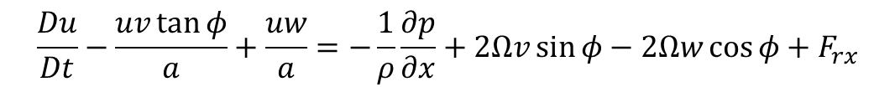
What you’re using the MERRA data for
To computationally find that what you find in scale analysis in the Tropics (at ~5ºN) and in mid-latitudes (at ~50ºN) is correct.
For example, in Section 2.4:
$$\frac{Du}{Dt}−\frac{uv\tan{φ}}{a}+\frac{uw}{a}=−\frac{1}{ρ}\frac{∂p}{∂x}+2Ωv\sin{φ−2Ωw\cos{φ+F_{rx}}}$$
10⁻⁴
10⁻⁵
10⁻⁸
10⁻³
10⁻³
10⁻⁶
10⁻¹²
U ~ 10 m/s
W ~ 1 cm/s
L ~ 10⁶ m
H ~ 10⁴ m
δP/ρ ~ 10³ m²/s²
L/U ~ 10⁵ s
f₀ ~ 10⁻⁴ s⁻¹

Slide 5
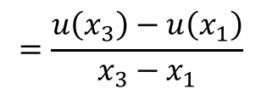
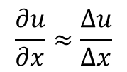
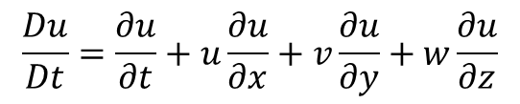
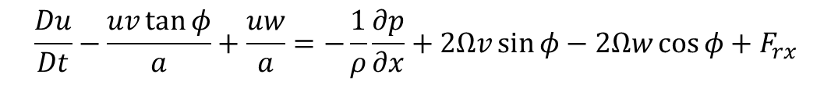
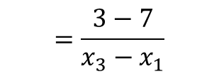
How to use the MERRA data
$$\frac{Du}{Dt}−\frac{uv\tan{φ}}{a}+\frac{uw}{a}=−\frac{1}{ρ}\frac{∂p}{∂x}+2Ωv\sin{φ−2Ωw\cos{φ+F_{rx}}}$$
$$\frac{Du}{Dt}=\frac{∂u}{∂t}+u\frac{∂u}{∂x}+v\frac{∂u}{∂y}+w\frac{∂u}{∂z}$$
 | x₁ | x₂ | x₃
u = | 7 | 5 | 3
$$\frac{∂u}{∂x}≈\frac{∆u}{∆x}$$
$$=\frac{u\left(x_{3}\right)−u\left(x_{1}\right)}{x_{3}−x_{1}}$$
$$=\frac{3−7}{x_{3}−x_{1}}$$

Slide 6

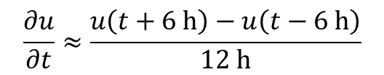
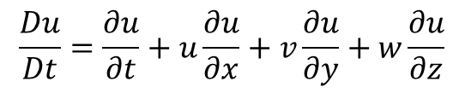
How to use the MERRA data
t – 6 h
$$t$$
t + 6 h
$$\frac{Du}{Dt}=\frac{∂u}{∂t}+u\frac{∂u}{∂x}+v\frac{∂u}{∂y}+w\frac{∂u}{∂z}$$
$$\frac{∂u}{∂t}≈\frac{u\left(t+6 \text{h}\right)−u\left(t−6 \text{h}\right)}{12 \text{h}}$$

Slide 7
How to use the MERRA data
0.100000E+16 0.168125E+03 0.169375E+03 0.170625E+03
0.562500E+01 -0.100552E+02 -0.907087E+01 -0.831306E+01
0.437500E+01 -0.749275E+01 -0.563728E+01 -0.386775E+01
0.312500E+01 -0.248494E+01 -0.230525E+01 -0.210212E+01
u.Y005.P700.2009011009.dat
Longitude
Latitude
January 6-15, 2009 at 700 hPa
Given data for January 5-16 at 650, 700, 725, and 750 hPa
Performing calculations at the center point.

Slide 8

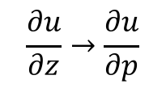
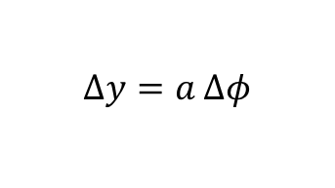
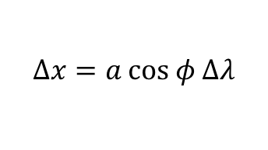

How to use the MERRA data
z → p
650 hPa
700 hPa
725 hPa
x, y → λ, φ
$$\frac{Du}{Dt}=\frac{∂u}{∂t}+u\frac{∂u}{∂x}+v\frac{∂u}{∂y}+w\frac{∂u}{∂z}$$
$$\frac{∂u}{∂x}$$
$$∆x=a \text{cos} φ Δλ$$
$$\frac{∂u}{∂z}→\frac{∂u}{∂p}$$
$$\frac{∂u}{∂y}$$
$$∆y=a Δφ$$

Slide 9
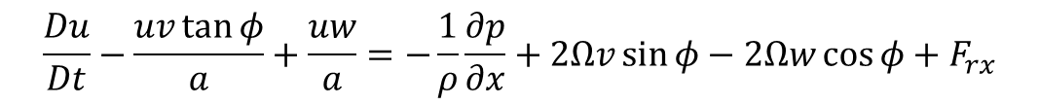
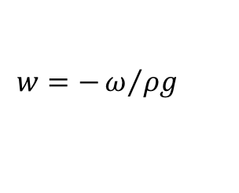
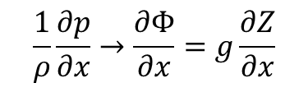
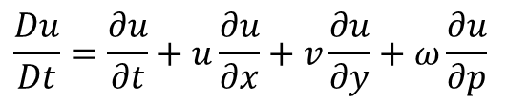
How to use the MERRA data
$$\frac{Du}{Dt}=\frac{∂u}{∂t}+u\frac{∂u}{∂x}+v\frac{∂u}{∂y}+ω\frac{∂u}{∂p}$$
$$\frac{1}{ρ}\frac{∂p}{∂x}→\frac{∂Φ}{∂x}=g\frac{∂Z}{∂x}$$
(3.3)
$$w=−ω/{ρg}$$
$$\frac{∂u}{∂t}+u\frac{∂u}{∂x}+v\frac{∂u}{∂y}+ω\frac{∂u}{∂p}−\frac{uv \text{tan} φ}{a}−\frac{uω}{ρga}=−g\frac{∂Z}{∂x}+2Ωv \text{sin} φ+\frac{2Ωω}{ρg} \text{cos} φ$$
$$\frac{Δu}{Δt}+u\frac{Δu}{Δx}+v\frac{Δu}{Δy}+ω\frac{Δu}{Δp}−\frac{uv \text{tan} φ}{a}−\frac{uω}{ρga}=−g\frac{ΔZ}{Δx}+2Ωv \text{sin} φ+\frac{2Ωω}{ρg}\text{cos} φ$$

Slide 10
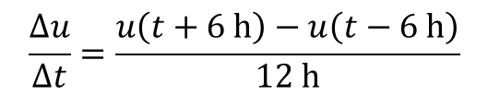

How to use the MERRA data
$$\frac{Δu}{Δt}+u\frac{Δu}{Δx}+v\frac{Δu}{Δy}+ω\frac{Δu}{Δp}−\frac{uv \text{tan} φ}{a}−\frac{uω}{ρga}=−g\frac{ΔZ}{Δx}+2Ωv \text{sin} φ+\frac{2Ωω}{ρg}\text{cos} φ$$
t – 6 h
$$t$$
t + 6 h
$$\frac{∆u}{∆t}=\frac{u\left(t+6 \text{h}\right)−u\left(t−6 \text{h}\right)}{12 \text{h}}$$

Slide 11
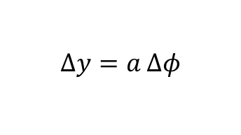
How to use the MERRA data
$$\frac{Δu}{Δt}+u\frac{Δu}{Δx}+v\frac{Δu}{Δy}+ω\frac{Δu}{Δp}−\frac{uv \text{tan} φ}{a}+\frac{uω}{ρga}=−g\frac{ΔZ}{Δx}+2Ωv \text{sin} φ−\frac{2Ωω}{ρg}\text{cos} φ$$
p
650 hPa
700 hPa
725 hPa
λ or φ
$$∆x=a \text{cos} φ Δλ$$
$$∆y=a Δφ$$

Slide 12
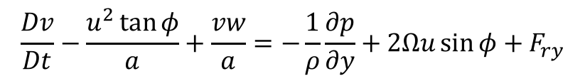
How to use the MERRA data
$$\frac{Dv}{Dt}−\frac{u^{2}\tan{φ}}{a}+\frac{vw}{a}=−\frac{1}{ρ}\frac{∂p}{∂y}+2Ωu\sin{φ+F_{ry}}$$
$$\frac{∂v}{∂t}+u\frac{∂v}{∂x}+v\frac{∂v}{∂y}+ω\frac{∂v}{∂p}−\frac{u^{2} \text{tan} φ}{a}−\frac{vω}{ρga}=−g\frac{∂Z}{∂y}+2Ωu \text{sin} φ$$
$$\frac{∆v}{∆t}+u\frac{∆v}{∆x}+v\frac{∆v}{∆y}+ω\frac{∆v}{∆p}−\frac{u^{2} \text{tan} φ}{a}−\frac{vω}{ρga}=−g\frac{∆Z}{∆y}+2Ωu \text{sin} φ$$

Slide 13
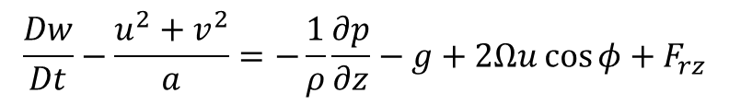
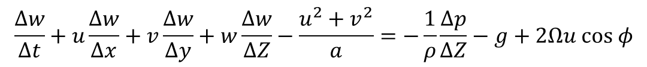
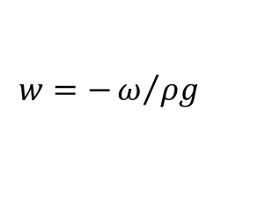
How to use the MERRA data
$$\frac{Dw}{Dt}−\frac{u^{2}+v^{2}}{a}=−\frac{1}{ρ}\frac{∂p}{∂z}−g+2Ωu\text{cos}{φ+F_{rz}}$$
$$w=−ω/{ρg}$$
$$\frac{∆w}{Δt}+u\frac{Δw}{Δx}+v\frac{Δw}{Δy}+w\frac{Δw}{ΔZ}−\frac{u^{2}+v^{2}}{a}=−\frac{1}{ρ}\frac{∆p}{∆Z}−g+2Ωu \text{cos} φ$$

Slide 14
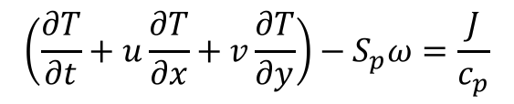
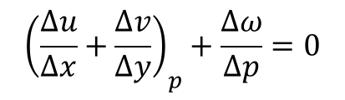
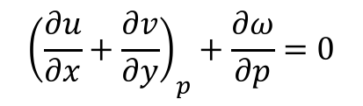
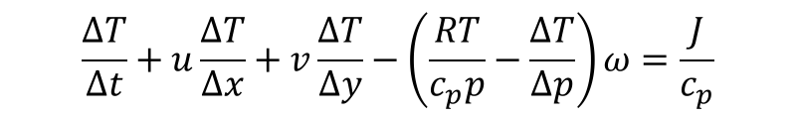
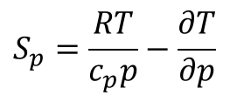
How to use the MERRA data
(3.6)
$$\left(\frac{∂T}{∂t}+u\frac{∂T}{∂x}+v\frac{∂T}{∂y}\right)−S_{p}ω=\frac{J}{c_{p}}$$
$$S_{p}=\frac{RT}{c_{p}p}−\frac{∂T}{∂p}$$
$$\frac{ΔT}{Δt}+u\frac{ΔT}{Δx}+v\frac{ΔT}{Δy}−\left(\frac{RT}{c_{p}p}−\frac{ΔT}{Δp}\right)ω=\frac{J}{c_{p}}$$
$${\left(\frac{∂u}{∂x}+\frac{∂v}{∂y}\right)}_{p}+\frac{∂ω}{∂p}=0$$
$${\left(\frac{∆u}{∆x}+\frac{∆v}{∆y}\right)}_{p}+\frac{∆ω}{∆p}=0$$

Slide 15
How to use the MERRA data
0.100000E+16 0.168125E+03 0.169375E+03 0.170625E+03
0.562500E+01 -0.100552E+02 -0.907087E+01 -0.831306E+01
0.437500E+01 -0.749275E+01 -0.563728E+01 -0.386775E+01
0.312500E+01 -0.248494E+01 -0.230525E+01 -0.210212E+01
u.Y005.P700.2009011009.dat
Place into u(t,i,j,k) where t is the time index = 1,194,
i is the longitude index = 1,3,
j is the latitude index = 1,3, and
k is the pressure index = 1,3
Then, calculate the terms of the governing equations for t = 2,193.

