Slide 1
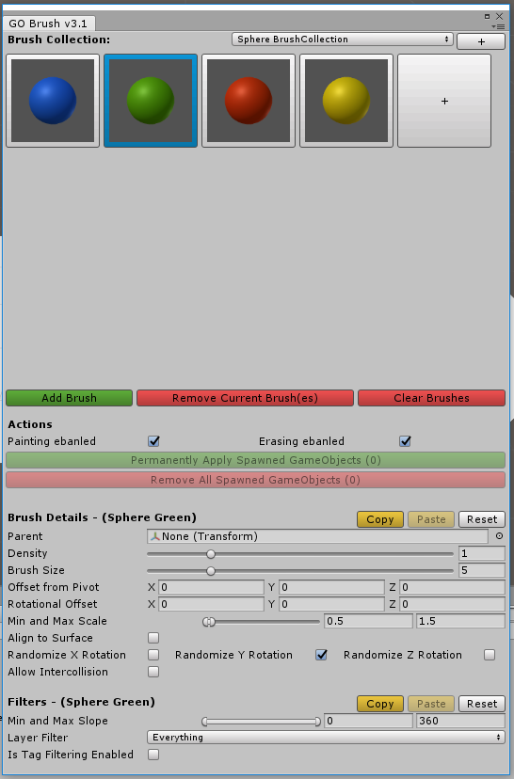

Slide 2
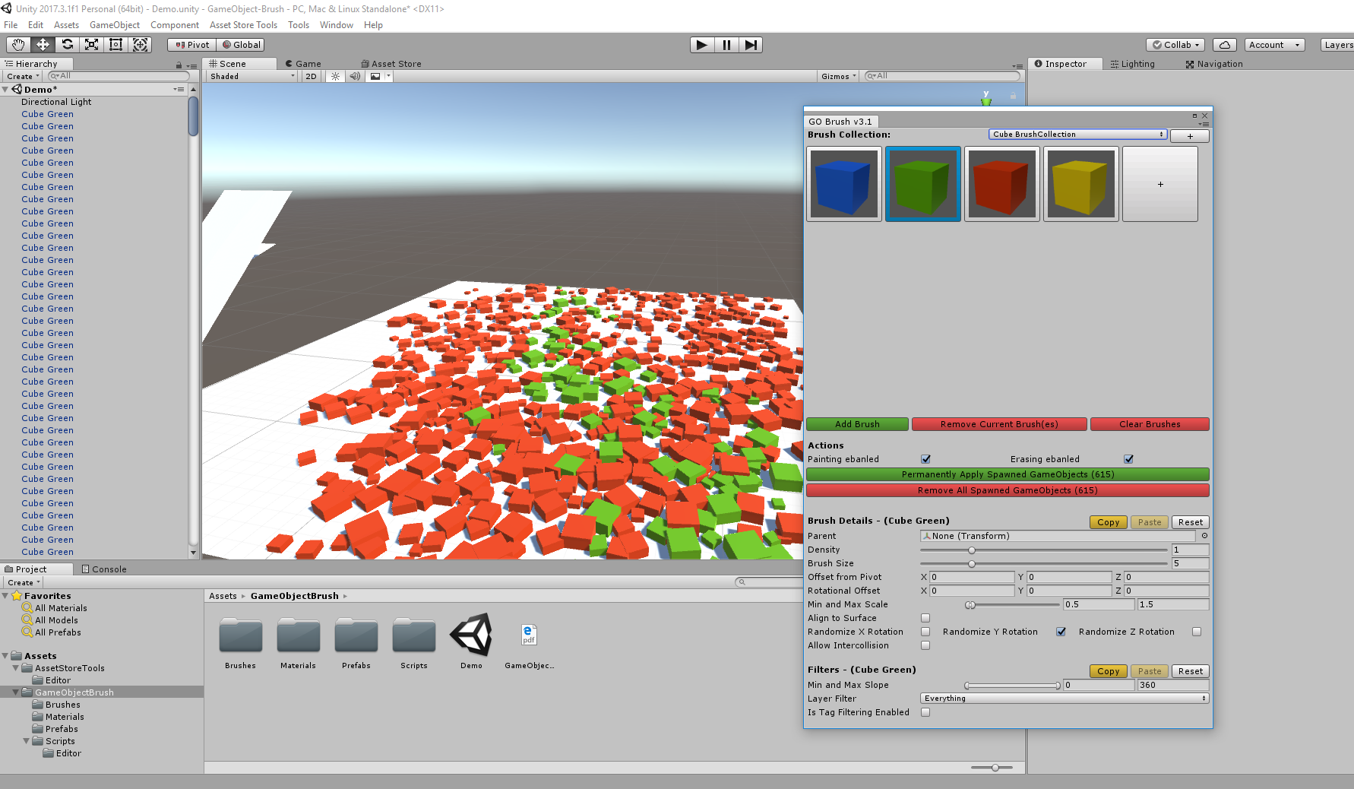
Key Features
Multi-Brush-Painting
Persisstent, Exportable Brush Collections
Copy And Paste Brush Settings
Parenting of created GameObjects
Density
Brush Size
Min and Max Scale
Offset From Pivot
Rotational Offset
Randomize Rotation
Align to Surface
Allow Intercollision
Enable/Disable Painting
Filter by Slope
Filter by Layer
Filter by Tag

Slide 3
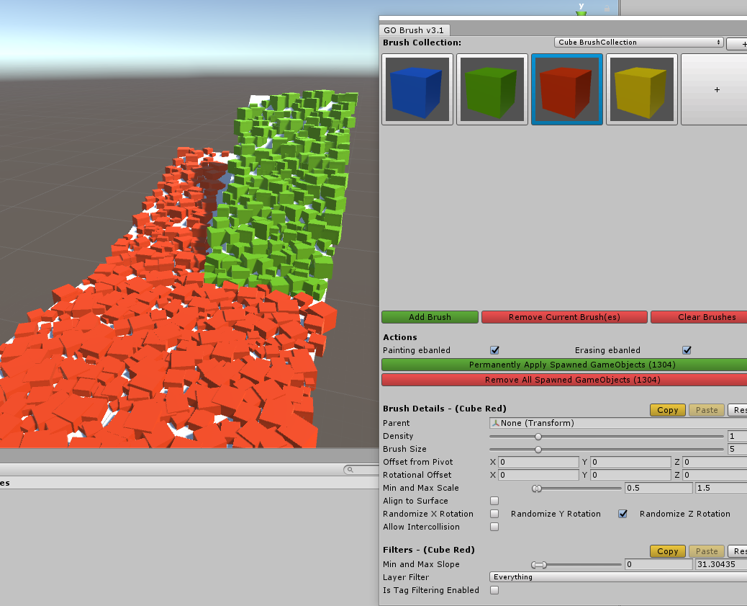
Filter by Slope

Slide 4
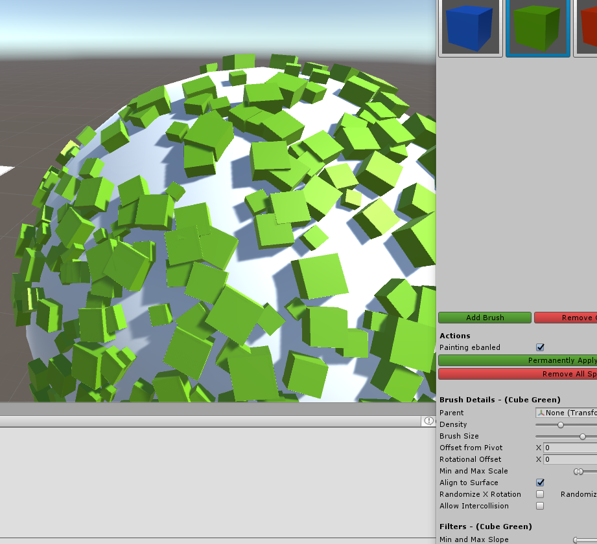
Align to Surface

Slide 5
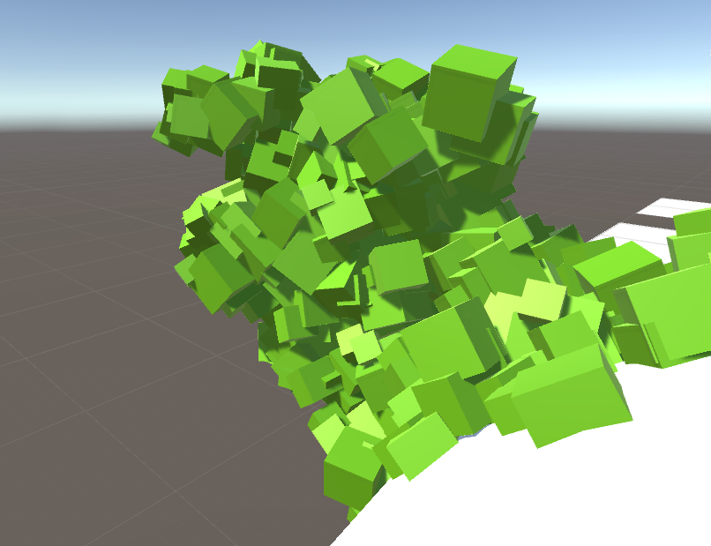
Intercollision

Slide 6
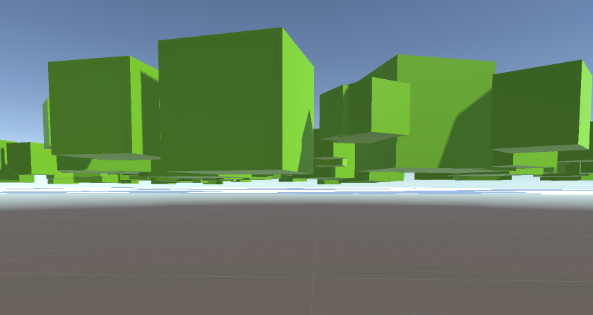
Fix this! With the Offset from the Object Pivot

Slide 7
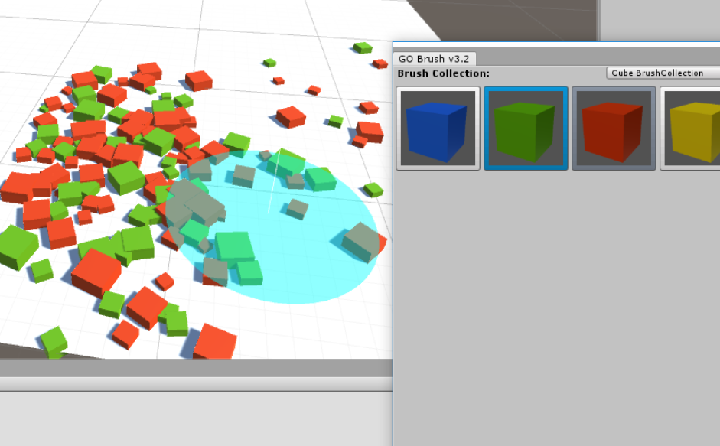
Paint with multiple Brushes at the same Time

Slide 8
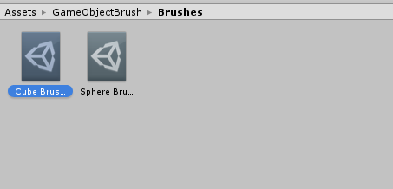
Save and share your Brush Collections

Slide 9
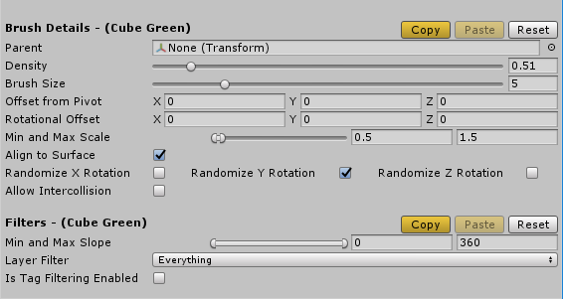
Customize every little Detail of your Brush

