Slide 1
Project

Slide 2
Problem statement
Affordability of student loans is a rising topic in the United States in recent years. Many argue that it has jeopardized many families’ financial situation.

Slide 3
Problem statement
-Skyrocketing student debts doesn’t seem to stop families apply for student loan. With more families put great emphasis on education, and supportive policy, many families are willing to take a risk. In fact, a survey showed that 90% of private student loans now have an adult co-signer.

Slide 4
Problem statement
-However,Do families have an clear idea about their financial situation to take a student loan? Do they really know how the educational loan is going to affect their finance ?

Slide 5
Goal of the analysis
Determine which characteristics of a family have correlations with education loan amount if they decide to apply for a loan.
Determine how amount of education loan can exacerbate financial struggle of a family.

Slide 6
Source of Data
The Survey of Consumer Finances(SFC) is a dataset which contains all the data needed for the analysis and is provided by The Federal Reserve, the central bank of the US for the purpose of helping the government and ultimately the public to understand the financial condition of families in the US and to study the effects of changes in the economy.

Slide 7
Source of the Data
The Survey comes with a code book to interpret the data.
The Data set has 31240 observations and 5321 variables.

Slide 8
Challenges
Finding the desired informaton among 5000+ variables
Translation of the values in the dataset
Finding an appropriate model for the data
Dealing with factors and 0’values

Slide 9
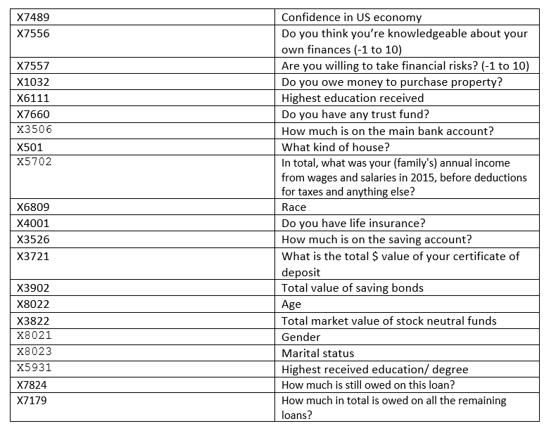
Predicting student loan
Variables

Slide 10
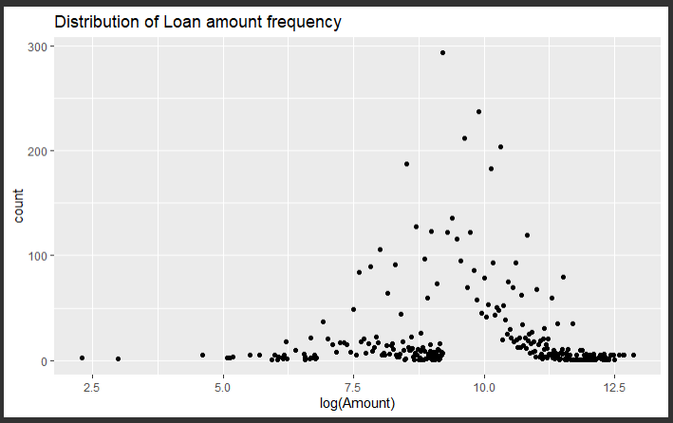
Loan amount-frequency distribution

Slide 11
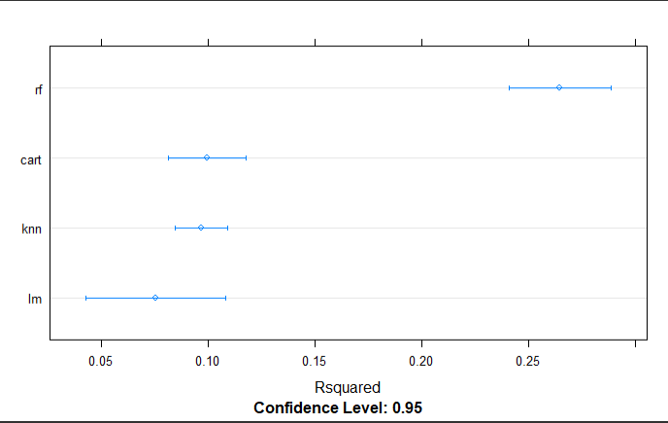
Model comparison

Slide 12
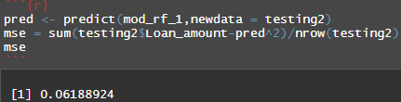
Mean Squared Error

Slide 13
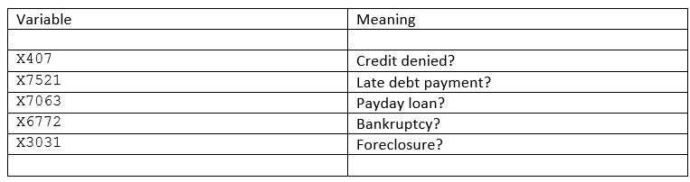
Impact of financial struggle indicators on student loan
Variables

Slide 14
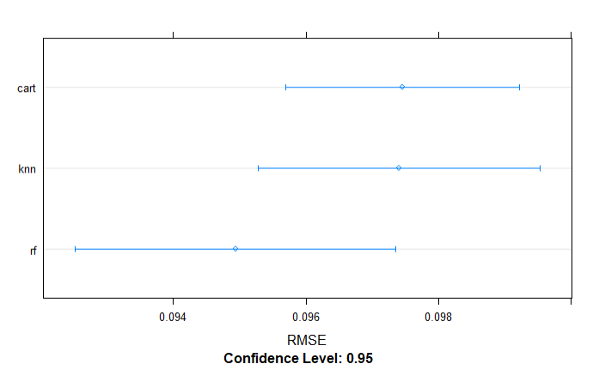
Model comparison

Slide 15
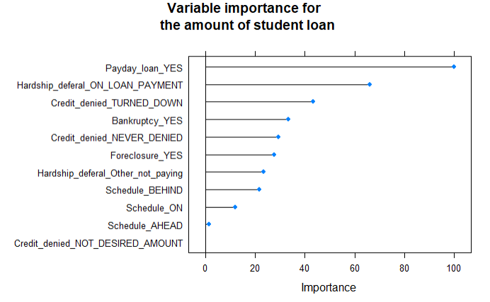
Importance

