Slide 1
Video game sales
A look at total sales over time, sales by area, popular genres,
and Nintendo games

Slide 2
Global sales over time * Data shows sales of each of 16,600 video games by the year of release
Sales peaked in 2006/2007, with release of Wii Sports for the Nintendo Wii
Sales since then have dropped sharply
Sales “flat-lined” around 2017

Slide 3
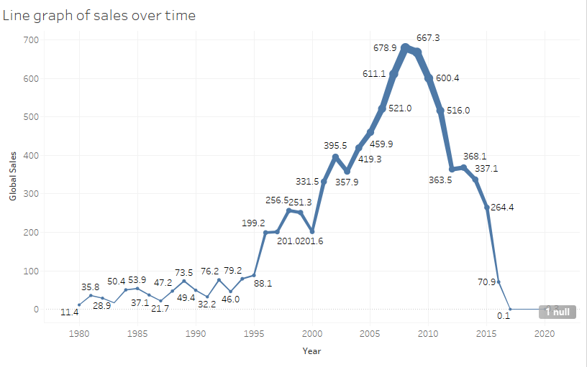
Global sales over time
Data lists the sales of each of 16,600 video games by the year of release
Wii Sports, released in 2006, made the most sales globally

Slide 4
Sales by region
North America has dominated in sales of video games
Japan, at least since the late 1990s, has seen the fewest sales

Slide 5
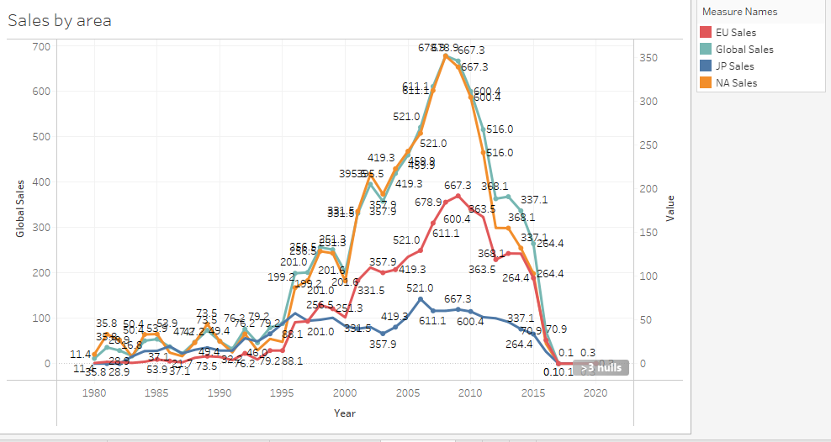
Sales by region
As we can see, North American sales have accounted for a good percentage of global sales, particularly between 1995 and around 2012

Slide 6
The most popular genres
Action games were most popular
Sports games were second most popular
Coming in last were strategy and adventure games

Slide 7
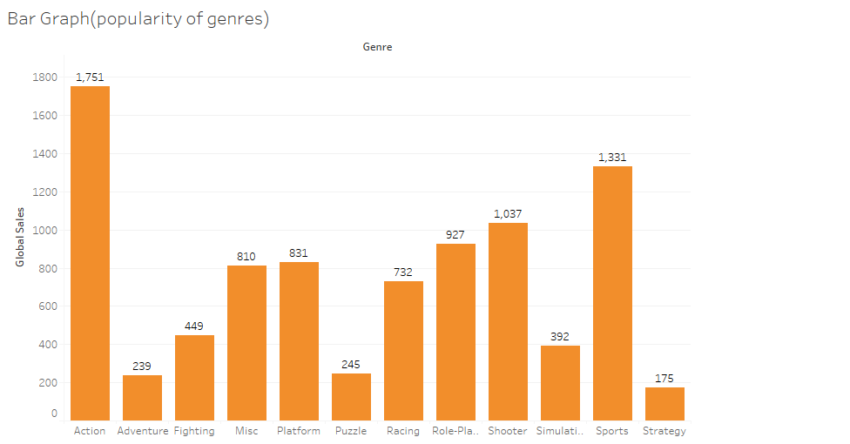

Slide 8
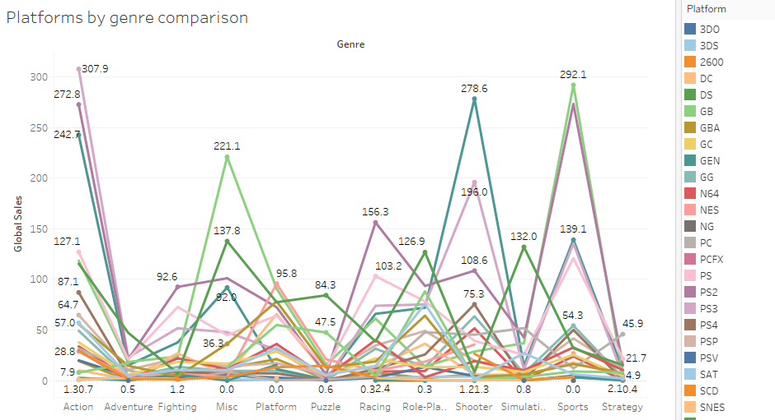
Game platforms by genre
Wii sold the most sports games (with Wii Sports)
Xbox 360 came in highest in shooter games, followed by the PS3
PS3 dominated action games, followed by PS2

Slide 9
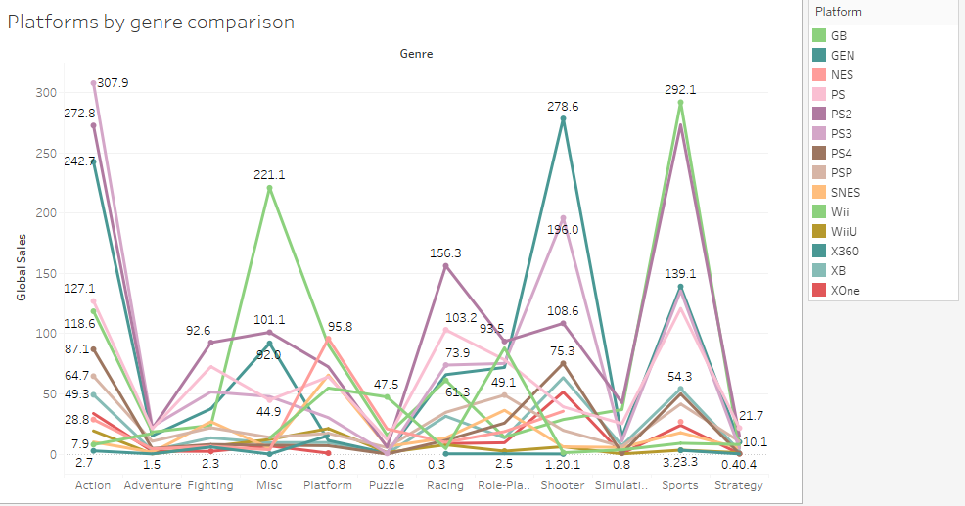
Platform by genre, simplified
This graph shows only the “heavy hitters”
Now easier to see which platform each line represents

Slide 10
Special look at Nintendo sales
Will look at:
Overall Nintendo sales over time
Nintendo sales by title
Nintendo sales by platform

Slide 11
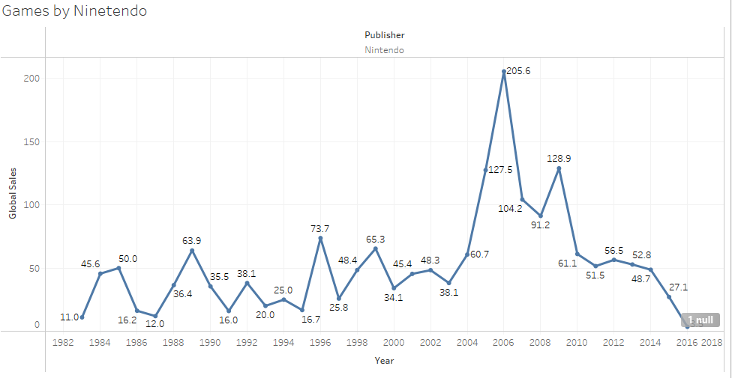
Nintendo sales over time
Highest sales made in 2006/2007 following release of Wii Sports
Sales jumped again (though much less so) around 2009

Slide 12
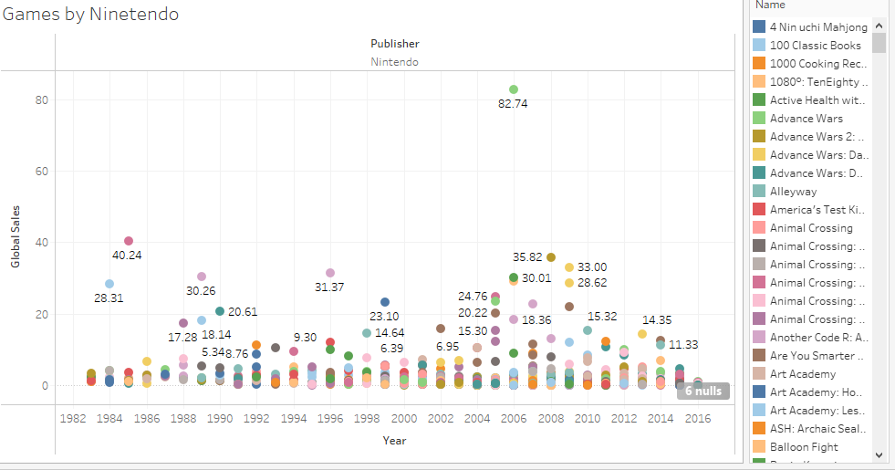
Nintendo sales by title
The biggest seller, by far, was Wii Sports (green dot)
Second biggest seller was the original Mario Bros way back in 1985

Slide 13
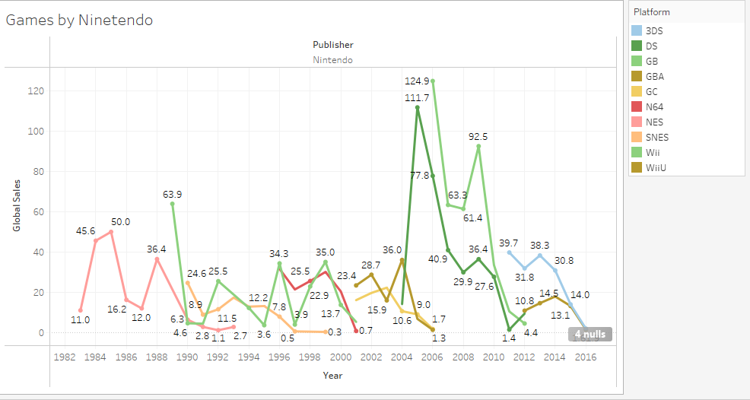
Nintendo sales by platform
- Most popular was the Wii, followed by the DS

Slide 14
Summary
Most popular genres of video game have been Action and Sports
Sales peaked around 2006 with release of Wii Sports and have declined since
North America has dominated the video game market
Most popular Nintendo games have been Wii Sports and Super Mario Bros.

