Slide 1

NBA Player Prediction
Using machine learning classification techniques to predict future performance of NBA players – By Patrick Wales-Dinan

Slide 2
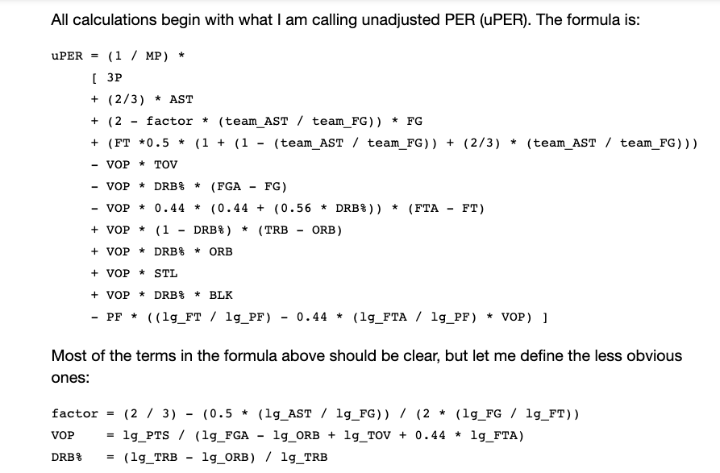
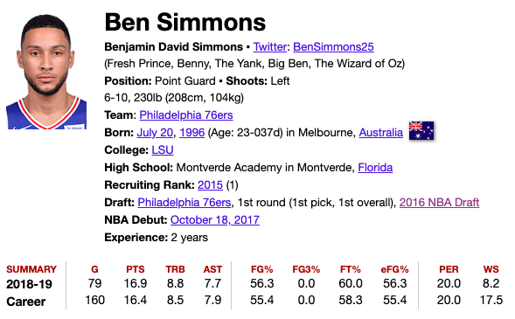
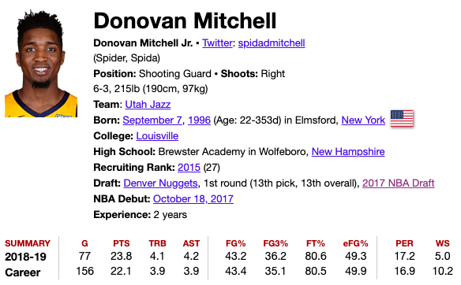
Understanding the Problem
Choosing a metric to predict
Player Efficiency Rating – PER
The PER sums up all a player's positive accomplishments, subtracts the negative accomplishments, and returns a per-minute rating of a player's performance. (Rate statistic – more on this later)
Can we accurately predict if someone will meet a particular PER threshold in the future?
What to choose: > 20 PER & > 1200 MP
THE PROBLEM
DATA GATHERING
DATA CLEANING
VISUALIZING
MODELING
ANALYSIS
CONCLUSIONS

Slide 3
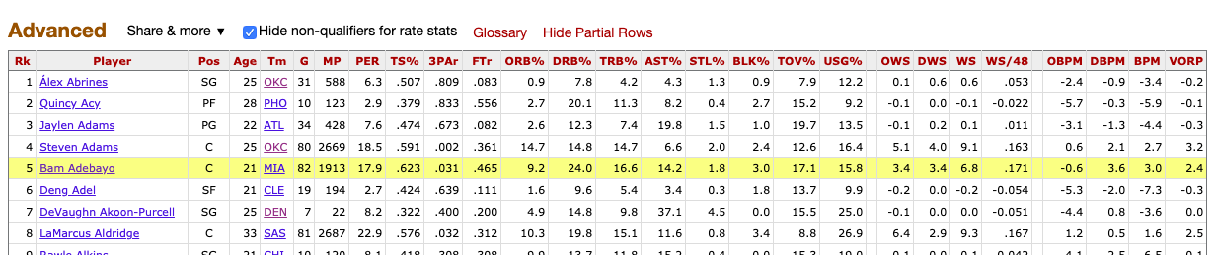
Obtaining the Data
basketball-reference.com
Has advanced metrics tables for every season in NBA history
Tables are downloadable
Needed NBA Draft data as well.
NBA Draft tables available for download
What data to choose, and why?
Future Idea?
THE PROBLEM
DATA GATHERING
DATA CLEANING
VISUALIZING
MODELING
ANALYSIS
CONCLUSIONS

Slide 4
Preparing the Data
Ideas
Player Improvement from 2 years previous
VORP
PER
WS
Future prediction based on first 2 years
PER
PREDICTING: If a player has not achieved a PER of > 20 and simultaneously played > 1200 minutes; can we predict if they will in future seasons? – Call this Target Benchmark
THE PROBLEM
DATA GATHERING
DATA CLEANING
VISUALIZING
MODELING
ANALYSIS
CONCLUSIONS

Slide 5
Creating my Dataframe
Process:
Concatenate all advanced metrics DFs into one advanced_df
Concatenate draft DFs into one draft_df
Merge these two DFs together to get an nba_df
Locate all players rookie and second years
Determine if any of those players achieved the target benchmark in there first two seasons
16 players did → Removed them from the DF
Give players a 5 year window to achieve the target benchmark
This means seasons 3 → 7 (Sort through nba_df and pull out these observations)
Look to see which players achieved this in years 3 → 7, if so assign 1 to target
Get dataframe of each players 2nd year with the target class assigned
THE PROBLEM
DATA GATHERING
DATA CLEANING
VISUALIZING
MODELING
ANALYSIS
CONCLUSIONS

Slide 6
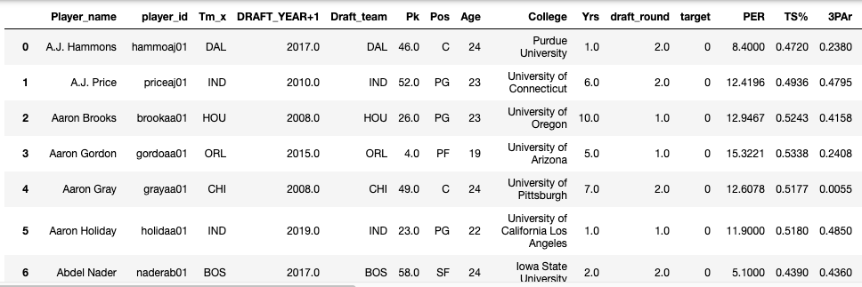
Creating my Dataframe
Results: Second Year Prime
Yielded 490 unique players with 42 who hit the benchmark target
This means that the baseline is 0.086%
Call it second_year_prime
THE PROBLEM
DATA GATHERING
DATA CLEANING
VISUALIZING
MODELING
ANALYSIS
CONCLUSIONS

Slide 7
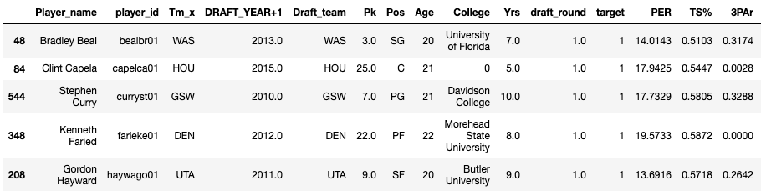
Creating my Dataframe
Results: 1st & 2nd year aggregated
More data so combine rookie and 2nd year into one entry
Problem: Rate data can’t be added: Weighted Average
Aggregate the cumulative stats and apply weighted average to the rate statistics.
Yielded 621 unique players
THE PROBLEM
DATA GATHERING
DATA CLEANING
VISUALIZING
MODELING
ANALYSIS
CONCLUSIONS

Slide 8
Creating my Dataframe
Validation Set: Future predictions
Removed players from the 2015, 2016, & 2017 drafts
After training the model → test on the validation set for prediction and inference (more on this later)
THE PROBLEM
DATA GATHERING
DATA CLEANING
VISUALIZING
MODELING
ANALYSIS
CONCLUSIONS

Slide 9
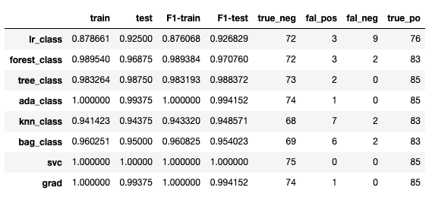
Modeling the Data
Aggregated Classification: second_year_prime
Imbalanced classes: 0.08% are from the target class
Oversampling techniques prior to modeling → balanced classes
Tested 8 models: - Logistic Regression, KNeighbors Classifier, DecisionTree Classifier, Bagging Classifier, Random Forest Classifier, AdaBoost Classifier, Support Vector Classifier, and Gradient Boosting Classifier
THE PROBLEM
DATA GATHERING
DATA CLEANING
VISUALIZING
MODELING
ANALYSIS
CONCLUSIONS

Slide 10
Modeling the Data
Goal: Minimize False Negatives
Personal Preference – losing a valuable player is worse than inventing in one that doesn’t become valuable
Used the Accuracy Score, F1-Score and the actual values of the false negatives and true positives to measure the performance of the model from an analytical perspective
THE PROBLEM
DATA GATHERING
DATA CLEANING
VISUALIZING
MODELING
ANALYSIS
CONCLUSIONS

Slide 11
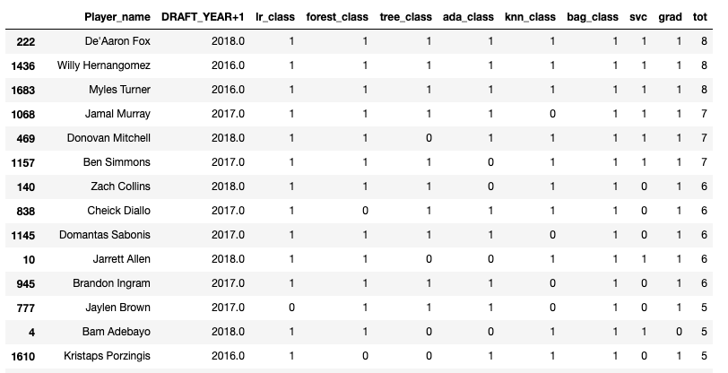
Modeling the Data
Goal: Minimize False Negatives
Personal Preference – losing a valuable player is worse than inventing in one that doesn’t become valuable
Used the Accuracy Score, F1-Score and the actual values of the false negatives and true positives to measure the performance of the model from an analytical perspective
THE PROBLEM
DATA GATHERING
DATA CLEANING
VISUALIZING
MODELING
ANALYSIS
CONCLUSIONS

Slide 12
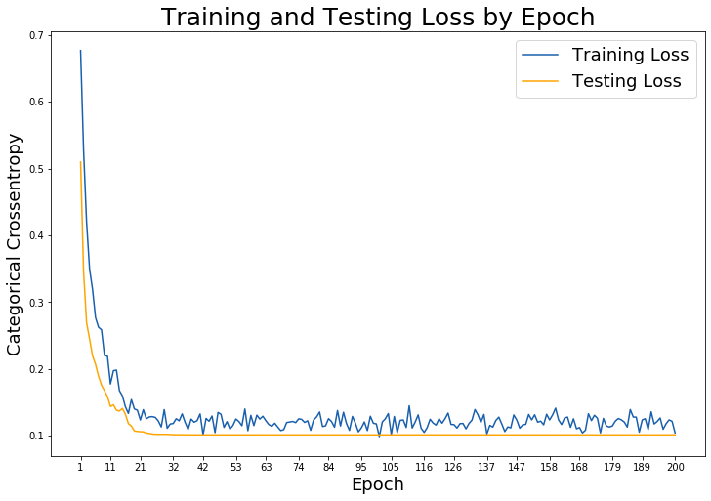
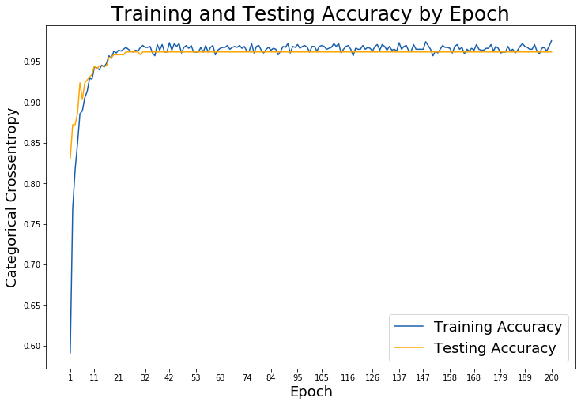
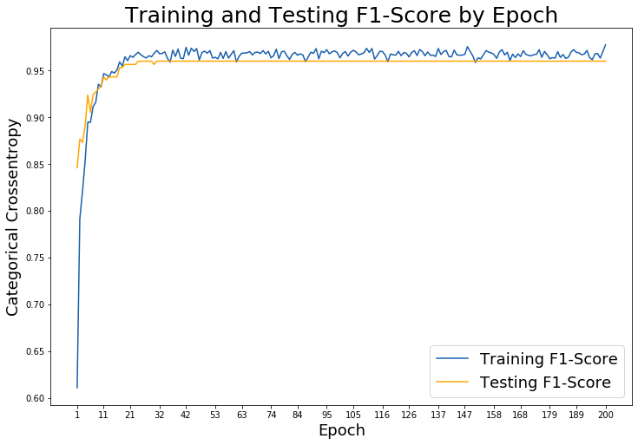
Modeling the Data
Goal: Neural Nets
Aggregating was successful but is there a better way?
Neural Net with dropout
Using a callback to reduce the learning rate
What did we see?
THE PROBLEM
DATA GATHERING
DATA CLEANING
VISUALIZING
MODELING
ANALYSIS
CONCLUSIONS

Slide 13
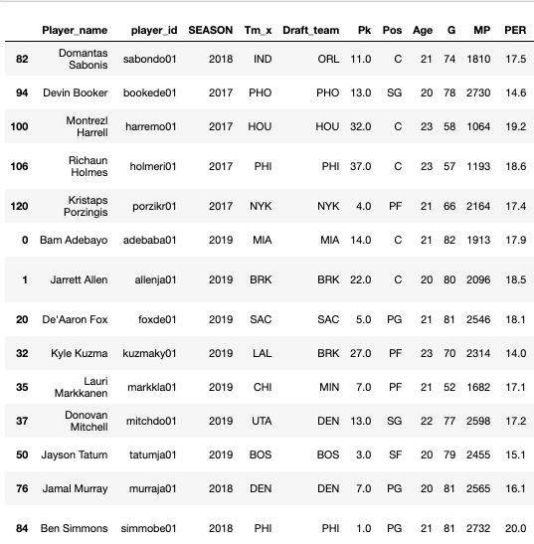
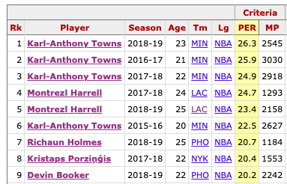
Findings
Neural Nets: Aggregated Data
What are we looking at?
Remember these guys?
THE PROBLEM
DATA GATHERING
DATA CLEANING
VISUALIZING
MODELING
ANALYSIS
CONCLUSIONS

Slide 14
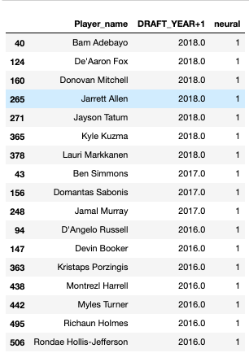
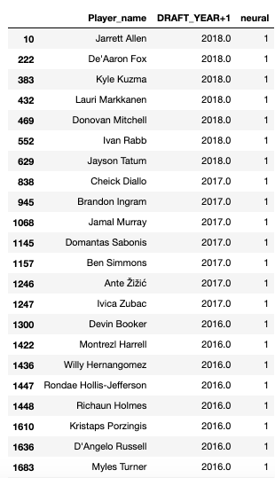
Findings
Comparison: Complied vs. Second Year Only
More data.
Makes up for a poor second year or injury or sophomore drop off
Sophomore drop off? Data doesn’t back that up
Second year data includes far more players? Is this good? False Negatives?
Compiled out performs
THE PROBLEM
DATA GATHERING
DATA CLEANING
VISUALIZING
MODELING
ANALYSIS
CONCLUSIONS

Slide 15

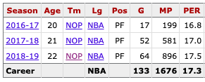

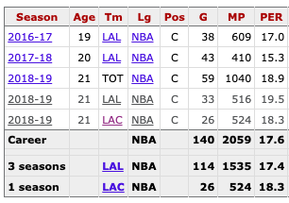
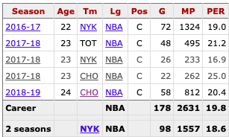
Findings
Comparison: Complied vs. Second Year Only
THE PROBLEM
DATA GATHERING
DATA CLEANING
VISUALIZING
MODELING
ANALYSIS
CONCLUSIONS

Slide 16
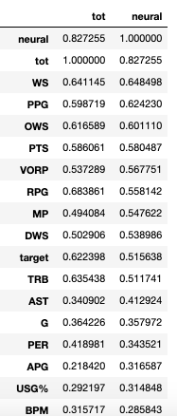
Conclusions
Was this a success?
The neural net did a fantastic job predicting future player performance
What were the features that are correlated with NN or ensemble success
RPG is an interesting number? Steady, from year to year
THE PROBLEM
DATA GATHERING
DATA CLEANING
VISUALIZING
MODELING
ANALYSIS
CONCLUSIONS

Slide 17
What’s next
Other predictions
Different metrics?
Easier metrics to predict?
Less statistical based predictions?
Predicting All-Stars? → Voted on
Predicting All-NBA Teams → Tier system
Apply this model to last years cohort at the conclusion of this season.
THE PROBLEM
DATA GATHERING
DATA CLEANING
VISUALIZING
MODELING
ANALYSIS
CONCLUSIONS

