Slide 1
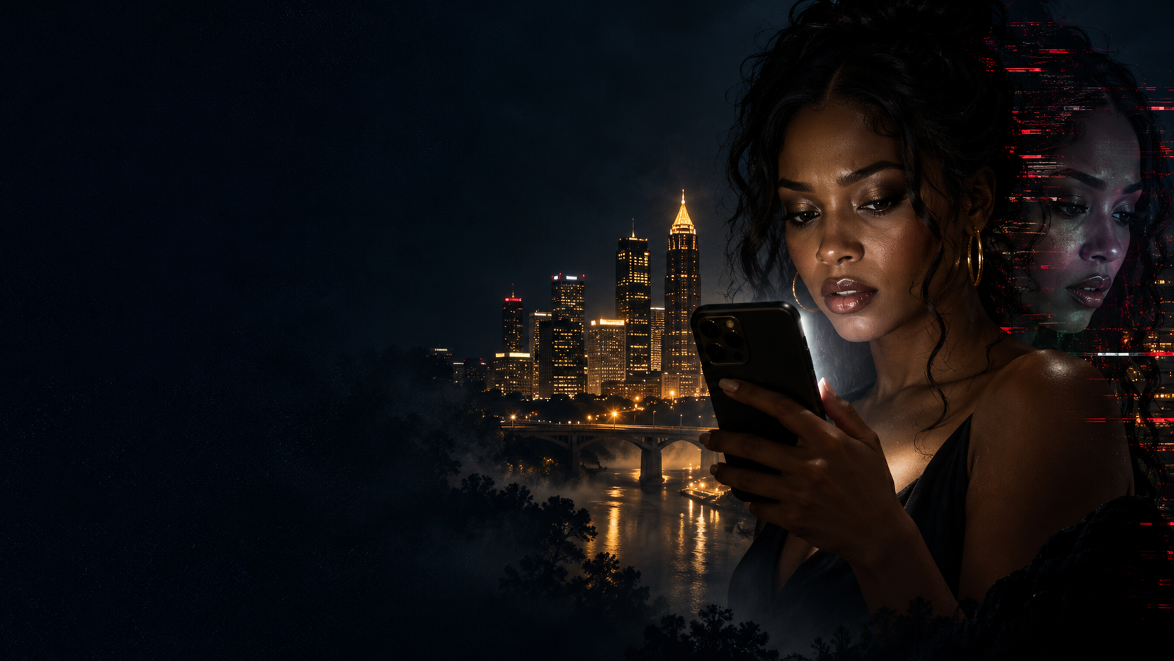
THE INFLUENCER'S
LAST POST
She built her life online.
He's about to take it apart.
FEATURE FILM
PSYCHOLOGICAL THRILLER
PROPOSED BUYER: BET+
Written by K.R. Tenney
NCCA ENTERTAINMENT
01
Notes:
Source: The Influencer's Last Post New One Pager.pdf, supplied by K.R. Tenney, pages 1 and 3. Character names and BET+ positioning follow this newer package. Earlier Green screenplay provides supporting scene context. Artwork is fictional concept art generated for this pitch. Proposed creative and production approaches are not confirmed production commitments.

Slide 2
The premise
When Atlanta influencer Taylor Monroe is framed for her best friend's staged suicide, she must expose the tech mogul running an AI behavioral-mimicry system before he uses her own digital identity to silence her permanently.
NCCA ENTERTAINMENT
02
Notes:
Source: The Influencer's Last Post New One Pager.pdf, supplied by K.R. Tenney, pages 1 and 3. Character names and BET+ positioning follow this newer package. Earlier Green screenplay provides supporting scene context. Artwork is fictional concept art generated for this pitch. Proposed creative and production approaches are not confirmed production commitments.

Slide 3
The story
A public collapse
Taylor has 2.3 million followers. After Nina disappears from an Atlanta bridge, the internet decides Taylor is responsible.
A friend who keeps posting
Nina's familiar captions and cadence continue online. Taylor discovers that her friend is alive and hiding from Derek Mason.
A manufactured identity
Project Echo can imitate the women so convincingly that even the people closest to them struggle to recognize the truth.
NCCA ENTERTAINMENT
03
Notes:
Source: The Influencer's Last Post New One Pager.pdf, supplied by K.R. Tenney, pages 1 and 3. Character names and BET+ positioning follow this newer package. Earlier Green screenplay provides supporting scene context. Artwork is fictional concept art generated for this pitch. Proposed creative and production approaches are not confirmed production commitments.

Slide 4
The investigation
Taylor follows the private clues
Handwritten captions and shared memories offer a way through the public evidence that Derek controls.
An insider carries the proof
Bianca helped Nina disappear. Her evidence and knowledge of Echo become essential to exposing Derek.
Taylor takes control
With Marcus beside her, Taylor turns Derek's own system against him and risks a final confrontation to recover her name.
NCCA ENTERTAINMENT
04
Notes:
Source: The Influencer's Last Post New One Pager.pdf, supplied by K.R. Tenney, pages 1 and 3. Character names and BET+ positioning follow this newer package. Earlier Green screenplay provides supporting scene context. Artwork is fictional concept art generated for this pitch. Proposed creative and production approaches are not confirmed production commitments.

Slide 5
The women at the center
TAYLOR MONROE
An Atlanta creator whose sharp instincts sit beneath years of brand training. She must become the investigator in her own story.
NINA BAPTISTE
Taylor's best friend and a planner under pressure. Her disappearance protects a secret and leaves Taylor to face its consequences.
BIANCA COLE
A gifted technical insider caught between Derek's coercion and loyalty to Nina. Helping the women requires confronting her complicity.
NCCA ENTERTAINMENT
05
Notes:
Source: The Influencer's Last Post New One Pager.pdf, supplied by K.R. Tenney, pages 1 and 3. Character names and BET+ positioning follow this newer package. Earlier Green screenplay provides supporting scene context. Artwork is fictional concept art generated for this pitch. Proposed creative and production approaches are not confirmed production commitments.

Slide 6
The ally and the antagonist
MARCUS WEBB
DEREK MASON
A former cybercrime investigator and Taylor's ally. His authority grounds the investigation, while his warmth lets Taylor risk trusting someone again.
A controlled, persuasive tech entrepreneur. He presents coercion as reasonable business and uses the women’s digital identities to keep them dependent.
Trust becomes a choice with consequences
NCCA ENTERTAINMENT
06
Notes:
Source: The Influencer's Last Post New One Pager.pdf, supplied by K.R. Tenney, pages 1 and 3. Character names and BET+ positioning follow this newer package. Earlier Green screenplay provides supporting scene context. Artwork is fictional concept art generated for this pitch. Proposed creative and production approaches are not confirmed production commitments.

Slide 7
Atlanta and Project Echo
The world
Creator ambition, luxury rooftops and curated apartments contrast with private rooms where friendship and family still matter.
The threat
Echo copies a face, a voice and a posting rhythm. The people who know Taylor best must decide whether they believe the woman or the screen.
NCCA ENTERTAINMENT
07
Notes:
Source: The Influencer's Last Post New One Pager.pdf, supplied by K.R. Tenney, pages 1 and 3. Character names and BET+ positioning follow this newer package. Earlier Green screenplay provides supporting scene context. Artwork is fictional concept art generated for this pitch. Proposed creative and production approaches are not confirmed production commitments.

Slide 8
Tone and visual approach
Psychological suspense with an intimate emotional center
Public image
Controlled framing, polished light and invasive screens make Taylor's curated life feel increasingly unsafe.
Private truth
Natural faces, handwritten words and imperfect rooms restore intimacy. The visual contrast follows Taylor's changing relationship with performance.
NCCA ENTERTAINMENT
08
Notes:
Source: The Influencer's Last Post New One Pager.pdf, supplied by K.R. Tenney, pages 1 and 3. Character names and BET+ positioning follow this newer package. Earlier Green screenplay provides supporting scene context. Artwork is fictional concept art generated for this pitch. Proposed creative and production approaches are not confirmed production commitments.

Slide 9
BET+ positioning and creative references
A Black female protagonist drives an Atlanta thriller about friendship, ambition and control in the creator economy.
CREATIVE REFERENCES
Acrimony
Betrayal and emotional escalation
Searching
Digital investigation and screen storytelling
A Fall from Grace
Atlanta setting and reversals of trust
The Girl on the Train
A compromised heroine and uncertain evidence
NCCA ENTERTAINMENT
09
Notes:
Source: The Influencer's Last Post New One Pager.pdf, supplied by K.R. Tenney, pages 1 and 3. Character names and BET+ positioning follow this newer package. Earlier Green screenplay provides supporting scene context. Artwork is fictional concept art generated for this pitch. Proposed creative and production approaches are not confirmed production commitments.
Comparisons are tonal references selected in the supplied one-pager, not financial forecasts, buyer endorsements or claims of affiliation.

Slide 10
Casting references: the women
Casting references only. No talent attachments represented.
TAYLOR MONROE
NINA BAPTISTE
BIANCA COLE
Keke Palmer
Dominique Fishback
Meagan Good
Antoinette Robertson
DeWanda Wise
Logan Browning
Nafessa Williams
Simone Missick
Essence Atkins
Performance focus
Taylor carries terror, wit and grief. Nina must earn renewed trust. Bianca holds the tension between complicity and courage.
NCCA ENTERTAINMENT
10
Notes:
Source: The Influencer's Last Post New One Pager.pdf, supplied by K.R. Tenney, pages 1 and 3. Character names and BET+ positioning follow this newer package. Earlier Green screenplay provides supporting scene context. Artwork is fictional concept art generated for this pitch. Proposed creative and production approaches are not confirmed production commitments.

Slide 11
Casting references: the men
Casting references only. No talent attachments represented.
DEREK MASON
MARCUS WEBB
Omari Hardwick
Morris Chestnut
Laz Alonso
Algee Smith
Sinqua Walls
Kendrick Sampson
Derek's menace lives in his restraint. Marcus brings authority without eclipsing Taylor's agency.
NCCA ENTERTAINMENT
11
Notes:
Source: The Influencer's Last Post New One Pager.pdf, supplied by K.R. Tenney, pages 1 and 3. Character names and BET+ positioning follow this newer package. Earlier Green screenplay provides supporting scene context. Artwork is fictional concept art generated for this pitch. Proposed creative and production approaches are not confirmed production commitments.

Slide 12
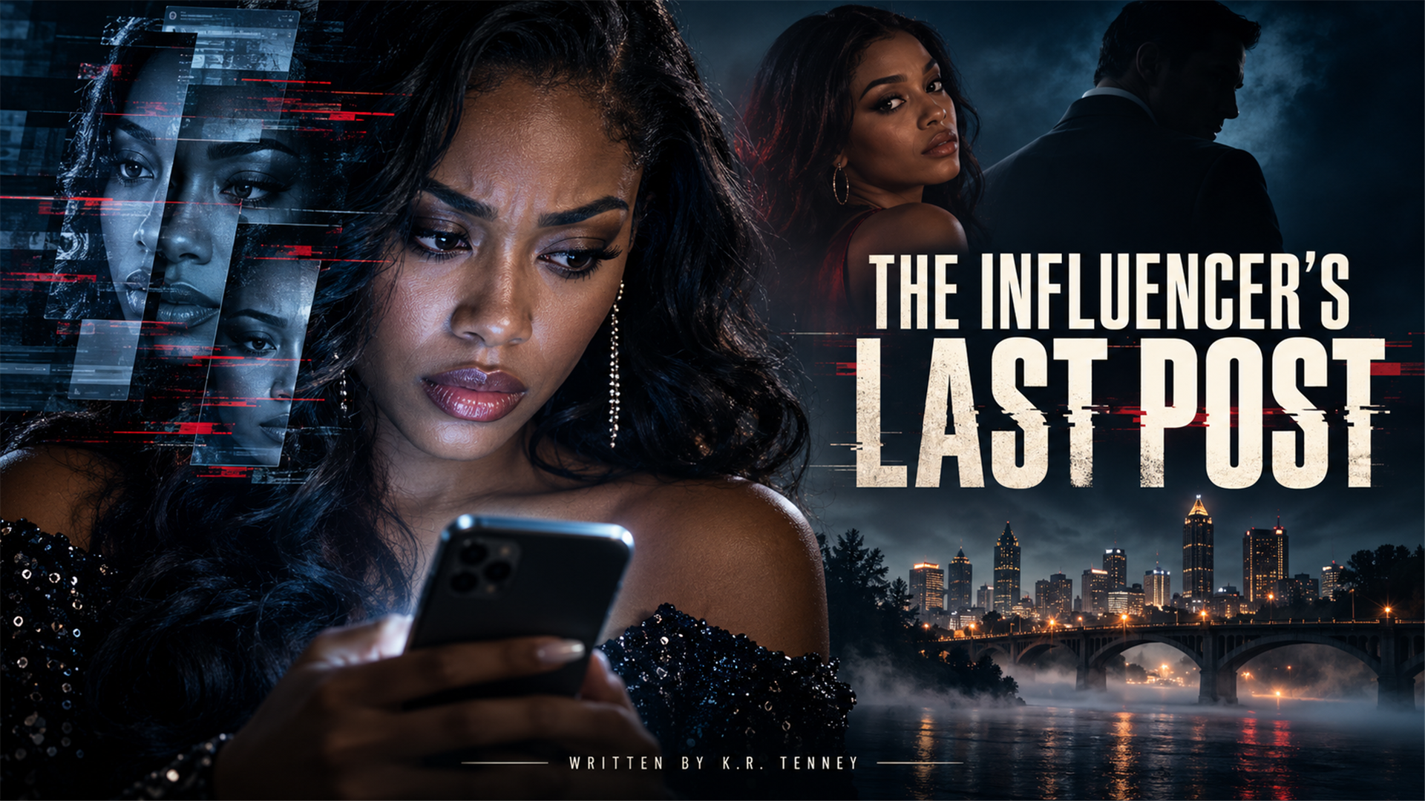
The film package
PROPOSED PRODUCTION APPROACH
Atlanta locations
A recurring core ensemble
Reusable apartment and office interiors
Selective bridge and mountain exteriors
K.R. Tenney
NCCA Entertainment Inc.
contact@nccaentertainment.com
NCCA ENTERTAINMENT
12
Notes:
Source: The Influencer's Last Post New One Pager.pdf, supplied by K.R. Tenney, pages 1 and 3. Character names and BET+ positioning follow this newer package. Earlier Green screenplay provides supporting scene context. Artwork is fictional concept art generated for this pitch. Proposed creative and production approaches are not confirmed production commitments.

