Slide 1
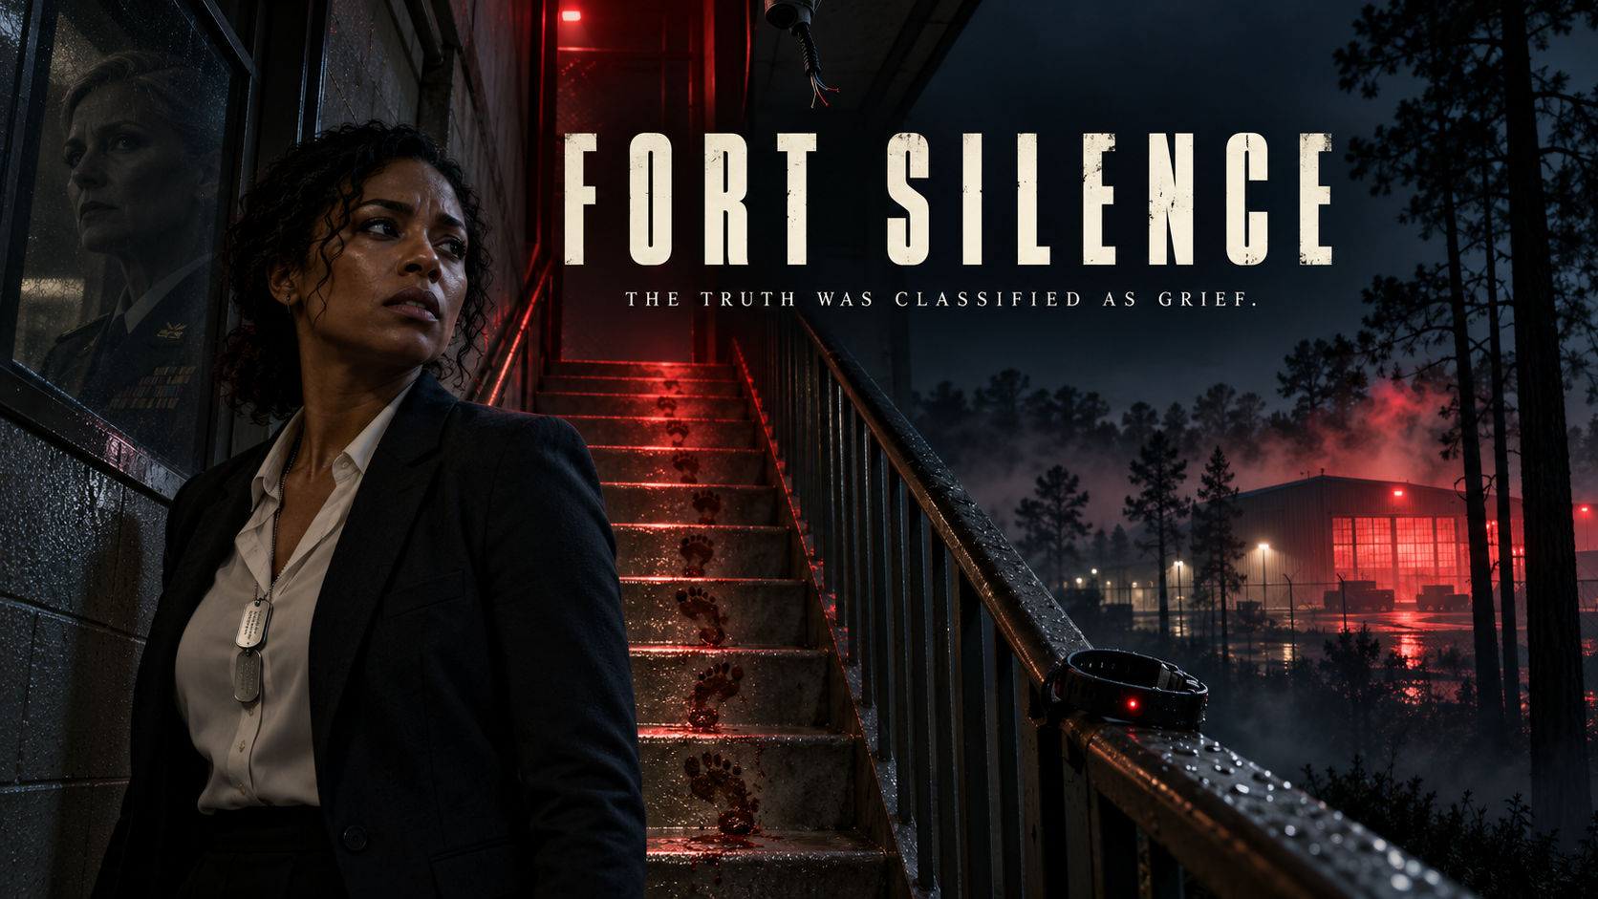
FEATURE FILM / MILITARY INVESTIGATIVE THRILLER
Notes:
Title art is original generated concept art. Story source: FORT SILENCE Second Draft by Kelly R. Tenney, October 1, 2026.

Slide 2
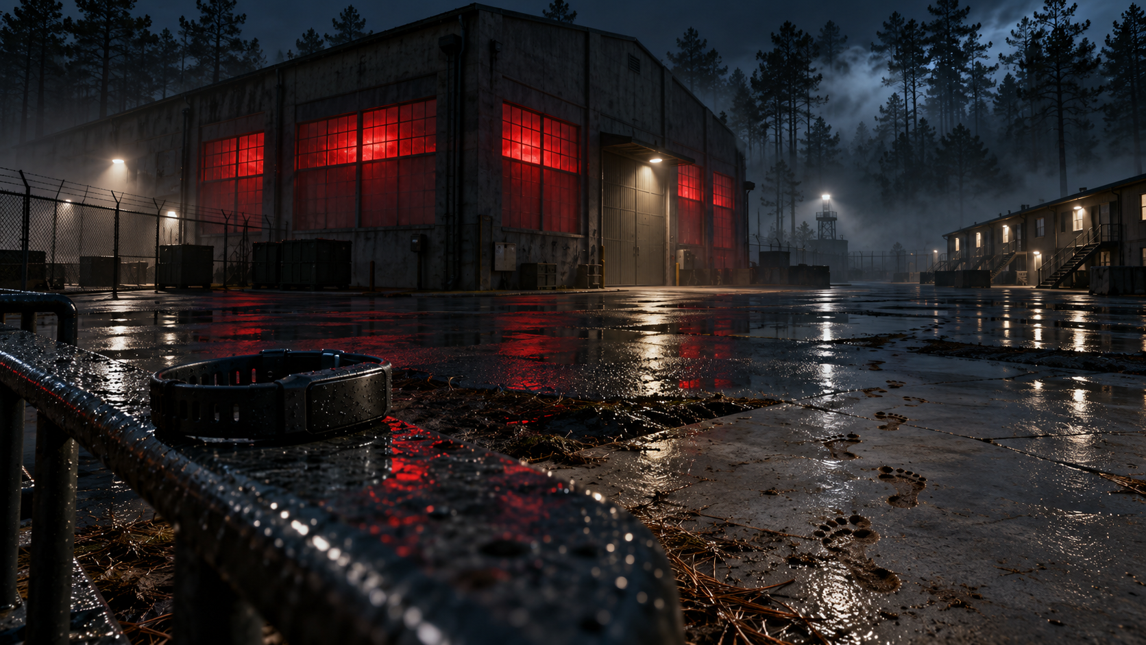
Logline
When a young soldier dies at Fort Stewart, CID agent Jordan Hayes finds the same hidden experiment that killed her father twenty years earlier. To expose it, she must defy the commander who raised her before another private becomes a closed case.
A death investigation becomes a daughter’s reckoning.
FORT SILENCE
02

Slide 3
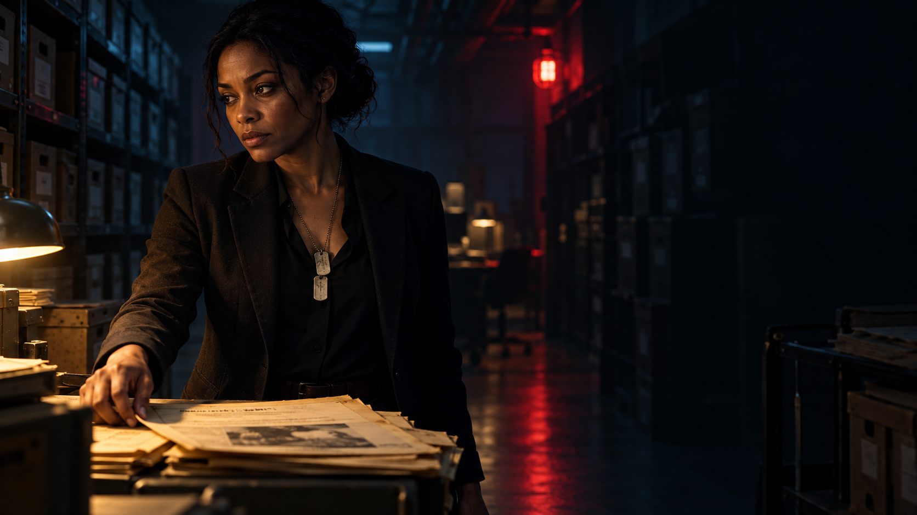
The hook
ONE CASE. TWO GENERATIONS. THE SAME BUILDING.
The woman who taught Jordan to seek the truth has spent twenty years hiding it.
A modern resilience program leaves a trail of exhausted soldiers and altered death reports. Every answer draws Jordan closer to the commander she calls family.
FORT SILENCE
03

Slide 4
Tone and comparables
INVESTIGATIVE TENSION / INTIMATE BETRAYAL
Grounded. Unsettling. Emotionally direct.
The Report
The procedural pursuit of an institutional truth.
Dark Waters
One investigator follows a pattern others dismiss.
A Few Good Men
Military authority and moral responsibility collide.
The Night Of
The system shapes the facts people are allowed to believe.
Comparables describe tone and dramatic approach, not financial performance.
FORT SILENCE
04

Slide 5
JORDAN HAYES
34 / CID SPECIAL AGENT
GOAL
Find out why Tyler Vogel died.
PRESSURE
Her credentials are suspended as fatigue erodes her certainty.
CHANGE
She stops counting closed files and starts protecting the people inside them.

Slide 6
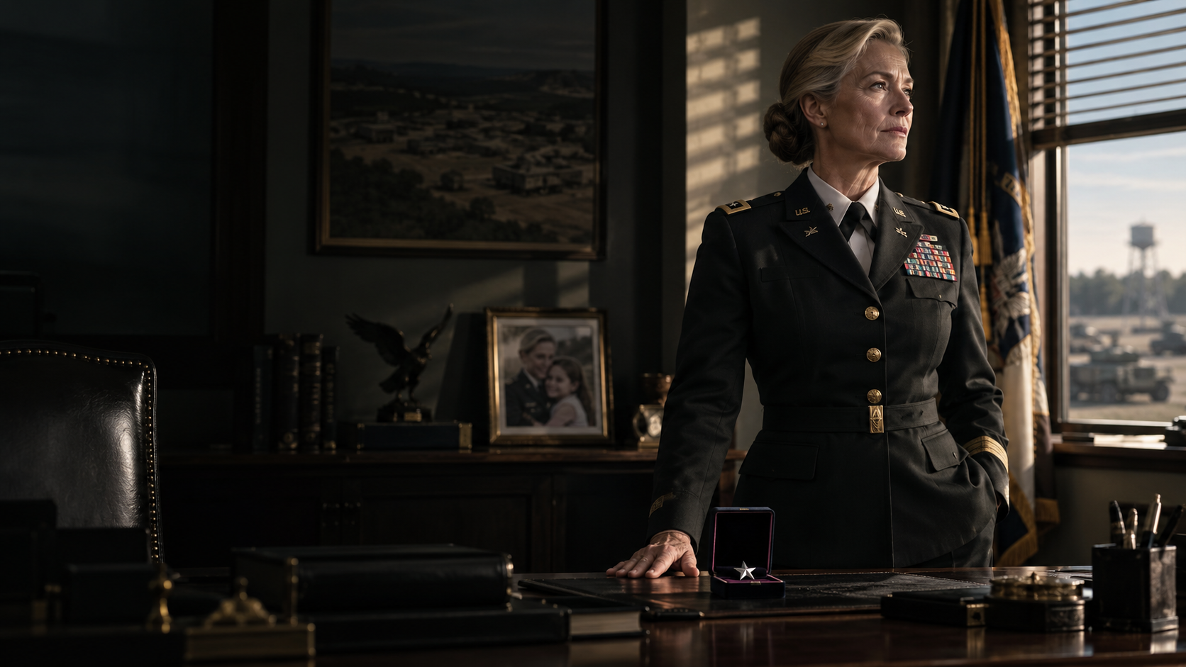
COLONEL DIANE MERCER
58 / GARRISON COMMANDER
HER POWER
A beloved commander and Jordan’s surrogate mother.
HER NEED
Keep the resilience program alive and secure her promotion.
HER CONTRADICTION
She loves Jordan while using that bond to bury the truth.

Slide 7
The people who force the truth into daylight
CARLA RUIZ
DEL NAVARRO
A private who saw Tyler’s final walk and risks her future to testify.
Jordan’s boss must decide whether to trust her evidence after pulling her badge.
ISAIAH BROOKS
ALAN PRUITT
A drill sergeant whose warning was filed away and whose guilt dates back twenty years.
Meridian’s scientist sees soldiers as data and defends the program’s results.
DONNA VOGEL
DEVONTE PRICE
Tyler’s mother refuses to let the Army close his life as a line in a report.
A records specialist risks his career to preserve the raw data.
FORT SILENCE
07

Slide 8
Story
THREE ACTS
I
THE DEATH
Jordan investigates Tyler Vogel’s apparent suicide. Matching wrist burns and three earlier deaths point to a covert program in Building 1147.
II
THE FAMILY LIE
An archived report reveals her father died in the same building. Mercer moves to discredit Jordan, while a frightened witness disappears into behavioral health custody.
III
THE RECORD
Jordan, Brooks, Price, and Carla assemble independent evidence. At a public hearing, Jordan confronts Mercer and forces the Army to face the deaths it hid.
FORT SILENCE
08

Slide 9
Visual language
RAIN ON CONCRETE
FILED SILENCE
COMMAND AND CARE
Blue-black nights, institutional olive, worn paper, and the red glow of Building 1147. Close observation carries the suspense.
FORT SILENCE
09

Slide 10
Casting wishlist
SUGGESTED CONVERSATIONS / NO ATTACHMENTS
JORDAN HAYES
DIANE MERCER
Dominique Fishback
Robin Wright
or Kiki Layne
or Laura Linney
ISAIAH BROOKS
CARLA RUIZ
Sterling K. Brown
Xochitl Gomez
or Colman Domingo
or Isabela Merced
The roles call for a precise investigative lead, a formidable maternal antagonist, and supporting players who make the cost of speaking tangible.
FORT SILENCE
10

Slide 11
Audience and platform fit
PREMIUM STREAMING OR SPECIALTY FEATURE
A sharp premise
A death on an Army post exposes a program with a twenty-year history.
Two major roles
Jordan and Mercer drive the thriller and its emotional stakes.
Contained production
The post, motel, records room, warehouse, and hearing anchor the story.
Trailer moments
The matching wrist burns, father’s file, witness removal, and public confrontation.
Conversation after the credits
Loyalty, duty, and institutional accountability remain in tension.
FORT SILENCE
11

Slide 12
Materials and next steps
AVAILABLE
NEXT
Second draft screenplay (87-page PDF)
First draft screenplay
16:9 concept poster
This editable pitch deck
Lock Tyler’s final sequence and the evidence trail.
Complete a military procedural review.
Prepare budget, schedule, and packaging plan.
Begin targeted cast and partner conversations.
NCCA ENTERTAINMENT
FORT SILENCE
12

