Slide 1
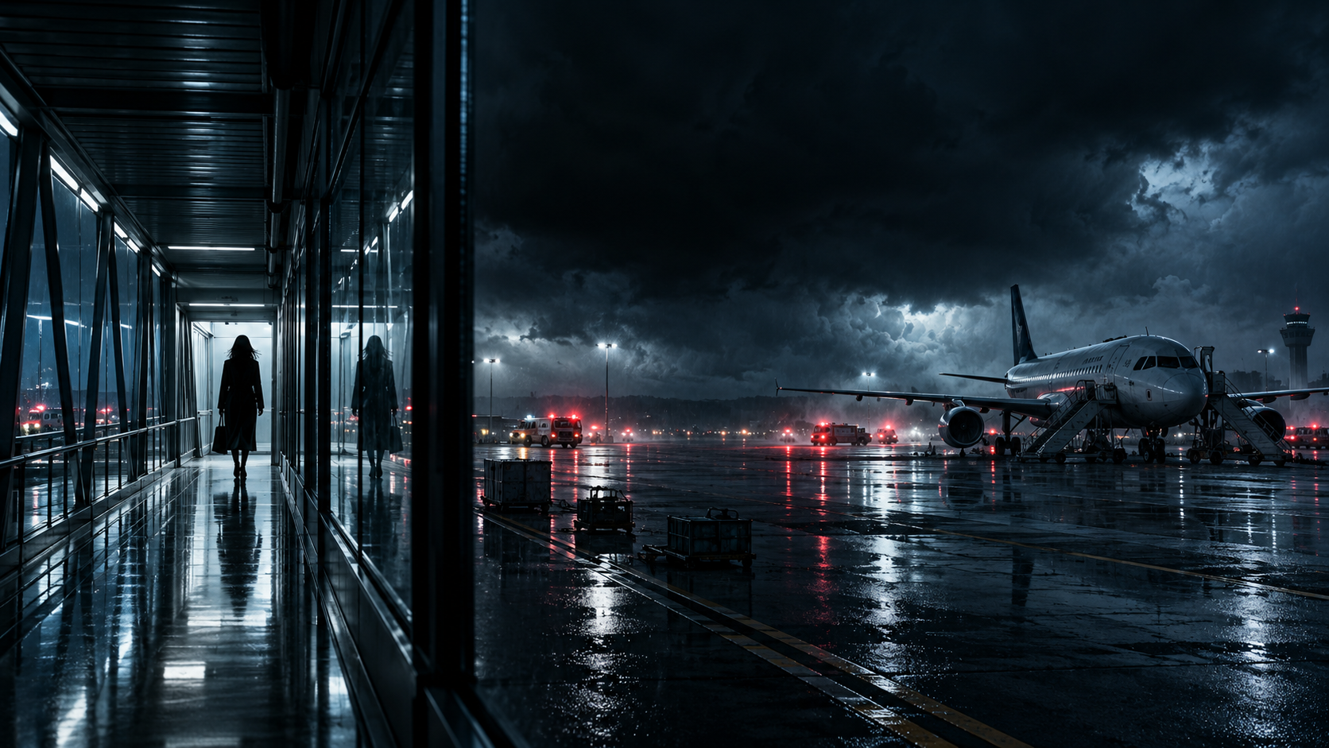
AN INTERNATIONAL CONSPIRACY THRILLER
THE 13TH
PASSENGER
If the system forgets you,
who will remember?
13
F
FEATURE FILM | TECHNO-THRILLER
Notes:
The 13th Passenger pitch deck, slide 1 of 12.

Slide 2
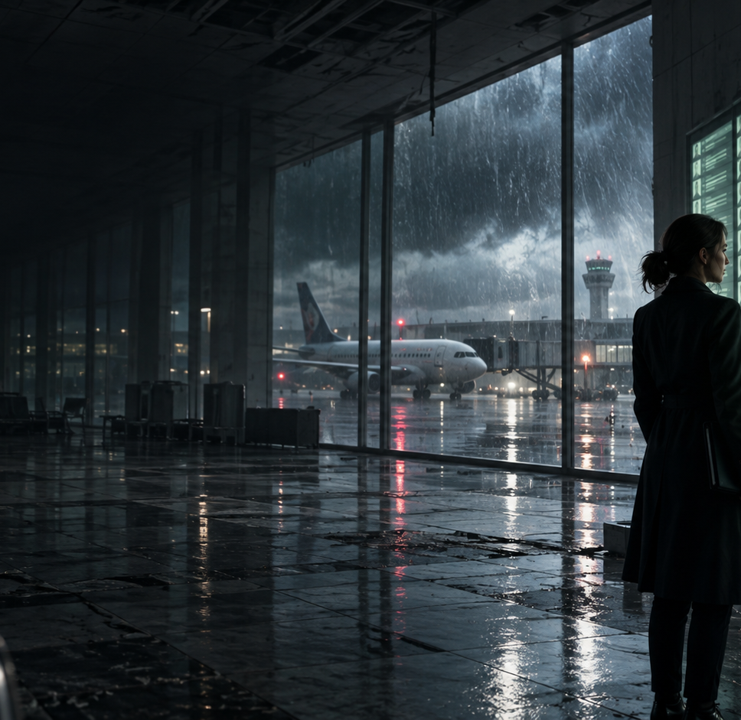
THE PREMISE
One death. Zero record.
LOGLINE
After a passenger dies aboard an international flight and is erased from its digital manifest, a guilt-haunted accident investigator must expose a private intelligence contractor capable of manufacturing and deleting human identities before everyone trapped inside a remote French airport is permanently rewritten out of existence.
A contained airport thriller with global stakes.
THE 13TH PASSENGER
02
Notes:
The 13th Passenger pitch deck, slide 2 of 12.

Slide 3
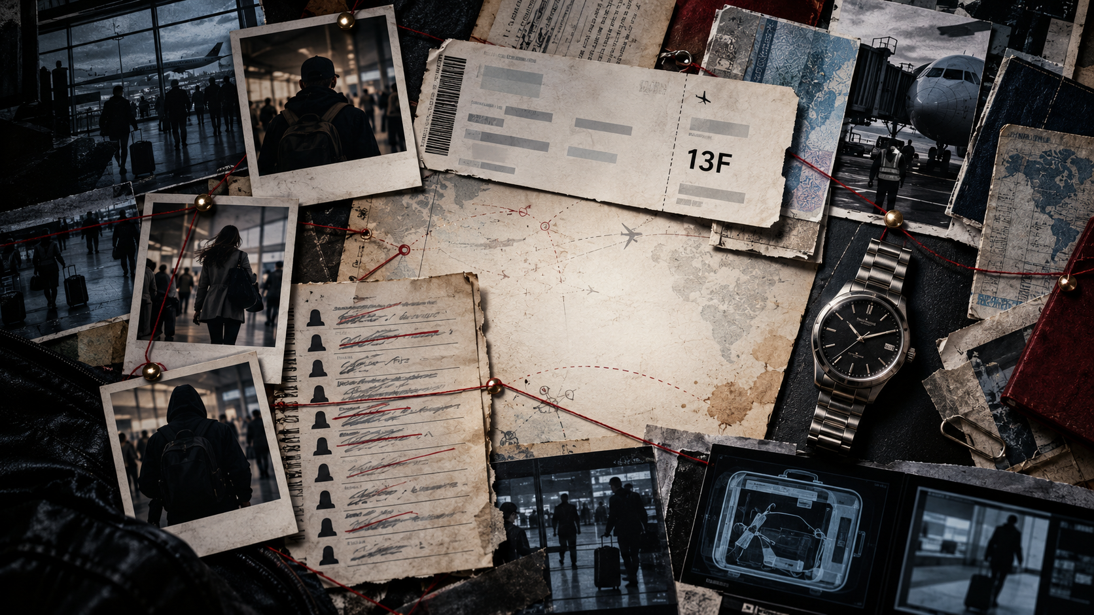
THE HOOK
A passenger dies.
Minutes later, every system says
she was never there.
In this world, identity is not stolen. It is edited.
THE 13TH PASSENGER
03
Notes:
The 13th Passenger pitch deck, slide 3 of 12.

Slide 4
CREATIVE POSITIONING
Tense. Intelligent. Propulsive.
A paranoid aviation mystery that expands into a muscular international conspiracy thriller.
FLIGHTPLAN
ENEMY OF THE STATE
SOURCE CODE
THE NIGHT AGENT
UNKNOWN
Contained aviation mystery
Surveillance conspiracy
Propulsive identity puzzle
Accessible institutional thriller
Stolen identity and pursuit
01
02
03
04
05
COMPARABLE DNA, DISTINCT EXECUTION
Analog human memory becomes the last defense against digital erasure.
THE 13TH PASSENGER
04
Notes:
The 13th Passenger pitch deck, slide 4 of 12.

Slide 5
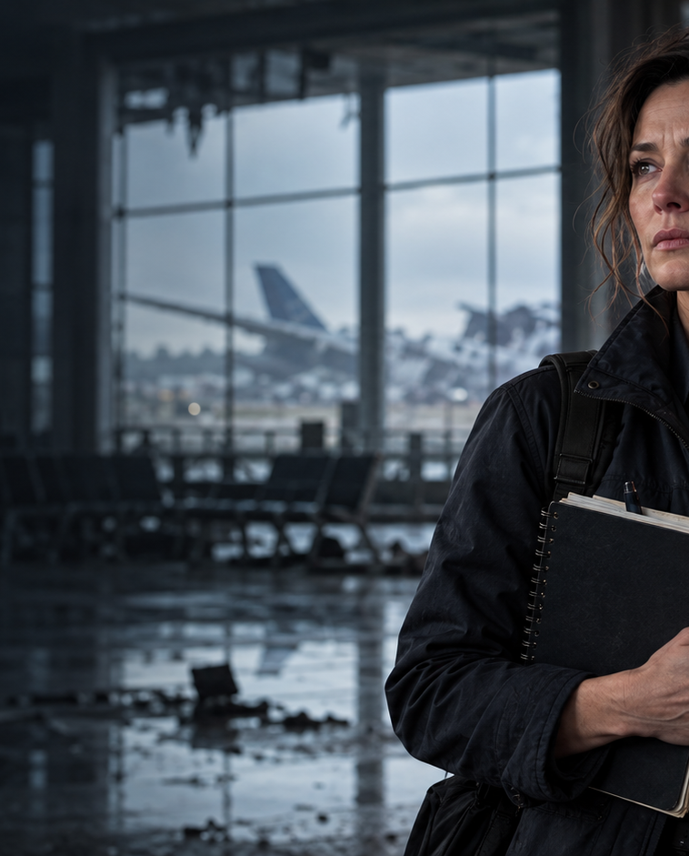
PROTAGONIST
Dr. Evelyn “Eve” Mercer
42 | AVIATION ACCIDENT INVESTIGATOR
PRECISION AS ARMOR
Brilliant, skeptical and controlled. Eve trusts evidence because people once failed her.
THE GOAL
Preserve the truth and protect 212 stranded passengers.
THE WOUND
She trusted clean paperwork over her husband. A bridge collapse killed him.
ARC
From certainty to moral courage.
THE 13TH PASSENGER
05
Notes:
The 13th Passenger pitch deck, slide 5 of 12.

Slide 6
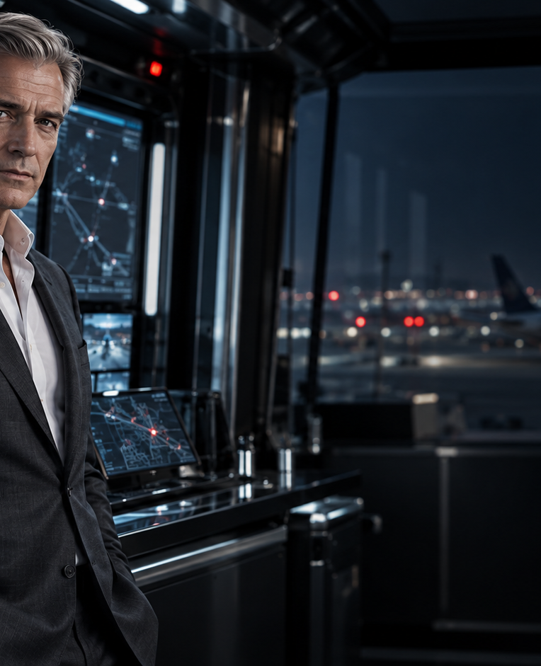
THE ANTAGONIST
Adrian Vale
50s | CEO, JANUS GLOBAL
CONTROL AS SALVATION
Calm, persuasive and chillingly practical. Vale believes MIRROR saves lives by deciding which identities are real.
CONNECTION
He weaponizes Eve’s faith in proof and offers her the comfort of a controlled truth.
“The system cannot fail if it owns the facts.”
THE 13TH PASSENGER
06
Notes:
The 13th Passenger pitch deck, slide 6 of 12.

Slide 7
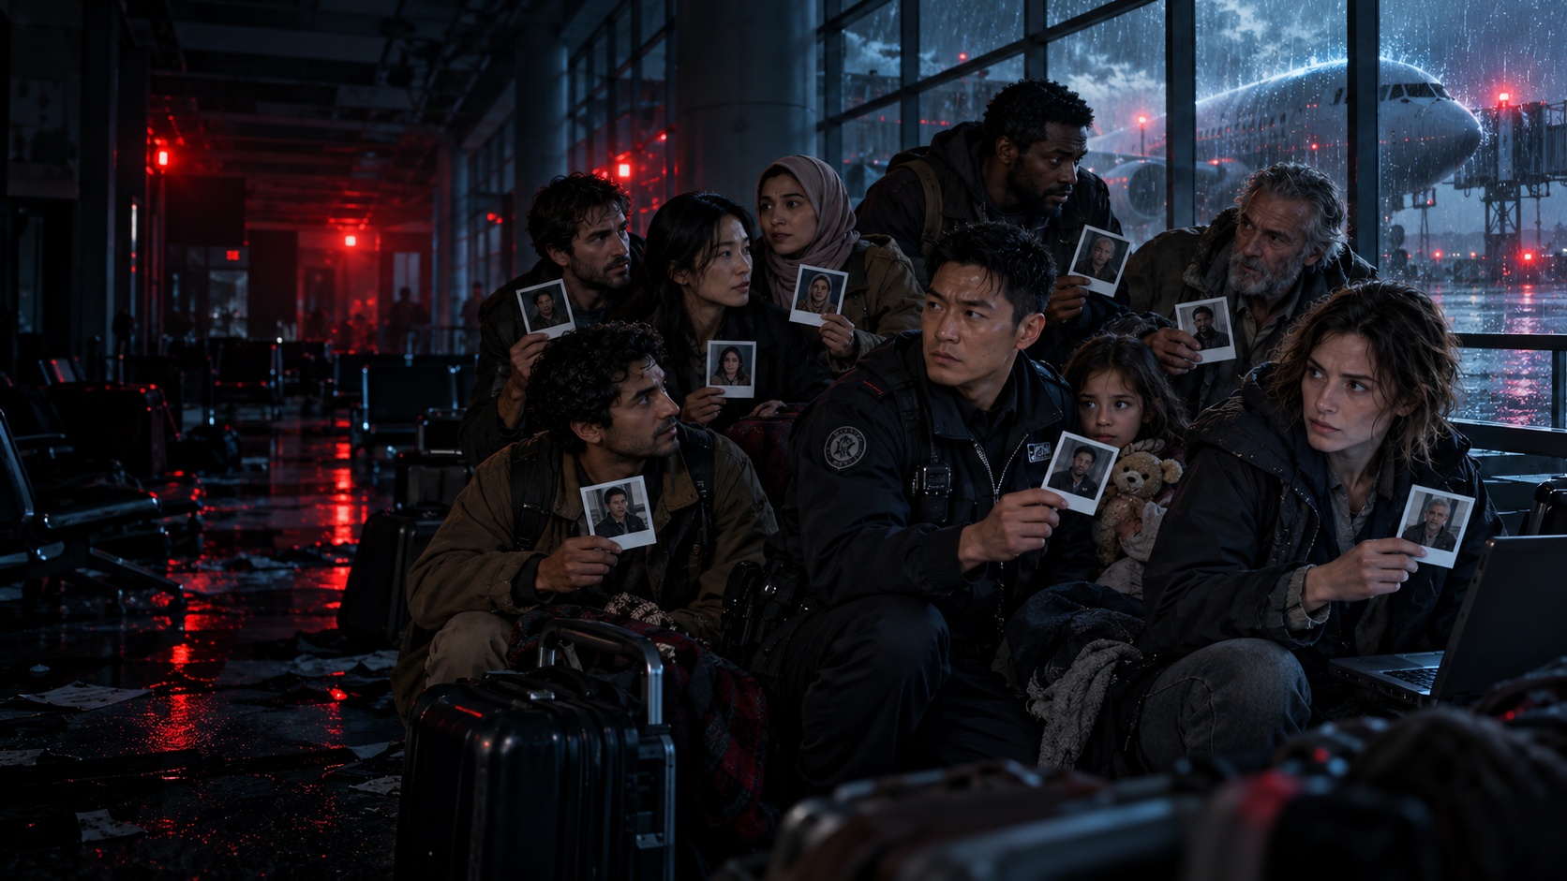
THE ENSEMBLE
Six people the system cannot reduce to data
LEILA HADDAD
MIRROR’s architect, hiding behind a purchased identity.
PARK MIN-JAE
Security commander torn between protocol and conscience.
CAMILLE LAURENT
Cyber analyst who sees systems as refuge and weapon.
CAPTAIN MOREAU
Deceived pilot who chooses accountability over survival.
NOAH
Seven-year-old witness who remembers behavior, not records.
NIGEL CROWTHER
Caustic whistleblower living under someone else’s name.
THE 13TH PASSENGER
07
Notes:
The 13th Passenger pitch deck, slide 7 of 12.

Slide 8
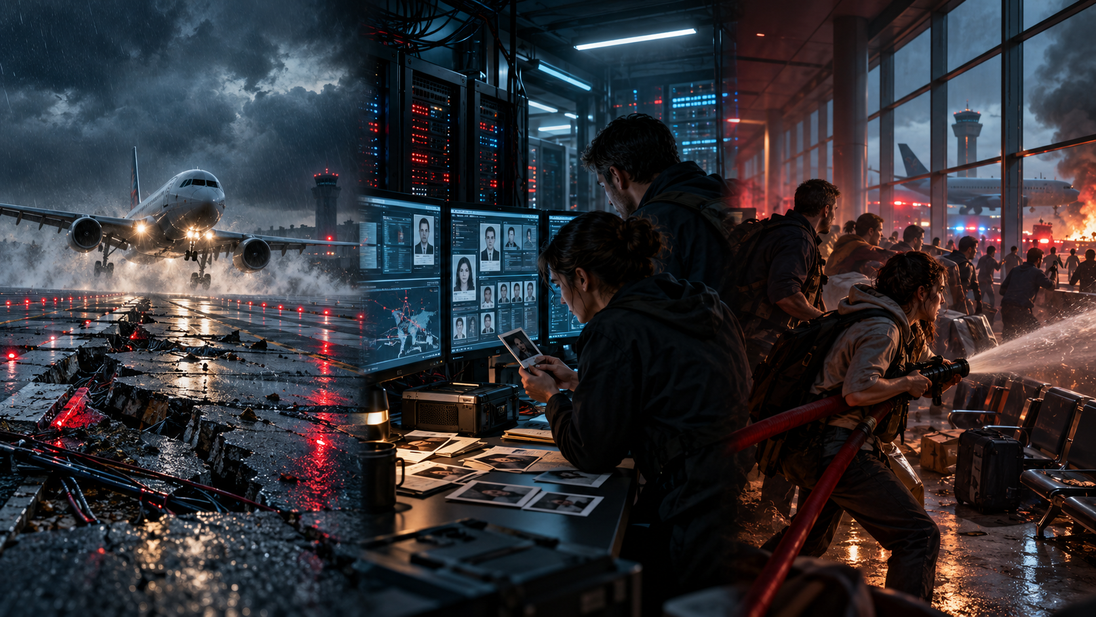
STORY IN THREE ACTS
From impossible death to public reckoning
ACT I
ACT II
ACT III
THE IMPOSSIBLE PASSENGER
THE SYSTEM CLOSES IN
TRUTH GOES ANALOG
Inès dies in seat 13A. Conflicting manifests force Flight 714 into a sabotaged airport.
Eve uncovers MIRROR, the Root Ledger and Leila’s true identity as Janus erases people in real time.
Passengers resist with memory and paper. Vale falls, the Ledger surfaces and the real architect remains free.
THE 13TH PASSENGER
08
Notes:
The 13th Passenger pitch deck, slide 8 of 12.

Slide 9
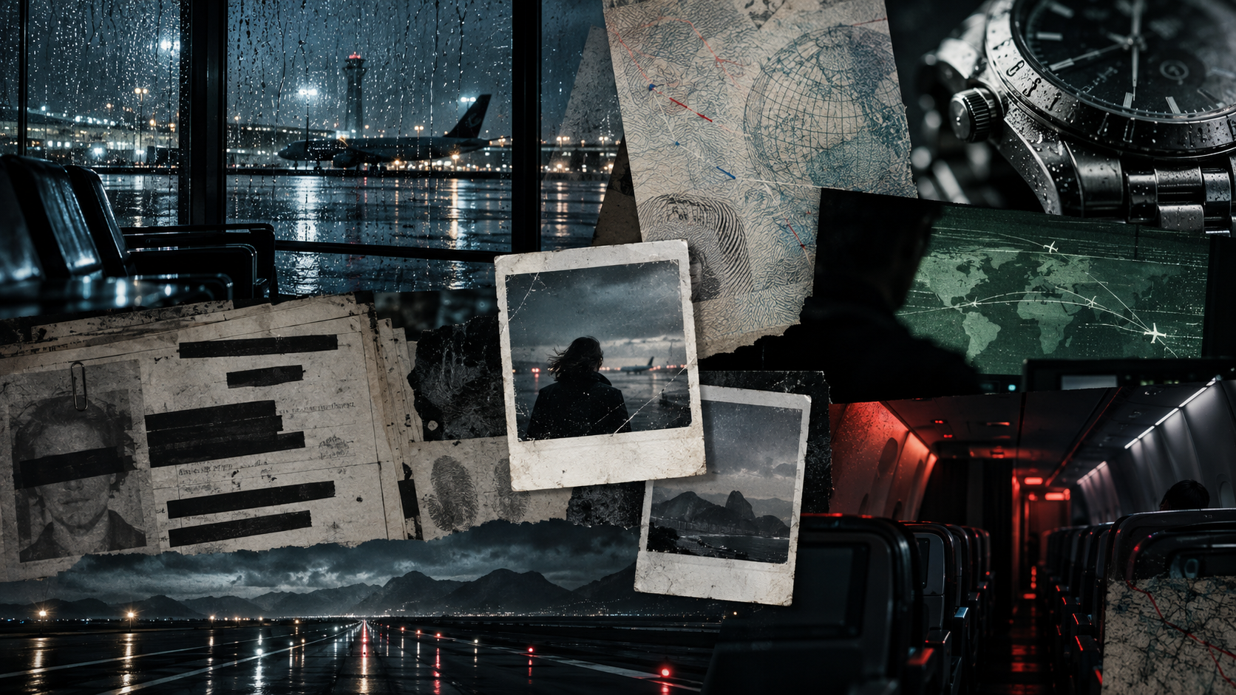
VISUAL LANGUAGE
Cold systems. Warm evidence.
RAIN ON GLASS
WET STEEL
PASSPORT FIBERS
REDACTED RECORDS
PALE MANIFEST GREEN
EMERGENCY RED
Analog objects carry emotion. Digital surfaces carry threat.
THE 13TH PASSENGER
09
Notes:
The 13th Passenger pitch deck, slide 9 of 12.

Slide 10
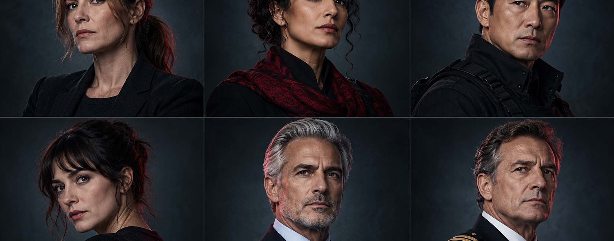
CASTING WISHLIST
International prestige with thriller authority
GUGU MBATHA-RAW
EVE MERCER
GOLSHIFTEH FARAHANI
LEILA HADDAD
PARK HAE-SOO
PARK MIN-JAE
MÉLANIE LAURENT
CAMILLE LAURENT
MARK STRONG
ADRIAN VALE
JEAN RENO
CAPTAIN MOREAU
Casting wishlist. Visuals represent character archetypes, not actor likenesses.
THE 13TH PASSENGER
10
Notes:
The 13th Passenger pitch deck, slide 10 of 12.

Slide 11
PLATFORM FIT
Why it works for Netflix
N
01
A one-sentence global hook audiences understand instantly.
02
A female-led international ensemble built for worldwide reach.
03
One controlled location with the perceived scale of a global chase.
04
A timely identity, surveillance and data-control theme.
05
Trailer-ready action anchored by a distinctive analog-evidence motif.
06
A clean franchise engine through Elias Voss and surviving clients.
CLICK DRIVER
Who was in seat 13A?
THE 13TH PASSENGER
11
Notes:
The 13th Passenger pitch deck, slide 11 of 12.

Slide 12
THE PATH FORWARD
Built to move from page to package
AVAILABLE NOW
NEXT STEPS
✓
Revision 7 screenplay
01
Final screenplay polish
✓
Buyer coverage
02
Proof-of-concept teaser
✓
45-second teaser script
03
Attach director and key cast
✓
Editable pitch deck
04
Budgeting and financing conversations
THE TRUTH SURVIVES WHEN PEOPLE REMEMBER.
THE 13TH PASSENGER
12
Notes:
The 13th Passenger pitch deck, slide 12 of 12.

