Slide 1
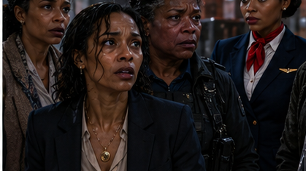
THE
LAYOVER
FIVE WOMEN. ONE EXIT. EVERY SECRET HAS A COST.
LOCKED ROOM SUSPENSE THRILLER / FEATURE FILM FOR TELEVISION
TV ONE ORIGINAL
NCCA ENTERTAINMENT
01
Notes:
Concept and story materials supplied by NCCA Entertainment.

Slide 2
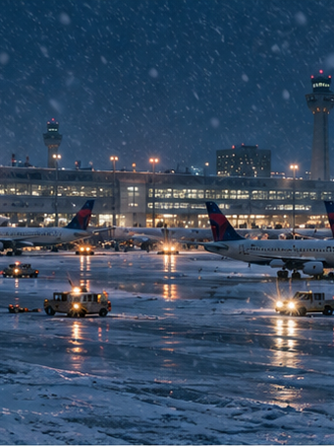
Logline
During a historic Atlanta ice storm, five Black women trapped beneath the airport turn on one another when a federal witness's deadly secret surfaces and a carbon monoxide leak leaves them forty-five minutes to decide who deserves to escape.
ATLANTA • ONE NIGHT • NO CLEAN WAY OUT
NCCA ENTERTAINMENT
02
Notes:
The logline foregrounds the contained setting, ensemble, emotional secret, ticking clock, and survival choice.

Slide 3
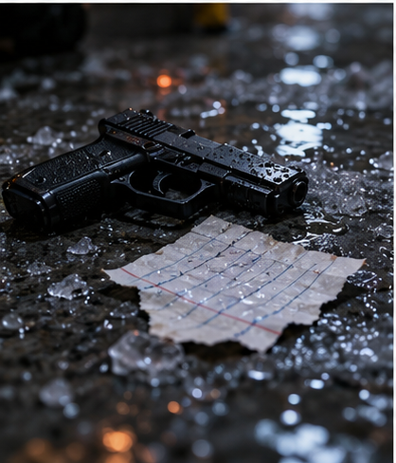
The Hook
A contained thriller with the emotional weight of a reckoning
Five women enter the room with different ideas of power. Before dawn, every role changes.
A sealed industrial maze
Conveyors, frozen security grates, dead radios, and a failing ventilation system turn one airport bay into a pressure cooker.
A dead woman connects them
The witness, the hitwoman, and the hidden child share one wound. Each new truth changes who deserves protection.
A forty-five-minute clock
Carbon monoxide forces enemies to cooperate while a cartel cleaner waits for the perfect accidental death.
NCCA ENTERTAINMENT
03
Notes:
The sell combines production efficiency with changing alliances, a personal mystery, and a physical clock.

Slide 4
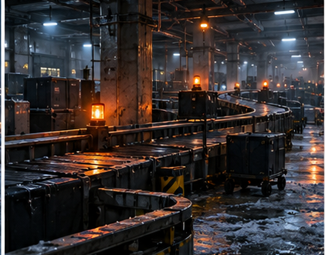
Tone and Comparables
Muscular suspense. Intimate moral drama. Restrained violence.
BREAKDOWN
Relentless escalation inside an ordinary transit nightmare
THE GUILTY
A contained thriller driven by voice, guilt, and incomplete truth
WIDOWS
Black women with distinct motives, competence, and moral risk
FROZEN RIVER
FROZEN INDUSTRIAL NOIR
Cold-weather desperation grounded in character and consequence
Amber work lights, black conveyor mouths, wet steel, warning red, and ice-blue dawn.
NCCA ENTERTAINMENT
04
Notes:
Comparables indicate tone and audience promise, not identical plot.

Slide 5
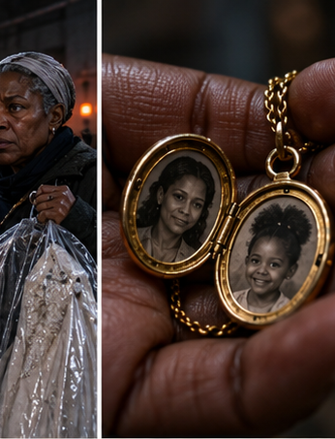
Monique Carter
38 / THE WITNESS
She can dismantle a cartel. First, she must tell the truth about the woman she left behind.
PERSONALITY
Exacting, hypervigilant, and fluent in the language of money and risk.
GOAL
Survive long enough to turn over the archive and protect Maya's daughter.
CONFLICT
Her immunity rests on a lie. The locket at her throat belongs to the friend she accidentally killed.
NCCA ENTERTAINMENT
05
Notes:
Monique drives the thriller and completes her arc by amending her federal statement, even if it costs her immunity.

Slide 6
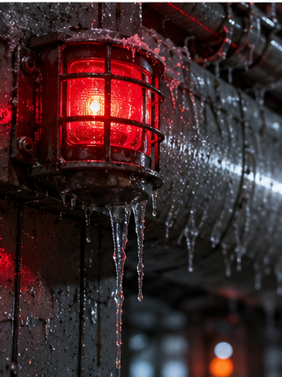
Kendra Vale
44 / THE CLEANER
She enters as comfort. She leaves every confession weaponized.
COVER
Airport crisis counselor with a voice made for trust.
MISSION
Recover the archive key, identify everyone with access, and stage the deaths as storm exposure.
PHILOSOPHY
Guilt is vanity performed by people who still need to believe they are good.
NCCA ENTERTAINMENT
06
Notes:
Kendra delays the kill because she must locate the evidence and learn who else can access it.

Slide 7
The Women in the Room
Every woman reads danger differently
DIANA COLE, 52
A veteran deputy marshal whose off-book trap turns her witness into bait.
SIMONE REED, 29
A contract killer hunting the truth about her missing sister, Maya.
PATRICIA BROWN, 64
A retired correctional officer racing to repair a three-year family rift.
NIA, 10
Maya's daughter, unseen but central to every choice Simone and Monique make.
Five castable women. Five moral positions. One room that will not let them stay fixed.
NCCA ENTERTAINMENT
07
Notes:
Patricia and Diana mirror each other: both confuse control with protection, but only Patricia learns to apologize before she knows she will survive.

Slide 8
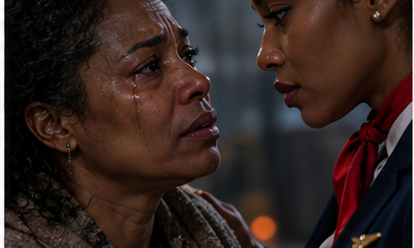
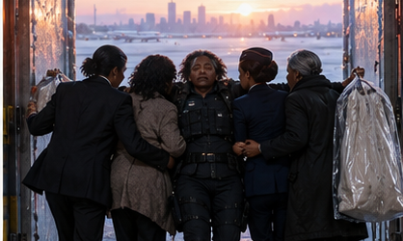
Story
Three acts of tightening pressure
ACT I / THE SEALED VAULT
ACT II / THE INTERROGATION
ACT III / BLOOD AND CLEAR AIR
Diana moves Monique through a monitored federal choke point as the airport freezes. The storm kills the cameras and locks Monique, Diana, Simone, Patricia, and Kendra inside. Simone's suppressed pistol hits the floor.
Maya's locket exposes the bond between Monique and Simone. Monique admits she fired the fatal shot and fled. As carbon monoxide enters the bay, Patricia discovers Diana engineered the route.
Kendra offers Simone revenge, but Simone chooses Maya's daughter over vengeance. The women carry a wounded Diana into the storm. Monique survives, then risks her immunity by amending her statement.
NCCA ENTERTAINMENT
08
Notes:
Act structure follows the revised treatment.

Slide 9
Visual World
Atlanta above. A steel courtroom below.
ICE BLUE
MIDNIGHT
EMERGENCY AMBER
WARNING RED
Wet concrete / Condensation / Rotating beacons / Security grates / Gold against steel
NCCA ENTERTAINMENT
09
Notes:
Mood board imagery is concept art generated for this pitch deck.

Slide 10
Casting Wishlist
A prestige ensemble with recognizable thriller authority
TEYONAH PARRIS
REGINA KING
KIKI LAYNE
ALFRE WOODARD
AUNJANUE ELLIS-TAYLOR
MONIQUE
DIANA
SIMONE
PATRICIA
KENDRA
CONTROLLED GUILT
AUTHORITY UNDER STRAIN
POLISHED DANGER
MORAL STEEL
WEAPONIZED EMPATHY
Casting references only. No talent is attached.
NCCA ENTERTAINMENT
10
Notes:
Casting wishlist reflects role energy and market positioning. No talent is attached.

Slide 11
Why TV One
A suspense package built around character, consequence, and conversation
Five substantial roles for Black women across generations
Contained production footprint with cinematic airport scale
A clean thriller hook with restrained, consequential violence
Family repair and accountability deepen the survival engine
Distinct performances built for recognizable ensemble casting
A final moral choice designed to drive post-premiere conversation
NCCA ENTERTAINMENT
11
Notes:
Platform fit is based on the intended TV One Original lane specified in the treatment.

Slide 12
Materials and Next Steps
AVAILABLE
NEXT
✓
Revised TV One treatment
01
Screenplay rewrite to 80–85 pages
✓
Tight logline and buyer positioning
02
Casting conversations and director shortlist
✓
16:9 key art concept
03
Budget, schedule, and location plan
✓
Character and visual direction
04
Buyer-facing verbal pitch and submission package
THE LAYOVER
When the doors lock, the truth becomes the only way out.
NCCA ENTERTAINMENT
12
Notes:
Prepared as a master pitch deck for producer, talent, and buyer conversations.

