Slide 1
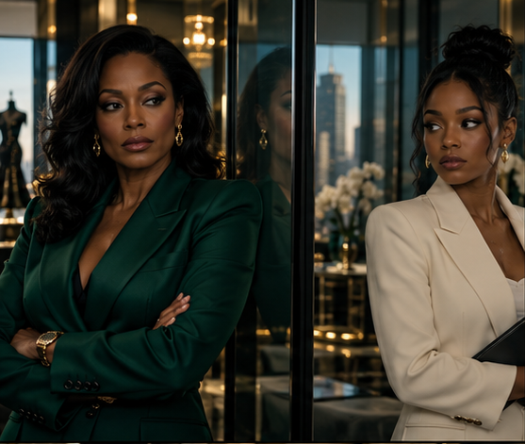
PSYCHOLOGICAL THRILLER / FEATURE FILM
THE PERFECT
ASSISTANT
She knows exactly what you need.
She also knows what your family buried.
ATLANTA. FASHION. FAMILY SECRETS.
01
Notes:
Story source: The_Perfect_Assistant_FULL_REVISED.fadein, supplied by the author. Adapted from the prior 12-slide deck conversation. Fictional generated character concepts and mood imagery, not cast photographs.

Slide 2

Logline
The perfect hire.
The buried truth.
When an Atlanta fashion founder hires an assistant who anticipates her every need, the young woman’s growing access exposes a secret tied to her late father. To protect her company, Brielle must confront the family history she has spent her life avoiding.
A PSYCHOLOGICAL THRILLER WITH A FAMILY-DRAMA CORE
02
Notes:
Story source: The_Perfect_Assistant_FULL_REVISED.fadein, supplied by the author. Adapted from the prior 12-slide deck conversation. Fictional generated character concepts and mood imagery, not cast photographs.

Slide 3
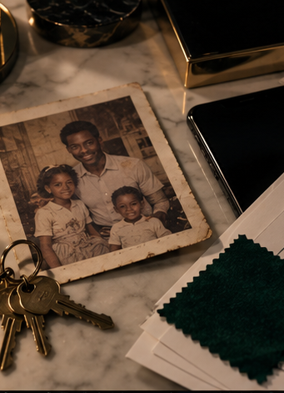
The hook
Brielle invited
her in
Kennedy earns access by becoming indispensable. Every boundary crossed first looks like exceptional competence.
She knows the coffee order.
Then the keys. Then the family.
03
Notes:
Story source: The_Perfect_Assistant_FULL_REVISED.fadein, supplied by the author. Adapted from the prior 12-slide deck conversation. Fictional generated character concepts and mood imagery, not cast photographs.

Slide 4
Tone & comparables
Elegant. Intimate. Unsettling.
THE PERFECT GUY
SINGLE BLACK FEMALE
Polished Black-led suspense. Charm gives danger its cover.
Assistant intimacy turns trust into a threat.
ACRIMONY
THE DEVIL WEARS PRADA
Old emotional wounds reshape the present.
Fashion hierarchy and executive-assistant intimacy. World reference.
The distinguishing turn: suspicion gives way to sisterhood, accountability and boundaries.
04
Notes:
Comparables are creative positioning references, not revenue or performance claims. Sources: https://www.sonypictures.com/movies/theperfectguy ; https://www.mylifetime.com/movies/single-black-female ; https://www.20thcenturystudios.com/movies/the-devil-wears-prada . Acrimony is a subjective thematic comparison from the prior deck.

Slide 5
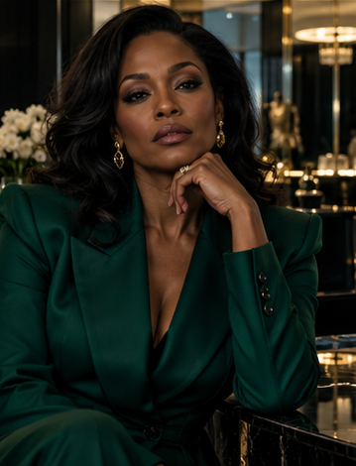
BRIELLE THOMAS / 42
The woman
behind the brand
FOUNDER & CEO, THOMAS LEGACY
GOAL
Protect the company and deliver the Legacy Collection showcase.
CONFLICT
She trusts Kennedy’s competence while ignoring the warning signs.
Her arc: trade the safety of silence for truth, with boundaries she can defend.
05
Notes:
Story source: The_Perfect_Assistant_FULL_REVISED.fadein, supplied by the author. Adapted from the prior 12-slide deck conversation. Fictional generated character concepts and mood imagery, not cast photographs.

Slide 6
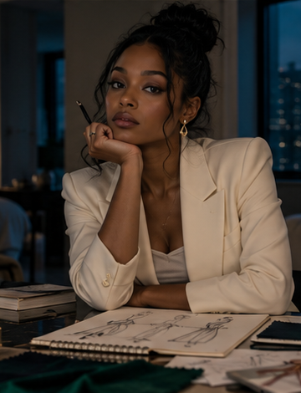
KENNEDY / 24
The assistant
with a claim
GOAL
Enter the family that excluded her and discover whether she can hate Brielle.
SECRET
She is Elijah Thomas’s daughter. The interview was a prepared way in.
Her arc: own the harm she caused and pursue design under her own name.
06
Notes:
Story source: The_Perfect_Assistant_FULL_REVISED.fadein, supplied by the author. Adapted from the prior 12-slide deck conversation. Fictional generated character concepts and mood imagery, not cast photographs.

Slide 7
Supporting characters
DOLORES THOMAS / 69
Brielle’s mother. Her attempts to confess disturb decades of silence.
NADINE BANKS / 41
Best friend and business partner. She questions Kennedy, then stands by Brielle.
MARCUS HOLLIS-THOMAS
The ex-husband. He turns family knowledge into business leverage.
ELIJAH THOMAS
The late father. His double life sits beneath the brand’s celebrated legacy.
KENNEDY’S MOTHER
Her account of Elijah fuels Kennedy’s anger and sense of exclusion.
07
Notes:
Story source: The_Perfect_Assistant_FULL_REVISED.fadein, supplied by the author. Adapted from the prior 12-slide deck conversation. Fictional generated character concepts and mood imagery, not cast photographs.

Slide 8
Plot summary
I THE PERFECT HIRE
II THE WOMAN INSIDE
III THE TRUTH IN PUBLIC
As a showcase and Marcus’s equity demands squeeze Brielle, Kennedy makes herself essential. Dolores’s hospitalization brings a warning: Elijah had another daughter.
Private access and false references prompt Brielle’s investigation. After a press interview violates her trust, Kennedy admits she is Brielle’s half-sister.
A pharmacy error clears Kennedy of the medication scare. Facing Marcus’s leverage and a leaked photograph, Brielle tells the truth, ends Kennedy’s access and offers family without a job.
Sunday dinner opens a door. Trust still has to be rebuilt.
08
Notes:
Story source: The_Perfect_Assistant_FULL_REVISED.fadein, supplied by the author. Adapted from the prior 12-slide deck conversation. Fictional generated character concepts and mood imagery, not cast photographs.

Slide 9
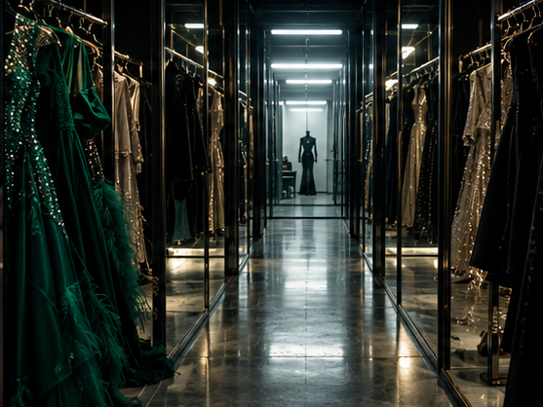
Visual style
BLACK GLASS / EMERALD / GOLD
SEPIA / IVORY / FAMILY HISTORY
COLD BLUE / FLUORESCENCE
Controlled symmetry gives way to shared frames and uneasy reflections. Garment racks become corridors. Phones, keys and old photos turn routine objects into evidence.
09
Notes:
Story source: The_Perfect_Assistant_FULL_REVISED.fadein, supplied by the author. Adapted from the prior 12-slide deck conversation. Fictional generated character concepts and mood imagery, not cast photographs.

Slide 10
Aspirational casting wishlist
Presence, precision and emotional range
BRIELLE THOMAS
Tika Sumpter
Authority with guarded vulnerability
KENNEDY
Ryan Destiny
Composure with an unsettled interior
NADINE BANKS
Teyonah Parris
Sharp wit and unwavering loyalty
DOLORES THOMAS
Alfre Woodard
The weight of a long-held secret
MARCUS
Morris Chestnut
Charm sharpened into leverage
Casting references only
10
Notes:
Aspirational creative wishlist from the prior deck conversation. No cast attachments, offers or availability implied. Casting descriptions are creative judgments.

Slide 11
Why it works / buyer lane
A commercial hook.
An emotional reckoning.
Two Black women drive the suspense and the family drama.
An instantly legible hook: the assistant knows far too much.
Atlanta fashion supplies aspiration and a distinct visual identity.
Offices and homes anchor the story, with a showcase as its event set piece.
PROPOSED PRIMARY LANE: BET+ / BET STUDIOS
Also explore Lifetime, TV One, ALLBLK and Tubi.
Positioning targets, subject to packaging and buyer interest.
11
Notes:
Buyer lanes are creative positioning proposals, not verified acquisition interest or access. Source for BET programming context: https://www.bet.com/tag/5k2gxx/bet-original-movies . Lifetime genre reference: https://www.mylifetime.com/movies/single-black-female . Production scope is inferred from the supplied screenplay and requires a breakdown and budget.

Slide 12
Deliverables & next steps
IN THE PACKAGE
BUILD NEXT
Completed revised feature screenplay
Logline and plot summary
Character and casting direction
Editable pitch deck and visual concept
Final continuity and thriller-logic polish
Buyer-specific one-page sell sheet
Production breakdown and budget
Director outreach and cast packaging
THE PERFECT ASSISTANT
She knows exactly what you need. She also knows what your family buried.
12
Notes:
Story source: The_Perfect_Assistant_FULL_REVISED.fadein, supplied by the author. Adapted from the prior 12-slide deck conversation. Fictional generated character concepts and mood imagery, not cast photographs.

