Slide 1
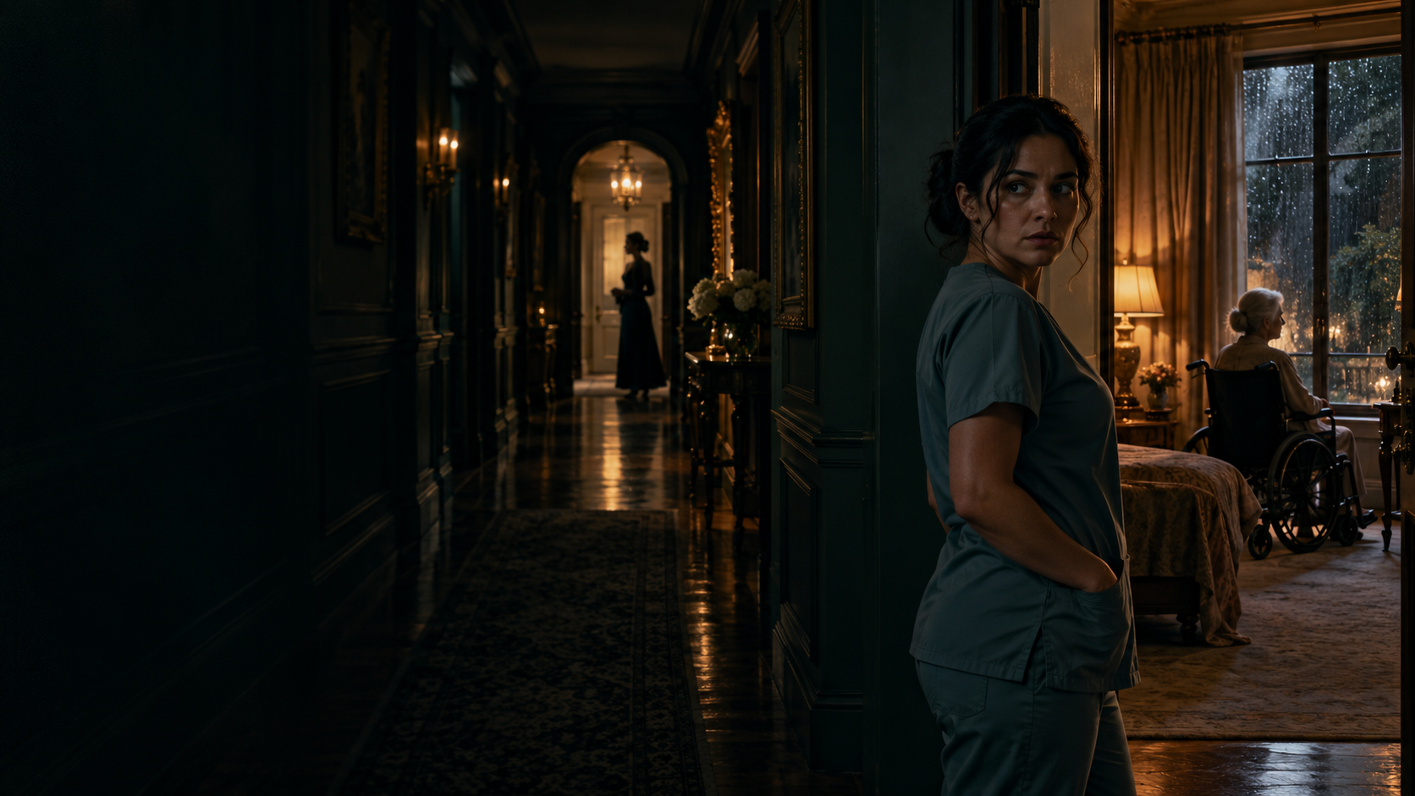
NCCA ENTERTAINMENT
THE CAREGIVER’S
SECRET
She was hired to care.
She was chosen to take the blame.
A domestic conspiracy thriller
Written by Kelly R. Tenney
01
Notes:
Sources: supplied THE_CAREGIVERS_SECRET_Studio_OnePager.pdf and THE_CAREGIVERS_SECRET_Cast_Suggestions.pdf (October 15, 2026); supplied v8 screenplay for supporting story details. Latest one-pager controls pitch positioning. Original AI-generated concept art illustrates fictional atmosphere and does not depict attached cast. No attachment or availability claims.

Slide 2
NCCA ENTERTAINMENT
The premise
A disgraced nurse takes a live-in job caring for a silenced former senator, then discovers the family that hired her chose her on purpose: her one bad mistake makes her the perfect person to blame.
Original movie / Domestic suspense / Atlanta setting
02
Notes:
Sources: supplied THE_CAREGIVERS_SECRET_Studio_OnePager.pdf and THE_CAREGIVERS_SECRET_Cast_Suggestions.pdf (October 15, 2026); supplied v8 screenplay for supporting story details. Latest one-pager controls pitch positioning. Original AI-generated concept art illustrates fictional atmosphere and does not depict attached cast. No attachment or availability claims.

Slide 3
NCCA ENTERTAINMENT
The audience’s way in
Dana needs this job to keep her family housed.
Eleanor needs someone to recognize that she is still there.
The woman paying Dana controls whose version of the truth survives.
An intimate alliance inside a house built to keep outsiders out.
03
Notes:
Sources: supplied THE_CAREGIVERS_SECRET_Studio_OnePager.pdf and THE_CAREGIVERS_SECRET_Cast_Suggestions.pdf (October 15, 2026); supplied v8 screenplay for supporting story details. Latest one-pager controls pitch positioning. Original AI-generated concept art illustrates fictional atmosphere and does not depict attached cast. No attachment or availability claims.

Slide 4
NCCA ENTERTAINMENT
The story
THE OFFER
THE DISCOVERY
THE CHOICE
Dana accepts a private-duty job at the Whitfield estate. Her patient’s fear contradicts the immaculate care records.
Eleanor begins to communicate. Dana uncovers diverted foundation money and a plan to make her the scapegoat.
With Eleanor’s transfer approaching and Luca within Priscilla’s reach, Dana must risk her future to keep her patient from disappearing.
04
Notes:
Sources: supplied THE_CAREGIVERS_SECRET_Studio_OnePager.pdf and THE_CAREGIVERS_SECRET_Cast_Suggestions.pdf (October 15, 2026); supplied v8 screenplay for supporting story details. Latest one-pager controls pitch positioning. Original AI-generated concept art illustrates fictional atmosphere and does not depict attached cast. No attachment or availability claims.

Slide 5
NCCA ENTERTAINMENT
Dana Reyes
34 / LPN / Single mother
She notices what everyone else has stopped seeing.
A false chart entry cost Dana her job and damaged her credibility. Now her employer intends to use that history against her.
Her journey: from protecting her livelihood through silence to protecting another woman by telling the truth.
05
Notes:
Sources: supplied THE_CAREGIVERS_SECRET_Studio_OnePager.pdf and THE_CAREGIVERS_SECRET_Cast_Suggestions.pdf (October 15, 2026); supplied v8 screenplay for supporting story details. Latest one-pager controls pitch positioning. Original AI-generated concept art illustrates fictional atmosphere and does not depict attached cast. No attachment or availability claims.

Slide 6
NCCA ENTERTAINMENT
Eleanor Whitfield
72 / Former senator / Whistleblower
Her voice is limited. Her will is not.
Once a public authority, Eleanor now depends on the people controlling her treatment. Her past contains a truth she would rather keep hidden.
A performance built through eyes, a left hand, and one determined thumb.
06
Notes:
Sources: supplied THE_CAREGIVERS_SECRET_Studio_OnePager.pdf and THE_CAREGIVERS_SECRET_Cast_Suggestions.pdf (October 15, 2026); supplied v8 screenplay for supporting story details. Latest one-pager controls pitch positioning. Original AI-generated concept art illustrates fictional atmosphere and does not depict attached cast. No attachment or availability claims.

Slide 7
NCCA ENTERTAINMENT
Priscilla Whitfield-Vance
Daughter / Foundation chair / Employer
She makes control look like care.
Priscilla offers Dana the help she needs, then turns that generosity into leverage. She knows how to manage a household, a donor, and a damaging account of events.
Her wound: a lifetime in her mother’s shadow.
Her choice: make her mother powerless.
07
Notes:
Sources: supplied THE_CAREGIVERS_SECRET_Studio_OnePager.pdf and THE_CAREGIVERS_SECRET_Cast_Suggestions.pdf (October 15, 2026); supplied v8 screenplay for supporting story details. Latest one-pager controls pitch positioning. Original AI-generated concept art illustrates fictional atmosphere and does not depict attached cast. No attachment or availability claims.

Slide 8
NCCA ENTERTAINMENT
The people around the bed
ADRIAN VANCE
The physician and husband whose professional authority sustains the deception. His final choice carries a cost.
MARGOT BELL
The housekeeper trapped by her son’s secret and years of obedience. Helping Dana means implicating herself.
ROSA & LUCA REYES
The family Dana is trying to protect. Their home and daily routines make the price of her courage tangible.
08
Notes:
Sources: supplied THE_CAREGIVERS_SECRET_Studio_OnePager.pdf and THE_CAREGIVERS_SECRET_Cast_Suggestions.pdf (October 15, 2026); supplied v8 screenplay for supporting story details. Latest one-pager controls pitch positioning. Original AI-generated concept art illustrates fictional atmosphere and does not depict attached cast. No attachment or availability claims.

Slide 9
NCCA ENTERTAINMENT
The suspense engine
Every act of communication changes the balance of power.
HELP
Dana recognizes the plea.
DON’T SIGN
Care records become evidence.
BOY FIRST
Eleanor protects her rescuer.
NO
Eleanor takes back the choice.
09
Notes:
Sources: supplied THE_CAREGIVERS_SECRET_Studio_OnePager.pdf and THE_CAREGIVERS_SECRET_Cast_Suggestions.pdf (October 15, 2026); supplied v8 screenplay for supporting story details. Latest one-pager controls pitch positioning. Original AI-generated concept art illustrates fictional atmosphere and does not depict attached cast. No attachment or availability claims.

Slide 10
NCCA ENTERTAINMENT
The world & tone
Buckhead privilege.
A patient behind a closed door.
Warm lamps and polished rooms conceal surveillance, coercion, and carefully maintained records.
The camera stays close to Dana and Eleanor. Suspense grows through withheld answers and small physical choices.
10
Notes:
Sources: supplied THE_CAREGIVERS_SECRET_Studio_OnePager.pdf and THE_CAREGIVERS_SECRET_Cast_Suggestions.pdf (October 15, 2026); supplied v8 screenplay for supporting story details. Latest one-pager controls pitch positioning. Original AI-generated concept art illustrates fictional atmosphere and does not depict attached cast. No attachment or availability claims. Visual direction: forest green, ivory, brass and amber; domestic spaces become threatening through blocking and sound. Concept art, not production photography.

Slide 11
NCCA ENTERTAINMENT
Moments that sell the film
The first plea
A broken glass. A hand on Dana’s sleeve. “Help.”
The impossible signature
A flowing signature on a document the patient could not have signed.
The blackout
One thumb holds an alarm down while the house tries to silence it.
The emotional turn
Eleanor sends Dana home to her son: “Boy first.”
11
Notes:
Sources: supplied THE_CAREGIVERS_SECRET_Studio_OnePager.pdf and THE_CAREGIVERS_SECRET_Cast_Suggestions.pdf (October 15, 2026); supplied v8 screenplay for supporting story details. Latest one-pager controls pitch positioning. Original AI-generated concept art illustrates fictional atmosphere and does not depict attached cast. No attachment or availability claims.

Slide 12
NCCA ENTERTAINMENT
Audience & production approach
Positioned for the Lifetime / LMN domestic-thriller audience
A female-led story of betrayal inside the home, with a vulnerable patient and a mother who must trust her own judgment.
One primary estate anchors the film. Supporting locations include a care facility, family home, hospital, and school pickup area.
Performance-driven suspense. Limited physical action. Practical blackout sequence. Budget and schedule to be developed.
12
Notes:
Sources: supplied THE_CAREGIVERS_SECRET_Studio_OnePager.pdf and THE_CAREGIVERS_SECRET_Cast_Suggestions.pdf (October 15, 2026); supplied v8 screenplay for supporting story details. Latest one-pager controls pitch positioning. Original AI-generated concept art illustrates fictional atmosphere and does not depict attached cast. No attachment or availability claims. Buyer positioning is creative positioning supplied by the one-pager, not a commissioning claim. Estate and supporting locations derive from source materials. Stunt coordination and other requirements require a production breakdown.

Slide 13
NCCA ENTERTAINMENT
Casting possibilities
Creative wish list only. No attachments or outreach confirmed.
DANA REYES
Melissa Barrera / Diane Guerrero / Camila Mendes
ELEANOR WHITFIELD
Phylicia Rashad / Sissy Spacek / Lorraine Toussaint
PRISCILLA
Elizabeth Reaser / Tiffani Thiessen / Kelly Rutherford
ADRIAN VANCE
Scott Foley / Jason Priestley / Tim Daly
MARGOT BELL
Wendy Raquel Robinson / Kimberly Elise / Judy Reyes
13
Notes:
Sources: supplied THE_CAREGIVERS_SECRET_Studio_OnePager.pdf and THE_CAREGIVERS_SECRET_Cast_Suggestions.pdf (October 15, 2026); supplied v8 screenplay for supporting story details. Latest one-pager controls pitch positioning. Original AI-generated concept art illustrates fictional atmosphere and does not depict attached cast. No attachment or availability claims. Names reproduce supplied suggestions. They are alternatives, not a proposed attached ensemble. Family relationships and casting approach should be developed together. Availability, interest and compensation unverified.

Slide 14
NCCA ENTERTAINMENT
Supporting cast possibilities
Creative wish list only. Availability and interest unverified.
ROSA REYES
Rosie Perez / Justina Machado / Angélica Aragón
KEZIA ADAMS
Sheryl Lee Ralph / Anika Noni Rose / Tonya Pinkins
LENA ORTIZ
Roselyn Sánchez / Aimee Garcia / Camille Guaty
THERESA HOLLIS
Yvonne Orji / Sufe Bradshaw / Gabrielle Dennis
LUCA, WALTER & RAY
Open child casting and a regional character-actor search
14
Notes:
Sources: supplied THE_CAREGIVERS_SECRET_Studio_OnePager.pdf and THE_CAREGIVERS_SECRET_Cast_Suggestions.pdf (October 15, 2026); supplied v8 screenplay for supporting story details. Latest one-pager controls pitch positioning. Original AI-generated concept art illustrates fictional atmosphere and does not depict attached cast. No attachment or availability claims.

Slide 15
NCCA ENTERTAINMENT
Under the Plate
A proposed eight-episode vertical companion
Before Dana, there was Theresa.
The prior caregiver’s story explores the same household from the woman who left it. Her experience leads into the opening of the feature.
Companion concept identified in the supplied package. Separate development and financing.
15
Notes:
Sources: supplied THE_CAREGIVERS_SECRET_Studio_OnePager.pdf and THE_CAREGIVERS_SECRET_Cast_Suggestions.pdf (October 15, 2026); supplied v8 screenplay for supporting story details. Latest one-pager controls pitch positioning. Original AI-generated concept art illustrates fictional atmosphere and does not depict attached cast. No attachment or availability claims.

Slide 16
NCCA ENTERTAINMENT
THE CAREGIVER’S
SECRET
A woman who listens can change everything.
NCCA ENTERTAINMENT
Kelly R. Tenney
contact@nccaentertainment.com
(910) 262-9307
16
Notes:
Sources: supplied THE_CAREGIVERS_SECRET_Studio_OnePager.pdf and THE_CAREGIVERS_SECRET_Cast_Suggestions.pdf (October 15, 2026); supplied v8 screenplay for supporting story details. Latest one-pager controls pitch positioning. Original AI-generated concept art illustrates fictional atmosphere and does not depict attached cast. No attachment or availability claims. Packaging: screenplay and companion materials available. No cast, director or financing attachments confirmed in supplied one-pager. Page count and draft label omitted because one-pager describes 83 pages/Rewrite 6 while the supplied v8 PDF has 72 screenplay pages.

