Slide 1
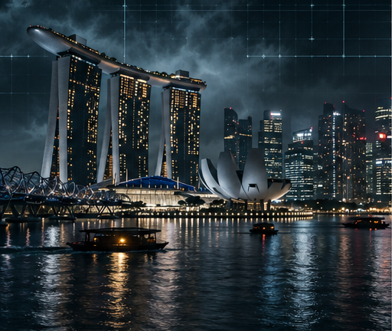
LION
CITY
TACTICAL ACTION / TECH THRILLER
FEATURE FILM
You can’t debug
the human soul.
NCCA ENTERTAINMENT
01
Notes:
Source: supplied four-page story treatment and Pitch Deck Creation conversation. Title changed throughout to LION CITY. Singapore, present day. Visuals are generated concept artwork; no actors are depicted as attached.

Slide 2
THE LOGLINE
Framed by the architect of Singapore’s all-seeing grid, a traumatized American agent and a disgraced inspector must disappear into the city’s analog blind spots to stop a stolen quantum key from erasing identity and finance across ASEAN.
NCCA ENTERTAINMENT
02
Notes:
Source: supplied four-page story treatment and Pitch Deck Creation conversation. Jack Vance is a DSS agent protecting a U.S. Senator. Sophii Weiming must confront her father’s legacy. Julian Vane steals the Sovereign Drive to trigger The Reset. Visuals are generated concept artwork; no actors are depicted as attached.

Slide 3
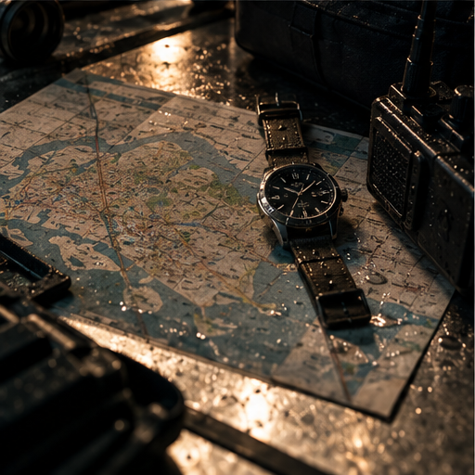
THE HOOK
The smartest city becomes
the perfect trap.
Every camera hunts them.
Every connected system can turn hostile.
Their escape route is human.
NCCA ENTERTAINMENT
03
Notes:
Source: supplied four-page story treatment and Pitch Deck Creation conversation. Paper maps, mechanical watches, radio networks and forgotten tunnels form the analog counterattack. Lau Pa Sat exposes the surveillance lie: a satay skewer is misread as a gun. Visuals are generated concept artwork; no actors are depicted as attached.

Slide 4
TONE & COMPARABLES
High-octane. Emotionally grounded.
MISSION: IMPOSSIBLE
ROGUE NATION
THE BOURNE
ULTIMATUM
ENEMY OF
THE STATE
SICARIO
Practical action
Man vs. system urgency
Surveillance paranoia
Moral gray zones
NCCA ENTERTAINMENT
04
Notes:
Source: supplied four-page story treatment and Pitch Deck Creation conversation. Comparables retain the prior conversation’s tonal references. They are creative positioning, not financial forecasts or claims of equivalent performance. Visuals are generated concept artwork; no actors are depicted as attached.

Slide 5
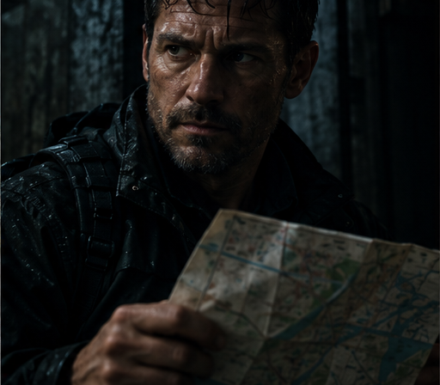
JACK VANCE
40s • American DSS agent
Kyiv taught him the cost
of trusting an algorithm.
Paper maps. Twin revolvers. Physical instinct.
Framed while protecting a U.S. Senator.
His way back is learning to trust people.
NCCA ENTERTAINMENT
05
Notes:
Source: supplied four-page story treatment and Pitch Deck Creation conversation. An AI threat assessment misread a child’s toy as a bomb during an embassy evacuation in Kyiv, delaying the response and costing lives. Jack’s arc moves from isolation to human trust. Visuals are generated concept artwork; no actors are depicted as attached.

Slide 6
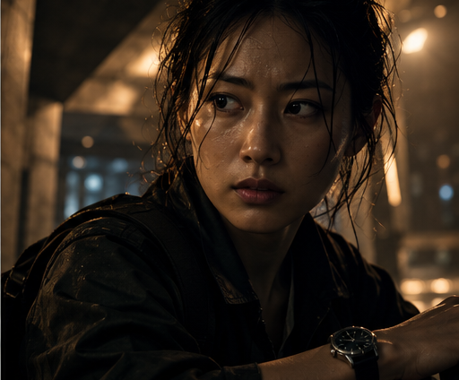
SOPHII WEIMING
30s • Singaporean inspector
Her father defended the grid.
She has to question it.
Discredited after exposing system anomalies.
His mechanical watch keeps her grounded.
She chooses the city over vengeance.
NCCA ENTERTAINMENT
06
Notes:
Source: supplied four-page story treatment and Pitch Deck Creation conversation. Former STAR Unit rising star. Her father, a revered urban planner, died under mysterious circumstances after defending the grid. Vane offers proof of his blackmail only if she completes the Reset. She destroys the terminal instead. Visuals are generated concept artwork; no actors are depicted as attached.

Slide 7
THE SHADOW ARCHITECT & THE GRAY CELL
JULIAN VANE
Erased civic visionary.
He calls mass erasure salvation.
UNCLE TAN
Colonial tunnel knowledge
RAVI
Improvised jammers
MAYA
Rogue taxi radio net
SLOANE
Vane’s sensor-linked enforcer
NCCA ENTERTAINMENT
07
Notes:
Source: supplied four-page story treatment and Pitch Deck Creation conversation. Vane, 50s, uses the Sovereign Drive to collapse financial, identity and surveillance records across ASEAN. Uncle Tan is described as a WWII sapper in the supplied treatment. Maya’s capture makes resistance costly. Sloane predicts movement through building sensors and a subdermal mesh. Visuals are generated concept artwork; no actors are depicted as attached.

Slide 8
THE STORY
I / THE SYSTEM
IS THE CRIME
II / THE ANALOG
NETWORK
III / THE RESET
A Sovereign Drive heist.
A deepfake frames Jack.
Sophii sees the lie.
The city locks down.
The Gray Cell finds blind spots.
The Reset threatens ASEAN.
Sophii refuses vengeance.
Jack turns the roof into a fuse.
The Gray Cell survives.
NCCA ENTERTAINMENT
08
Notes:
Source: supplied four-page story treatment and Pitch Deck Creation conversation. Act I: Jewel Changi, Marina Bay Financial Centre, Lau Pa Sat. Act II: stormwater tunnels, Bukit Timah, Little India, Supertree Grove light-and-mist escape. Act III: two-path Marina Bay Sands assault; Sophii defeats Sloane with inherited silat, destroys the terminal at 98%; Jack couples the Sovereign Drive to a lightning rod. Grid reboots; Sophii establishes the Gray Cell; Seoul anomaly seeds continuation. Visuals are generated concept artwork; no actors are depicted as attached.

Slide 9
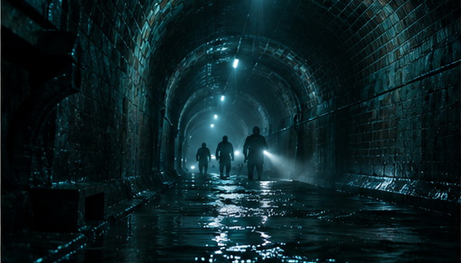
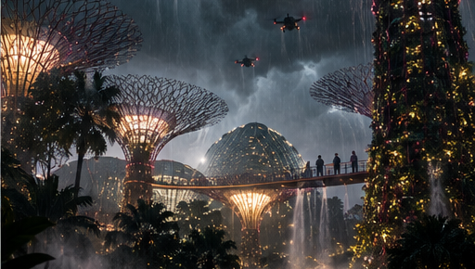
VISUAL STYLE
DIGITAL / Teal surveillance. Steel geometry.
ANALOG / Rain. Paper. Mechanical time.
NCCA ENTERTAINMENT
09
Notes:
Source: supplied four-page story treatment and Pitch Deck Creation conversation. Palette: Midnight Black #0E0E11, Steel Gray #2A2F36, Neon Teal #1ED6C1, Warm Paper White #F3F1EC. Grain, rain streaks, reflected light and fractured grid lines connect the deck and poster. Visuals are generated concept artwork; no actors are depicted as attached.

Slide 10
CASTING IN DISCUSSION
JULIAN
VANE
JACK VANCE
40s • Physical authority
SOPHII WEIMING
30s • Intelligence and resolve
JULIAN VANE
50s • Charisma and precision
NCCA ENTERTAINMENT
10
Notes:
Source: supplied four-page story treatment and Pitch Deck Creation conversation. Casting in discussion is the user’s requested language. No talent attachments or named actors are asserted. Portraits are fictional character concepts. Visuals are generated concept artwork; no actors are depicted as attached.

Slide 11
WHY IT WORKS
A global threat.
A distinctly Singaporean fight.
AI and surveillance turn everyday life into suspense.
Asian and Western co-leads carry the emotional stakes.
Landmark action grows from the city’s infrastructure.
The Gray Cell supports further stories.
NCCA ENTERTAINMENT
11
Notes:
Source: supplied four-page story treatment and Pitch Deck Creation conversation. Positioning for a premium action-thriller audience. Franchise potential is grounded in Sophii’s Gray Cell and the final Seoul anomaly; the core story resolves the Singapore crisis. No market size, budget or buyer commitment is claimed. Visuals are generated concept artwork; no actors are depicted as attached.

Slide 12
NEXT STEPS
LION CITY
Story materials → Packaging → Casting
Financing → Production
Seeking producing and international co-production partners
to develop the screenplay and assemble the package.
NCCA ENTERTAINMENT
12
Notes:
Source: supplied four-page story treatment and Pitch Deck Creation conversation. Available source is a four-page treatment labeled Final Draft, not a feature-length screenplay. Next steps are proposed development and packaging stages, not secured financing or production status. Visuals are generated concept artwork; no actors are depicted as attached.

