Slide 1
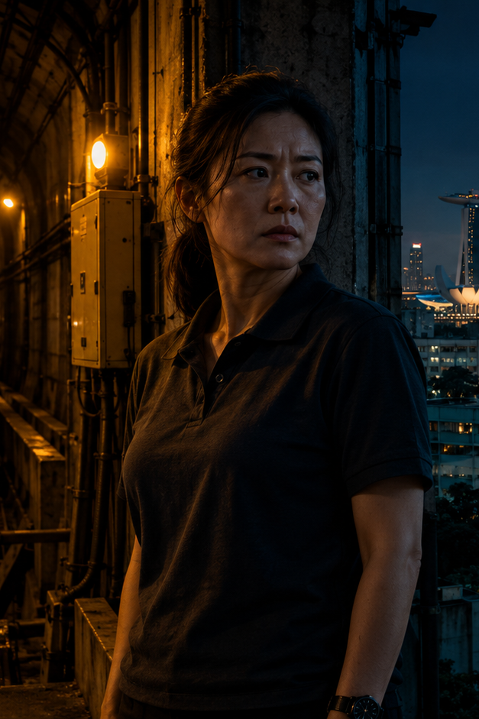
GRAY CELL
EVERY LIFE COUNTS.
UNTIL IT DOESN’T.
8 × 60-minute episodes
Singapore tech-noir thriller
NCCA Entertainment
Kelly R. Tenney
NCCA ENTERTAINMENT / 01
Notes:
Source: GRAY CELL 101 Headway v2.1, full pilot pasted by the author in this conversation. Deck language adapts the supplied script for pitching. Format: proposed 8 × 60-minute series. No casting or financing attachments represented. All concept artwork is illustrative.

Slide 2
The premise
In Singapore’s automated future, a covert team hunts threats dismissed by the city’s predictive system. Each intervention forces its leader to choose whose life the system can afford to lose.
A human decision inside a machine-run city.
NCCA ENTERTAINMENT / 02
Notes:
Source: GRAY CELL 101 Headway v2.1, full pilot pasted by the author in this conversation. Deck language adapts the supplied script for pitching. Format: proposed 8 × 60-minute series. No casting or financing attachments represented. All concept artwork is illustrative.

Slide 3
The hook
A dead man’s badge.
A valid work order.
A threat the system calls safe.
Four people notice what the algorithm ignores.
Stopping the attack makes them responsible for its consequences.
NCCA ENTERTAINMENT / 03
Notes:
Source: GRAY CELL 101 Headway v2.1, full pilot pasted by the author in this conversation. Deck language adapts the supplied script for pitching. Format: proposed 8 × 60-minute series. No casting or financing attachments represented. All concept artwork is illustrative.

Slide 4
Singapore, 2030
Above ground
Below the surface
A city of precise grids, driverless trains and frictionless routines. LATTICE keeps public life moving.
Maintenance tunnels, service corridors and old equipment preserve gaps in the digital map.
Hawker centres and HDB homes give every system failure a human address.
NCCA ENTERTAINMENT / 04
Notes:
Source: GRAY CELL 101 Headway v2.1, full pilot pasted by the author in this conversation. Deck language adapts the supplied script for pitching. Format: proposed 8 × 60-minute series. No casting or financing attachments represented. All concept artwork is illustrative.

Slide 5
LATTICE
The city’s predictive system ranks anomalies and models the cost of intervention.
A badge outweighs a face.
A risk falls below review.
A death falls within tolerance.
The rules embed human choices. The consequences reach people who never made them.
NCCA ENTERTAINMENT / 05
Notes:
Source: GRAY CELL 101 Headway v2.1, full pilot pasted by the author in this conversation. Deck language adapts the supplied script for pitching. Format: proposed 8 × 60-minute series. No casting or financing attachments represented. All concept artwork is illustrative.

Slide 6
Sarah Chen Hui Min
41. Team leader. Railway daughter.
Sarah reads habits, rooms and silences. She follows a maintenance ritual to an attacker the system has already authorized.
She lies to a widow for access. She turns the key that redirects an attack. Then she meets the name behind the casualty count.
Her season question: how much authority can she claim before she becomes what she opposes?
NCCA ENTERTAINMENT / 06
Notes:
Source: Headway v2.1, pasted pilot. Sarah’s precise role in the 2027 Bedok incident remains unresolved in this draft. The season question is proposed development. All concept artwork is illustrative.

Slide 7
The team
CLAIRE DE SOUZA
DEVAN PILLAI
UNCLE ROS
34. Aircon operator.
Her real business gives the team access. She trusts the result until an ordinary service call brings the death home.
29. System insider.
He built the identity rule the attacker exploits. His faith in the model collides with his own authorship.
63. Rail veteran.
He knows the routes the network forgot. When he hands Sarah the keys, he shares responsibility for the turn.
One team. Four different accounts of the same decision.
NCCA ENTERTAINMENT / 07
Notes:
Source: GRAY CELL 101 Headway v2.1, full pilot pasted by the author in this conversation. Deck language adapts the supplied script for pitching. Format: proposed 8 × 60-minute series. No casting or financing attachments represented. All concept artwork is illustrative.

Slide 8
The opposing forces
DARREN SIM
BENEDICT HO
A former signalling technician whose sister died in a LATTICE-assisted response. He builds an attack around the system’s own playbook.
An official with access to anomalies others never see. He chooses observation over escalation and keeps a private record of Sarah’s interventions.
He records names.
He records counts.
Dr. Evelyn Koh provides a mandate she refuses to acknowledge when Sarah asks for permission.
NCCA ENTERTAINMENT / 08
Notes:
Source: GRAY CELL 101 Headway v2.1, full pilot pasted by the author in this conversation. Deck language adapts the supplied script for pitching. Format: proposed 8 × 60-minute series. No casting or financing attachments represented. All concept artwork is illustrative.

Slide 9
The series engine
An anomaly slips below review.
Sarah’s team investigates through ordinary work, human relationships and forgotten infrastructure.
A deadline turns the investigation into a decision. The intervention leaves a consequence someone must own.
Each case advances the larger mystery: who shapes the forecasts, and who benefits from the accepted losses?
NCCA ENTERTAINMENT / 09
Notes:
Proposed series engine based on Headway and the index-card anomalies in the pilot. Recurring procedural structure and season conspiracy require development. All concept artwork is illustrative.

Slide 10
Pilot: Headway
A dead technician’s badge admits an attacker into a rail tunnel. Sarah’s team finds a device designed around LATTICE’s emergency playbook.
The model projects 37 deaths if they do nothing. Sarah redirects the fault to a lightly occupied train.
An elderly cleaner dies during evacuation. Sarah discovers that the woman had cleaned her table every morning.
NCCA ENTERTAINMENT / 10
Notes:
Source: Headway v2.1, pasted pilot. 37 is the model’s projection, not a verified number of lives saved. One death occurs after intervention. Rail mechanism remains subject to screenplay revision. All concept artwork is illustrative.

Slide 11
The cost of intervention
“She cleared my table.”
Madam Low turns an acceptable loss into a life Sarah recognizes too late.
The team can agree on what happened.
They cannot agree on what it means.
NCCA ENTERTAINMENT / 11
Notes:
Source: GRAY CELL 101 Headway v2.1, full pilot pasted by the author in this conversation. Deck language adapts the supplied script for pitching. Format: proposed 8 × 60-minute series. No casting or financing attachments represented. All concept artwork is illustrative.

Slide 12
Season One
Who gets to decide what
“acceptable damage” means?
Sarah follows the connection between Bedok, Darren’s attacks and Benedict’s private record. New cases expose the human decisions inside LATTICE.
As the team’s interventions become visible, its members must decide whether to repair the system, expose it or resist the authority behind it.
NCCA ENTERTAINMENT / 12
Notes:
Proposed season direction, not a summary of an existing season bible. The pilot establishes the 2027 Bedok link, Darren’s sister and Benedict’s two Sarah entries. The season resolution remains a development proposal. All concept artwork is illustrative.

Slide 13
Episodes 1–4
01 HEADWAY
02 PRIORITY
A rail attack forces Sarah to redirect danger. One death fractures the team’s confidence.
Hospital delays reveal whose care the model repeatedly postpones. Devan confronts a rule he once defended.
03 DEAD LOAD
04 WITHIN TOLERANCE
A port anomaly threatens workers behind a clean safety record. Claire’s service cover becomes an exposure risk.
The Bedok record ties Sarah to Pei Shan’s death. Darren forces the team to revisit the original decision.
PROPOSED EPISODE DEVELOPMENT
Notes:
Episode 1 summarizes the supplied pilot. Episodes 2–4 are proposed concepts. Hospital and port anomalies appear on the pilot’s index cards. No later-episode scripts were supplied. All concept artwork is illustrative.

Slide 14
Episodes 5–8
05 WORK ORDER
06 OBSERVE
A case in an HDB block turns Ros’s trusted access into a liability. The team loses a route it depends on.
Evidence of Benedict’s monitoring forces Sarah to question who has been steering their interventions.
07 NAMES
08 THE NECESSARY SIN
Darren’s ledger connects accepted losses. The team divides over how to expose it without triggering further harm.
Sarah confronts the authority behind the forecasts. She must choose what to reveal and take public responsibility for the cost.
PROPOSED EPISODE DEVELOPMENT
Notes:
Episodes 5–8 are proposed development concepts, not established canon or completed scripts. Finale title draws on the project’s thematic phrase. All concept artwork is illustrative.

Slide 15
Tone and audience
Grounded suspense. Intimate consequences.
Person of Interest
Surveillance and intervention
The Capture
Institutional control of evidence
Slow Horses
A fallible covert ensemble
For viewers of intelligent thrillers who want a weekly crisis, an unfolding conspiracy and characters worth following home.
NCCA ENTERTAINMENT / 15
Notes:
Creative comparison references only. No claim of audience size, sales performance, broadcaster interest or affiliation. Near-future Singapore is fictionalized. All concept artwork is illustrative.

Slide 16
Production and partnership
A Singapore-led world with an international thriller engine.
Recurring base: Seng Heng Aircon.
Civic locations: hawker centres, HDB homes and service corridors.
Rail sequences: controlled sets and planned visual effects.
Seeking development and production partners.
Budget, rail access and financing structure to be developed with the producing team.
NCCA ENTERTAINMENT / 16
Notes:
Production approach is proposed, not a feasibility guarantee. No access agreements, budget, financing, incentive eligibility, buyer commitments or attachments are represented. All concept artwork is illustrative.

Slide 17
GRAY CELL
Every life counts.
Until it doesn’t.
NCCA Entertainment
Kelly R. Tenney
nccaentertainment.com
NCCA ENTERTAINMENT / 17
Notes:
Source: GRAY CELL 101 Headway v2.1, full pilot pasted by the author in this conversation. Deck language adapts the supplied script for pitching. Format: proposed 8 × 60-minute series. No casting or financing attachments represented. All concept artwork is illustrative.

