Slide 1
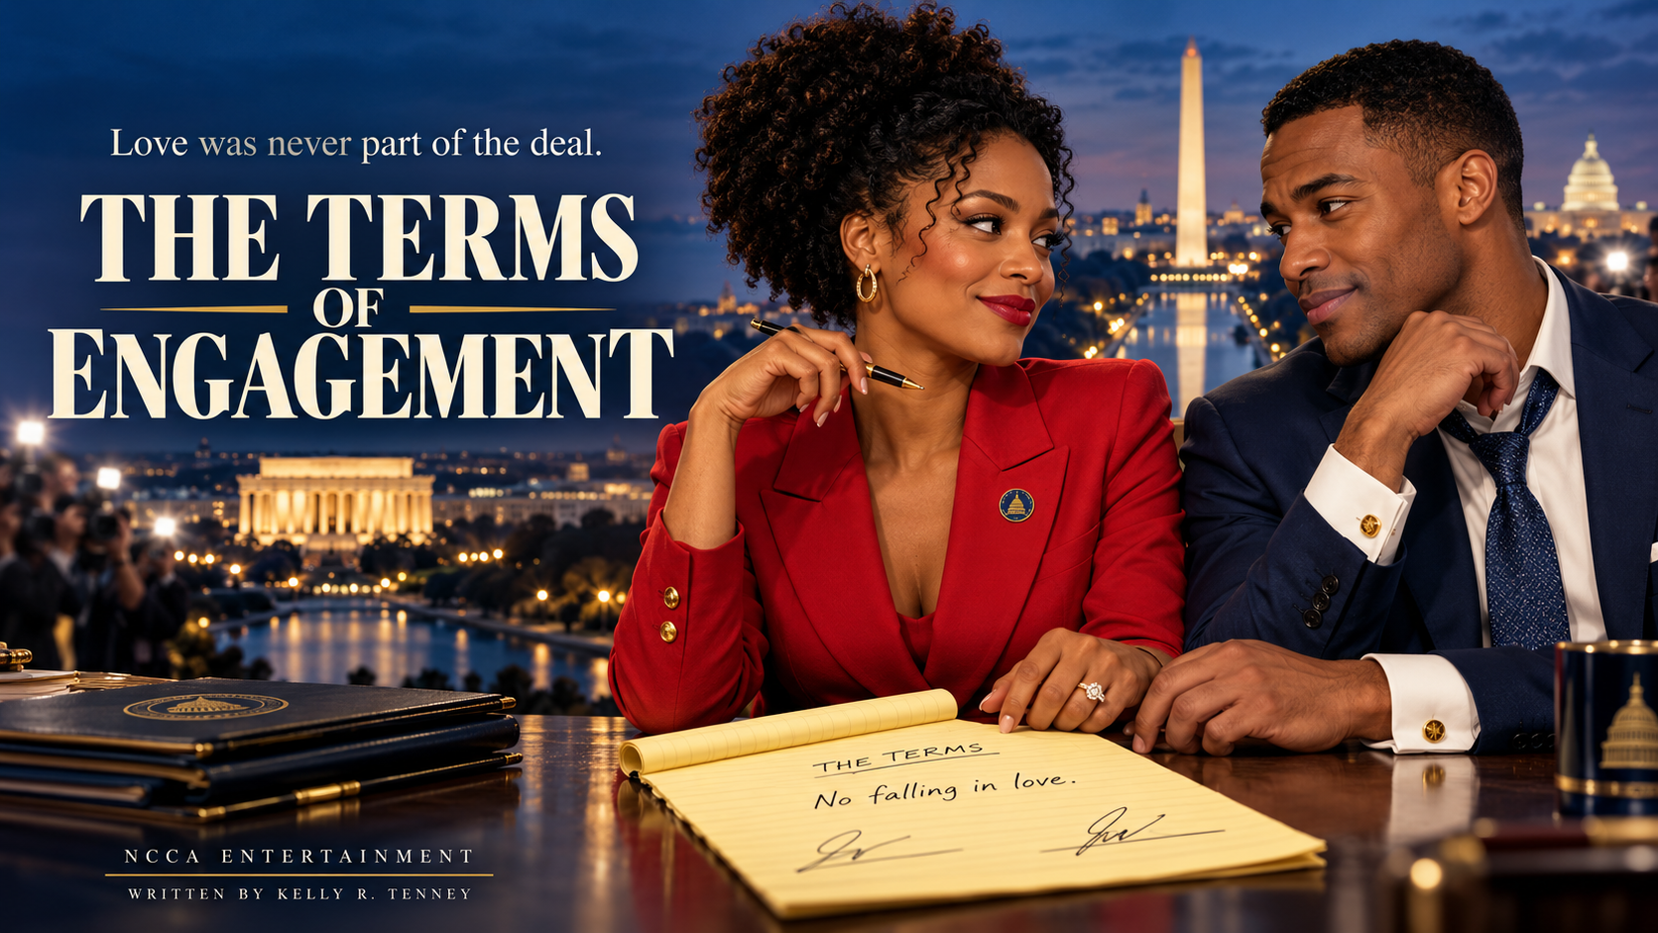
Notes:
Opening pitch: a political romantic comedy about two experts in public performance who learn to risk telling the truth. Written by Kelly R. Tenney, NCCA Entertainment. Poster is concept artwork, not a representation of attached cast.

Slide 2
THE PREMISE
The only honest thing is the fake romance.
When a hot mic catches two rival political
strategists trashing their own candidates, their
bosses rebrand the scandal as a secret romance
and stage an engagement through Election Day.
×
RIVALS
TO FIANCÉS
As their signed contract threatens to leak, the
relationship they are faking becomes the only honest
thing either has done in a decade.
Original feature
Political romantic comedy
NCCA ENTERTAINMENT / THE TERMS OF ENGAGEMENT
02
Notes:
Logline adapted from the studio one-pager supplied by NCCA. The engagement is manufactured by both campaigns, and the leads knowingly consent. The leak threatens their reputations just as their private connection becomes real.

Slide 3
THE ENGINE
Eleven years of rivalry. One career-saving lie.
01
02
03
THE SCANDAL
THE SPIN
THE TRAP
A green-room recording
costs both strategists their
jobs.
A focus group sees
chemistry. Their bosses
sell America a secret
couple.
The engagement restores
access, then makes every
private choice a public
event.
The clock runs out on Election Night.
NCCA ENTERTAINMENT / THE TERMS OF ENGAGEMENT
03
Notes:
The premise supplies escalating public obligations. Alex needs her job to protect paid retraining and wage replacement in the Heartland Jobs Act. Marcus needs his father’s approval. Their goals make accepting the stunt plausible, while the contract creates a clear comic promise.

Slide 4
THE CONTRACT
The terms are simple. Keeping them is impossible.
TERMS OF ENGAGEMENT
She writes the rules
to stay in control.
01 Public appearances only.
02 No kissing on the mouth.
03 Ends on Election Night.
04 No falling in love.
He signs because
he always performs.
Neither knows how to stop.
NCCA ENTERTAINMENT / THE TERMS OF ENGAGEMENT
04
Notes:
The yellow legal pad is the recurring visual motif. These are the central terms, summarized for the pitch. The no-love clause is emotional armor, not merely a comic rule.

Slide 5
THE LEADS
Two professionals. Two kinds of armor.
ALEX CHASE | 33
MARCUS THORNE | 35
Democratic strategist. Dayton union roots.
Wants to protect the jobs bill she wrote. Defines
every clause so nobody can ask for too much.
Her arc: from control to trust.
Republican strategist. Georgia political dynasty.
Wants his father’s approval. Charms on cue
and touches a cufflink when he lies.
His arc: from performance to conviction.
NCCA ENTERTAINMENT / THE TERMS OF ENGAGEMENT
05
Notes:
Alex and Marcus are Black political professionals, with genuinely different beliefs. Their romance does not erase their disagreement over the jobs bill. Alex’s pen and Marcus’s cufflink turn familiar gestures into emotional tells.

Slide 6
THE ENSEMBLE
Love has a constituency. So does the lie.
THE CHASE FAMILY
THE THORNE FAMILY
THE MACHINE
Rose asks the plain
questions Washington
avoids.
Mother Pearl lends Marcus a
union pin, and leaves Alex a
legacy of love.
Calvin turns his son’s future
into a campaign strategy.
Vivian’s heirloom ring quietly
makes the engagement
personal.
Dana and Gil convert
intimacy into a message.
Priya’s mistake and Kara’s
reporting bring the signed
terms into daylight.
NCCA ENTERTAINMENT / THE TERMS OF ENGAGEMENT
06
Notes:
Pearl’s death is the emotional hinge of the film. Rose grounds the political argument in lived labor experience. Calvin is a father who confuses control with love. Vivian sees the personal cost. Dana and Gil see numbers. Priya is caught in the machinery she is learning to operate.

Slide 7
THE STORY
From damage control to a costly truth.
I
II
III
THE PERFORMANCE
THE REAL THING
THE RECKONING
Fired rivals become a staged
couple. A truthful meet-cute
slips into their rehearsed
story.
Donor dinners and family
visits deepen the bond. At
Pearl’s funeral, Marcus
chooses Alex over a $3M
fundraiser.
The contract leaks. Each is
offered a comeback by
blaming the other. Both
choose the truth.
NCCA ENTERTAINMENT / THE TERMS OF ENGAGEMENT
07
Notes:
Story overview with spoilers, appropriate for a development pitch. Alex makes her own public confession before knowing what Marcus will do. Marcus then refuses to scapegoat her and withdraws his candidacy. Each pays independently for honesty.

Slide 8
SIGNATURE SEQUENCES
The scenes audiences will remember.
HOT MIC
THE DINNER
Weaponized banter becomes a
career-ending recording.
A Georgetown donor table turns into a
chess match.
THE FUNERAL
THE PAUSE
Marcus stands beside Alex with nothing to
gain.
On live television, he stops performing and
owns the lie.
NCCA ENTERTAINMENT / THE TERMS OF ENGAGEMENT
08
Notes:
The film moves from verbal velocity to emotional stillness. The opening hot mic is the hook; the Georgetown donor dinner exposes money and family power; the funeral is the private turning point; the televised pause is the public reckoning.

Slide 9
TONE AND VISUAL LANGUAGE
Fast dialogue. Quiet devastation. An earned sunrise.
SATIRICAL BITE
Quick, precise, competitive dialogue.
Politics played through people and
power.
ROMANTIC INTIMACY
Glances, tells, pauses, and the moment
someone shows up without a deal.
Public polish gives way to private warmth.
NCCA ENTERTAINMENT / THE TERMS OF ENGAGEMENT
09
Notes:
Tone is drawn from the supplied one-pager. Use the comps as creative references, not as revenue or audience guarantees. Formal staging and polished media surfaces give way to intimate, unmediated spaces. Concept art is illustrative.

Slide 10
THE WORLD
Three cities. Three versions of belonging.
WASHINGTON, D.C.
DAYTON, OHIO
ATLANTA, GEORGIA
THE IMAGE
THE ROOTS
THE INHERITANCE
Studios, green rooms,
donor tables. Every
moment can become a
message.
A union family, a factory,
a church, and a porch
where nobody buys the
spin.
A political dynasty and
the Fox Theatre’s painted
sky. A future Marcus must
choose.
NCCA ENTERTAINMENT / THE TERMS OF ENGAGEMENT
10
Notes:
Story settings, not a finalized production plan. Washington embodies image and control; Dayton brings labor, family, and accountability; Atlanta carries inheritance, status, and the pressure of a political dynasty. Interiors and landmark sequences require location and schedule planning.

Slide 11
THE EMOTIONAL LANGUAGE
A ring. A pin. A tell. A real sky.
R
P
C
S
THE RING
THE UNION PIN
THE CUFFLINK
THE SUNRISE
Family makes the lie
feel real.
Trust is placed in his
hands.
Charm gives away
the truth.
An honest future, still
unwritten.
NCCA ENTERTAINMENT / THE TERMS OF ENGAGEMENT
11
Notes:
The symbols carry the story without exposition. The ring is borrowed belonging, the union pin is a trust placed in Marcus, the cufflink is the habit of performance. The painted Fox Theatre sky contrasts with the actual dawn at the Lincoln Memorial.

Slide 12
AUDIENCE AND CREATIVE POSITIONING
A familiar romantic engine. A specific new world.
LONG SHOT
RED, WHITE & ROYAL BLUE
Political friction and romantic-comedy
momentum.
Public duty colliding with private desire.
INSECURE
VEEP
The emotional register of Black ambition,
intimacy, and vulnerability.
The language, pressure, and absurdity of the
political machine.
For viewers who want chemistry, sharp comedy, and emotional consequences.
NCCA ENTERTAINMENT / THE TERMS OF ENGAGEMENT
12
Notes:
Creative positioning from the studio one-pager. These are tone references, not financial comparables. Intended audience: adult romantic-comedy viewers, viewers of sharp ensemble comedy, and audiences interested in contemporary Black family stories. No quantified audience or performance claims are made.

Slide 13
CASTING VISION
Two leads who can win the argument and hold the silence.
DREAM PAIRING
ALTERNATE PAIRING
Ayo Edebiri as Alex Chase
Regé-Jean Page as Marcus Thorne
Precision comedy meets a polished romantic
lead.
Keke Palmer as Alex Chase
Damson Idris as Marcus Thorne
Rapid-fire energy and a more combustible
rivalry.
Additional lead options: Zazie Beetz / Corey Hawkins
Casting wish list only. No talent attached or availability confirmed.
Notes:
All names are a casting wish list from the supplied NCCA cast suggestions. No availability, interest, attachment, or quotes are confirmed. Alternate individual options: Alex: Zazie Beetz. Marcus: Corey Hawkins. Final casting should serve chemistry and the emotional range of the film.

Slide 14
SUPPORTING CAST WISH LIST
An ensemble with authority, wit, and warmth.
Calvin Thorne
Courtney B. Vance
Vivian Thorne
Angela Bassett
Rose Chase
Niecy Nash-Betts
Mother Pearl Chase
Leslie Uggams
Dana Whitmore
Allison Janney
Gil Brannigan
Walton Goggins
Priya Raman
Maitreyi Ramakrishnan
Wish list only. Availability, interest, and quotes have not been confirmed.
NCCA ENTERTAINMENT / THE TERMS OF ENGAGEMENT
14
Notes:
Primary suggestions selected from the supplied casting document. Alternatives are preserved here in notes: Calvin: Laurence Fishburne, Giancarlo Esposito. Vivian: Lorraine Toussaint, Regina King. Rose: Aunjanue Ellis-Taylor, Tichina Arnold. Pearl: Margaret Avery, CCH Pounder. Dana: Edie Falco, Julianne Nicholson. Gil: Sam Rockwell, Bill Camp. Priya: Geraldine Viswanathan, Avantika. Featured roles: Lena Park: Sandra Oh or Greta Lee; Kara Voss: Rachel Brosnahan or Merritt Wever; Grant Halloway: Patrick Wilson or Josh Lucas; Chip Whitlock: Bradley Whitford or Dylan Baker; Dez Little: Lil Rel Howery or Jerrod Carmichael. All are unconfirmed suggestions.

Slide 15
PLATFORM AND PACKAGE
A clear streaming pitch with a theatrical heart.
NETFLIX
$30M–$55M
Proposed platform target
Indicative budget tier
A high-concept romance about public
performance and private truth, centered
on two Black professionals and two
distinct American families.
Two central leads. Dialogue-driven
ensemble. Three story settings.
Original feature • Budget and production scope subject to validation
NCCA ENTERTAINMENT / THE TERMS OF ENGAGEMENT
15
Notes:
Netflix is a proposed target from the supplied studio one-pager, not an affiliation or commitment. The $30M–$55M range is NCCA’s indicative budget tier, not a line-item budget or financing commitment. Scope and budget need producer validation, including cast quotes, locations, music, crowds, and schedule.

Slide 16
THE ENDING
The promise: still disagreeing, finally honest.
Alex tells the truth before she knows
whether Marcus will choose her.
Marcus takes the pause his father taught him
never to take, and walks away from the future
chosen for him.
A REAL
SUNRISE
Love becomes a choice they can make without a contract.
NCCA ENTERTAINMENT / THE TERMS OF ENGAGEMENT
16
Notes:
After Marcus owns the stunt and walks away from the Senate candidacy, the pair return to the Lincoln Memorial at dawn. Their original bagel meet-cute is echoed. Alex will keep fighting for the jobs bill. Marcus supports Section Nine while opposing Section Twelve. Romance changes how they behave, not every belief they hold.

Slide 17
NCCA ENTERTAINMENT
Love was never part of the deal.
THE TERMS
OF ENGAGEMENT
NCCA
Written by Kelly R. Tenney
NCCA Entertainment
contact@nccaentertainment.com
(910) 262-9307
NCCA ENTERTAINMENT / THE TERMS OF ENGAGEMENT
17
Notes:
Written by Kelly R. Tenney. Contact details supplied in NCCA’s studio one-pager and casting PDF. Development conversation: creative partnership, packaging, and platform fit. No financing or talent attachments are represented.

