Slide 1

NCCA ENTERTAINMENT PRESENTS
They found the perfect match.
They just used the wrong names.
CONTEMPORARY ROMANTIC COMEDY / FEATURE FILM
Written by Kelly R. Tenney
Notes:
Story content derived from the supplied STANDBY screenplay by Kelly R. Tenney. Original concept imagery created for this deck.

Slide 2
LOGLINE
Love gets complicated
when both people send a stand-in.
When a guarded Atlanta dating consultant secretly goes on first dates for anxious clients, she meets her match in an architect impersonating his equally nervous best friend. As the two proxies fall for each other under borrowed names, they risk their careers, their closest friendships, and the real romance forming between the clients they betrayed.
ATLANTA • MODERN DATING • BORROWED IDENTITIES
NCCA ENTERTAINMENT
02
Notes:
Story content derived from the supplied STANDBY screenplay by Kelly R. Tenney. Original concept imagery created for this deck.

Slide 3
THE HOOK
Two stand-ins fall for each other
while their clients fall for the idea of each other.
01
02
03
04
PROXY DATES
DOUBLE ROMANCE
PUBLIC EXPOSURE
EMOTIONAL PAYOFF
A fresh engine for escalating romantic deception
Two couples move toward love on opposite tracks
The scheme detonates at a glamorous BlindMatch gala
The fantasy survives only when the performance ends
NCCA ENTERTAINMENT
03
Notes:
Story content derived from the supplied STANDBY screenplay by Kelly R. Tenney. Original concept imagery created for this deck.

Slide 4
TONE & COMPARABLES
Sexy, sophisticated, fast-witted, emotionally honest
HITCH
Professionalized dating meets personal blind spots
SET IT UP
Contemporary rom-com momentum and workplace polish
THE TRUTH ABOUT CATS & DOGS
Attraction grows inside a borrowed identity
INSECURE
Specific Black professional life, intimacy, and humor
Positioning: elevated studio rom-com with sharp social satire and a warm, commercial finish
NCCA ENTERTAINMENT
04
Notes:
Story content derived from the supplied STANDBY screenplay by Kelly R. Tenney. Original concept imagery created for this deck.

Slide 5
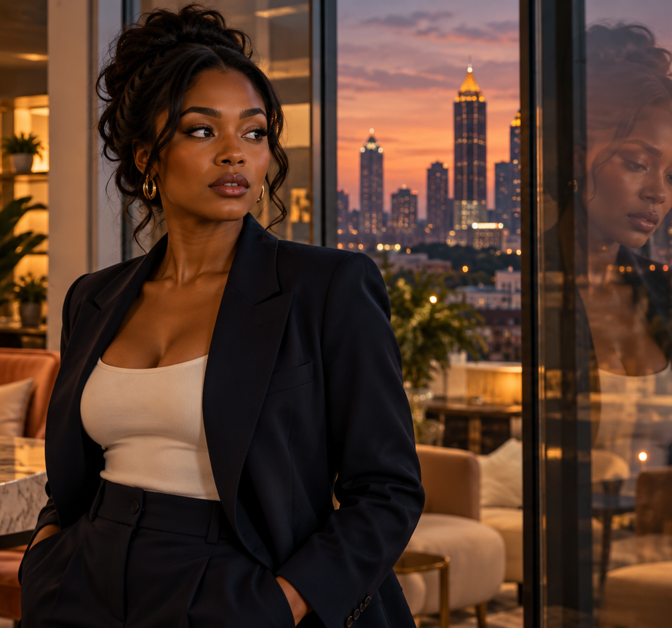
CHLOE MARSH
27 / FOUNDER OF STANDBY
She can read everyone in the room except herself.
PERSONALITY
Controlled, observant, dryly funny. She turns emotional risk into a system she can manage.
GOAL
Protect StandBy, prove her judgment, and keep love at a safe professional distance.
CONFLICT
Ben sees through the performance. Choosing him means admitting that control has become her disguise.
NCCA ENTERTAINMENT
05
Notes:
Story content derived from the supplied STANDBY screenplay by Kelly R. Tenney. Original concept imagery created for this deck. Chloe concept image is fictional casting visualization, not an actor attachment.

Slide 6

BEN WHITFIELD
29 / ARCHITECT
He designs honest spaces while living inside someone else’s name.
PERSONALITY
Warm, quick, loyal. He improvises confidence for everyone except himself.
ARC
What begins as a favor becomes the first choice he makes for his own emotional life.
CONNECTION
Chloe challenges his charm. Their chemistry deepens when both stop performing their clients.
NCCA ENTERTAINMENT
06
Notes:
Story content derived from the supplied STANDBY screenplay by Kelly R. Tenney. Original concept imagery created for this deck. Ben concept image is fictional casting visualization, not an actor attachment.

Slide 7
THE PEOPLE CAUGHT IN THE PERFORMANCE
Every supporting character pressures Chloe and Ben toward the truth from a different angle.
1
2
3
4
5
SADIE OKAFOR
MARK
REGINA MARSH
RILEY
GREGORY & WALTER
Chloe’s brilliant best friend and first boundary crossed. Romantic anxiety hides fierce self-respect.
Ben’s numbers-first best friend. Socially anxious, unexpectedly tender, and capable of choosing honesty.
Chloe’s formidable wedding-planner mother. She sees love as both feeling and public architecture.
StandBy’s bold proxy dater. A glimpse of what happens when the service outruns Chloe’s control.
Ben’s opposing father figures: one rewards ambition, the other demands integrity.
NCCA ENTERTAINMENT
07
Notes:
Story content derived from the supplied STANDBY screenplay by Kelly R. Tenney. Original concept imagery created for this deck.

Slide 8
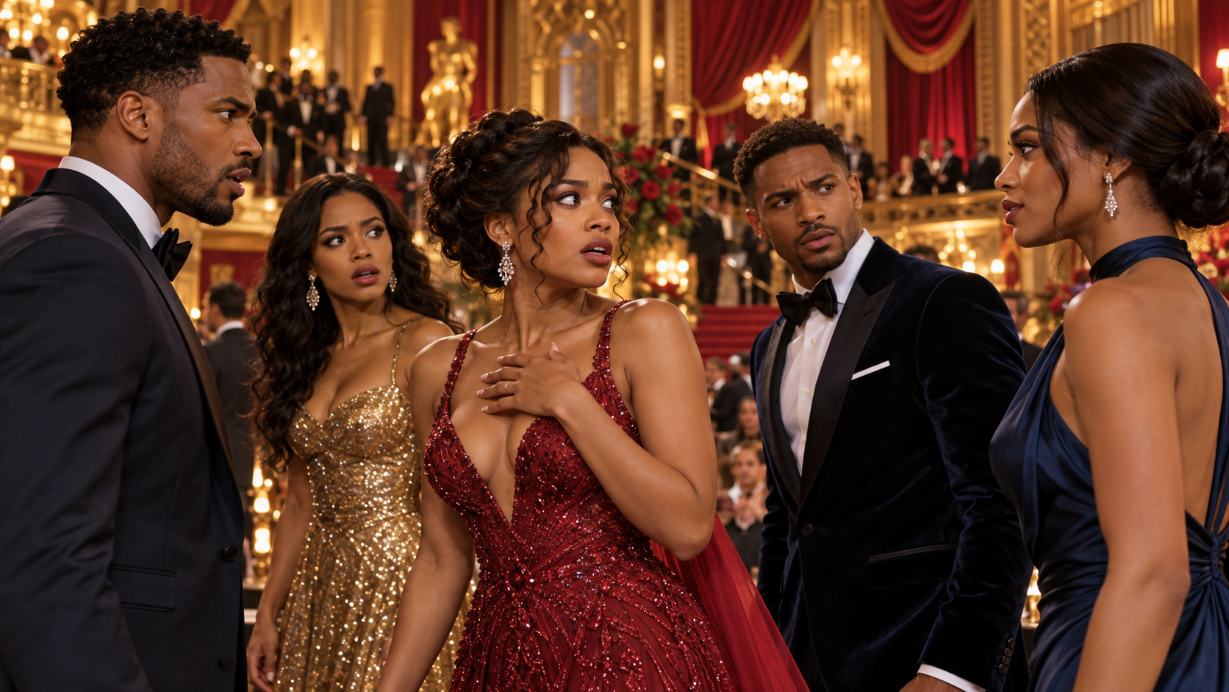
STORY IN THREE ACTS
ACT I
ACT II
ACT III
THE MATCH
THE PERFORMANCE
THE REVEAL
Chloe takes Sadie’s first date. Ben takes Mark’s. The proxies recognize a rare spark and each decides to keep the truth off the table.
Secret dates become real intimacy. Meanwhile, Sadie and Mark connect by text. Chloe and Ben’s careers rise as their friendships begin to fracture.
At the BlindMatch gala, every identity collides. Public fallout forces both couples to decide whether trust can survive the truth.
NCCA ENTERTAINMENT
08
Notes:
Story content derived from the supplied STANDBY screenplay by Kelly R. Tenney. Original concept imagery created for this deck.

Slide 9
VISUAL LANGUAGE
Atlanta after dark, where romance feels polished and every reflection suggests a second self.
BLUE-HOUR ATLANTA
SPEAKEASY AMBER
GLASS REFLECTIONS
APP WAVEFORMS
TAILORED ROMANCE
PUBLIC SPECTACLE
Texture: paper grain, brushed brass, velvet shadow, rain on glass
NCCA ENTERTAINMENT
09
Notes:
Story content derived from the supplied STANDBY screenplay by Kelly R. Tenney. Original concept imagery created for this deck.

Slide 10
CASTING WISHLIST
Aspirational casting direction. No attachments implied.
RD
LL
CJ
TW
RH
RYAN DESTINY
LUCIEN LAVISCOUNT
COCO JONES
TYLER JAMES WILLIAMS
REGINA HALL
CHLOE MARSH
BEN WHITFIELD
SADIE OKAFOR
MARK
REGINA MARSH
Casting goal: magnetic leads with comic timing, dramatic weight, and genuine adult chemistry
NCCA ENTERTAINMENT
10
Notes:
Story content derived from the supplied STANDBY screenplay by Kelly R. Tenney. Original concept imagery created for this deck. Named performers are an aspirational wishlist only. No attachment or participation is represented.

Slide 11
WHY STANDBY FITS BET+
A commercial romance centered on Black professional life, friendship, and adult emotional stakes.
✓
Black professionals drive the romance rather than orbiting it.
✓
Atlanta supplies recognizable culture, aspiration, and production texture.
✓
The high-concept premise lands in a sentence and cuts cleanly into a trailer.
✓
The story balances romance with friendship, career, and family consequences.
✓
A contained feature scale supports premium locations without spectacle-level cost.
✓
The StandBy business can generate future clients, conflicts, and companion stories.
SECONDARY POSITIONING
Netflix / Amazon MGM / Tubi / OWN
NCCA ENTERTAINMENT
11
Notes:
Story content derived from the supplied STANDBY screenplay by Kelly R. Tenney. Original concept imagery created for this deck.

Slide 12
PACKAGE & NEXT STEPS
AVAILABLE NOW
NEXT STEPS
✓
Feature screenplay
LOCK POLISH
01
✓
Pitch deck
Complete final logic and dialogue pass
✓
16:9 key art
PACKAGE
02
✓
Casting wishlist
Confirm director and casting targets
✓
Buyer positioning
ATTACH
03
Approach lead talent and producing partners
TAKE OUT
04
Schedule targeted buyer meetings
STANDBY
Written by Kelly R. Tenney / NCCA Entertainment
Notes:
Story content derived from the supplied STANDBY screenplay by Kelly R. Tenney. Original concept imagery created for this deck.

