Slide 1
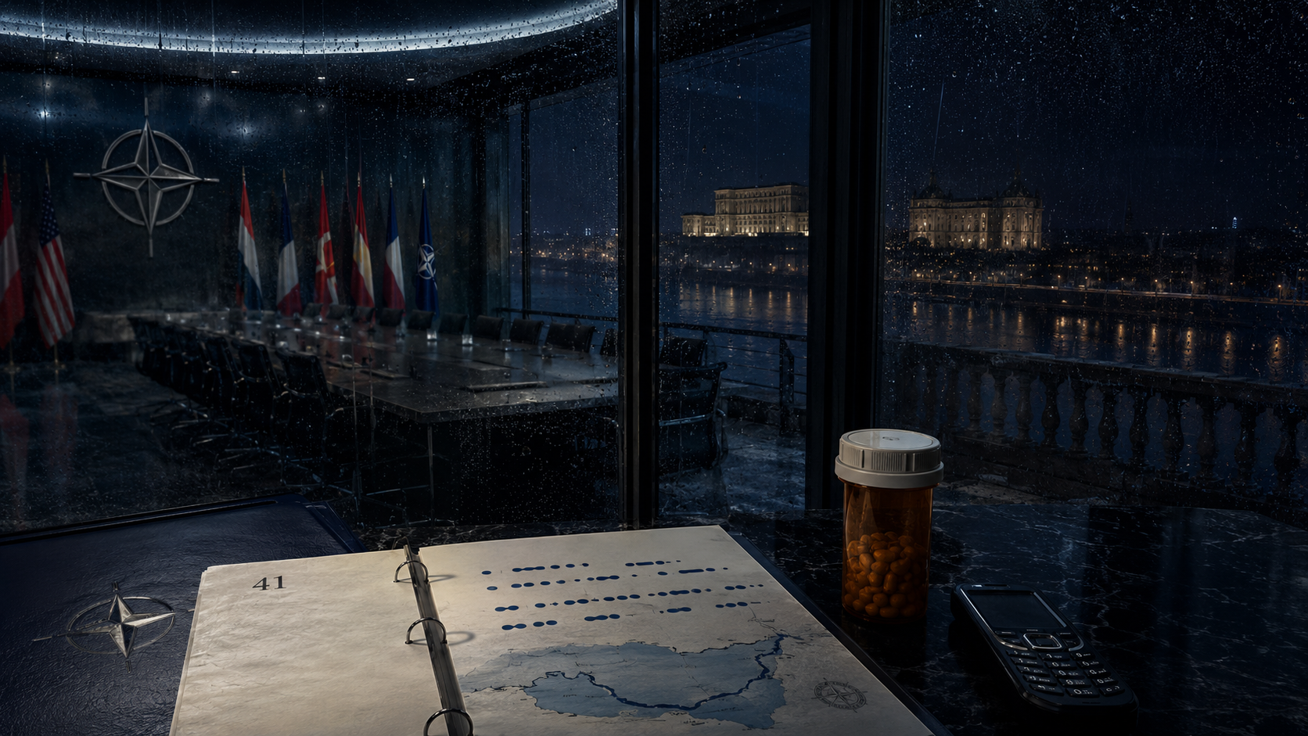
ONE-HOUR SERIALIZED SERIES
PAGE 41
PSYCHOLOGICAL ESPIONAGE
All she has left is a code her hands still remember.
Created by Kelly R. Tenney

Slide 2
THE PROMISE
A clean hook with a built-in clock
A visionary NATO treaty architect survives the ambush that kills her secret lover, then discovers the mentor guiding her grief is quietly editing her memories and remaking her into the conspiracy’s perfect instrument.
The most terrifying surveillance state is not watching her. It is rewriting her and calling it care.
PAGE 41
02

Slide 3
THE WORLD
The setting creates pressure, not decoration
WORLD
WHY NOW
Washington policy rooms, Bucharest balconies, black water, burner phones and diplomacy used as the polished surface of an intelligence operation.
Deepfakes, memory pharmacology and collapsing institutional trust converge on the last private territory a person owns: the mind.
PAGE 41
03

Slide 4
THE LEAD
KAT SULLIVAN
The most gifted policy mind of her generation. Each recovered memory restores not only the case, but the woman being erased.
The role is built for transformation, authority and a sustained close-up.
PAGE 41
04

Slide 5
THE CONSTELLATION
Every ally carries a competing version of the truth
MARKUS VOSS
Intelligence operative, secret love and possible ghost in the glass.
CARL REEVES
Paternal mentor whose warmth curdles into control.
DR. LILLIAN SHAW
A trauma specialist whose care functions as a scalpel.
DESSA
An off-grid signal contact and Kat’s cleanest surviving line.
PAGE 41
05

Slide 6
THE ENGINE
Pressure escalates because every answer changes the trap
01
02
03
04
05
A Bucharest operation becomes an ambush.
Kat traces the trap to Carl’s budget.
Evidence is reframed as trauma and delusion.
Each episode restores one stolen memory.
A tapping code proves muscle memory survived the rewrite.
PAGE 41
06

Slide 7
TONE & POSITIONING
HOMECOMING × BOURNE
PRESTIGE
A global prestige thriller combining intimate performance, elegant international locations and a repeatable memory-recovery engine.
WITH PULSE
Commercial propulsion is carried by morally complex characters, a specific cultural world and a visual motif that can power the campaign.
PAGE 41
07

Slide 8
THE THEMATIC PROMISE
The thriller delivers a reckoning, not a lecture
01
Trust as a weapon
02
The erasure of self
03
Grief versus truth
04
Love as resistance
PAGE 41
08

Slide 9
NETFLIX • GLOBAL PRESTIGE
PAGE 41
The most terrifying surveillance state is not watching her. It is rewriting her and calling it care.
A global prestige thriller combining intimate performance, elegant international locations and a repeatable memory-recovery engine.
Created by Kelly R. Tenney

